Slide 1
Treasurer's Report 2022
PLUG financial position remains healthy
There are net outgoings but they are small
Position at the end of: 2021 / 2022
Current Assets $4531.50 $4418.01
Current Liabilities $0.00 $0.00
Revenue $853.50 $626.00
Expenditure $1066.41 $767.14
Net ($212.91) ($141.14)
Notes:
PLUG again finished 2022 with a good bank balance and no outstanding payments.
This year we continued to keep expenses under control, reducing them more than enough to offset the slight reduction in income. So our net outgoings have been reduced by a small amount.

Slide 2
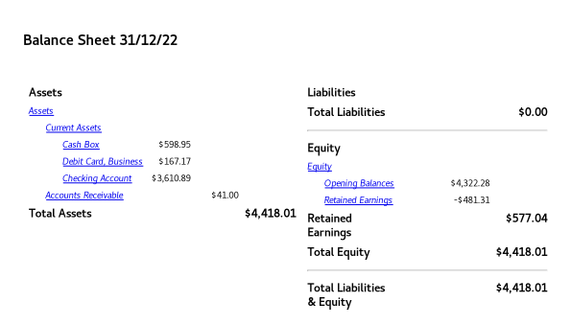
2022 Financials - 1
Notes:
Balance Sheet 2022
Most of our assets are the balance held in our Bendigo Bank Account, though the cash box has a moderate unbanked amount. And some working capital is held in out debit card.

Slide 3
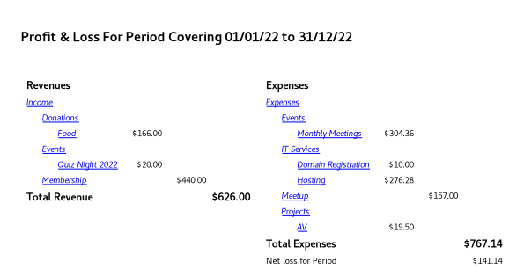
2022 Financials - 2
Notes:
Profit & Loss 2021
Our income is now solely provided by “regular” items. And our combined food donations and membership income almost covered our expenses. There are some good potential savings available by reducing hosting costs.. (And lesser potential in the Meetup subscription.)

Slide 4
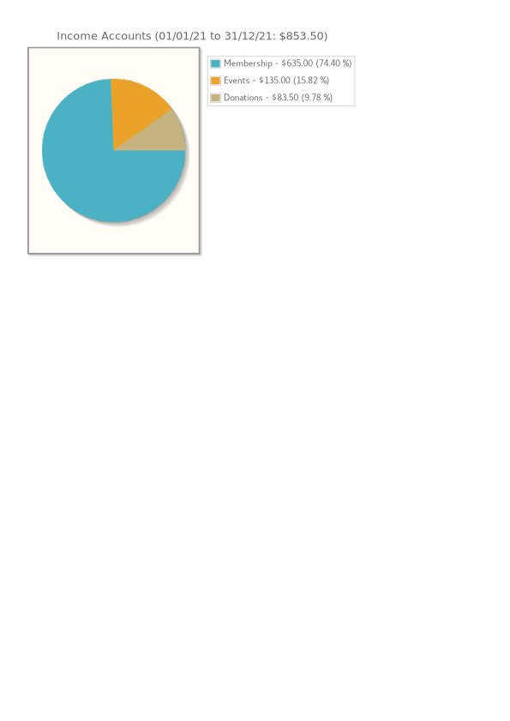
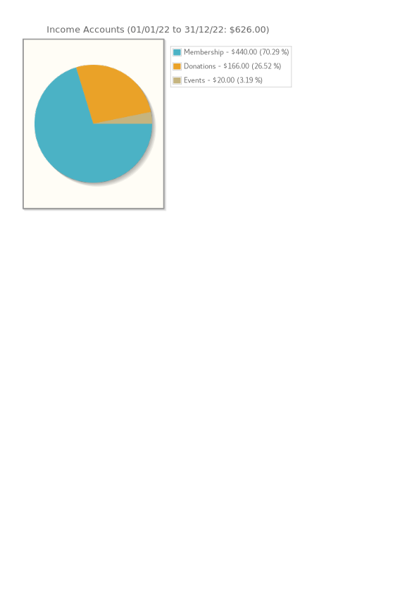
Income 2021 vs 2022
Notes:
Membership renewals constitute the bulk of our income. This takes us close to a sustainable position.

Slide 5
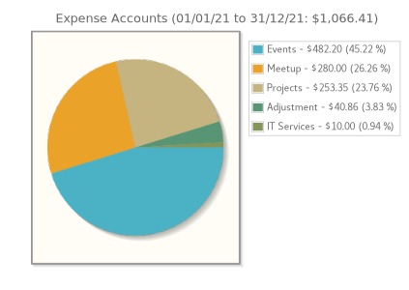
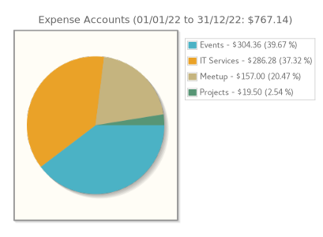
Expense 2021 vs 2022
Notes:
Our major expense consists of event expenses (primarily catering). IT Services (hosting) expenses have grown over the last year, overshadowing thee Meetup charge.

Slide 6
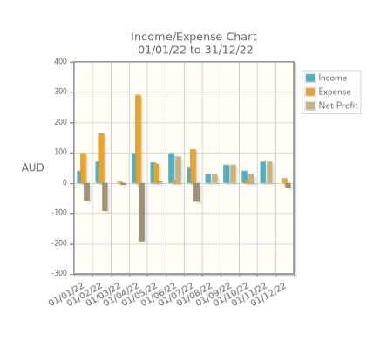
Monthly Chart for 2022
Notes:
As is typical, our income and expenses display a very “spiky” tendency based on event expense and (to a lesser extent) membership renewal periods.

