Slide 1
Treasurer's Report 2017
PLUG financial position healthy
Net outgoings can be sustained in the short term
Position at the end of 2016 / 2017:
  Current Assets $4,479.40 $3924.57
  Current Liabilities $0.00 $0.00
  Revenue $711.63 $663.00
  Expenditure $1,295.81 $1237.83
  Net Outgoings ($584.18) ($574.83)
Notes:
PLUG finishes 2016 with a healthy bank balance and no outstanding debts. Much of this balance is held in our Bendigo Bank Account, though a notable sum remains in the cash box, which needs to be deposited.
Though, our expenses exceeded our revenues, the net outgoings are sustainable in the near term. However, we will need to improve revenues or reign in expenditure.

Slide 2
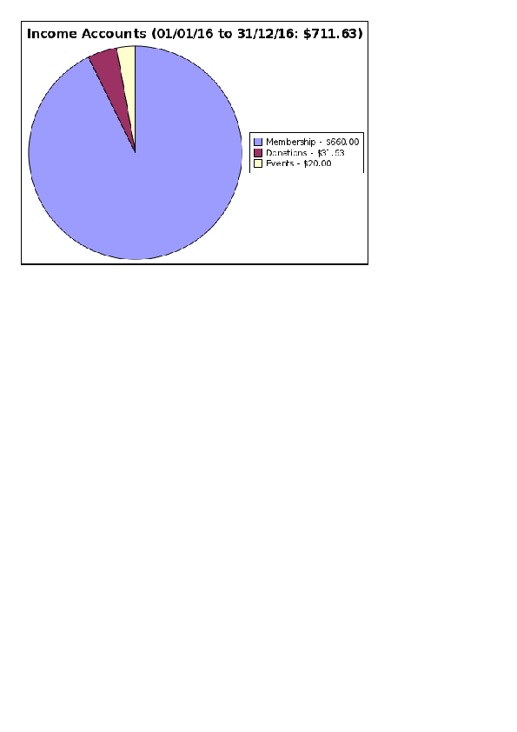
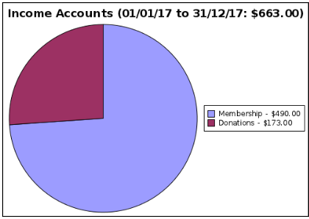
Income 2016 vs 2017
Notes:
This year almost all our income came from membership fees. Unlike previous years, we received no donations from organizations in exchange for our providing AV services.
While this makes a large difference, our operating income comes from membership fees which are down this year. Retaining the same level of memberships as last year would have almost halved our outgoings.

Slide 3
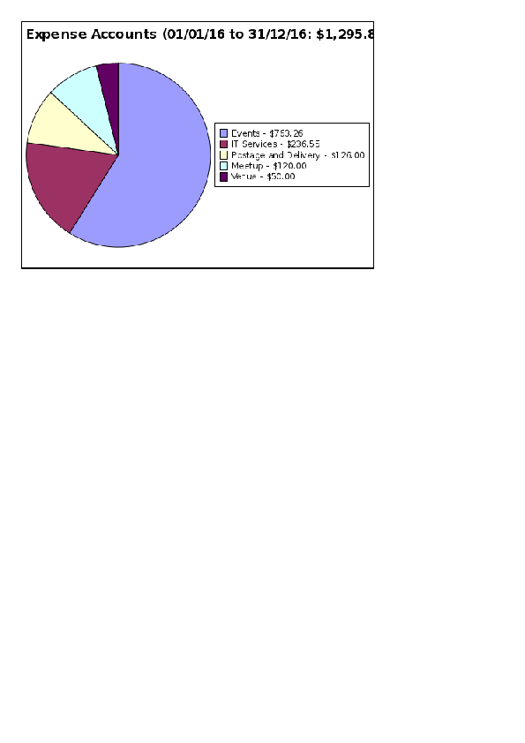
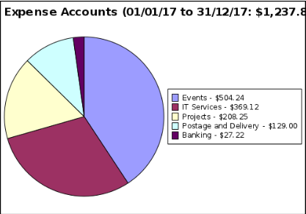
Expense 2016 vs 2017
Notes:
Our largest expense in 2016 was catering for events, which increased by 50% compared to 2015. Last year our largest expense was on the AV project.
The next largest expense is our payment for hosting on AWS. This was previously covered by credits received from AWS, which ran out earlier in the year. So, it is likely to increase this year.
Fixed fees for our meetup group and post box make up the remainder of our expenses.

Slide 4
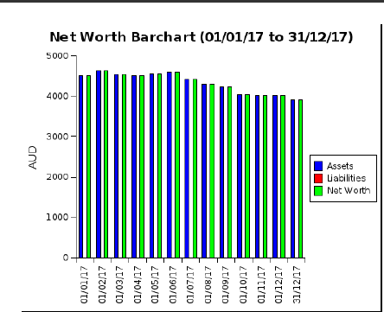
Future
Notes:
Obviously, for the long term we will need to not make a net loss.
While an increase in revenue requires recruiting new members, our expenses are relatively modest. No venue hire fees at the moment, and our event catering expense while substantial in 2016, can scale to the number present.
There is also some scope to reduce AWS hosting cost by securing credits and/or making more efficient use of resources, eg: moving to a reserved instance.
However, our AV gear is reaching end of useful life and we must make a decision on spending for renewal.

