Slide 1




Header
Credits
Group names
Basic Song Search
Browse / Search Results
GitHub url
Title
Title
Artist
Year
Genre
Popularity
Artist
Add
Add to existing
Genre
Add to new
Year
Create New List
Less
Greater
2017
Popularity
Less
Greater
Clear
Search
Footer

Slide 2
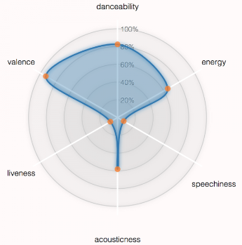
Header
Close View
Credits
Song Information
Radar Chart
title, artist name, artist type, genre, year, duration
Analysis data:
bpm,
energy,
danceability,
liveness,
valence,
acousticness,
speechiness,
popularity
Footer

Slide 3
Header
Close View
Credits
List of Playlists
Playlist Details
# songs, popularity ranking
Delete
Title
Artist
Year
Genre
Popularity
Remove
Footer

