Slide 1
Managing Network Configurations with Git
Pete Lumbis - @PeteCCDE
Customer Solutions Engineer CCIE #28677, CCDE 2012::3

Slide 2
$whoami
My Background
Not My Background
10+ year Network Engineer
2x top level Cisco Certified
Former Cisco senior support engineer
Design and builds datacenter networks
Not a programmer
Not a SysAdmin
Perl has 4 letters
So does Ruby
Python’s okay

Slide 3


Slide 4
Sidebar: Configuration vs State
Configuration
State
A file containing what we want the system to do
/etc/network/interfaces
auto eth0
iface eth0 inet static
address 192.168.1.1/24
What the system is doing right now.
ip addr add 192.168.1.1/24 dev eth0
cumulus@spine1$ ip addr show eth0 3: eth0: <BROADCAST,MULTICAST,UP,LOWER_UP> inet 192.168.1.1/24 scope global eth0

Slide 5
Anatomy of Network Configuration
Cisco/Juniper/Arista
Running Configuration (current state)
Startup Configuration (state loaded at boot)
No state/config separation
Cumulus Linux (Linux based Switch OS)
Debian standard state/configuration separation
Configured exactly like a Linux server

Slide 6
The Bad Old Days (Today)
When Configuration == State
Log into production box
Make changes, hope for best
Copy state (running) into configuration (startup)
Hope Rancid* works tonight to backup configuration
Notes:
Rancid- http://www.shrubbery.net/rancid/

Slide 7
What about….
Staging?
Pre-Prod?
DevTest?
Rollback?

Slide 8

What about….
Staging?
Pre-Prod?
DevTest?
Rollback?

Slide 9
Git for Dummies
Source Code text file repository
Automatic file revision/change management
Built for teams to work on the same files
Easy to get started, lots of knobs for advanced users

Slide 10

Git for Dummies - Glossary
Remote Repository – Central Server hosting files
Local Repository – Your local copy of the remote. Where you change things
Branch – Isolated copy for new features, risky changes
Merge – Apply branch changes to master repository copy (see also: “Pull Request”)

Slide 11
Applying Git to Networking
Create changes in branches
master
IPv6
Merge and review
master
Use merge/pull request as an opportunity to review impact of changes
IPv6

Slide 12
Applying Git to Networking (cont’d)
Rollback failures after merge
master
IPv6
For for new project/datacenter/office
east-dc
west-dc

Slide 13
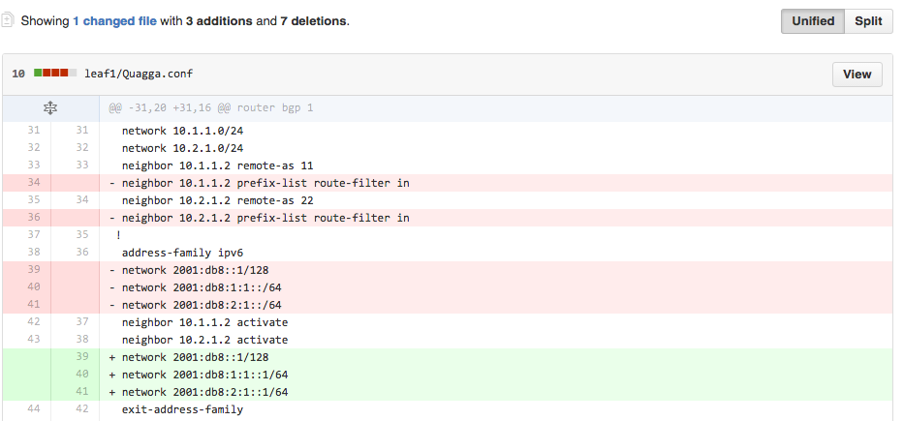
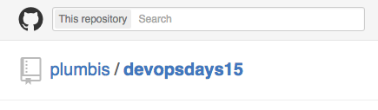
In Action

Slide 14
In Action!
Spine 1
Spine 2
Cumulus Linux
Cumulus Linux
Cumulus Linux
Cisco IOS
Leaf 1
Leaf 2

Slide 15
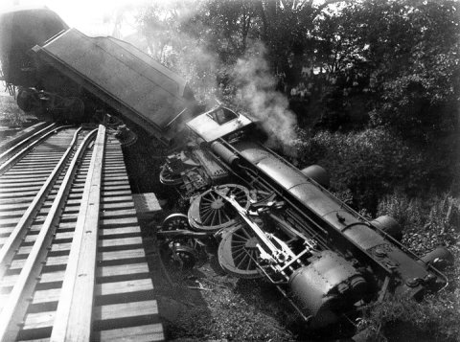
Demo

