Slide 1
Managing Network Configurations with Git
Pete Lumbis - @PeteCCDE
Customer Solutions Engineer CCIE #28677, CCDE 2012::3

Slide 2
$whoami
My Background
Not My Background
10+ year Network Engineer
2x top level Cisco Certified
Former Cisco senior support engineer
Design and builds datacenter networks
Not a programmer
Not a SysAdmin
Perl has 4 letters
So does Ruby
Python’s okay

Slide 3


Slide 4
Git for Dummies
Source Code text file repository
Automatic file revision/change management
Built for teams to work on the same files
Easy to get started, lots of knobs for advanced users

Slide 5

Git for Dummies - Glossary
Remote Repository – Central Server hosting files
Local Repository – Your local copy of the remote. Where you change things
Branch – Isolated copy for new features, risky changes
Merge – Apply branch changes to master repository copy (see also: “Pull Request”)

Slide 6
Applying Git to Networking
Create changes in branches
master
IPv6
Merge and review
master
Use merge/pull request as an opportunity to review impact of changes
IPv6

Slide 7

Applying Git to Networking (cont’d)
Rollback failures after merge
master
IPv6
Fork for new project/datacenter/office
east-dc
west-dc

Slide 8
Using Git: The Good
Git is great at version control
Existing Tools Suck
Rancid most common. SSH + diff
$$$$ for pretty SSH + diff

Slide 9
Using Git: The Bad
Implies “push” method
Still need to get on-box changes committed back
No easy deployment
Git manages code, not pushes files
One piece of a puzzle
+ Ansible, + Organization Behavior

Slide 10
Using Git: The Ugly
Incumbent Vendors Bad at Rollback
Typos Cause Chaos
interface eth0
ip address 192.168.1.1 255.255.255.0
Apply
interface eth0
no ip address 192.168.1.1 255.255.255.0
Remove
Remove from single Interface
Remove all routing configuration
interface eth0
no ip router isis
interface eth0
no router isis

Slide 11
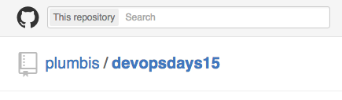
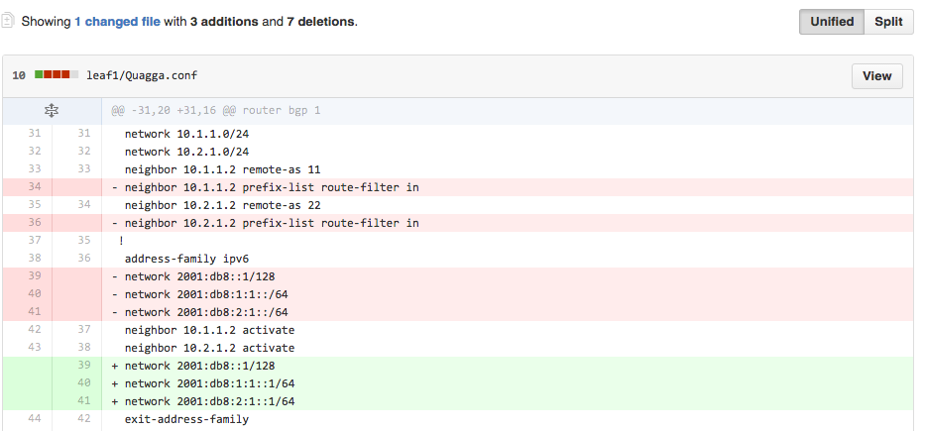
In Action

Slide 12
In Action!
Spine 1
Spine 2
Cumulus Linux
Cumulus Linux
Cumulus Linux
Cisco IOS
Leaf 1
Leaf 2

Slide 13

Demo

Slide 14
Takeaway
Git solves problems
But not all of them
Network vendors need to provide better interfaces
Separate state and configuration
New tools require new operational models
NetOps, like DevOps, requires cultural shift

Slide 16
Sidebar: Configuration vs State
Configuration
State
A file containing what we want the system to do
/etc/network/interfaces
auto eth0
iface eth0 inet static
address 192.168.1.1/24
What the system is doing right now.
ip addr add 192.168.1.1/24 dev eth0
cumulus@spine1$ ip addr show eth0 3: eth0: <BROADCAST,MULTICAST,UP,LOWER_UP> inet 192.168.1.1/24 scope global eth0

Slide 17
Anatomy of Network Configuration
Cisco/Juniper/Arista
Running Configuration (current state)
Startup Configuration (state loaded at boot)
No state/config separation
Cumulus Linux (Linux based Switch OS)
Debian standard state/configuration separation
Configured exactly like a Linux server

Slide 18
The Bad Old Days (Today)
When Configuration == State
Log into production box
Make changes, hope for best
Copy state (running) into configuration (startup)
Hope Rancid* works tonight to backup configuration
Notes:
Rancid- http://www.shrubbery.net/rancid/

