Slide 1
Gaussian Process Regression (GPR)

Slide 2
from numpy import genfromtxt, zeros
# read the first 4 columns
data = genfromtxt('iris.csv',delimiter=',',usecols=(0,1,2,3))
# read the fifth column
target = genfromtxt('iris.csv',delimiter=',',usecols=(4),dtype=str)
#文字轉為數值
t = zeros(len(target))
t[target == 'setosa'] = 1
t[target == 'versicolor'] = 2
t[target == 'virginica'] = 3

Slide 3
import numpy as np from numpy.random import rand
x = rand(40,1)
y = x*x*x+rand(40,1)/5

Slide 4
from sklearn.gaussian_process import GaussianProcessRegressor
gpreg = GaussianProcessRegressor()
gpreg.fit(x,y)#train

Slide 5
from numpy import linspace, matrix from pylab import plot, show
# 建立一個最小值0，最大值1，共分40塊相等間距的矩陣
xx = linspace(0,1,40)
plot(x,y,'o',xx,gpreg.predict(matrix(xx).T),'--r')
show()

Slide 6
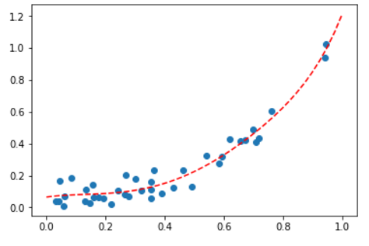
第一次

Slide 7
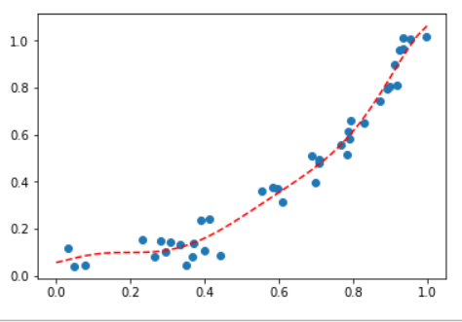
第二次

Slide 8
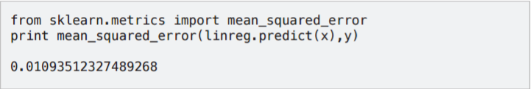
from sklearn.metrics import mean_squared_error
print (mean_squared_error(gpreg.predict(x),y))
第一次的結果
0.00286788986924
第二次的結果
0.00235684216187

