Slide 1
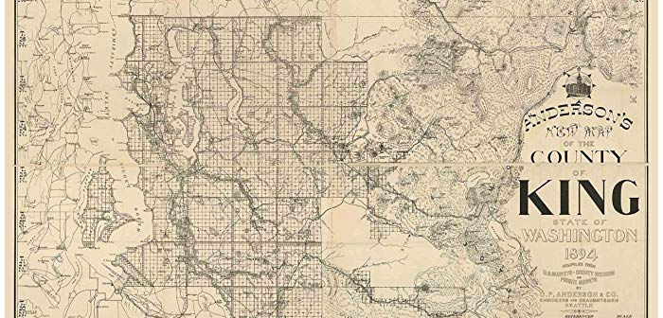
ASSESSMENT OF PRICE DRIVERS IN KING COUNTY

Slide 2

Purpose of the project: to find the best factors, from a large collection of factors, to help us predict the prices of homes in the King County area.
WHY WE’RE HERE

Slide 3
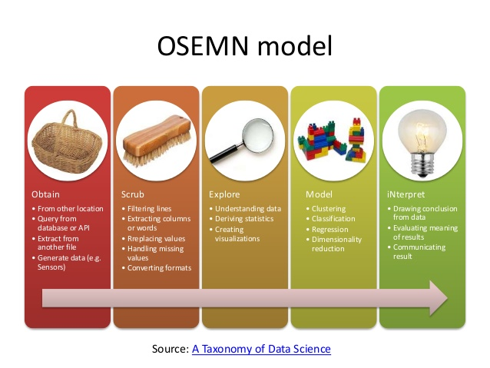
METHODOLOGY
We’re using the OSEMN model of data analytics; very common among data scientists.
The process is not quite finished, however.
A model that hasn’t been explained isn’t a complete model.
You will be able to take the findings of the analysis and implement them as you see fit.

Slide 4


KING COUTY AT A GLANCE
Founded – 1852
Renamed after MLK, Jr. – 1986
Est. Population. – 2,233,163 (2018)
Median Household Income - $78,800
Largest Industry – Information/Technology
Census Median Home Value
2000 – $235,000
2016 – $407,400
2018 Net New Residential Units – 14,970
Single Family – 2,610
Multifamily – 12,360

Slide 5
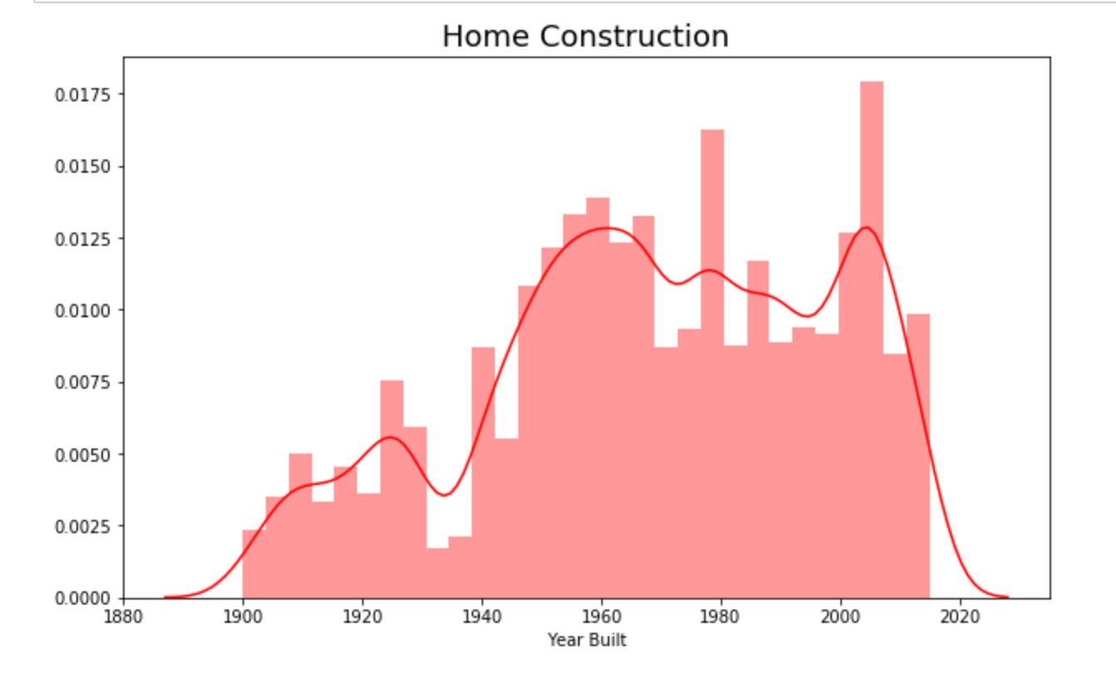
OUR DATA SET AT A GLANCE
Over 20,000 observations—a very healthy sample size
Median Home Value: $450,000
Median Home Square Footage: 1,910
Some features included:
Square footage
Year home was built
Grade given by K. County
# of beds & baths
Zip code
Latitude & longitude
Home construction ranges from 1900 – 2015, with consistent growth from the mid 50’s to mid 60’s, and brief spikes in construction around 1980 and 2010.

Slide 6
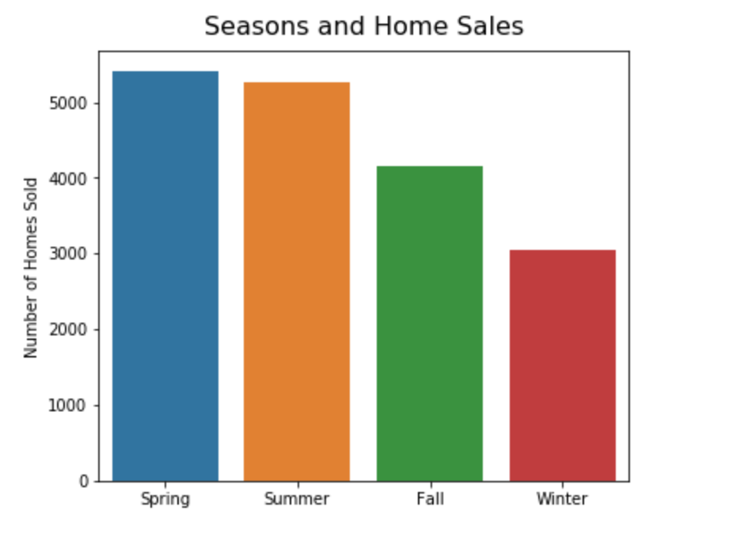
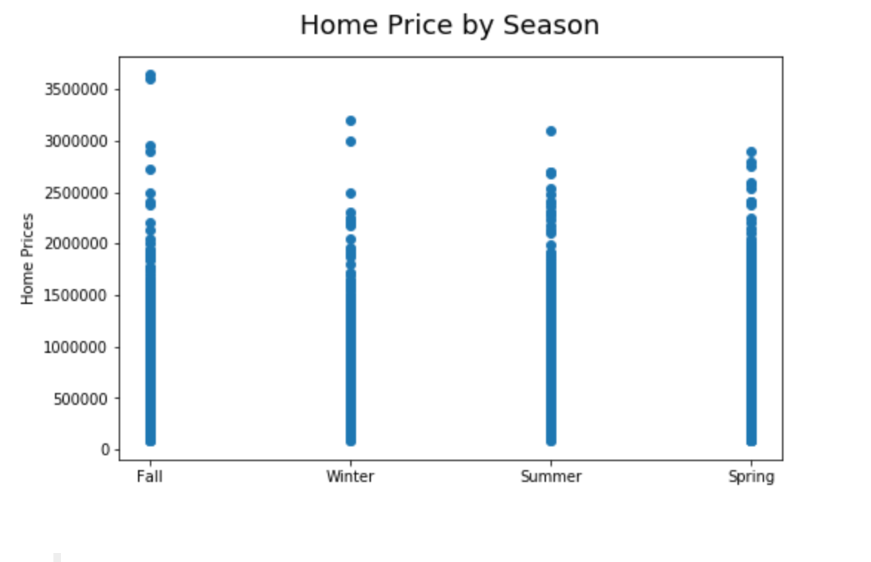
A NOTE ON SEASONS
Common sense would tell us that the time of year would have a substantial effect on our data set. And it does. But maybe not in all the ways we would expect it to. Let’s investigate below.
There is clearly a higher number of homes sold in the warmer months.
But with the exception of a few outliers, the time of year doesn’t seem to have a large effect on price.

Slide 7
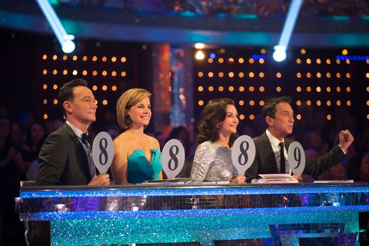
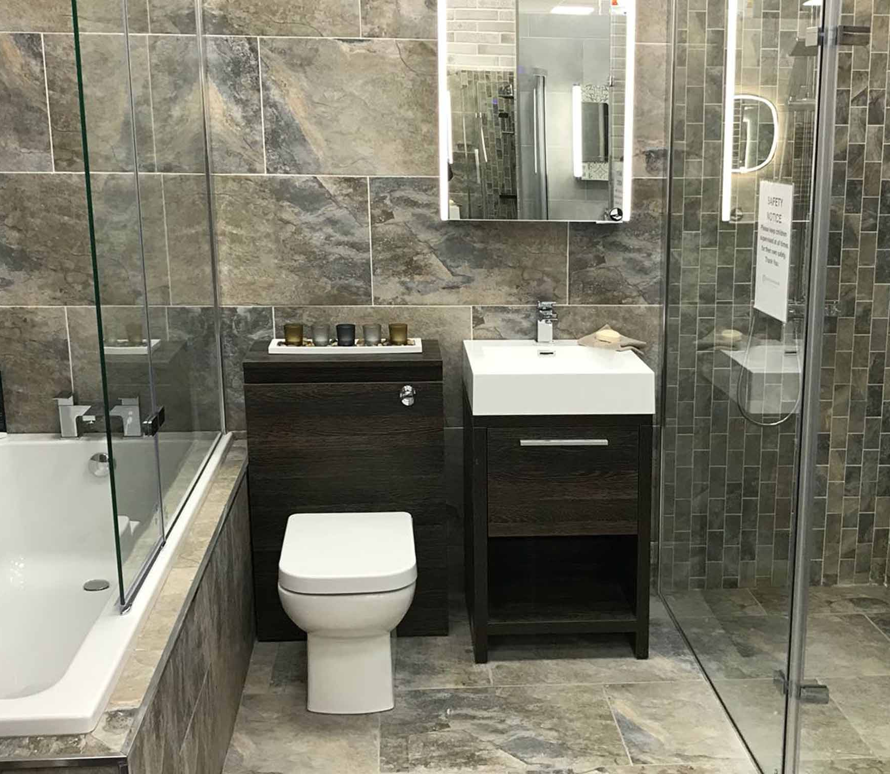
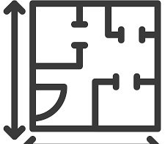
RESULTS — FEATURES
Most Significant Features:
Grade
Bathrooms
Square Footage
When we crunched the numbers we got a “R^2 score” of .71. This means our model can explain ~ 71% of the cost of the homes

Slide 8
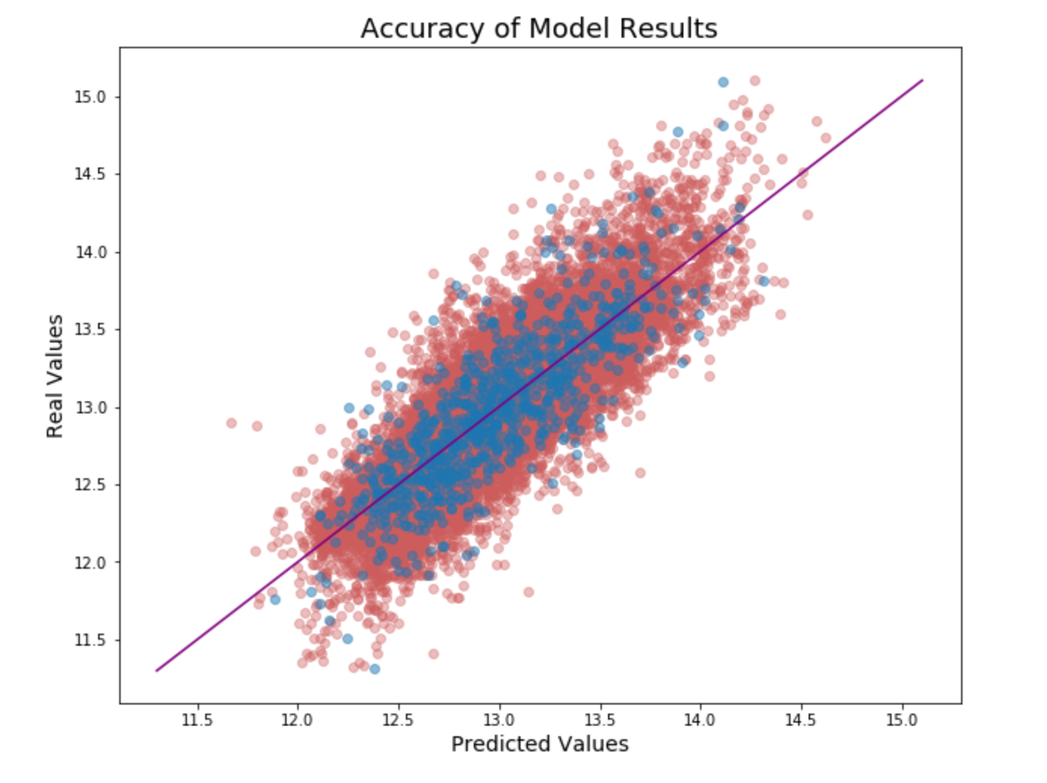
RESULTS — ACCURACY
One way of checking the soundness of your model is to plot your actual values against your predicted values. The closer to a 45 degree angle they are, the better.
In this example, the red dots represent the data we trained our model on, and the blue are the data we tested our model on.
The fact that they both follow a nice 45 degree trend, as well as aligning with each other, bodes well for the accuracy of our model.

Slide 9
THANK YOU!
Questions?
Comments?
Parker Lumkes, data scientist in-training
plumkes@gmail.com

