Slide 1

Intro to SQL

Slide 2
SQL
SQL stands for Structured Query Language
In order to display data from a database we need to query it
In SQL, there are many different statements and clauses that can be used to query data
Notes:
http://www.c-sharpcorner.com/article/top-10-mostly-used-sql-queries/

Slide 3
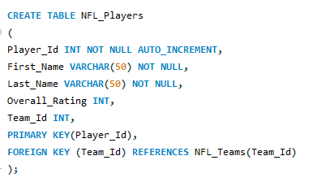

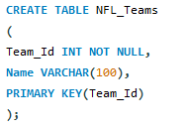

Table

Slide 4
Select Statement
SELECT statement fetches the data from a table which returns data in a new table with the selected results.
It is possible to select specific attributes (Id, Name, etc.) or select all data from the table ( * ).

Slide 5


Select Statement
SELECT Last_Name, Overall_Rating FROM NFL_Players
SELECT * FROM NFL_Players

Slide 6
Insert Statement
INSERT INTO statement is a way to add new records (rows) of data to a table.

Slide 7
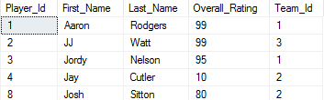
Insert Statement
INSERT INTO NFL_Players (Player_Id, First_Name, Last_Name, Overall_Rating, Team_Id)
VALUES (8, 'Josh', 'Sitton', 80, 2)

Slide 8
Update Query
UPDATE modifies an existing record in a table

Slide 9
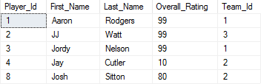
Update Query
UPDATE NFL_Player
SET Overall_Rating = 99
WHERE Last_Name = 'Nelson'

Slide 10
Delete Query
DELETE an existing record from the table
IMPORTANT NOTE: There is no undo for deleting in SQL

Slide 11

Delete Query
DELETE FROM NFL_Player
WHERE Last_Name = 'Sitton'

Slide 12
CRUD Operations
Main business logic
Create (Insert)
Read (Select)
Update (Update)
Delete (Delete)

Slide 13
AND & OR Operators
AND and OR operators allow the ability to combine multiple conditions to help narrow data.
Makes it possible for there to be multiple comparisons in the same SQL statement

Slide 14

AND Operator
SELECT Last_Name, Overall_Rating, Team_Id
FROM NFL_Player
WHERE Team_Id = 1 AND Overall_Rating = 99

Slide 15

OR Operator
SELECT First_Name, Last_Name, Team_Id
FROM NFL_Player
WHERE Team_Id = 1 OR Team_Id = 4

Slide 16
Like Clause
LIKE is used when you want to compare values
Need to supply a wildcard operator (i.e. %) with the LIKE clause

Slide 17

Like Clause
SELECT * FROM NFL_Player
WHERE First_Name LIKE 'J%'

Slide 18
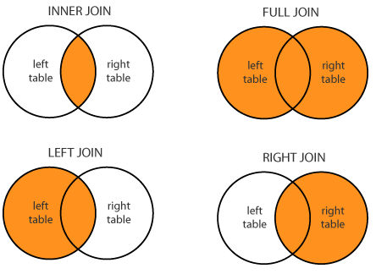
Join Clauses

Slide 19
Join Clauses
Inner Join: returns rows when there is a match in both tables
Full Outer Join: returns rows when there is a match in one of the tables
Left Join: returns rows from left table, even if there are no matches in right table
Right Join: returns rows from right table, even if there are no matches in left table

Slide 20
Stored Procedure
Think of a stored procedure as a function.
Stored procedure is a group of SQL statements that have been created and stored in the database.
Instead of having to write a common query over and over again, you can call a procedure (like call a function) to execute the query.
Just like a function, procedures have parameter values that can be passed in.

Slide 21
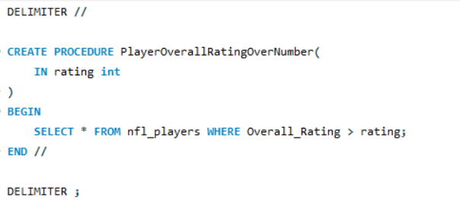

Stored Procedure Example

Slide 22
Schema
A schema within a database is mainly used to group logical objects together.

Slide 23
SQL Terminology
Constraints: rules enforced on columns on a table i.e. Foreign Key Constraint
Alias: it’s possible to temporarily rename a table or column by giving it an alias
Distinct: used with SELECT to return only unique records by getting rid of duplicates
Group By: used with SELECT to group identical data
Order By: sort data in ascending or descending order based on columns
Drop Table: completely deletes all of the data within a table as well as table itself
Truncate Table: deletes only data in the table but keeps table as is

