Slide 1
Loan Defaults
Loan defaults in an age of data

Slide 2
Objective
Explore new criteria for evaluating loan applications
Easily verifiable
Easily integrated into workflow
Socially/legally acceptable

Slide 3
Loan Officer’s Considerations
FICO Score
Income to Debt Ratio
Collateral

Slide 4

Data Set: Lending Club
Benefits:
Large
Free
Large amount of collected data
Issues:
Single source (biased)
Missing data
Different populations
The Lending Club, a peer to peer lending marketplace which brings individuals looking for loans with investors looking for returns together.
Image sources: The Lending Club

Slide 5
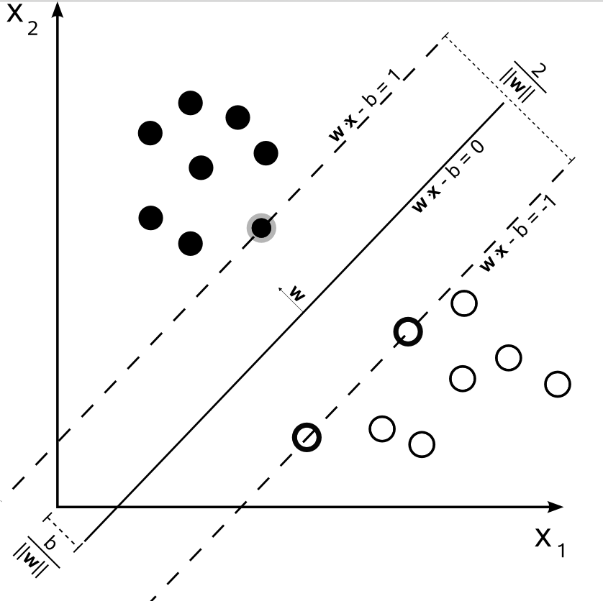
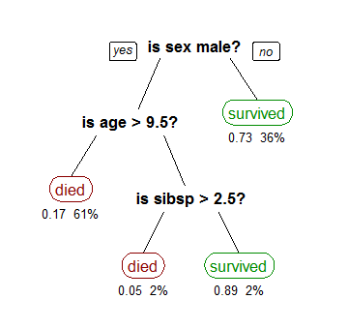
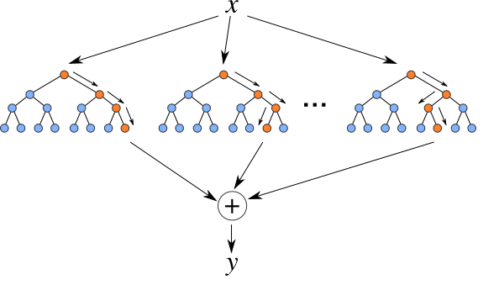
Algorithms
Support Vector Machines
Generate line separating loans in which default from those that don’t.
Decision Tree
Generate a Decision Tree, a series of conditions, to separate loans in which default from those that don’t.
Random Forest
Generates many Decision Trees with a level of randomness(random sample from training data, random features considered when asking the conditions.)
Image sources: Wikipedia, http://f.hatena.ne.jp/

Slide 6
Data Analyzed
loan_amnt: Size, in dollars, of the requested loan
home_ownership: Living situation of applicant. Possible values: RENT, OWN, MORTGAGE, or OTHER. Coded as 1, 2, 3, or 4 respectively.
annual_inc: Applicant’s annual income, in dollars
fico_range_high: The upper boundary of the FICO range that the applicant falls under
badloan: Status of the loan, a feature defining the status of the loan as GOOD or BAD, coded as 2 or 1 respectively.

Slide 7
Results
None of the algorithms tested, with the features considered, produced an usable classifier.
This is not unexpected; this is an active research field.
Next steps are to perform a PCA analysis on the same features and run the same analysis using those features.
Further steps would include performing a PCA analysis on the entire data set and then analyzing those features.
It would be advisable to perform these analyses on a computer with more processing power than what I have available to cut down calculating time to a reasonable level.

