Slide 1
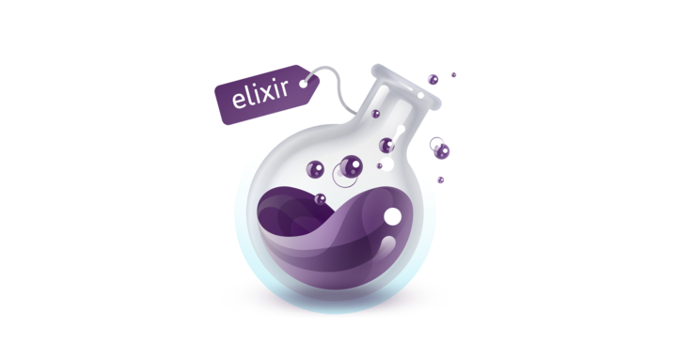
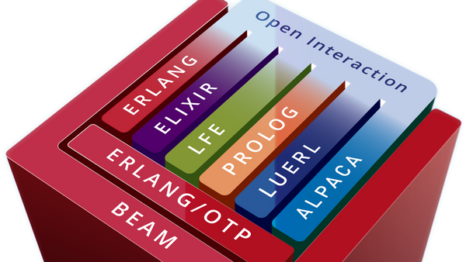




Actor Model
DDD

Slide 2
Qué es Elixir y de dónde viene?
Su relación con Erlang y la BEAM (Bogdan Erlang Abstract Machine)
OTP (Open Telecom Platform)
Joe Armstrong (Creador de Erlang)
Installing Elixir/Erlang
Sintaxis (y porqué su similaritud con otros lenguajes)
Es un lenguaje funcional?
Qué vino a solucionar?
Actor Model - OTP en Elixir o cómo dominar la concurrencia facilmente
IEx console
Mix tool
Consola remota en una app en ejecución
Stream and Flow (processing large amount of data in chunks and concurrently)
Phoenix Framework

Slide 3
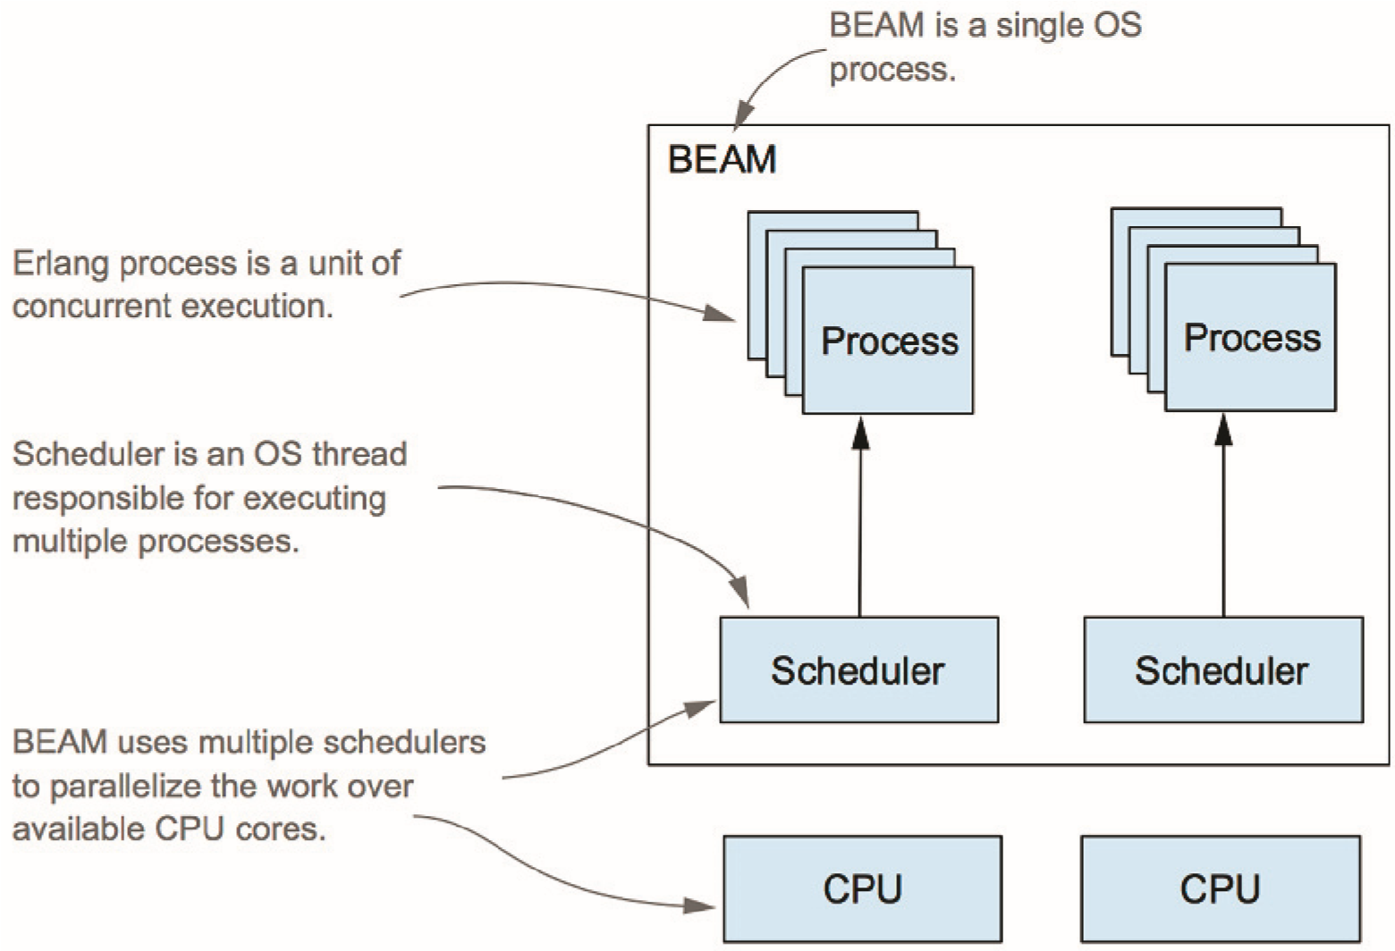
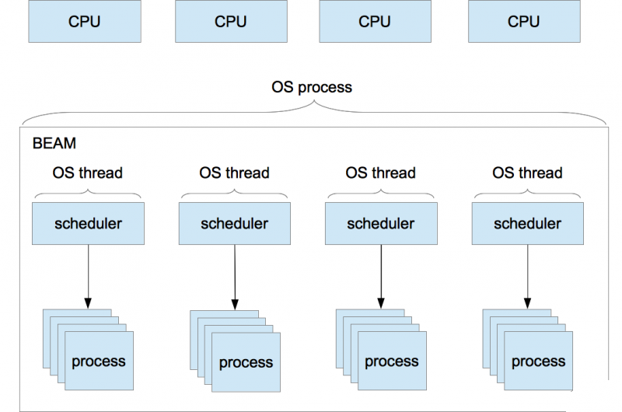
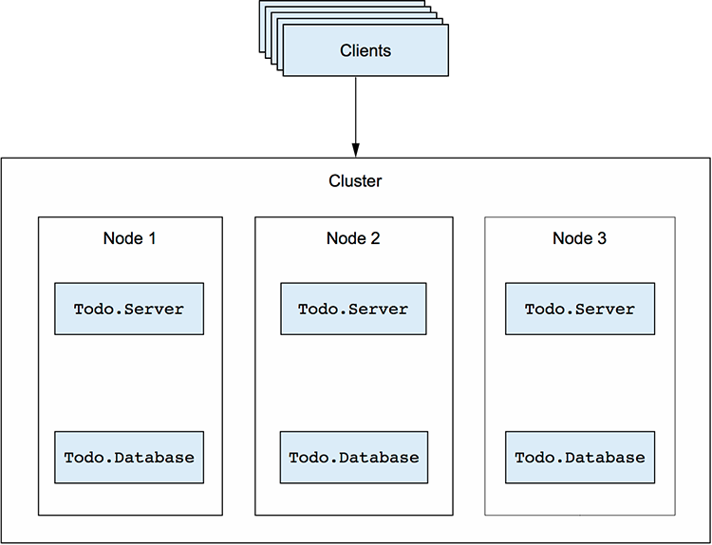
Qué es Elixir?
Qué es Erlang?
...Y la BEAM?

Slide 4
Three major characteristics:
Concurrency: Elixir uses lightweight threads of execution (called processes). These are isolated, run across all CPUs, and communicate through messages. Together with the immutability of data that comes from the functional nature of the language, this makes it less hard to write concurrent programs in Elixir
Scalability: These same processes allow us to scale systems easily, either horizontally (adding more machines to the cluster) or vertically (using the available resources of the machine more efficiently)
Reliability: Elixir and Erlang have a unique approach to fault-tolerance. While things sometimes inevitably fail in production, lightweight processes can be quickly restarted by the supervisor system. This deals with most bugs that are not due to serious faults in software development

Slide 5
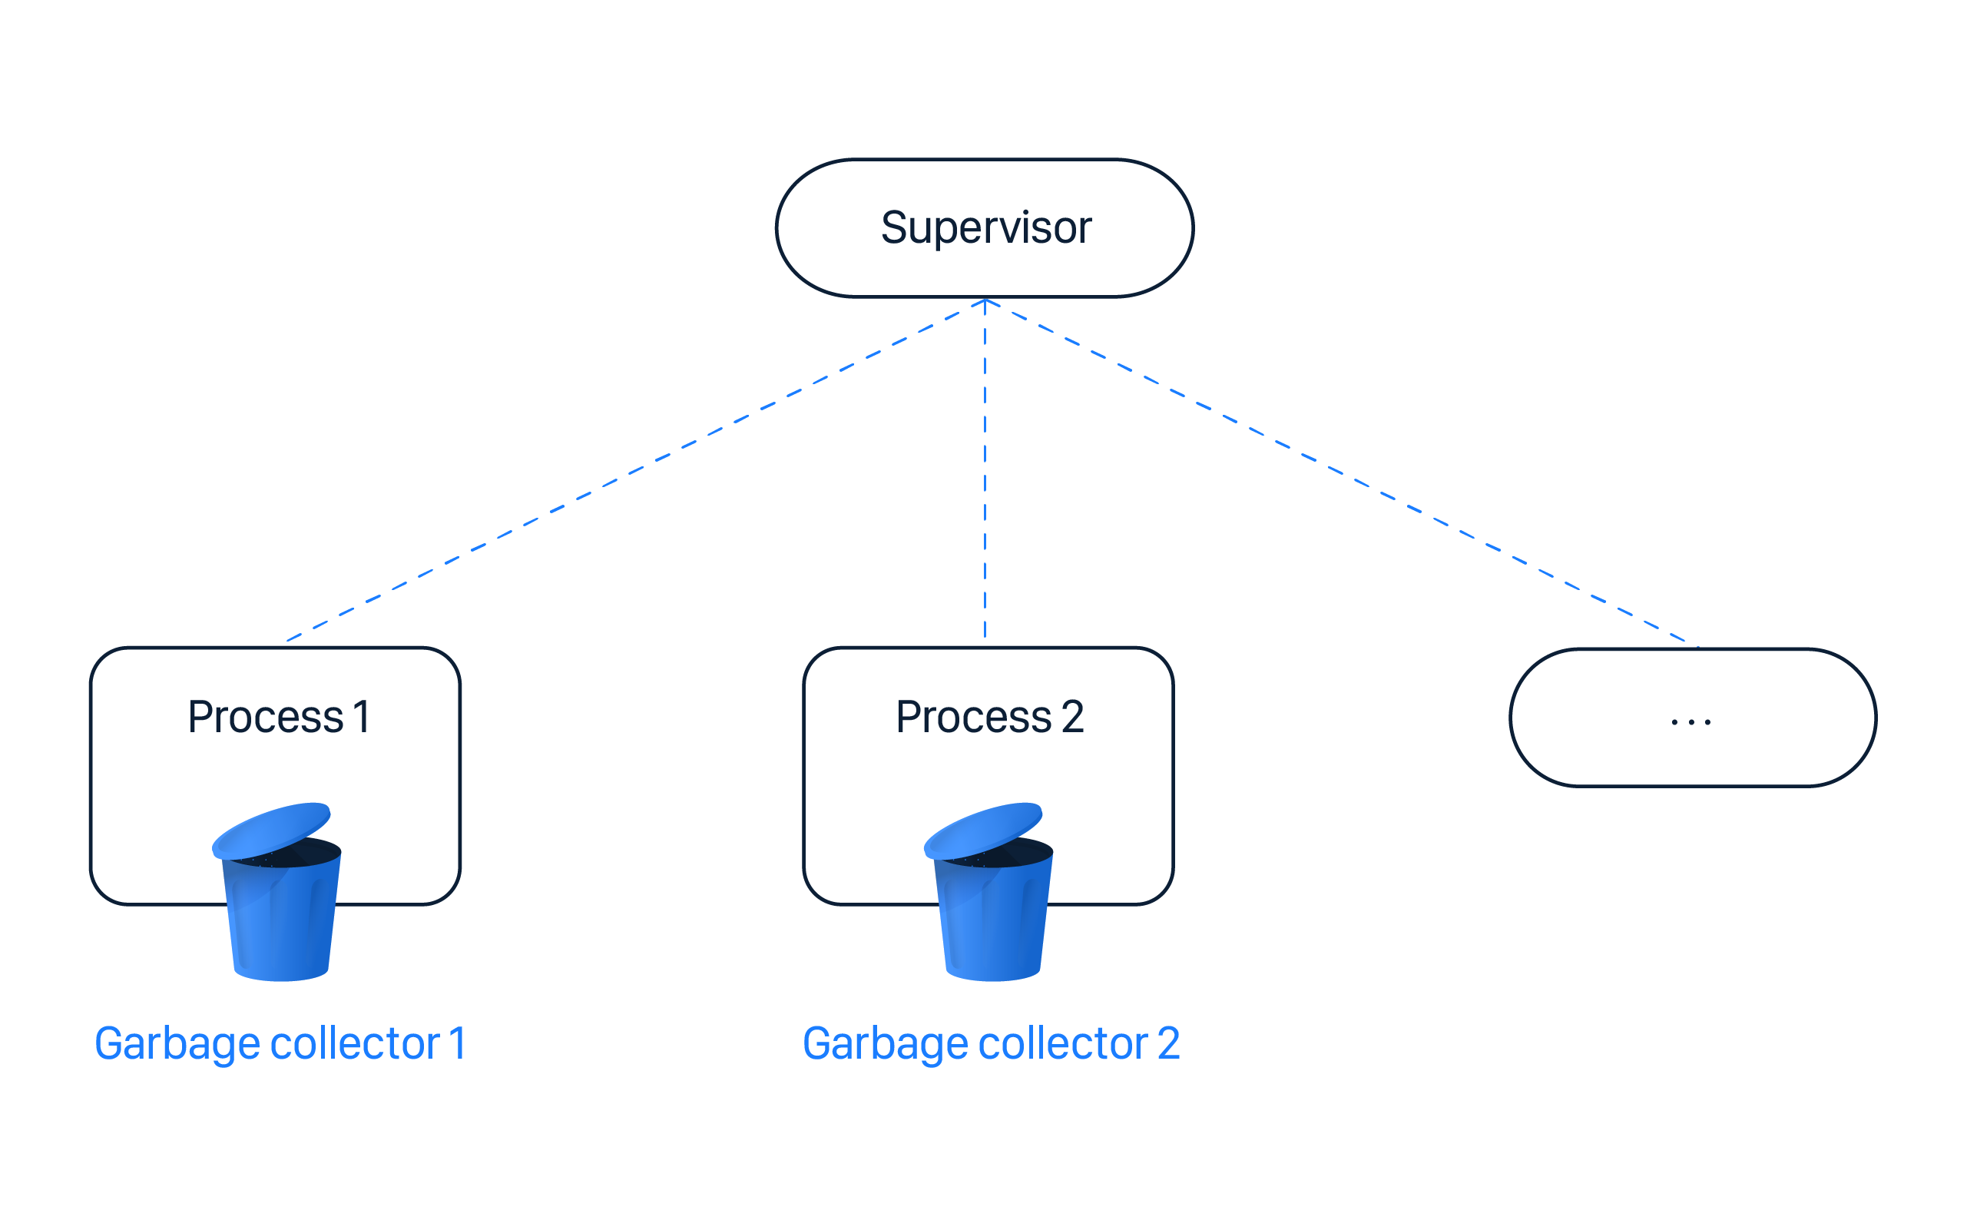
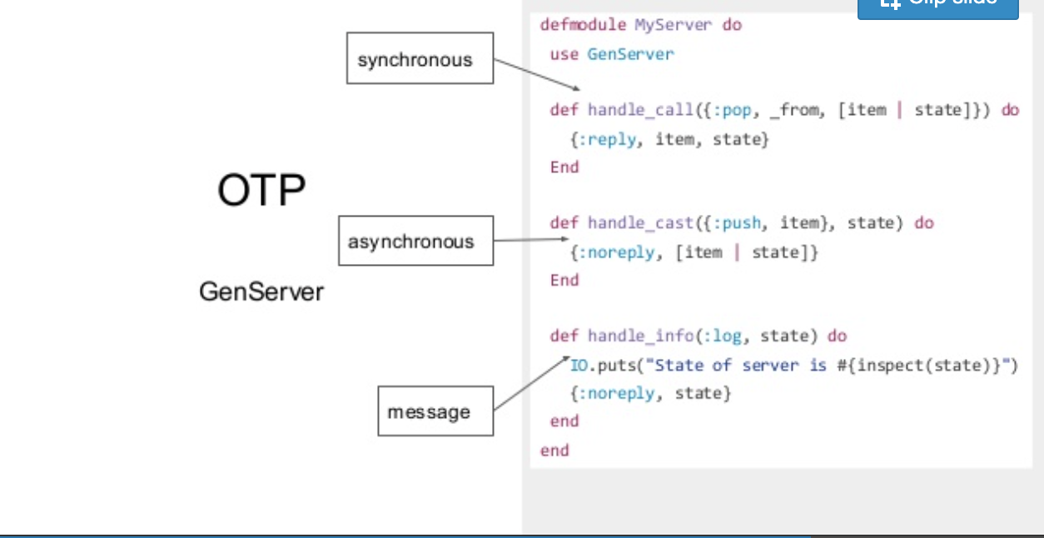
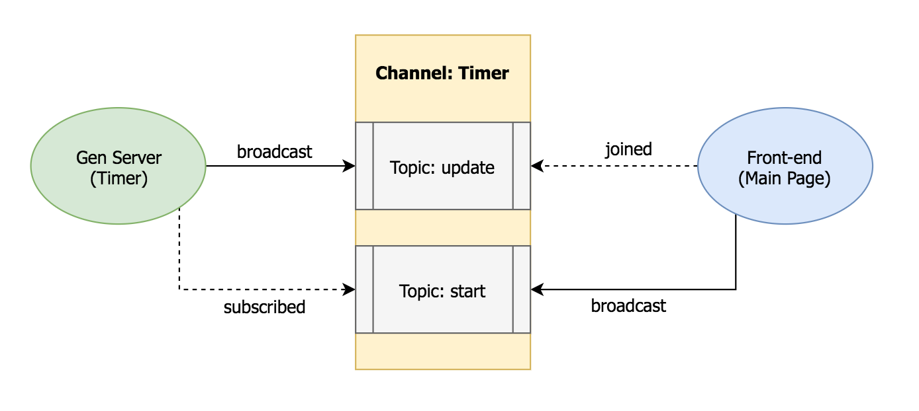
Supervisors:
- Watches its childrens
- Manage its children based on a strategy
- :one_for_one, :rest_for_all, :rest_for_one
OTP
(Open Telecom Platform)
Builtin solution: GenServers

Slide 6
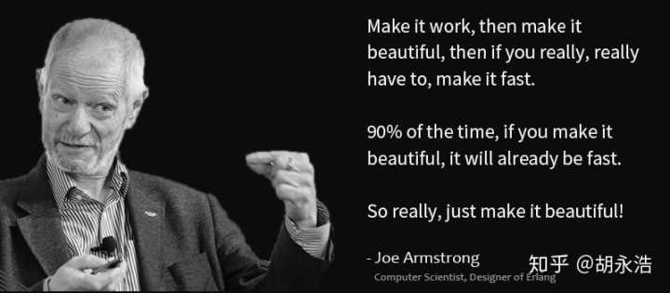
Joe Armstrong

Slide 7
Installing Elixir
https://elixir-lang.org/install.html

Slide 8
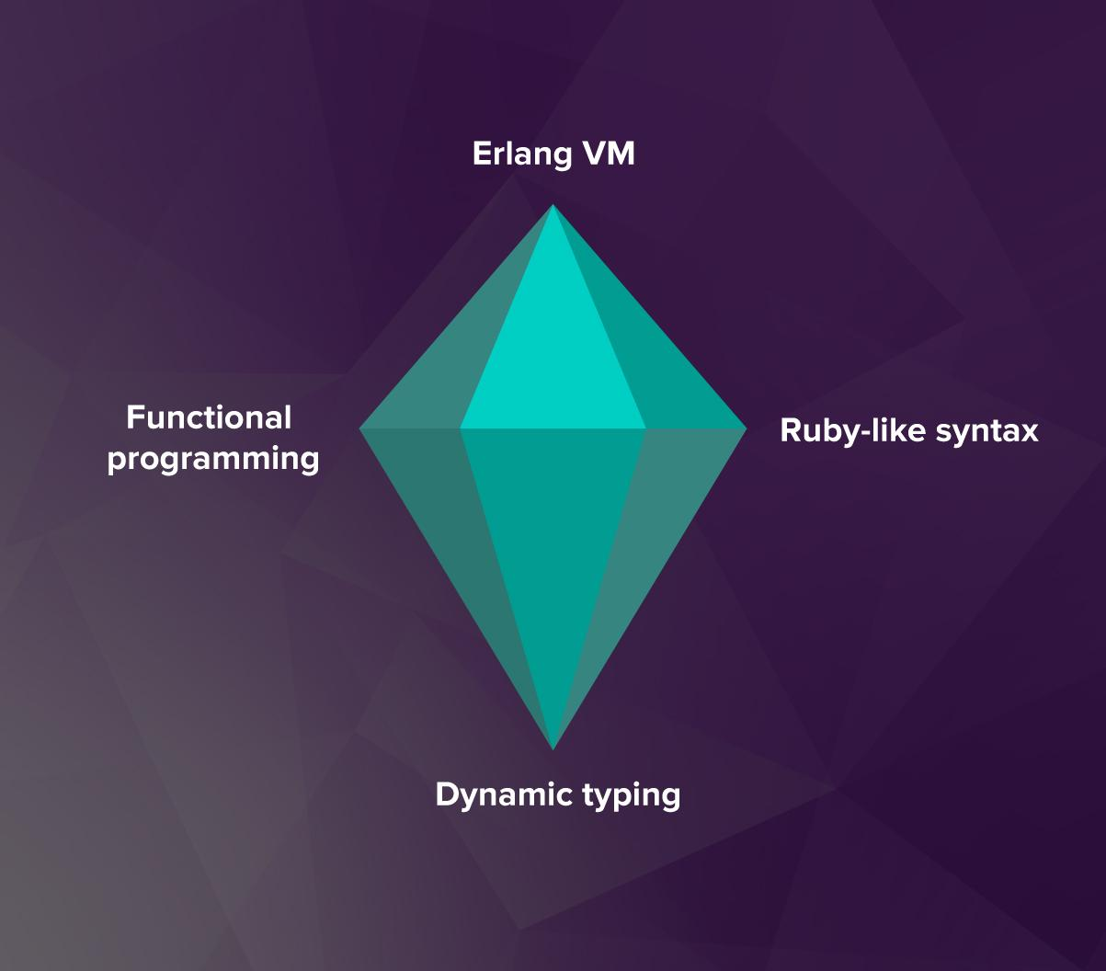
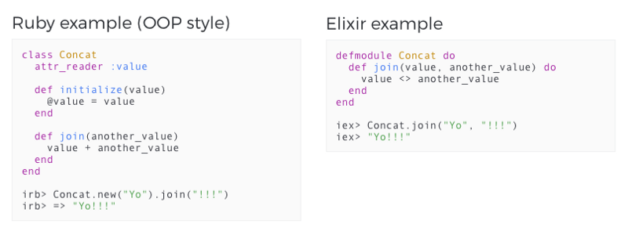
Ruby-like Sintaxis

Slide 9
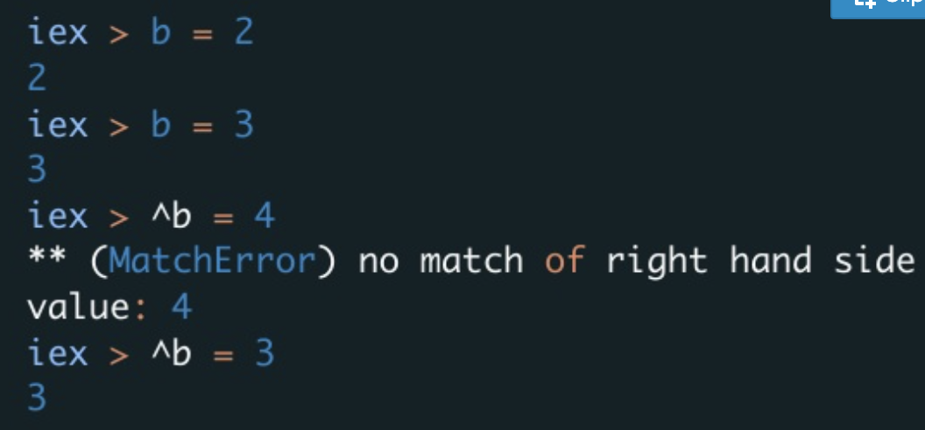
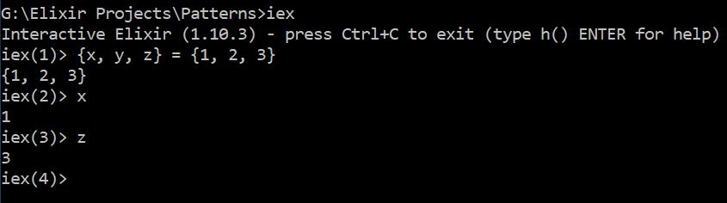
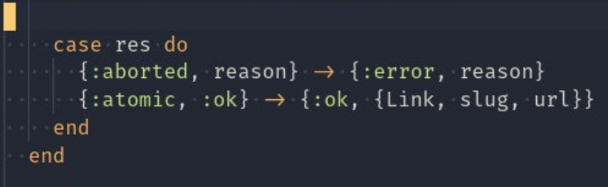
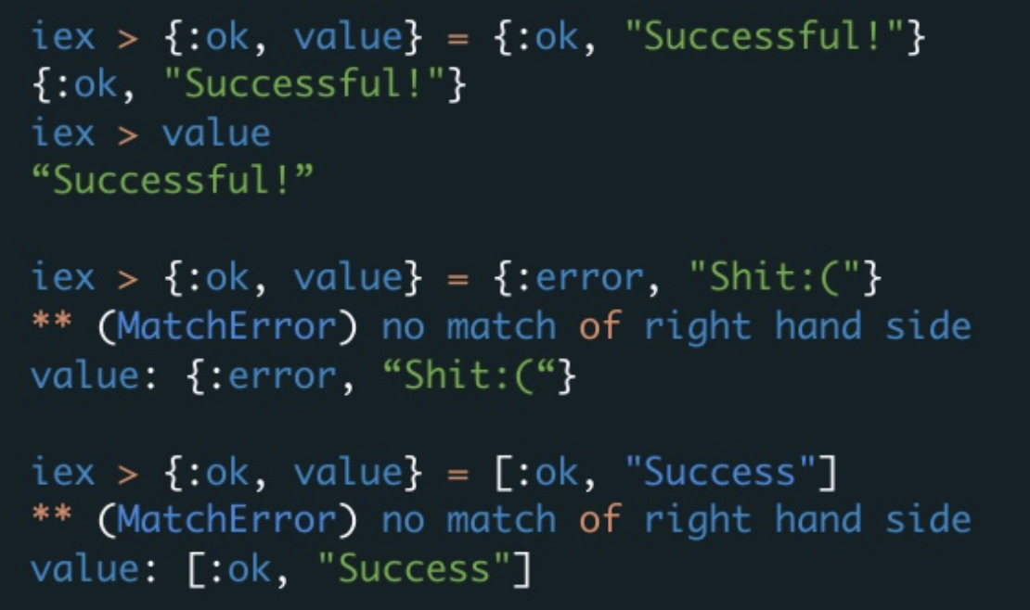
Pattern Matching

Slide 10
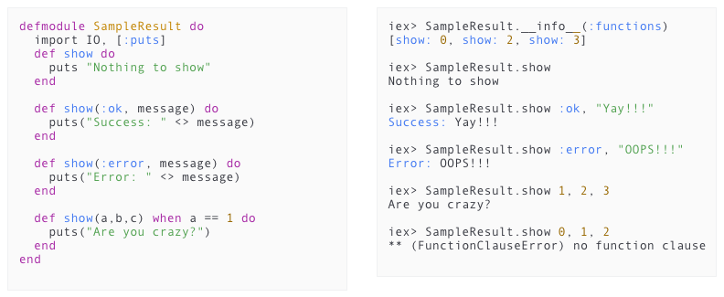
Functions Arity

Slide 11
Es Elixir un lenguaje fucnional?
Pure functions (first class functions)
Immutable data
Modularity
No side-effects
Recursive function-calls

Slide 12
Qué vino a solucionar?

Slide 13
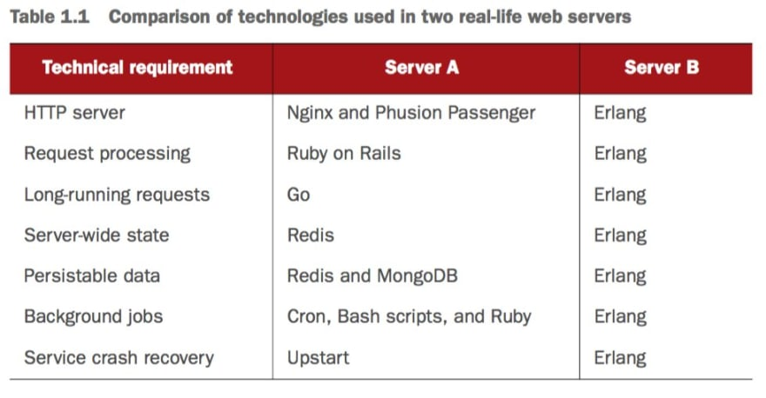
All in one place

Slide 14
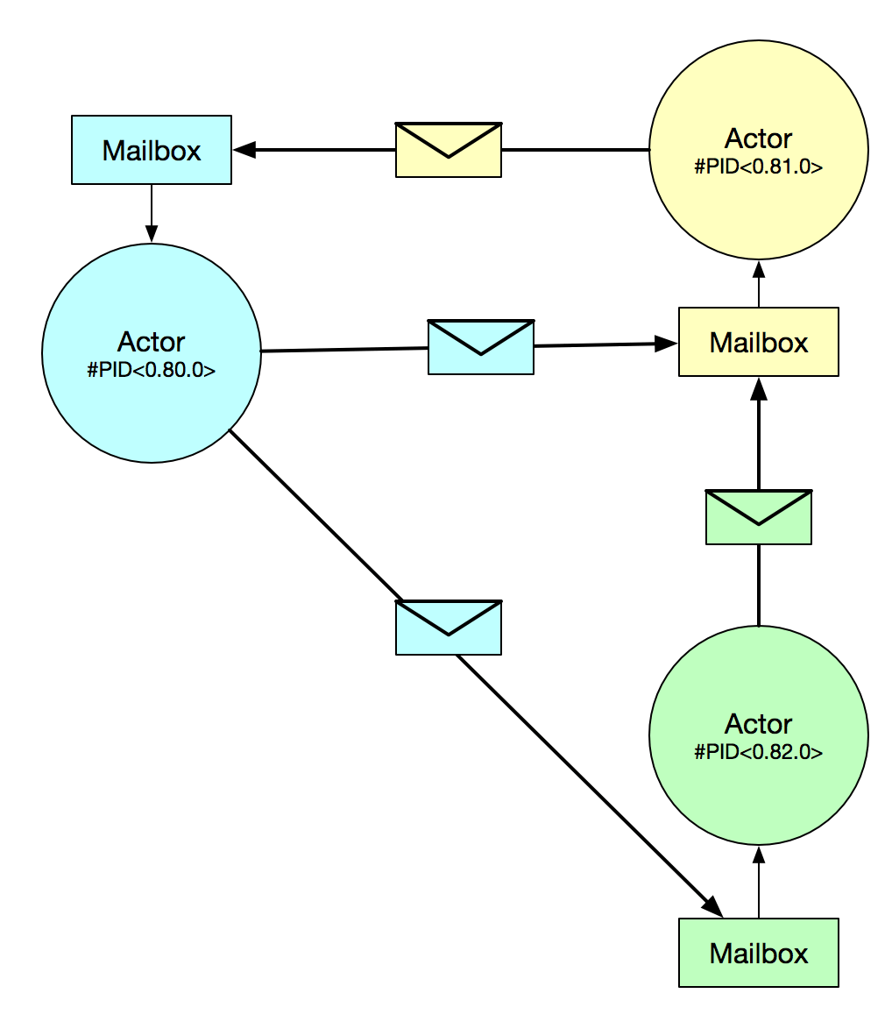
Actor Model Pattern

Slide 15
Some useful links:
Elixir: The Documentary
https://www.youtube.com/watch?v=lxYFOM3UJzo&t=2s&ab_channel=Honeypot
Go vs Elixir (CSP vs Actor Model) https://codesync.global/media/go-vs-elixir-a-concurrency-comparison/
Elixir School
https://elixirschool.com/
Books
Elixir in Action (Second Edition) by Saša Jurić
Elixir weekly newsletter
https://elixirweekly.net/

