Slide 1
Hello World
Subtitle

Slide 2
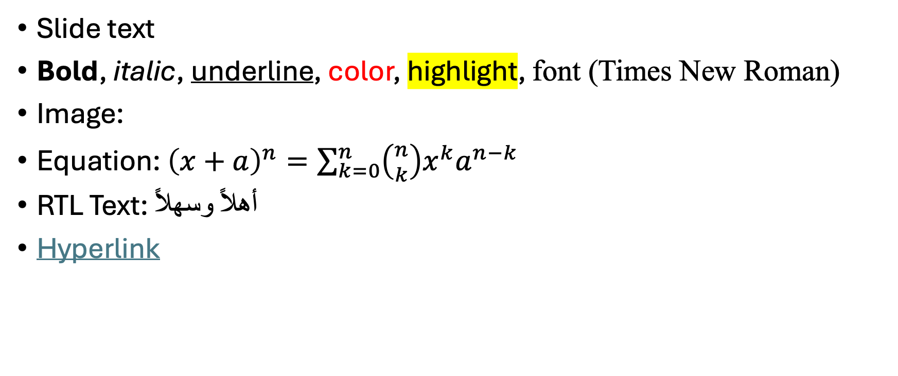
Slide Title
Text box
Slide text
Bold, italic, underline, color, highlight, font (Times New Roman)
Image:
Equation: ${\left(x+a\right)}^{n}=\sum_{k=0}^{n}{\left({n \atop k}\right)x^{k}a^{n−k}}$
RTL Text: أهلاً وسهلاً
Hyperlink

Slide 3
Second Slide
Some more text

