Slide 1


Download Visual Studio code from https://code.visualstudio.com/download.
Open Visual Studio code.
Open the extensions menu on the left by clicking on the extension icon.
Type ‘Five Server’ in the Search box and click on icon when it appears.
Click on INSTALL to add and start the extension. Now select the folders icon on the top left so that you can setup the site.
Click on File – Open Folder and navigate to the folder where you want to setup the site. I will be using the Users/Public/Public Documents folder which is located at C:\Users\Public\Documents on a Windows PC.
You might be asked to ‘Trust the authors’ which you can safely do.
Click on the new folder icon and create a folder with your website name. I will use the name ‘Photo_Store’.

Slide 2
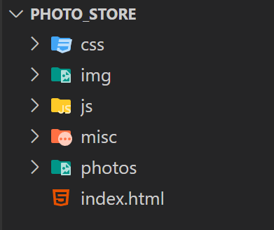
Go back to the open folder icon and open the empty ‘Photo_Store’ folder.
Now create the folder structure for our site which is a group of 5 folders named:-
css
js
img
photos
misc
Create these folders as before using the new folder icon.
Click on the new file icon and create a file named index.html. Once completed the structure should look like this:-

