Slide 1
UniCoord: An Information Coordinate System for scRNA Atlas
Gao Haoxiang
2021/09/07

Slide 2
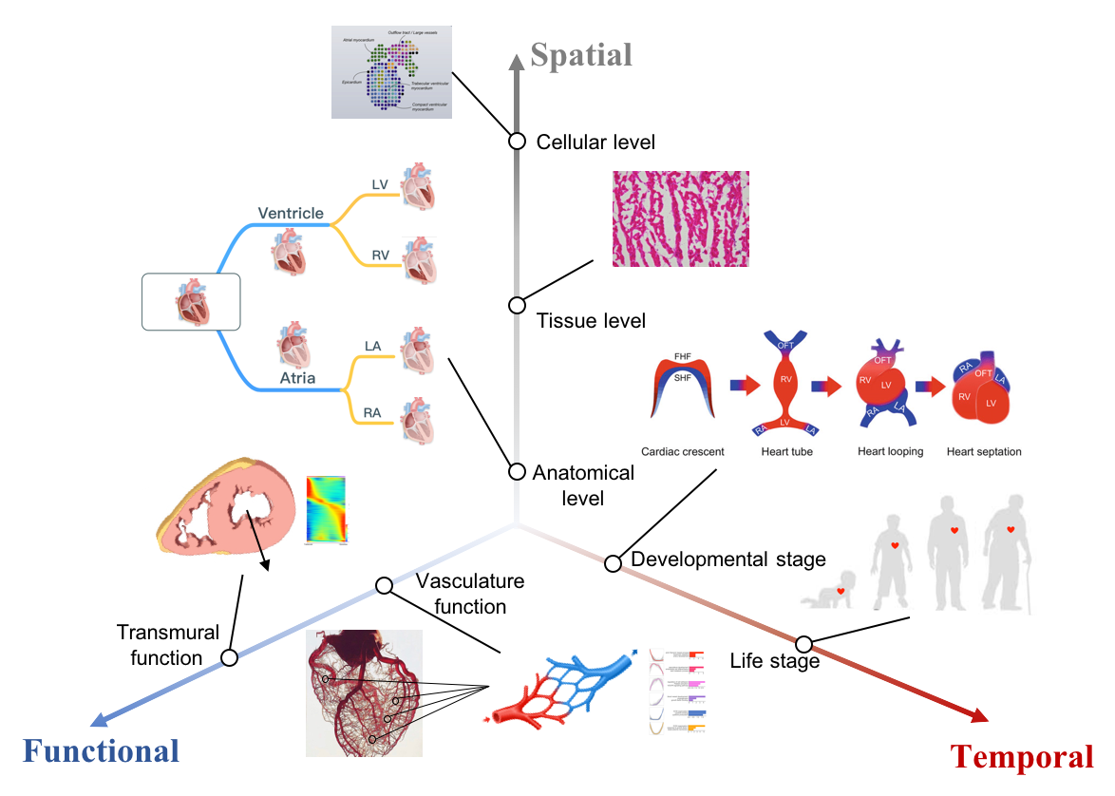
Cellular Heterogeneity: Biological Aspect
Spatial position of cells
Organ/Tissue
Spatial coordinates
Temporal stage of cells
Embryonic stage
Donor age
Functional activity of cells
Transmural function
Artery-capillary-vein gradient
Cell type

Slide 3
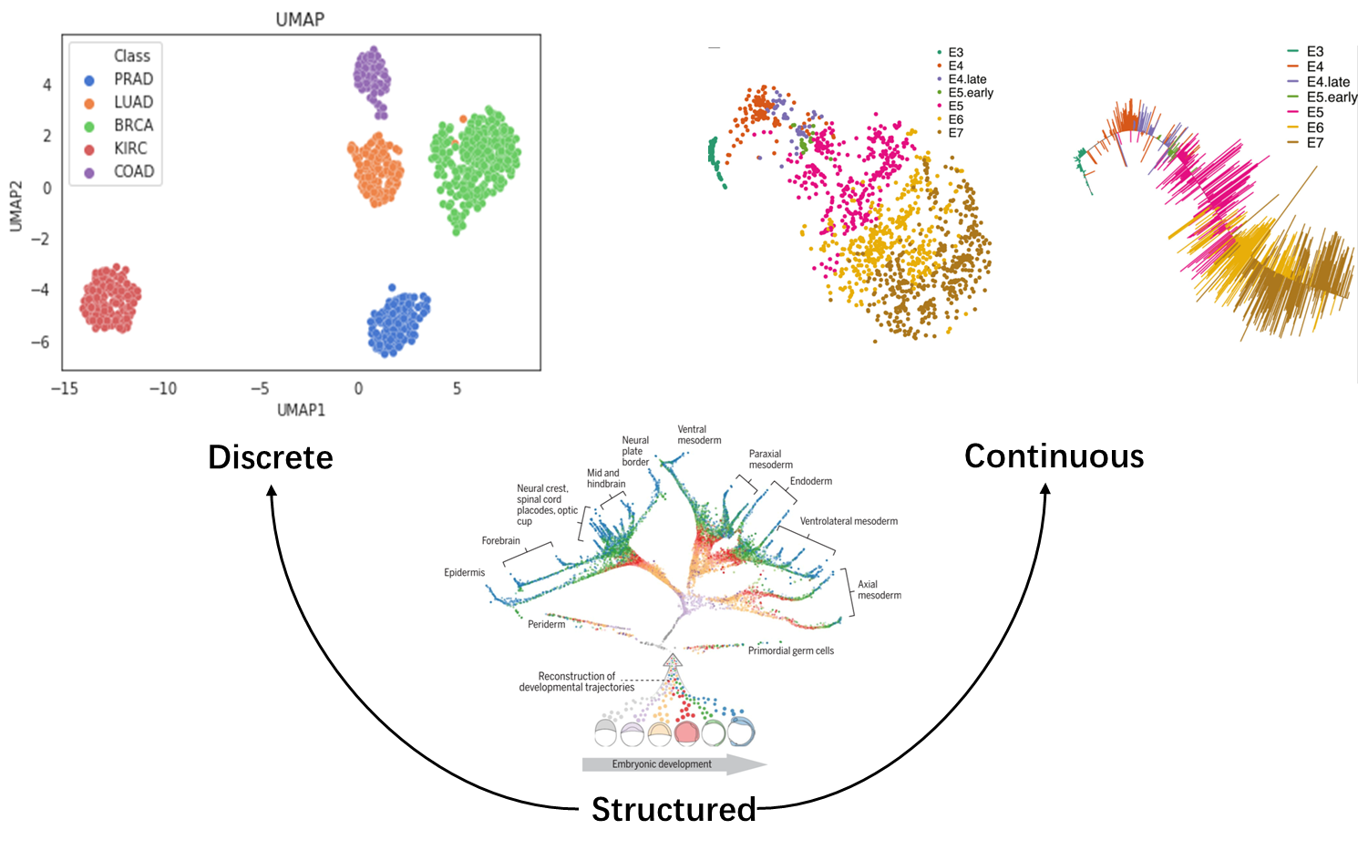
Cellular Heterogeneity: Information Aspect
Discrete
Cell type
Organ
Embryonic day
Continuous
Spatial coordinates
Transmural function
Structured
Hierarchical relationship between cell types

Slide 4
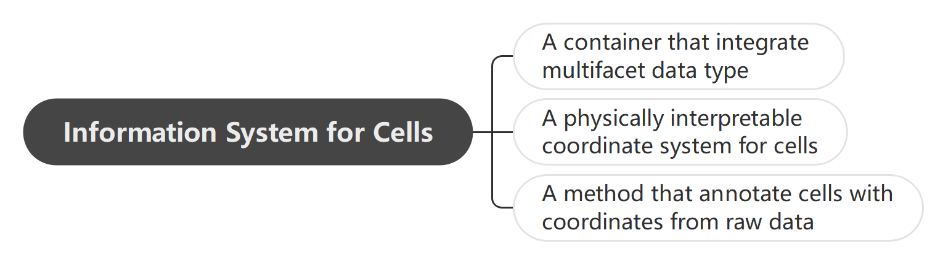
Towards a Information System for Cells

Slide 5
Universal Coordinate Method
Continuous
PCA
VAE
UniCoord
Regression
MLP
Unsupervised
Supervised
Kmeans
Louvain
SVM
Random Forest
Discrete

Slide 6
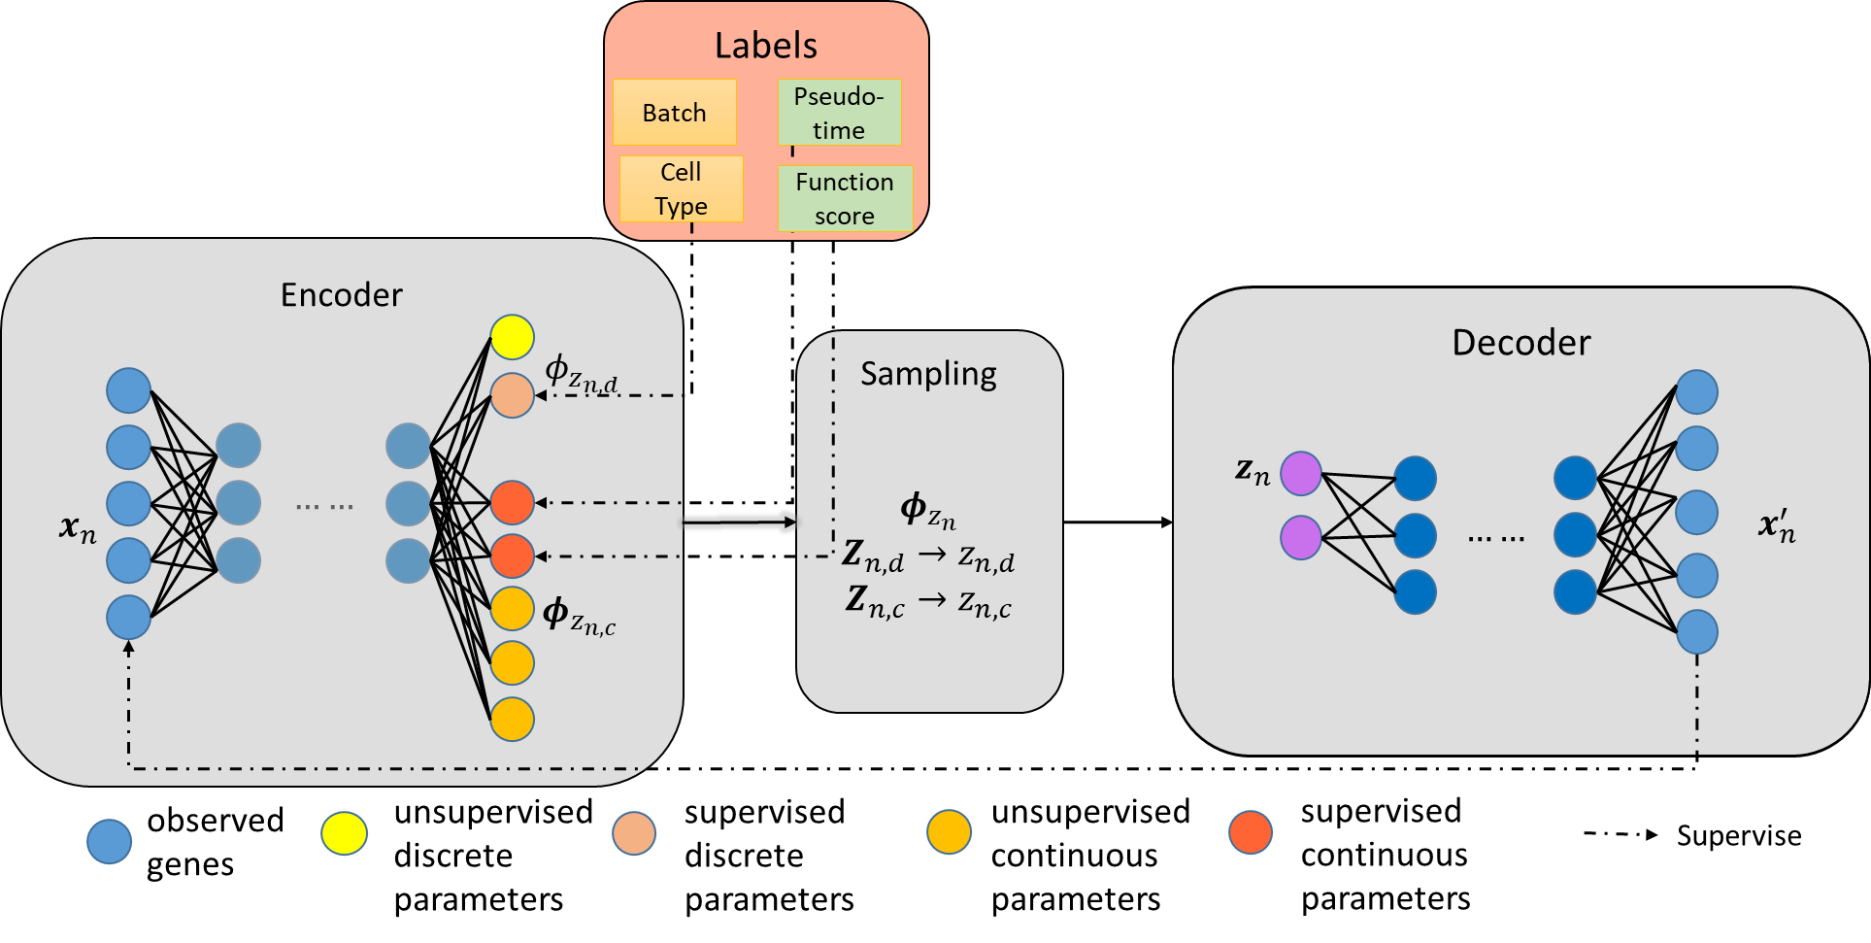
The UniCoord Model: A Mixture VAE

Slide 7
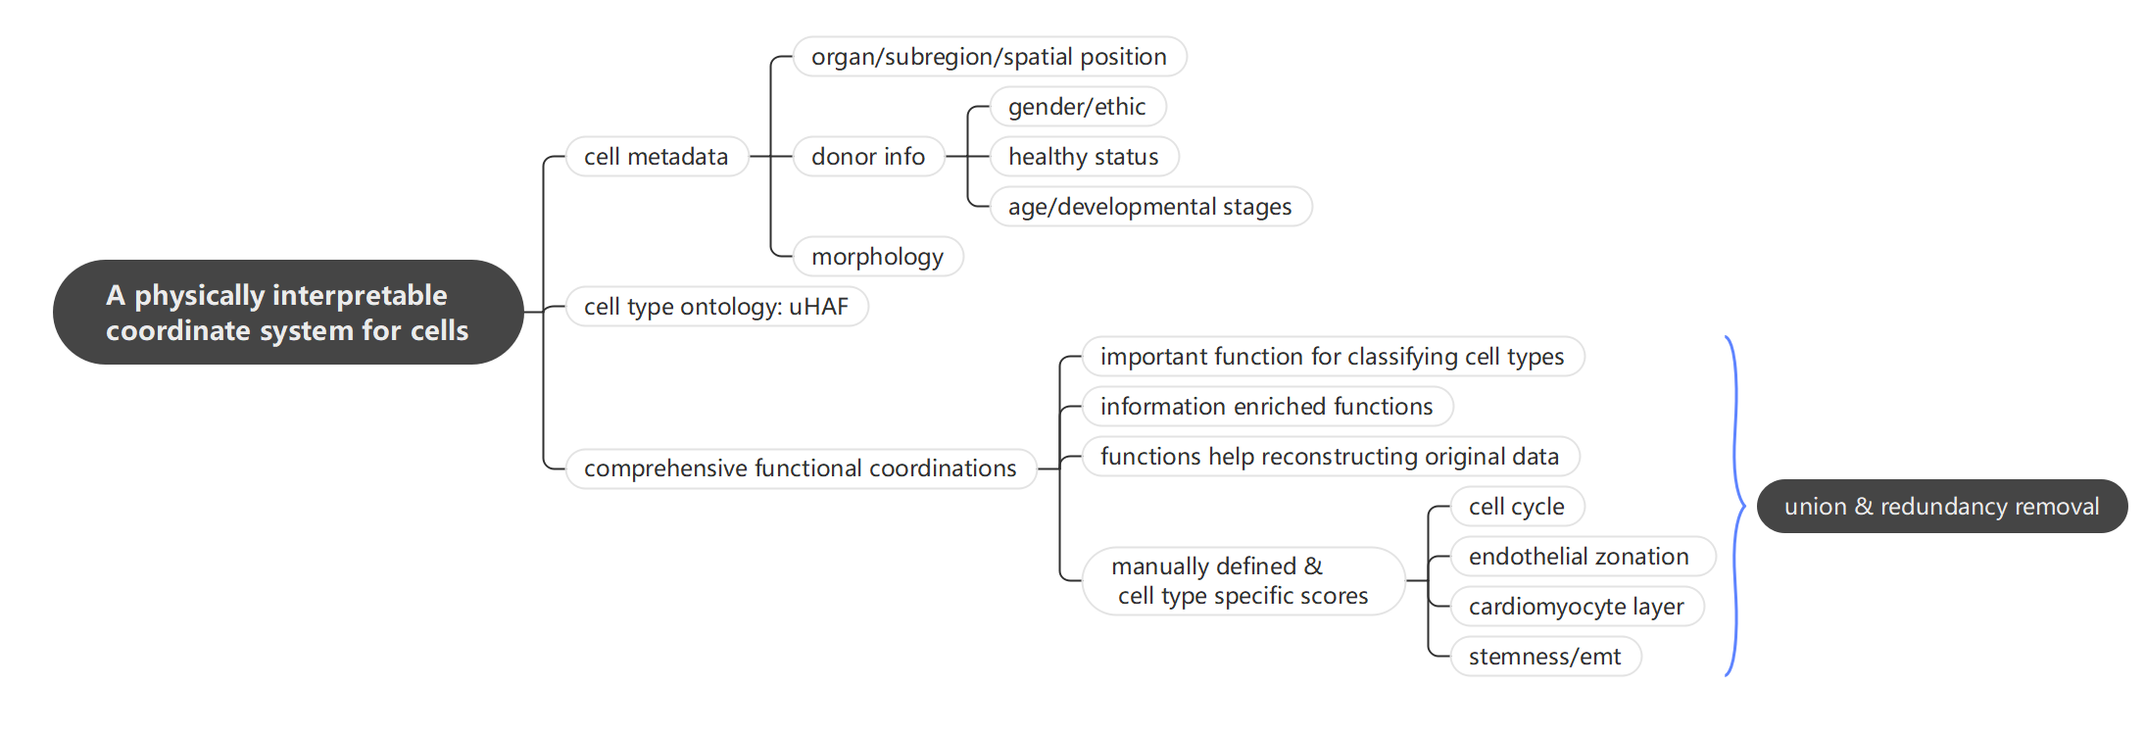
The Coordinate System

Slide 8
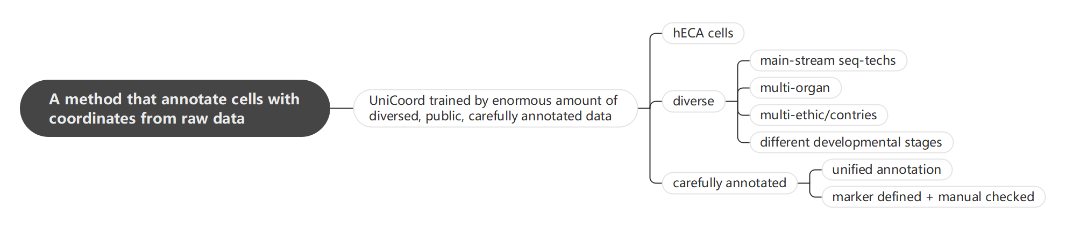
The Annotating Method

Slide 9
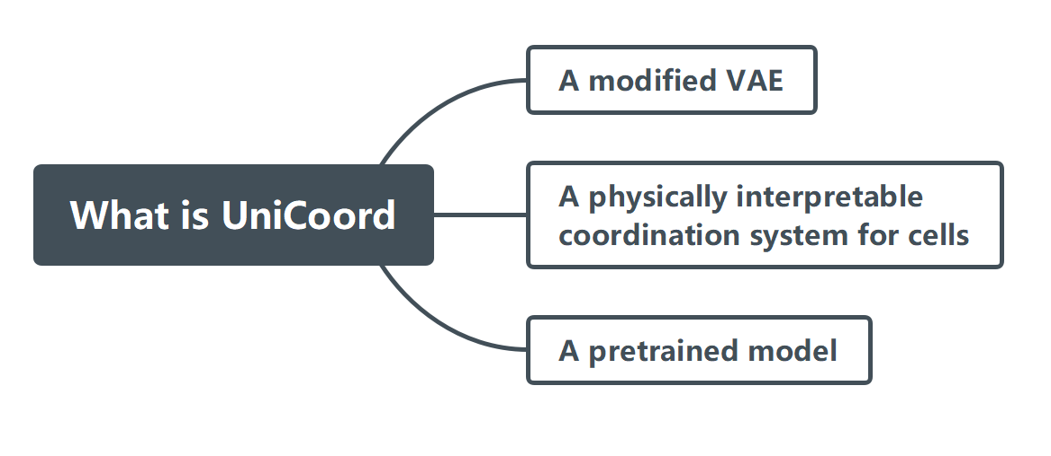
UniCoord Overview

Slide 10
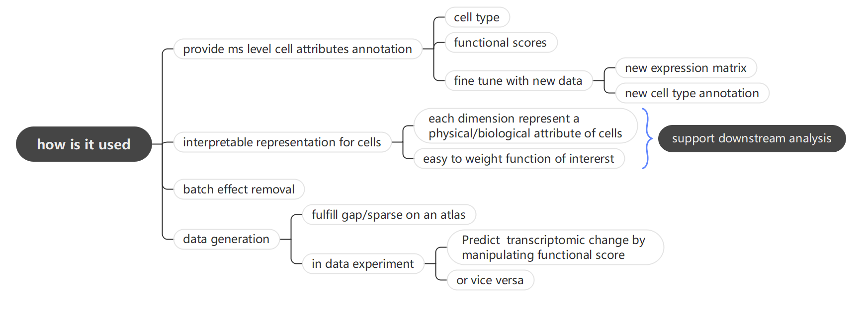
How Could UniCoord be Used

Slide 11
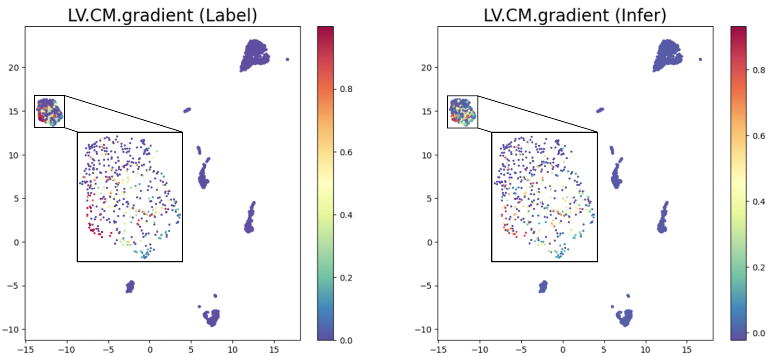

Infer Cellular Coordinate
$$R^{2}=0.928$$

Slide 12
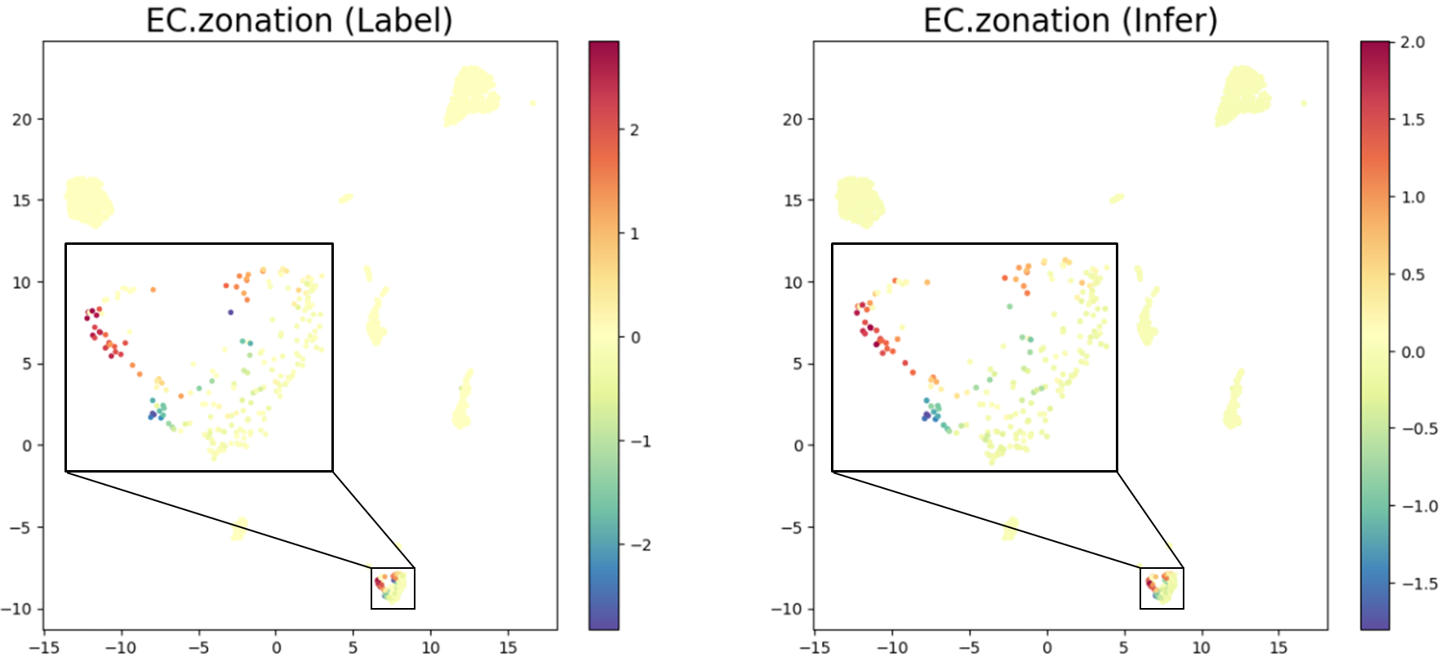

Infer Cellular Coordinate
$$R^{2}=0.945$$

Slide 13
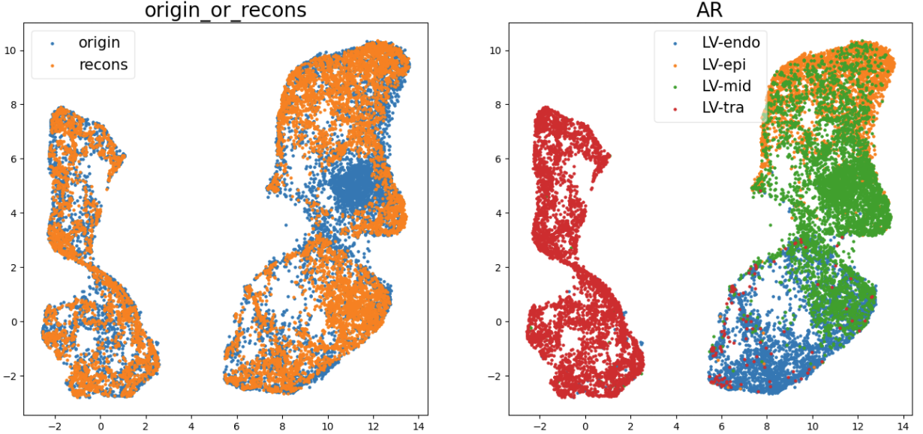
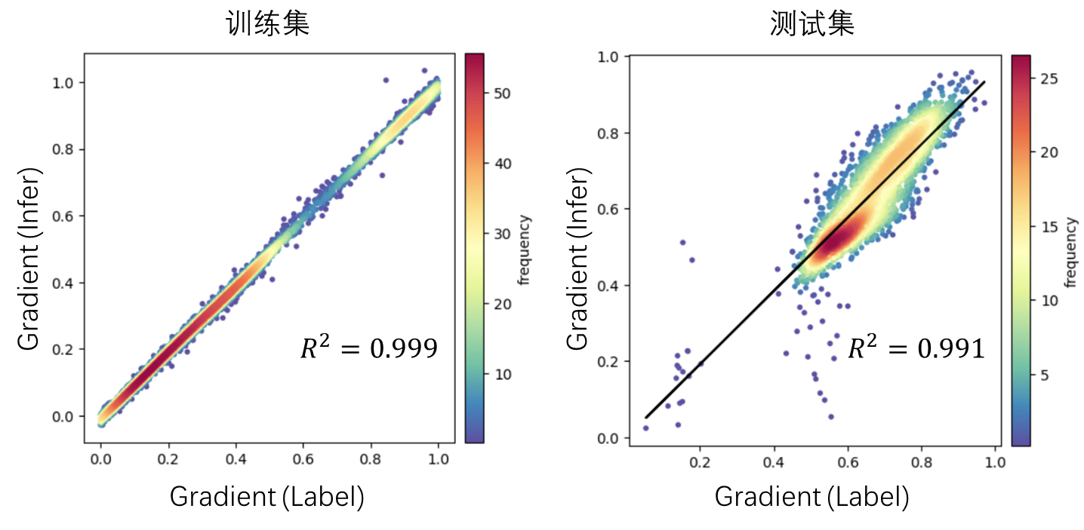
Generate Simulated Data

Slide 14
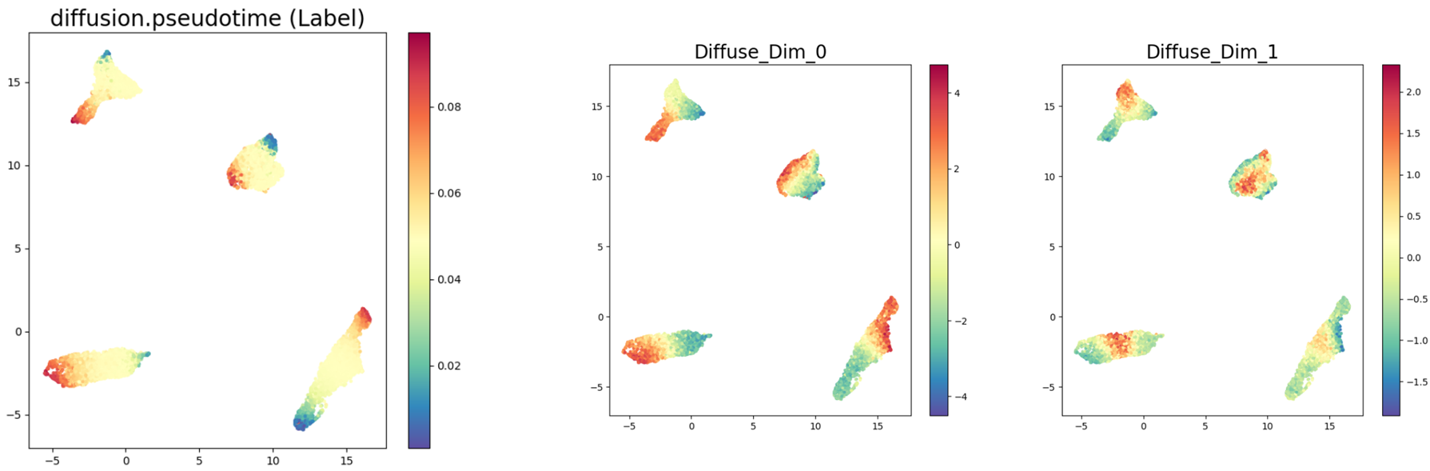
Extract Yet-unknown Coordinates

