Slide 1
HLS Progress
19 Dec

Slide 2
Problems
Many memory and logic resource
No IO
Constant data width (32 and 64)
No support fix point multiply (No operations for vivado)

Slide 3
Methods
Package peripheral
Use IP or DSP configuration

Slide 4
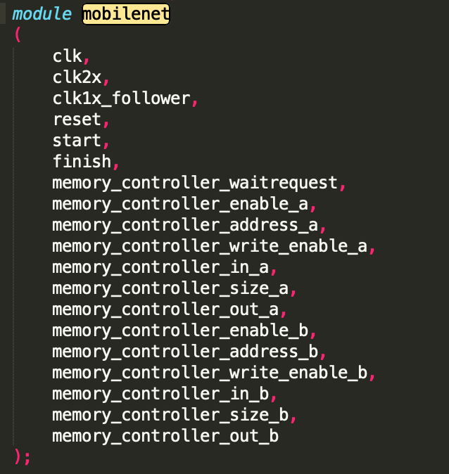
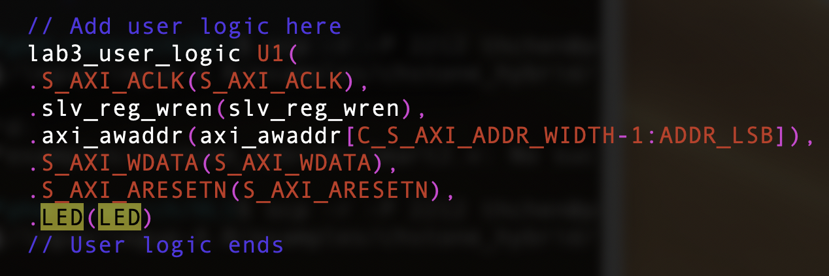
Package peripheral
clk, rst, enable, address, data

Slide 5
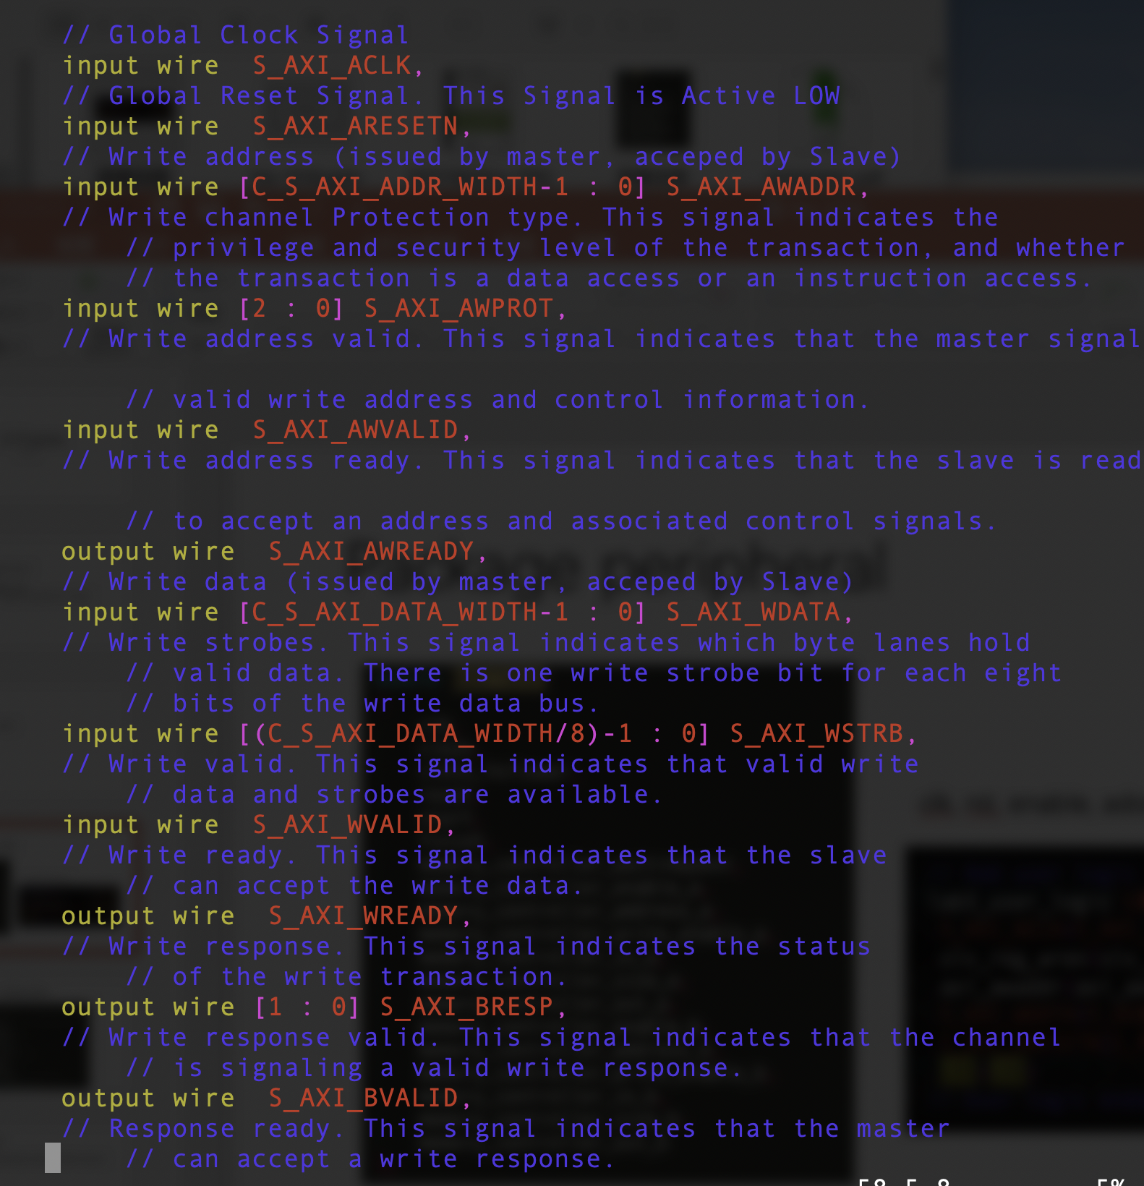

Slide 6
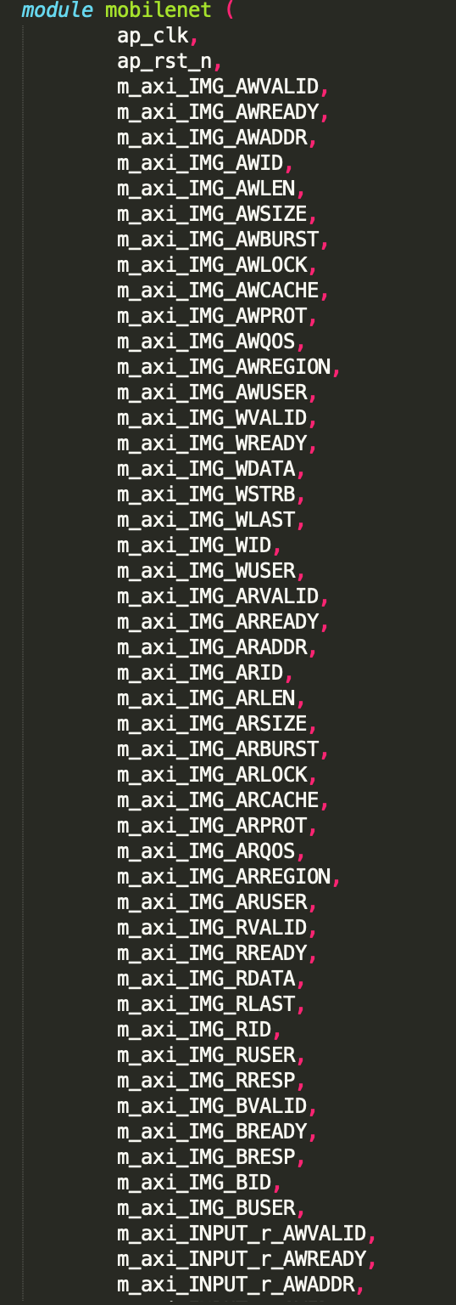
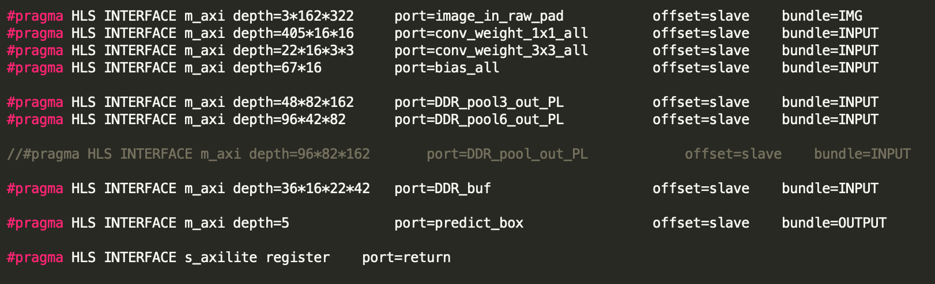

Slide 7
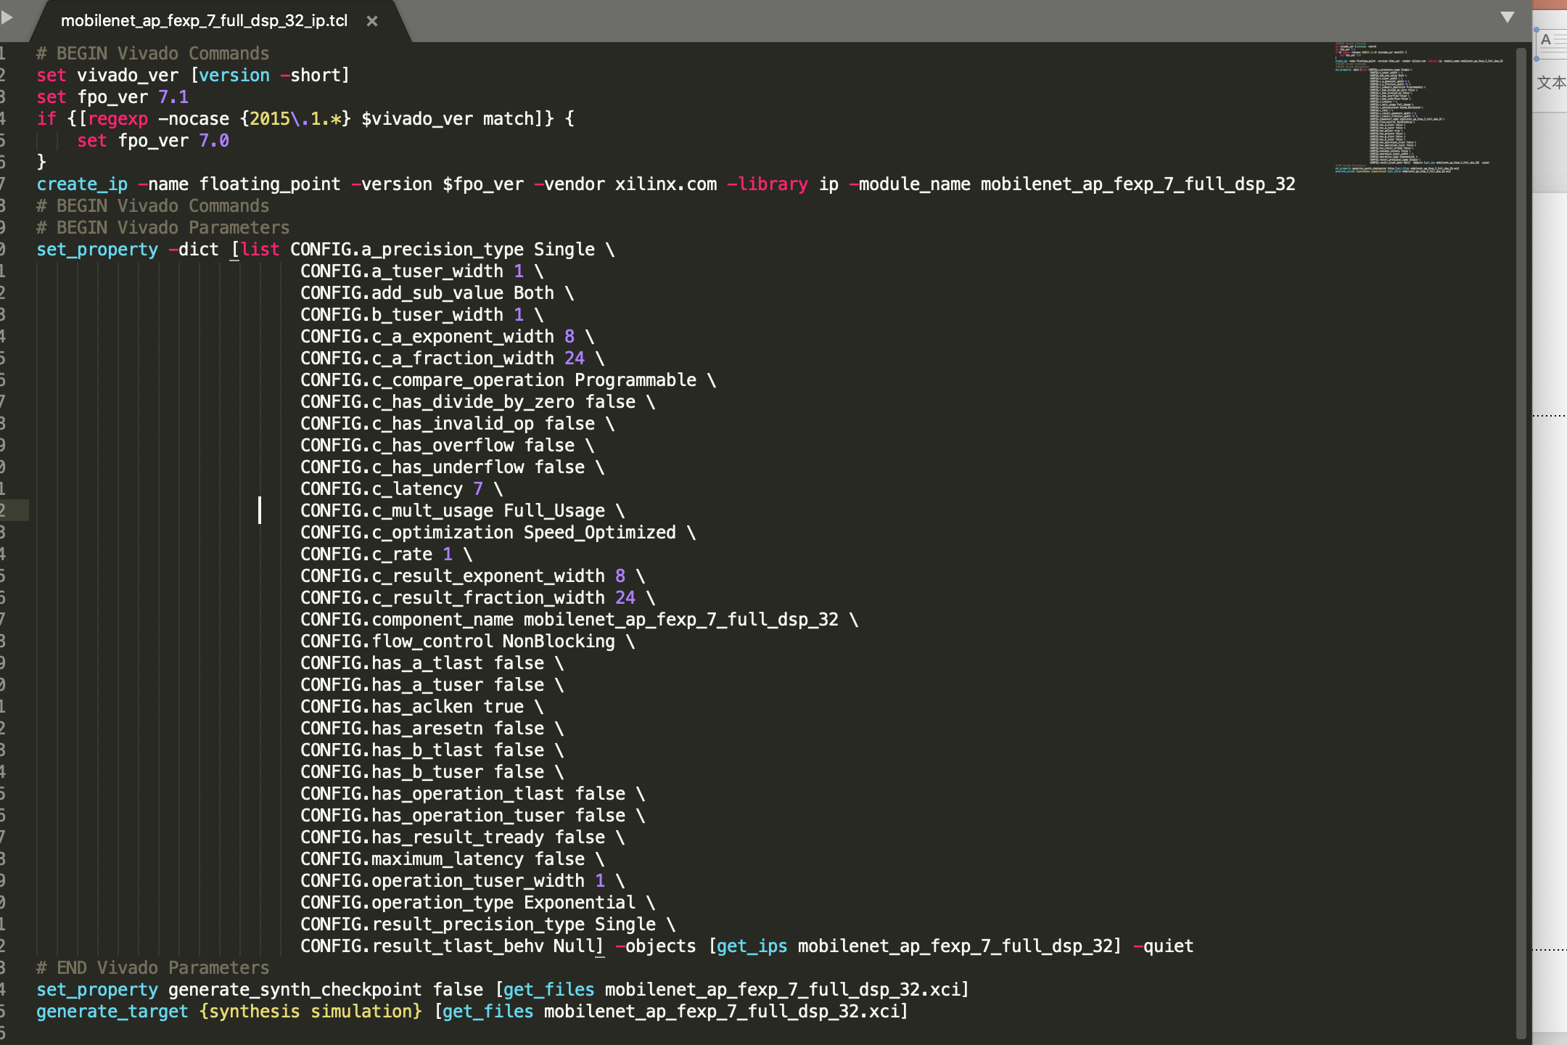
Use IP or DSP configuration

Slide 8
Other problems
C++ support (weight and feature read and initialize memory)
vivado tcl (finish)

