Slide 1


中级计量经济学
Intermediate Econometrics
吴玉鸣
15618791716
wuyuming@ecust.edu.cn
http://bs.ecust.edu.cn/szky/teacherdetail/oid/07978/m/jsml

Slide 2
VISION & MISSION
商学院愿景：
  成为国内一流商学院
  to be a leading business school in China
商学院使命：
  联接商业与科技，培养知行合一的经管人才
  to bridge business with technology, and to nurture managerial talent with advanced knowledge and practical ability

Slide 3


主讲教师
  主讲教师：吴玉鸣 博士、教授、博士生导师
  电话：15618791716(微信)
  微信：jadesing60616
  E-mail: wuyuming@ecust.edu.cn
  个人网页：http://bs.ecust.edu.cn/szky/teacherdetail/oid/teacher.07978/m/jsml
助教
  莫靖新：博士生
  电话：13737734245
  E-mail: 117563487@qq.com

Slide 4
课堂资料下载
内容：视频、补充资料、课件、数据集、教学基本要求、教学大纲、复习要点等。
超星慕课在线课堂
http://ecust.mooc.chaoxing.com/
学号为慕课登录账号，手机号、常用邮箱激活及修改密码，初始密码为123456，第一次登录需要修改
公共邮箱：empublic@126.com，
密码：wuyuming

Slide 5
More on Specification and Data Issues

Slide 6
模型设定与数据问题

Slide 7
More on Specification and Data Issues
Tests for functional form misspecification
  One can always test whether explanatory should appear as squares or higher order terms by testing whether such terms can be excluded
  Otherwise, one can use general specification tests such as RESET
Regression specification error test (RESET)
  The idea of RESET is to include squares and possibly higher order fitted values in the regression (similarly to the reduced White test)
Test for the exclusion of these terms. If they cannot be excluded, this is evidence for omitted higher order terms and interactions, i.e. for misspecification of functional form.

Slide 8
模型设定与数据问题
函数形式误设的检验
  我们可以通过检验是否可以将解释变量高阶项排除在外的方式，来推断这些解释变量是否应该以平方或高阶项出现。
  另外, 我们可以采用一般的检验，比如：回归设定误差检验
回归设定误差检验（ RESET ）
  RESET的思想是在回归中添加平方和可能更高阶的OLS拟合值（类似于简化的White 检验）
检验这些高阶OLS拟合值是否被排除.如果他们不能被排除在外,这是忽略了较高阶项和相互作用的证据, 也就是存在函数形式误设.

Slide 9
More on Specification and Data Issues
Example: Housing price equation
Discussion
  One may also include higher order terms, which implies complicated interactions and higher order terms of all explanatory variables
  RESET provides little guidance as to where misspecification comes from
Evidence for
misspecification
Less evidence for
misspecification

Slide 10
模型设定与数据问题
例如:房价方程
讨论
  一种可能还包括更高阶项，这意味着复杂的交互作用和所有解释变量的更高阶项
  RESET 提供了很少的关于函数误设形式从何而来的信息（缺陷）
误设的证据
缺少误设的证据

Slide 11
More on Specification and Data Issues
Testing against nonnested alternatives
Discussion
  Can always be done; however, a clear winner need not emerge
  Cannot be used if the models differ in their definition of the dep. var.
Which specification
is more appropriate?
Model 1:
Model 2:
Define a general model that contains both models as subcases and test:

Slide 12
模型设定与数据问题
对非嵌套模型的检验
讨论
  总是可以这么做；然而，没有赢家
  如果模型的定义不同，就不能使用.
哪一种设定更合适?
Model 1:
Model 2:
构造一个综合模型，将每个模型都作为一个特殊情形包含在其中:

Slide 13

More on Specification and Data Issues
Using proxy variables for unobserved explanatory variables
Example: Omitted ability in a wage equation
General approach to use proxy variables
Replace by proxy
In general, the estimates for the returns to education and experience will be biased because one has omit the unobservable ability variable. Idea: find a proxy variable for ability which is able to control for ability differences between individuals so that the coefficients of the other variables will not be biased. A possible proxy for ability is the IQ score or similar test scores.
Omitted variable, e.g. ability
Regression of the omitted variable on its proxy

Slide 14
模型设定与数据问题
对无法观测的解释变量使用代理变量
例如:工资方程式中遗漏的能力
使用代理变量的一般方法
更换代理
一般来说，对教育和经验回报的估计会有偏差，因为人们忽略了不可观测的能力变量。一个想法：找到一个能够控制个体之间能力差异的代理变量，这样其他变量的系数就不会有偏差。一个可能的衡量能力的指标是IQ分数或类似的测试分数.
遗漏了变量,如能力
被遗漏的变量对其代理变量进行回归

Slide 15

More on Specification and Data Issues
Assumptions necessary for the proxy variable method to work
  The proxy is “just a proxy” for the omitted variable, it does not belong into the population regression, i.e. it is uncorrelated with its error
  The proxy variable is a “good” proxy for the omitted variable, i.e. using other variables in addition will not help to predict the omitted variable
If the error and the proxy were correlated, the proxy would actually have to be included in the population regression function
Otherwise x₁ and x₂ would have to be included in the regression for the omitted variable

Slide 16
模型设定与数据问题
代理变量方法所必需的假设
  这个代理只是对被遗漏变量的一个代理，它不属于总体回归，也就是说它与它的误差无关
  代理变量是对被遗漏变量的“好”代理，也就是说，使用其他变量将无法帮助预测被遗漏的变量。
如果误差和代理变量是相关的，那么这个代理就必须包含在总体回归函数中
否则， x₁ 和 x₂必须包含在对被遗漏变量的回归中

Slide 17
More on Specification and Data Issues
Under these assumptions, the proxy variable method works:
Discussion of the proxy assumptions in the wage example
  Assumption 1: Should be fullfilled as IQ score is not a direct wage determinant; what matters is how able the person proves at work
  Assumption 2: Most of the variation in ability should be explainable by variation in IQ score, leaving only a small rest to educ and exper
In this regression model, the error term is uncorrelated with all the explanatory variables. As a consequence, all coefficients will be correctly estimated using OLS. The coefficents for the explanatory variables x₁ and x₂ will be correctly identified. The coefficient for the proxy va-riable may also be of interest (it is a multiple of the coefficient of the omitted variable).

Slide 18
模型设定与数据问题
在这些假设下，代理变量方法才是有效的:
关于工资中代理假设的讨论
例如
  假定 1：当智商满分的分数不是直接的工资决定因素时，重要的是这个人在工作中是如何被证明的
  假定2:大部分的能力变化都应该通过IQ分数的变化来解释,只剩下一小部分属于受教育和劳动年限
在这个回归模型中，误差项与所有的解释变量没有关联。因此，所有的系数都将使用OLS进行正确的估计。x1和x2的解释变量的有效值将被正确识别。代理变量的系数也可能是有效的（它是被忽略变量的系数的倍数）.

Slide 19
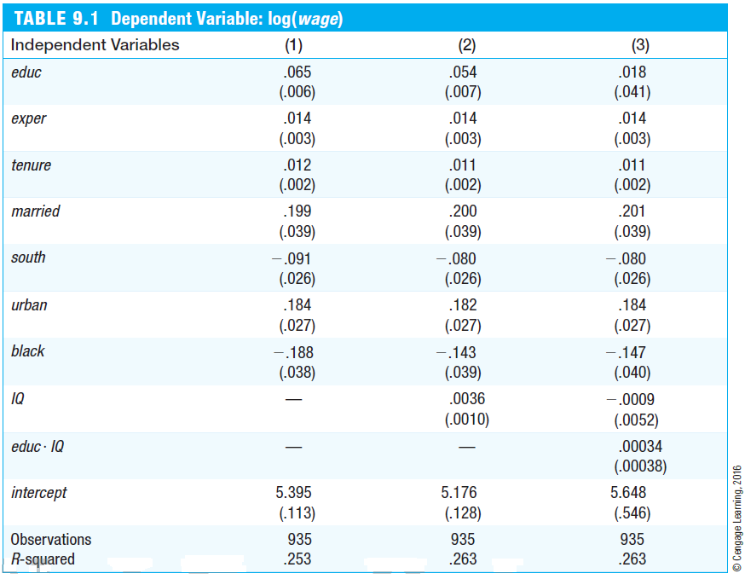
More on Specification and Data Issues
As expected, the measured return to education decreases if IQ is included as a proxy for unobserved ability.
The coefficient for the proxy suggests that ability differences between indivi-duals are important (e.g. +15 points IQ score are associated with a wage increase of 5.4 percentage points).
Even if IQ score imperfectly soaks up the variation caused by ability, inclu-ding it will at least reduce the bias in the measured return to education.
No significant interaction effect bet-ween ability and education.

Slide 20
模型设定与数据问题
正如预期的那样，如果将IQ作为未被观察能力的代理，那么测量的教育回报就会降低。.
代理的系数表明，个人之间的能力差异是很重要的（例如，+15点智商得分与工资增长5.4个百分点相关联）。.
即使IQ分数不能完美地吸收能力所引起的变化，但它至少能减少在测量的教育回报上的偏差。.
在能力和教育上没有显著的交互作用。

Slide 21
More on Specification and Data Issues
Using lagged dependent variables as proxy variables
  In many cases, omitted unobserved factors may be proxied by the value of the dependent variable from an earlier time period
Example: City crime rates
  Including the past crime rate will at least partly control for the many omitted factors that also determine the crime rate in a given year
  Another way to interpret this equation is that one compares cities which had the same crime rate last year; this avoids comparing cities that differ very much in unobserved crime factors

Slide 22
模型设定与数据问题
使用滞后因变量作为代理变量
  在很多情况下，未被观察到的因素可能将有早期的因变量值代替
例如: 城市犯罪率
  过去的犯罪率至少在一定程度上控制了许多被忽略的因素，这些因素也决定了一个特定年份的犯罪率
  另一种解释这个等式的方法是比较去年犯罪率相同的城市;这就避免了在未被观察到的犯罪因素中存在很大差异的城市

Slide 23
More on Specification and Data Issues
Models with random slopes (= random coefficient models)
The model has a random intercept and a random slope
Average intercept
Random component
Average slope
Random component
Error term
The individual random com-ponents are independent of the explanatory variable
Assumptions:
WLS or OLS with robust standard errors will consistently estimate the average intercept and average slope in the population

Slide 24
模型设定与数据问题
随机斜率模型（=随机系数模型）
这个模型有一个随机的截距和一个随机的斜率
平均截距
随机分量
平均斜率
随机分量
误差项
单独的随机组合是独立于解释变量的
假定:
WLS or OLS稳健标准误将持续地估计总体的截距和平均斜率

Slide 25

More on Specification and Data Issues
Properties of OLS under measurement error
Measurement error in the dependent variable
Consequences of measurement error in the dependent variable
  Estimates will be less precise because the error variance is higher
  Otherwise, OLS will be unbiased and consistent (as long as the mea-surement error is uncorrelated to the values of the explanatory variables)
Mismeasured value = True value + Measurement error
Population regression
Estimated regression

Slide 26
模型设定与数据问题
有测量误差时OLS的性质
因变量中的测量误差
在因变量中测量误差的结果
  由于误差方差更高，估计就不那么精确了
  另外, OLS 将是无偏和一致的(只要这个误差与解释变量不相关)
测量值= 真实值+ 误差
总体回归
估计回归

Slide 27


More on Specification and Data Issues
Measurement error in an explanatory variable
Mismeasured value = True value + Measurement error
Population regression
Estimated regression
Error uncorrelated to true value
Classical errors-in-variables assumption:
The mismeasured variable x₁ is cor-related with the error term

Slide 28
模型设定与数据问题
解释变量中的测量误差
测量值= 真实值+误差
总体回归
估计回归
误差与无法观测的解释变量无关
Classical errors-in-variables assumption:
经典变量误差假定
错误测量的变量x1与误差项有关

Slide 29

More on Specification and Data Issues
Consequences of measurement error in an explanatory variable
  Under the classical errors-in-variables assumption, OLS is biased and inconsistent because the mismeasured variable is endogenous
  One can show that the inconsistency is of the following form:
  The effect of the mismeasured variable suffers from attenuation bias, i.e. the magnitude of the effect will be attenuated towards zero
  In addition, the effects of the other explanatory variables will be biased
This factor (which involves the error variance of a regression of the true value of x₁ on the other explanatory variables) will always be between zero and one

Slide 30
模型设定与数据问题
在解释变量中具有测量误差的结果
  在经典假设下，OLS是有偏见的且不一致的，因为残差测量的变量是具有内生性的
  可以证明不一致性是以下形式:
  测量误差的影响受衰减偏误的影响，即效应的强度将衰减为零。
  另外，其他解释变量的影响也会有偏差。
这个因素（涉及到x1在其他解释变量上的真实值的回归的误差方差）总是在0和1之间

Slide 31
More on Specification and Data Issues
Missing data and nonrandom samples
Missing data as sample selection
  Missing data is a special case of sample selection (= nonrandom sampling) as the observations with missing information cannot be used
  If the sample selection is based on independent variables there is no problem as a regression conditions on the independent variables
  In general, sample selection is no problem if it is uncorrelated with the error term of a regression (= exogenous sample selection)
  Sample selection is a problem, if it is based on the dependent variable or on the error term (= endogenous sample selection)

Slide 32
模型设定与数据问题
数据缺失和非随机样本
数据缺失作为样本选择
  缺失的数据是样本选择的特例（=非随机抽样），因为无法使用信息
  如果样本选择是基于独立变量，那么独立变量的回归条件就没有问题了
  一般来说，如果样本选择与回归的误差项无关（即外源样本选择），那么样本选择是没有问题的。
  样本选择是一个问题，如果它基于因变量或误差项（=内生样本选择）

Slide 33
More on Specification and Data Issues
Example for exogenous sample selection
Example for endogenous sample selection
If the sample was nonrandom in the way that certain age groups, income groups, or household sizes were over- or undersampled, this is not a problem for the regression because it examines the savings for subgroups defined by income, age, and hh-size. The distribution of subgroups does not matter.
If the sample is nonrandom in the way individuals refuse to take part in the sample survey if their wealth is particularly high or low, this will bias the regression results because these individuals may be systematically different from those who do not refuse to take part in the sample survey.

Slide 34
模型设定与数据问题
外生样本选择的例子
内生样本选择的例子
如果样本是非随机的，就像某些年龄层，收入群体，或家庭规模都超过或采样不足，这不是回归的问题，因为它考察了由收入，年龄，和房子大小定义的子组的储蓄。子组的分布并不重要.
如果样本是非随机的个体拒绝参加抽样调查如果他们的财富特别高或低,这将对回归结果产生偏误，因为这些人可能与那些不拒绝参加抽样调查的人有所不同。

Slide 35
More on Specification and Data Issues
Outliers and influential observations
  Extreme values and outliers may be a particular problem for OLS because the method is based on squaring deviations
  If outliers are the result of mistakes that occured when keying in the data, one should just discard the affected observations
  If outliers are the result of the data generating process, the decision whether to discard the outliers is not so easy
Example: R&D intensity and firm size

Slide 36
模型设定与数据问题
异常数据和有重要影响的观测值
  OLS对异常观测敏感是因为它最小化了残差平方和
  如果异常值是在输入数据时出现错误的结果，那么应该丢弃受影响的观察结果
  如果异常值是数据生成过程的结果，那么是否抛弃异常值的决定就不那么容易了。
  例如: R&D强度和公司规模

Slide 37
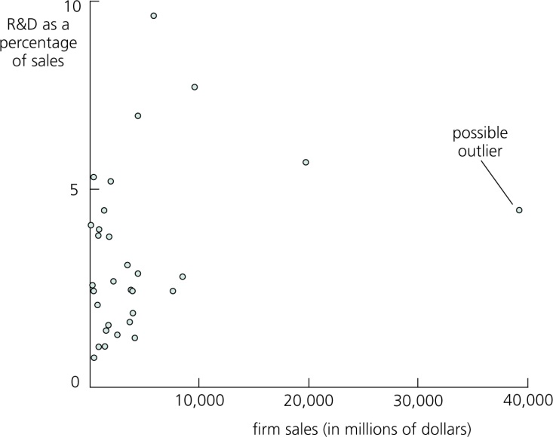
More on Specification and Data Issues
Example: R&D intensity and firm size (cont.)
The outlier is not the result of a mistake: One of the sampled firms is much larger than the others.
The regression without the outlier makes more sense.

Slide 38
模型设定与数据问题
例如: R&D强度和公司规模(cont.)
异常值并不是一个错误的结果：抽样公司中的一个比其他公司大得多。.
没有异常值的回归更有意义。

Slide 39

More on Specification and Data Issues
Least absolute deviations estimation (LAD)
  The least absolute deviations estimator minimizes the sum of absolute deviations (instead of the sum of squared deviations, i.e. OLS)
  It may be more robust to outliers as deviations are not squared
  The least absolute deviations estimator estimates the parameters of the conditional median (instead of the conditional mean with OLS)
  The least absolute deviations estimator is a special case of quantile regression, which estimates parameters of conditional quantiles

Slide 40
模型设定与数据问题
最小绝对离差估计(LAD)
  最小的绝对离差估计量最小化了残差绝对值之和（与最小化了残差平方和的OLS不同）
  对于离差值来说可能更稳健，因为偏差不是平方
  最小绝对离差估计是条件中位数的参数（而不是用OLS的条件平均值）
  最小绝对离差估计量是量化回归的一个特例，它估计了条件量化的参数

Slide 41

模型设定与数据问题
More on Specification and Data Issues

Slide 42

Q&A！

