Slide 1
Project work-Intro

Slide 2
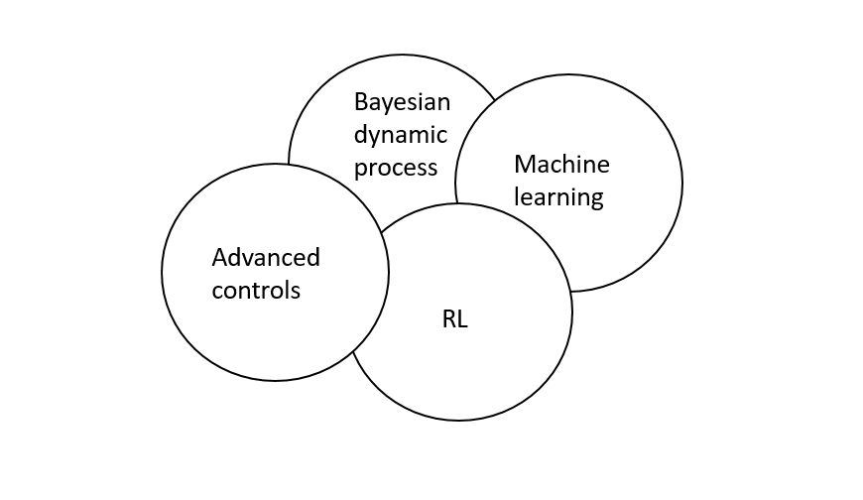
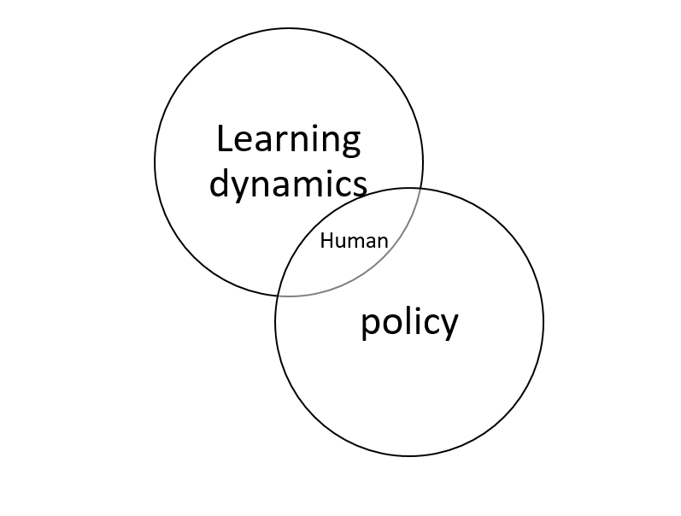
Autonomous algorithm development

Slide 3
Hardware
Testing and trials
Load testing
Human trails
Code debugging
Electrical layout

Slide 4
Existing work performed
Can bus architecture
PID control
LQR
PD based torque control

Slide 5
Diff robots, actuators

