Slide 1
5G USE CASES
ENERGY SECTOR

Slide 2
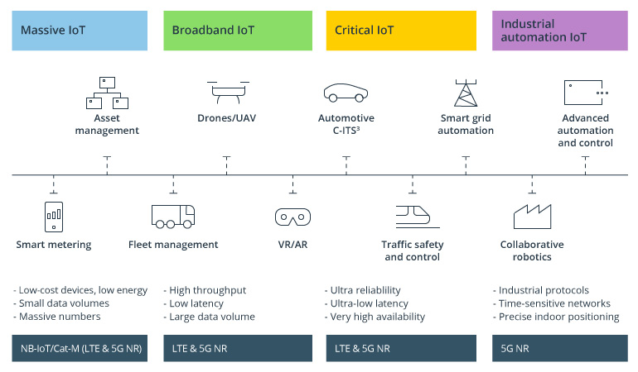
APPLICATIONS

Slide 3
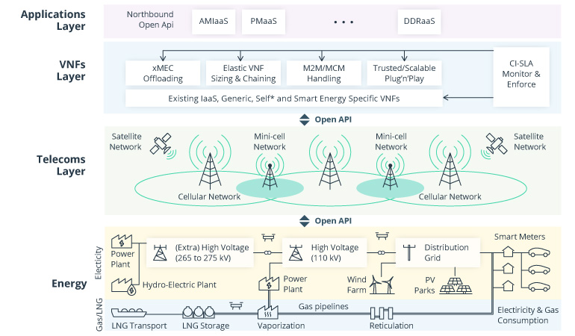
OVERVIEW

Slide 4
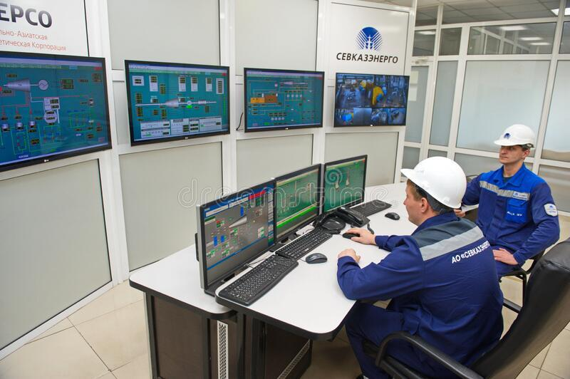
SENSOR SUITES
POSSIBLE BECAUSE
uRLLC
eMBB
mMTC
CRITICAL SECTORS
Nuclear
Fossil Based
Geothermal
Biomass

Slide 5
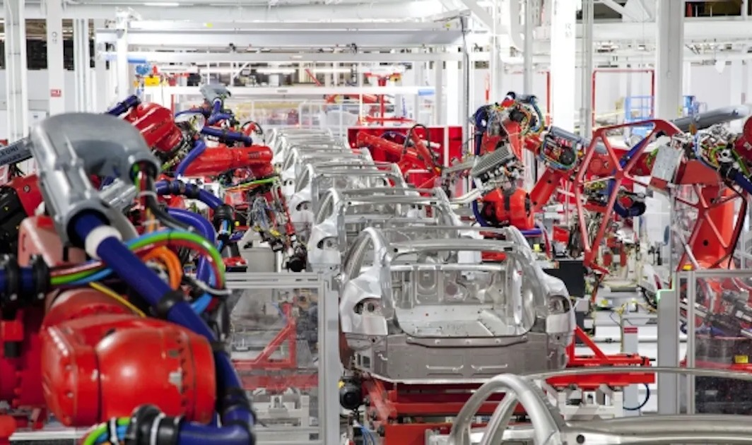
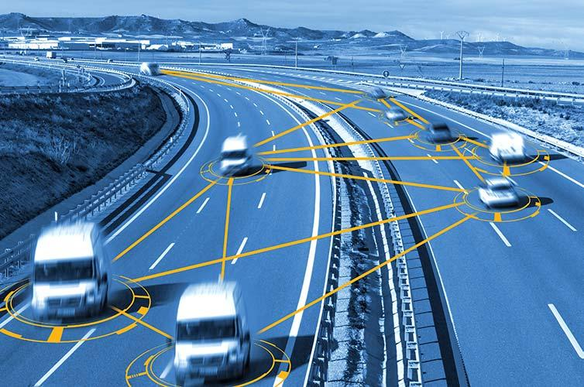
BOTS & VEHICLES
On Demand Surge. CV2X allows fleets to automatically deploy with raw material. Ex. Coal
In Toxic & Radioactive env, bots can inspect instead of humans. Ex. Fukishima
Boston Dynamics Spot can patrol remote & hazardous locations. Ex Illwerke Vkw, Austria

Slide 6

DIGITAL TWINS
Simulation of Product in software as is in realtime for monitoring, debugging and predicting. Ex. Jet Engines on Oil Rigs (Boeing does for aircrafts)
Tollerance level for 5G is 100x less than 4G, allowing extremely precise location monitoring in sensitive equipment & confined spaces
Mix Reality Inspection without in person presence. Ex, As already used in construction industry assisted by UnReal Engine

Slide 7
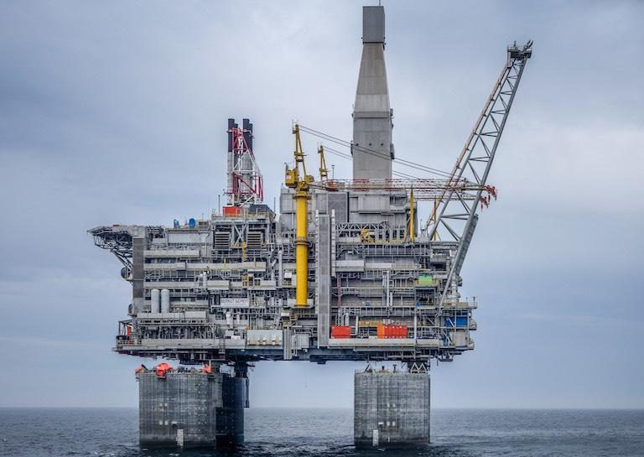
WHOLISTIC MONITORING: OIL RIGS
FULLY AUTOMATED OIL RIGGS
Senor Suites + Drones + Digital Twins + Patrol Bots can be used to make Oil Rigs to be fully unmanned. potentially saving 100s of lives a year.
Pipes & Ships can all be monitored and controlled from remote onland stations.
Full automation with realtime Machine Learning with 5G also increases efficiency and revenue

Slide 8

WHOLISTIC MONITORING: GRID
SMART GRIDS
Intelligent Distributed Feeder Automation
Grids Can be monitored for minute/minute usage
Millisecond-Level Precise Load Control
See More

Slide 9
REFERENCE
CLICK HERE

