Slide 1
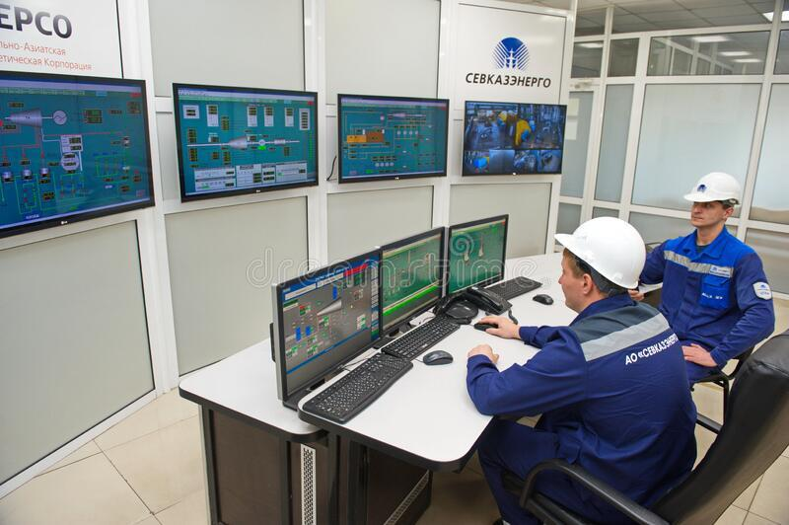
SENSOR SUITES
Nuclear: Monitor Neutron Density, Rods insertion etc in realtime & calibrate before runaways
Fossil Based: Automatically manage for demand surges with more input by self driving wagon tipplers and trucks
Geothermal: Sensors can monitor for surges, empty pockets and depletions in realtime giving ample time to plan ahead
Biomass: Extremely large amount of metrics can be analysed with ML at very small epoch time due to 5G with continual learning

Slide 2
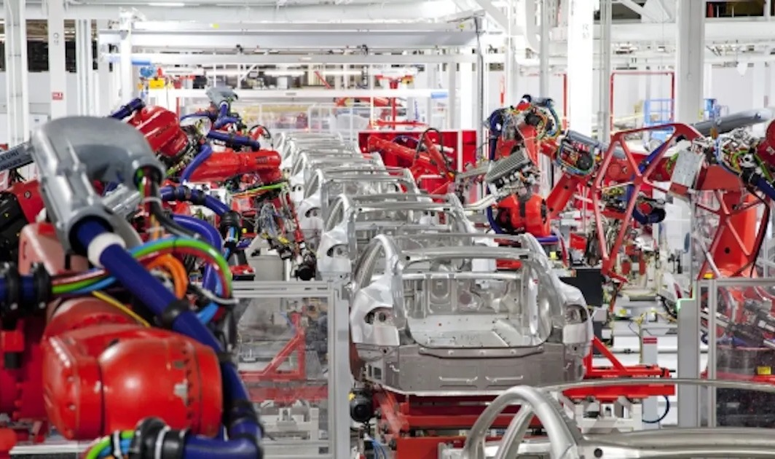
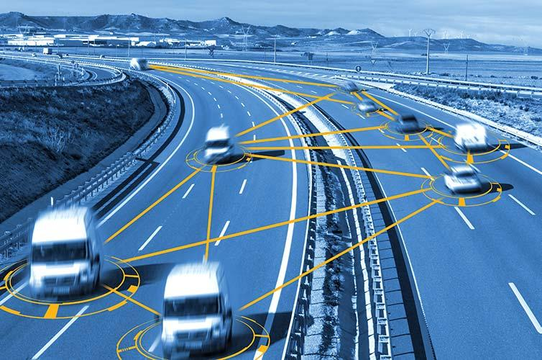
BOTS & VEHICLES
On Demand Surge. CV2X allows fleets to automatically deploy with raw material. Ex. Coal
In Toxic & Radioactive env, bots can inspect instead of humans. Ex. Fukishima
Boston Dynamics Spot can patrol remote & hazardous locations. Ex Illwerke Vkw, Austria
C-V2X: Cellular Vehicle-to-Everything is a unified connectivity platform including vehicle-to-vehicle (V2V), vehicle-to-roadside infrastructure (V2I) and vehicle-to-pedestrian (V2P) comms

Slide 3
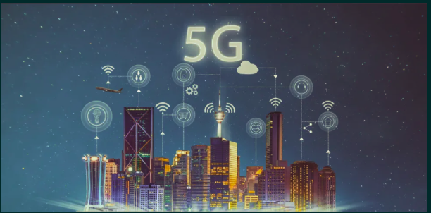
WHOLISTIC MONITORING: SMART GRID
Intelligent Distributed Feeder Automation
Automatic grid fault detection & isolation within ms Ex. Enel's grid, Olbia, Italy
Remote inspection of working areas Ex. Garraf Naural Park Substation, Barcelona, Spain
Realtime wide area monitoring & usage data Ex. Cross Border Area, North Greece & South Bulgaria with phasor measurement units connected with 5G comm link to virtual phasor data concentrator
Millisecond-Level Precise Load Control Ex. Wind Farm, south-eastern Bulgaria

Slide 4
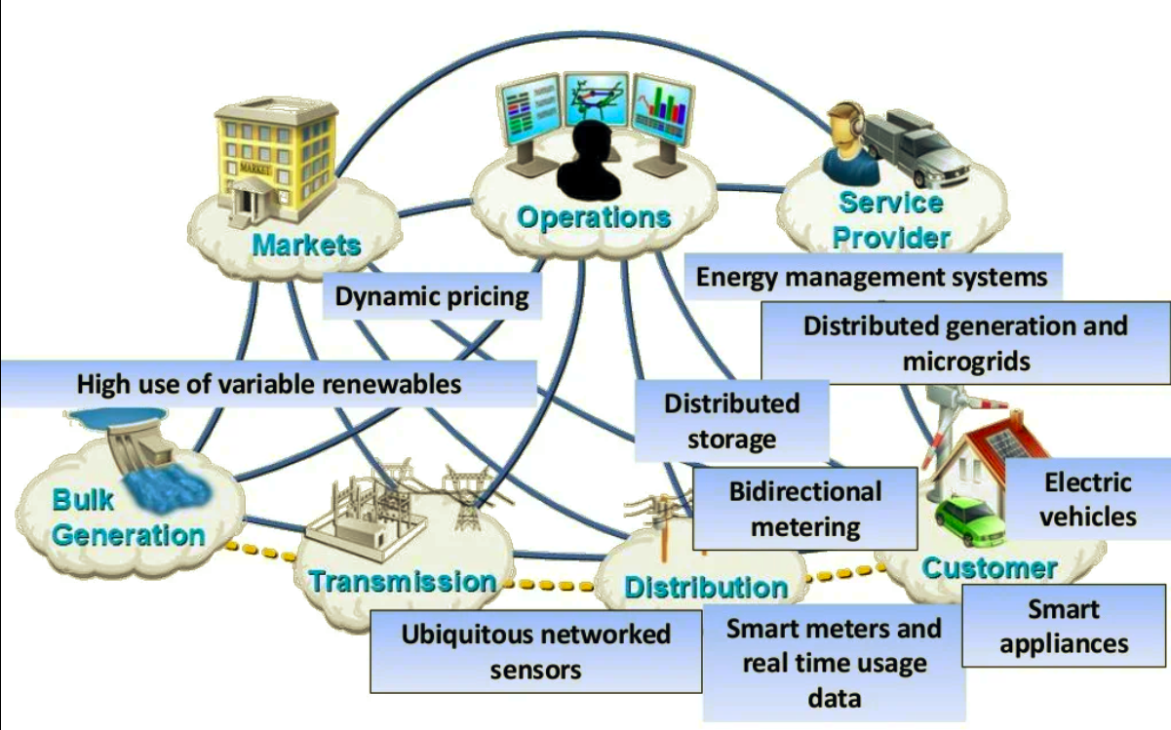
Source: Slide 14

Slide 5
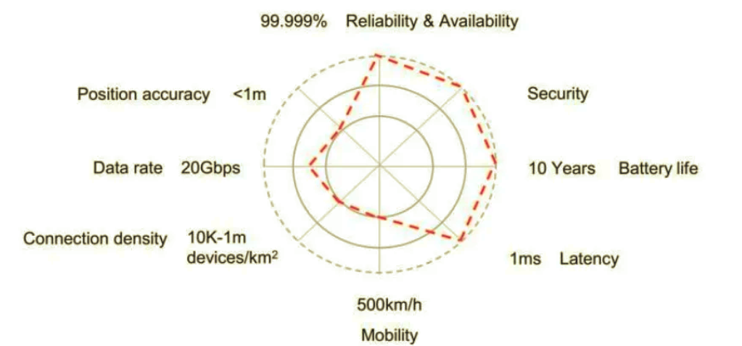
Source: Slide 16
Smarter grids’ – 5G KPI The key requirements of smarter grids for communications networks are as follows:
Massive access: millions of to tens of millions of terminals
Low latency: Distributed power supply management includes uplink data collection and downlink control. Downlink control flows require second-level latency.
High reliability: 99.999%
High security
Extended battery life

Slide 6
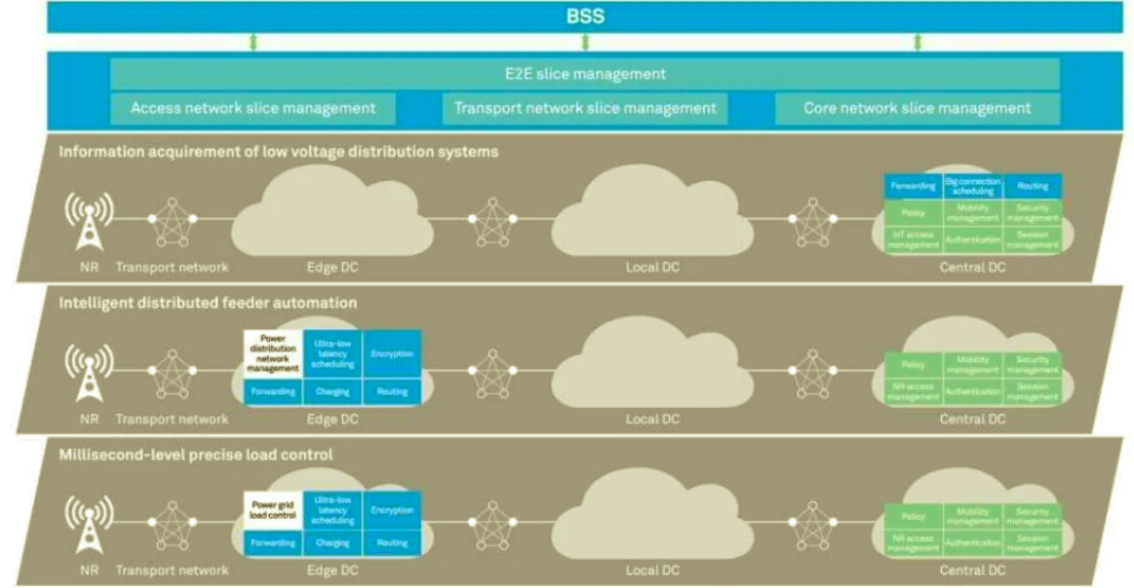
Source: Slide 17
Smarter’ Grid's Multi-Slice Architecture
The diversity of power grid services requires a flexible and orchestrated network, high reliability requires isolated networks, and millisecond-level ultra-low latency requires networks with optimal capabilities. A network slice consists of multiple sub-domains and involves the management plane, control plane, and user plane.

Slide 7
Source: Slide 19
5G Local Edge Processing
Edge computing allows data produced by intelligent sensor devices in the power grid to be processed closer to where it is created instead of sending it across long routes to data centers or clouds.
This enables the storage and preprocessing of IEDs which have poor connectivity and thus cannot afford constant connection to a central cloud.
Another use cases have to do with latency-sensitive processing of information which reduces latency because data does not have to traverse over a network to a data center or cloud for processing.
This is ideal for situations where latencies of milliseconds can be untenable, such as alarms.

Slide 8
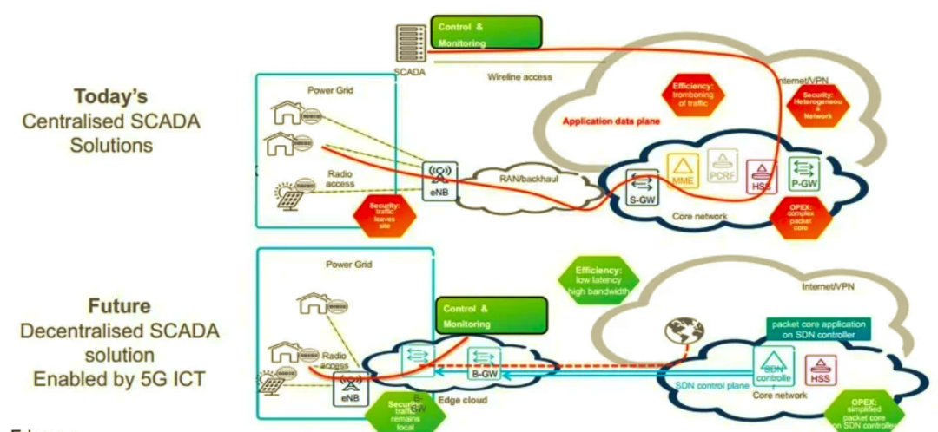
Source: Slide 19

