Slide 1
Cloud computing
Студент гр. ИУ6-22Б А. П. Плютто
Преподаватель М. В. Юдина

Slide 2
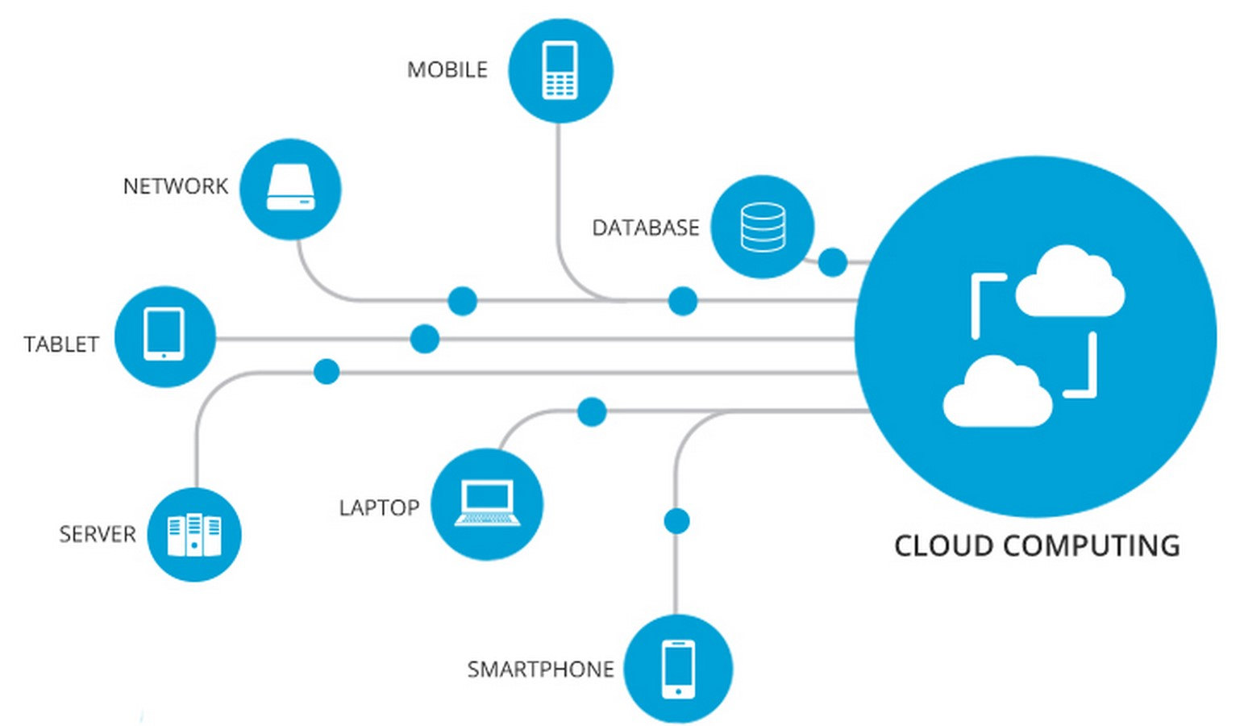
Introduction
Cloud computing has transformed how businesses operate, offering scalability, cost savings, flexibility, and increased security. We will explore cloud computing basics, advantages, disadvantages, and best practices for implementation.

Slide 3
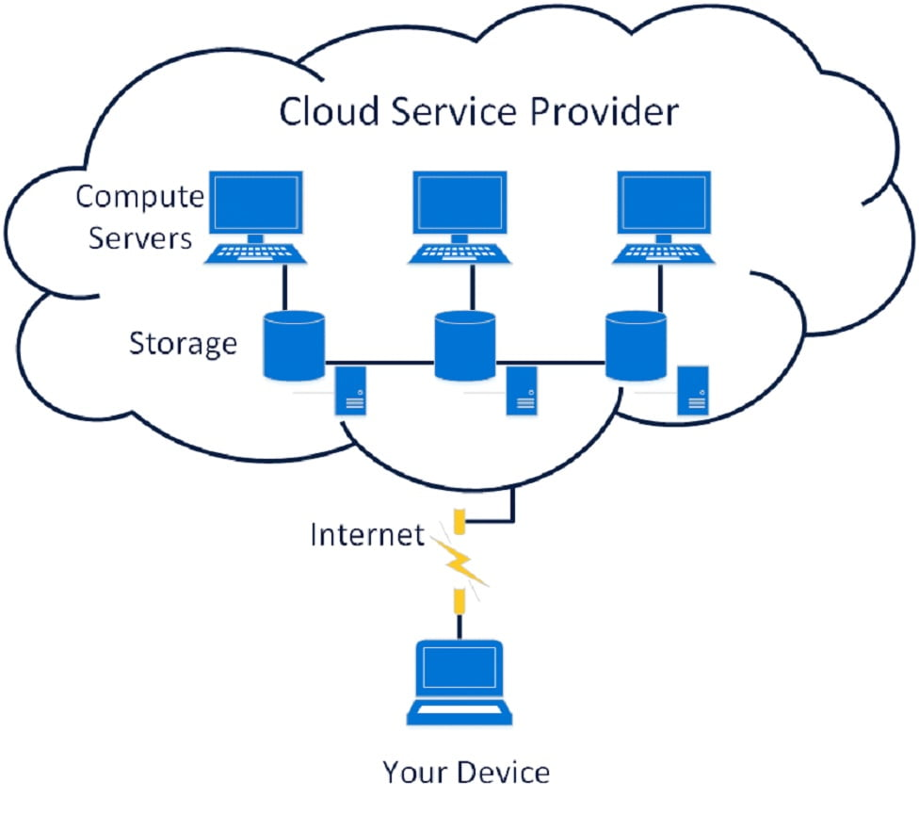
Cloud Computing
Cloud computing delivers computing services such as servers, storage, databases, networking, software, analytics, and intelligence over the internet.

Slide 4

Advantages
Cloud computing provides scalability, cost savings, flexibility, and increased security by eliminating the need for on-premise hardware.

Slide 5

Disadvantages
Cloud computing has some potential disadvantages to consider, such as dependence on the internet, lack of control over data and applications, and compliance issues.

Slide 6
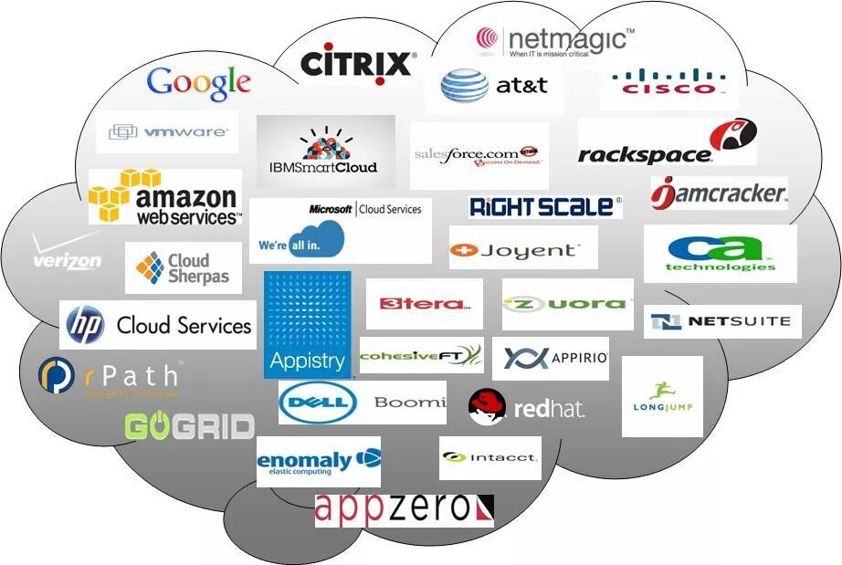
Best Practices
To implement cloud solutions effectively, companies should assess their needs, establish security protocols and policies, and ensure compliance with relevant regulations and standards.

Slide 7
Thank you for your attention

