Slide 1
The Evolution of Submarines

Slide 2
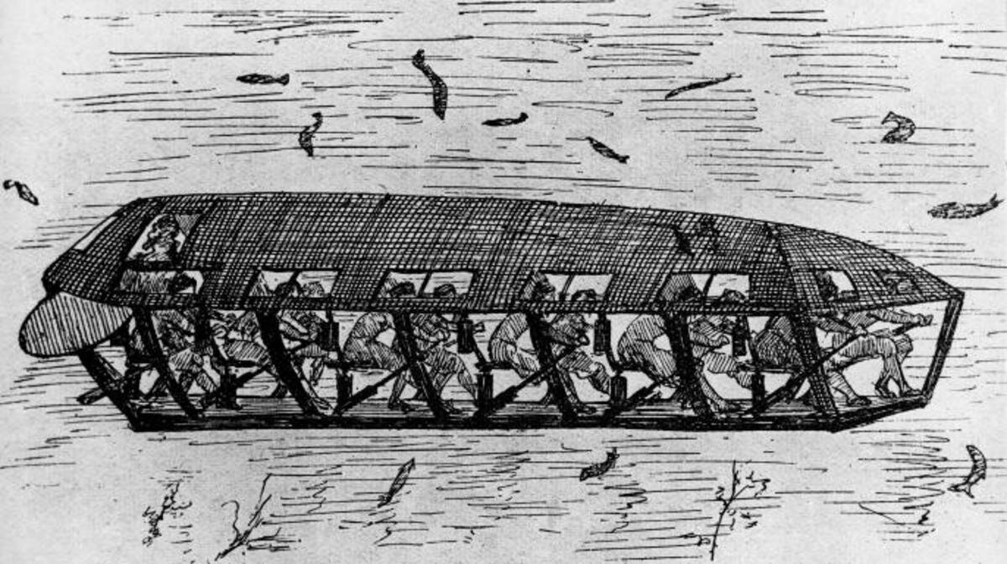
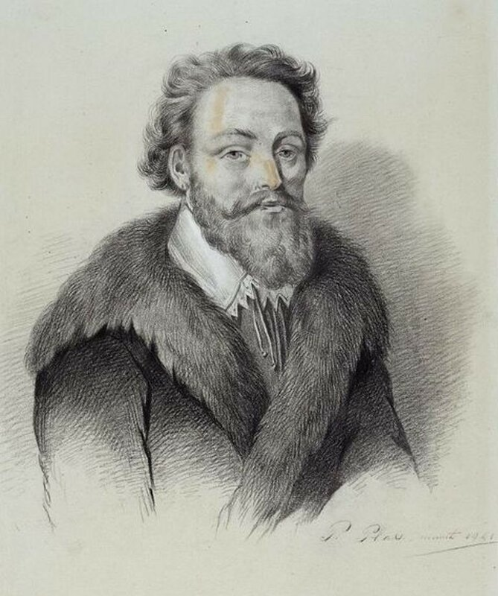
Early Concepts and Experiments

Slide 3
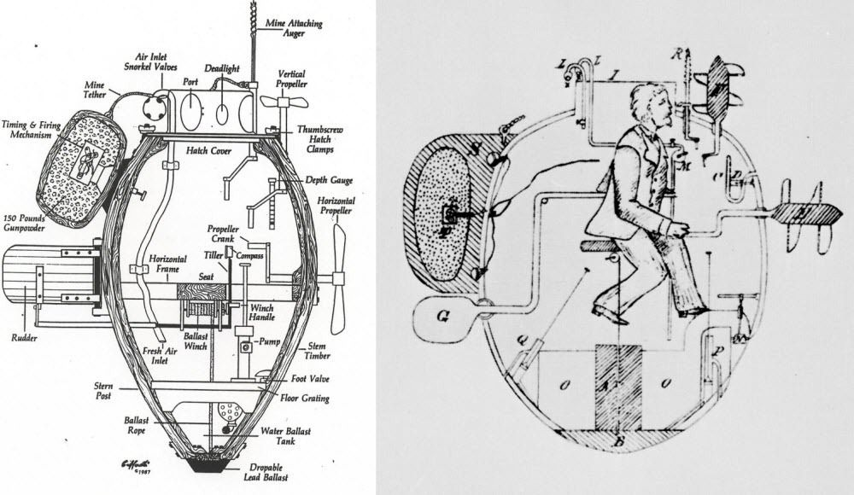
The Turtle and the American Revolution

Slide 4
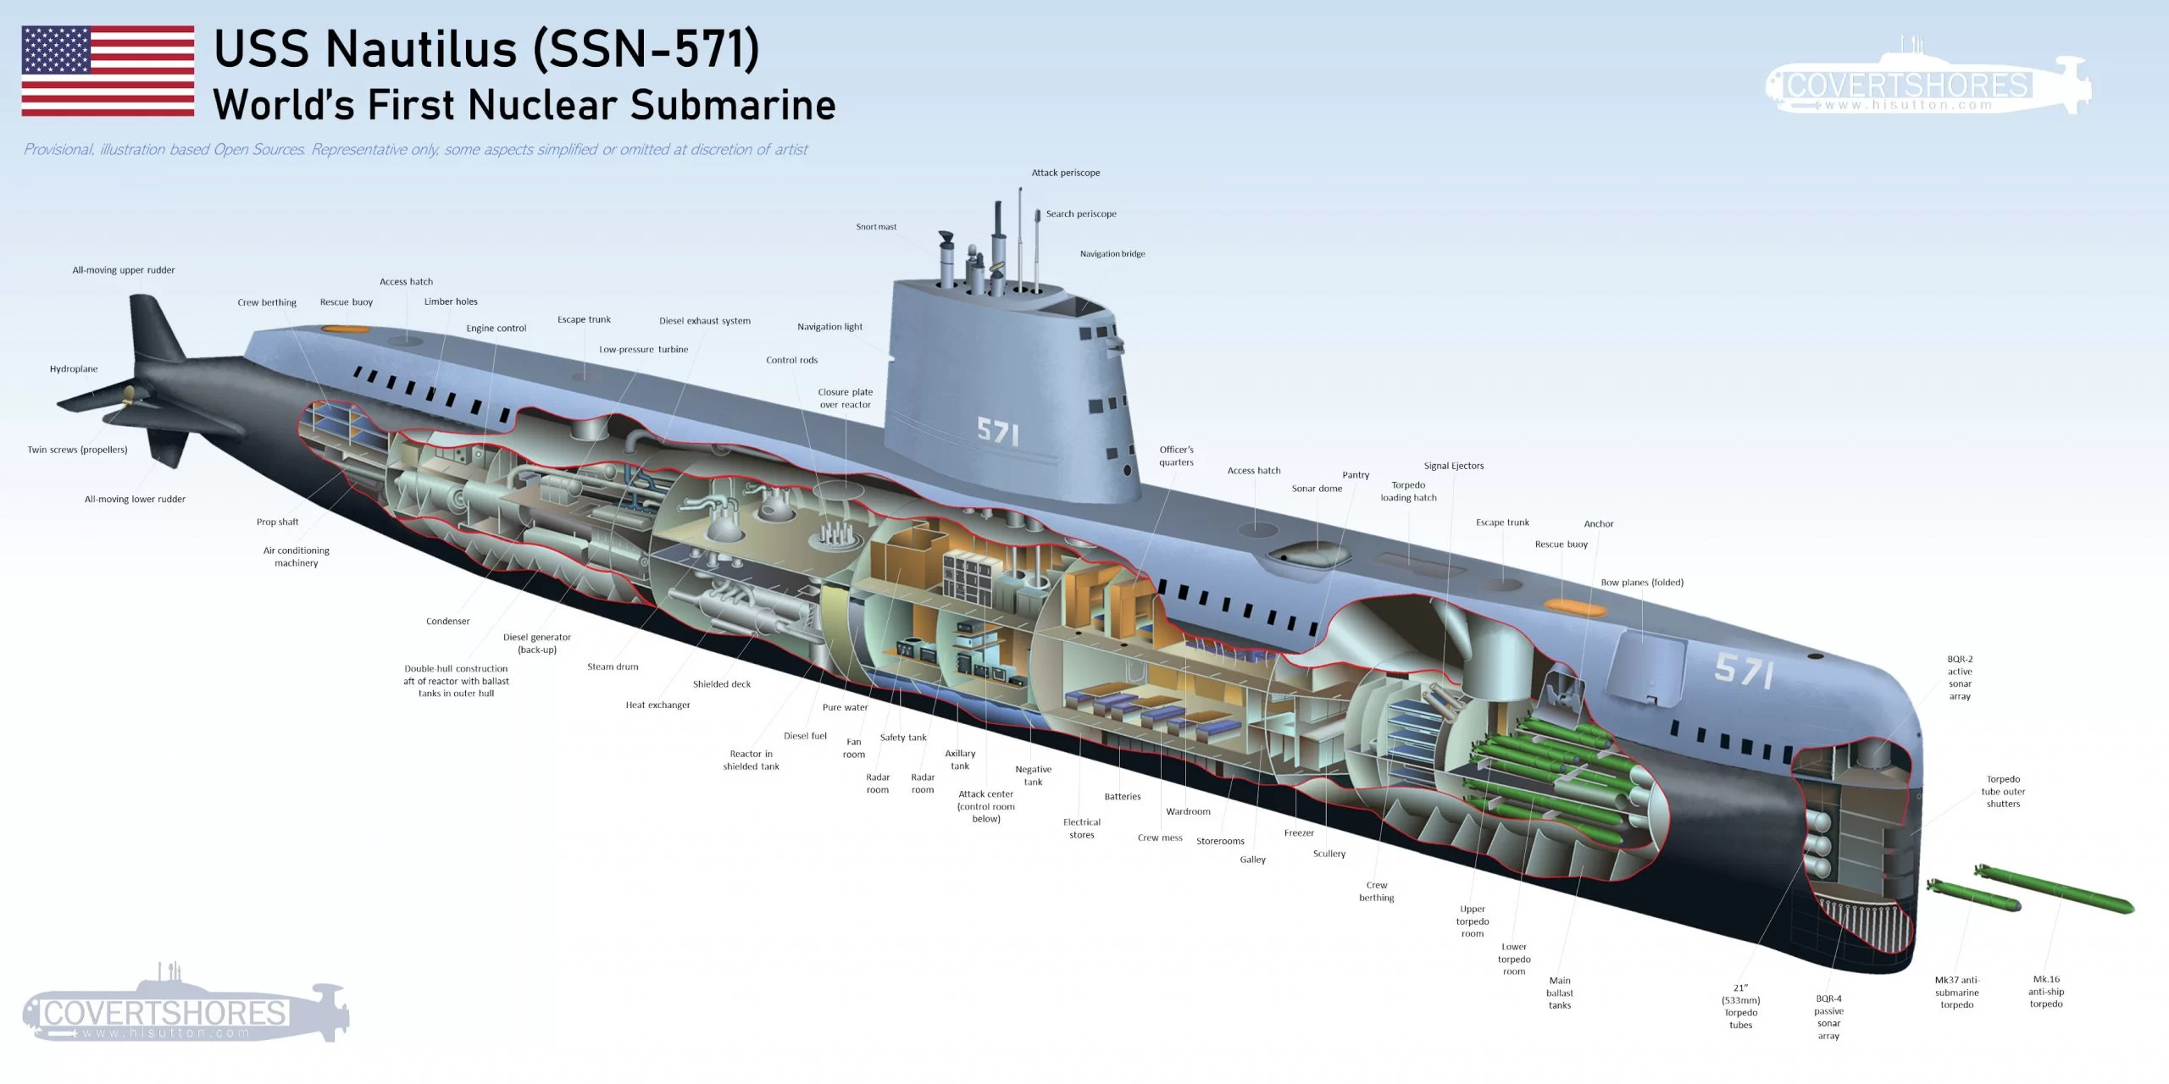
The Nautilus and Submarine Warfare

Slide 5
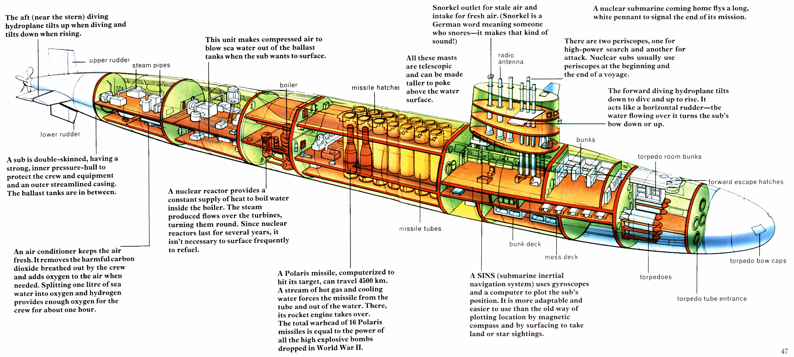
Electric Propulsion and the Submarine Revolution

Slide 6
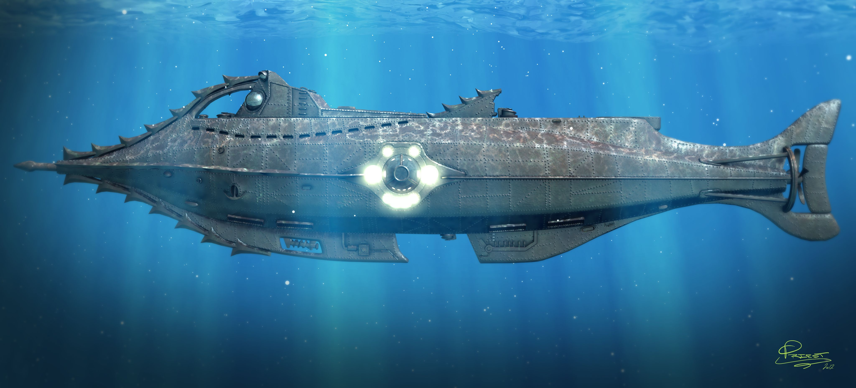
Thank you for your attention

