Slide 1
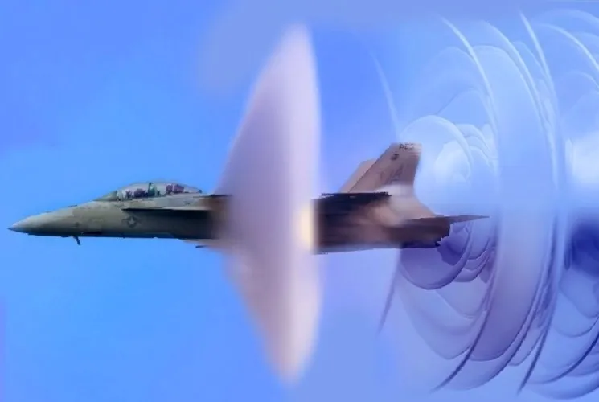
Supersonic aircraft

Slide 2
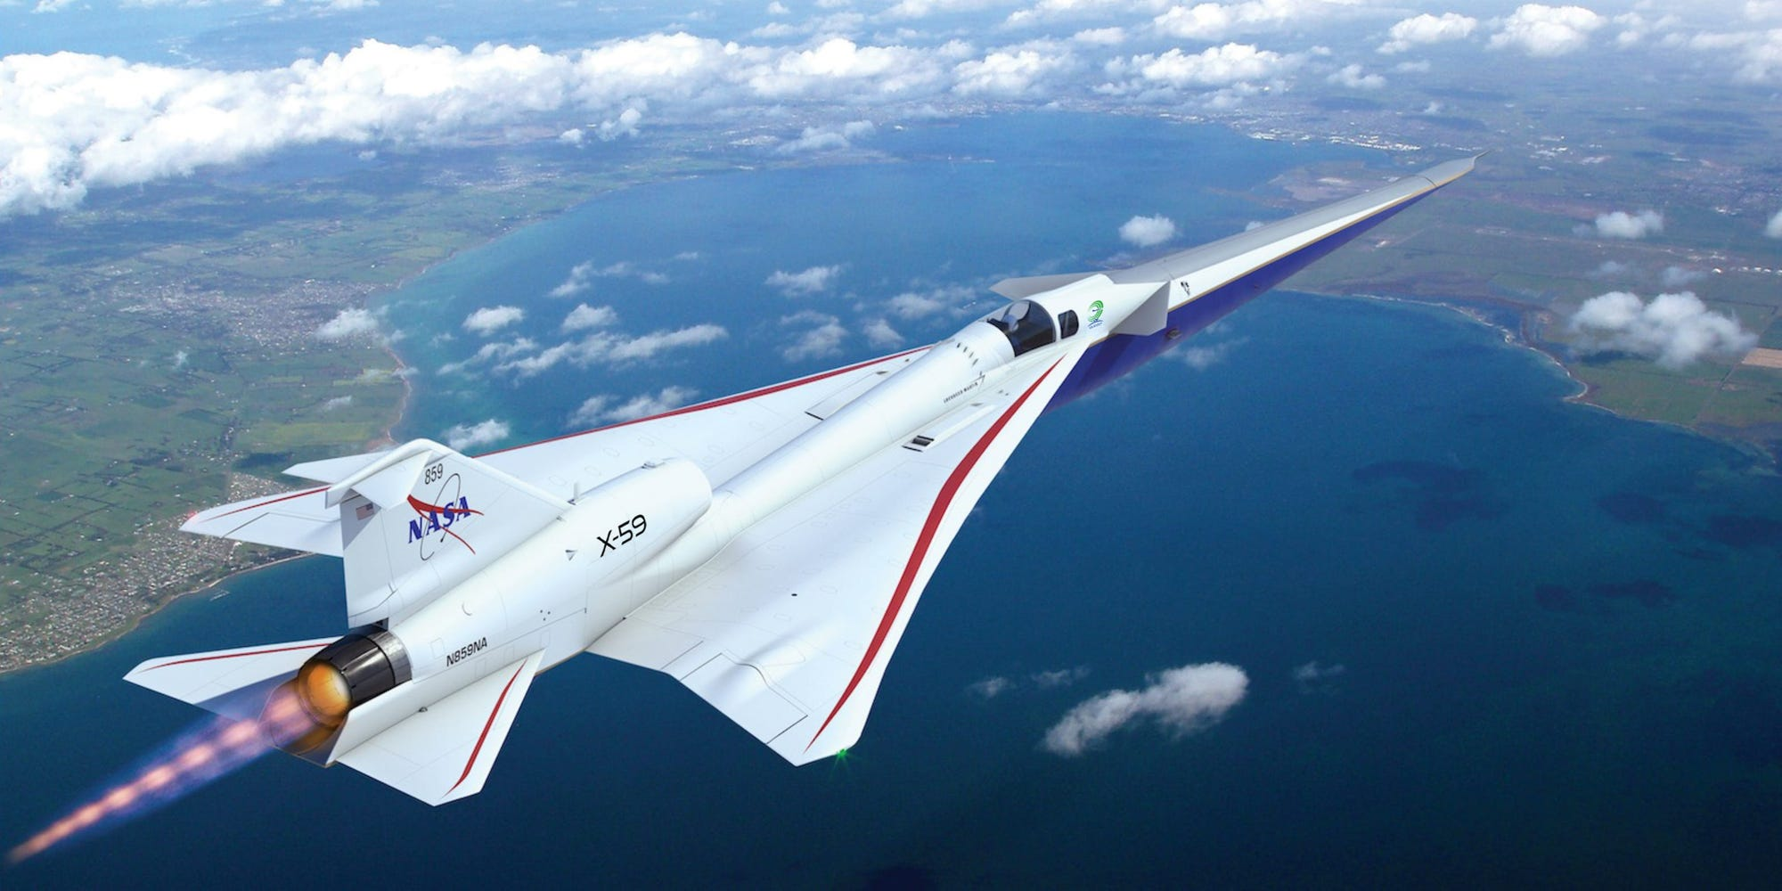
Supersonic aircraft in flight

Slide 3
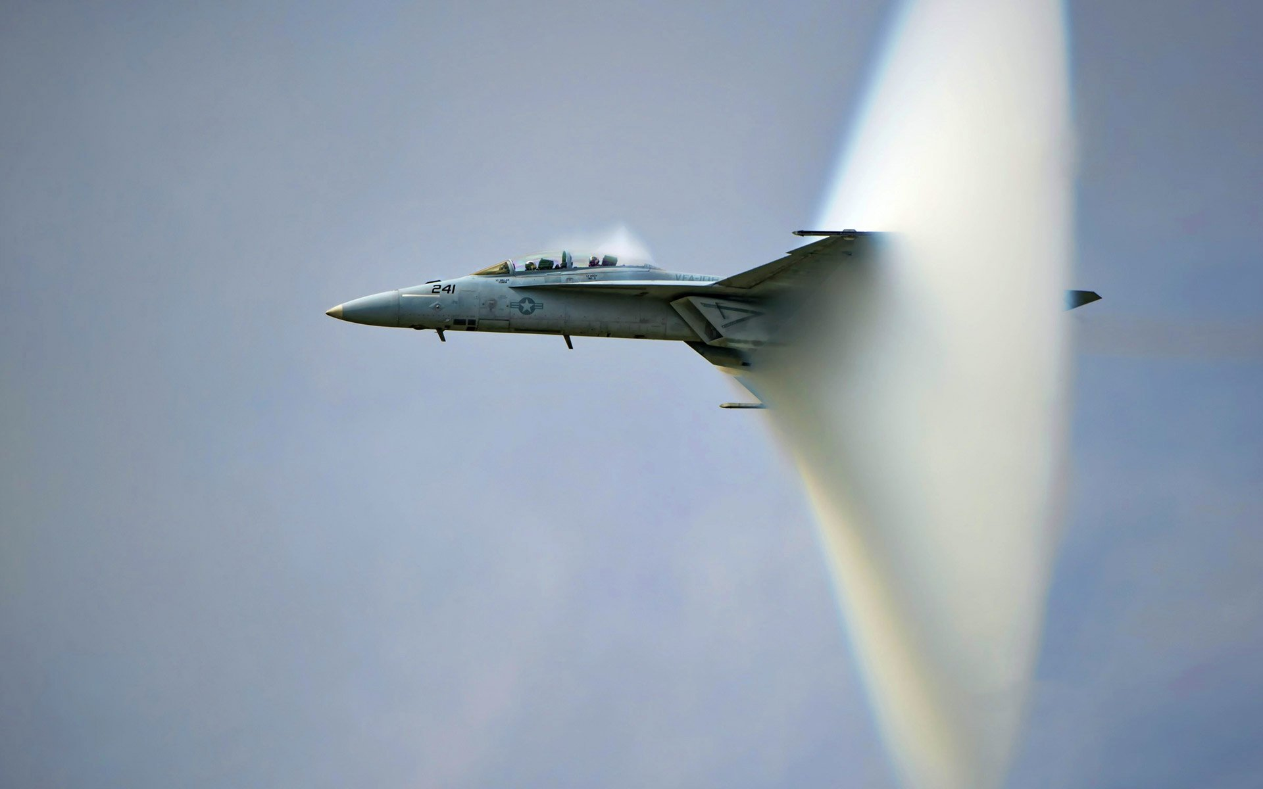
Breaking the sound barrier illustration

Slide 4
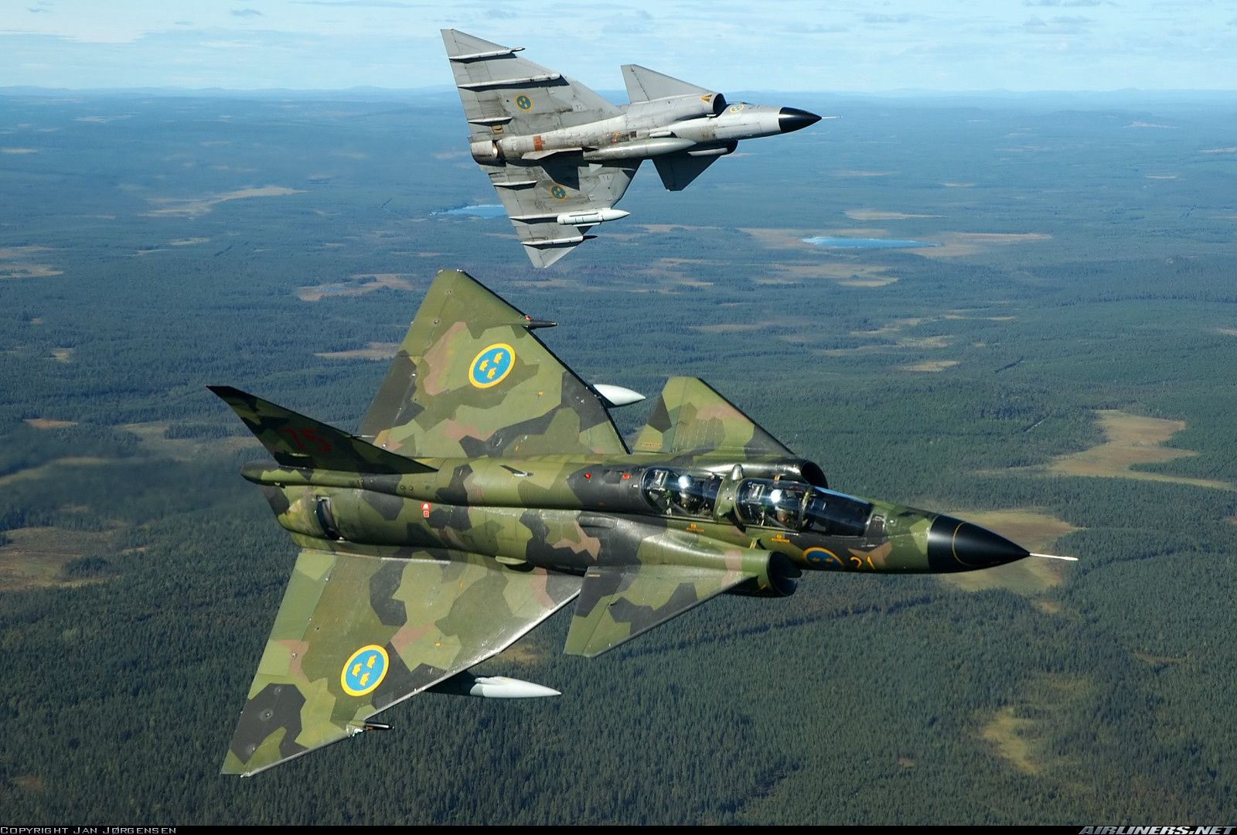
Military supersonic aircraft maneuvers

Slide 5
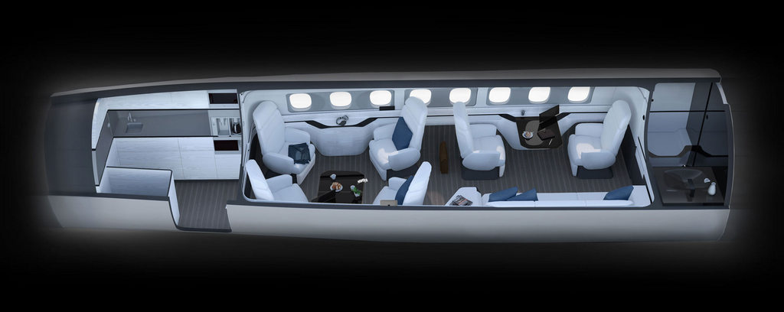
Civilian supersonic aircraft interior

Slide 6
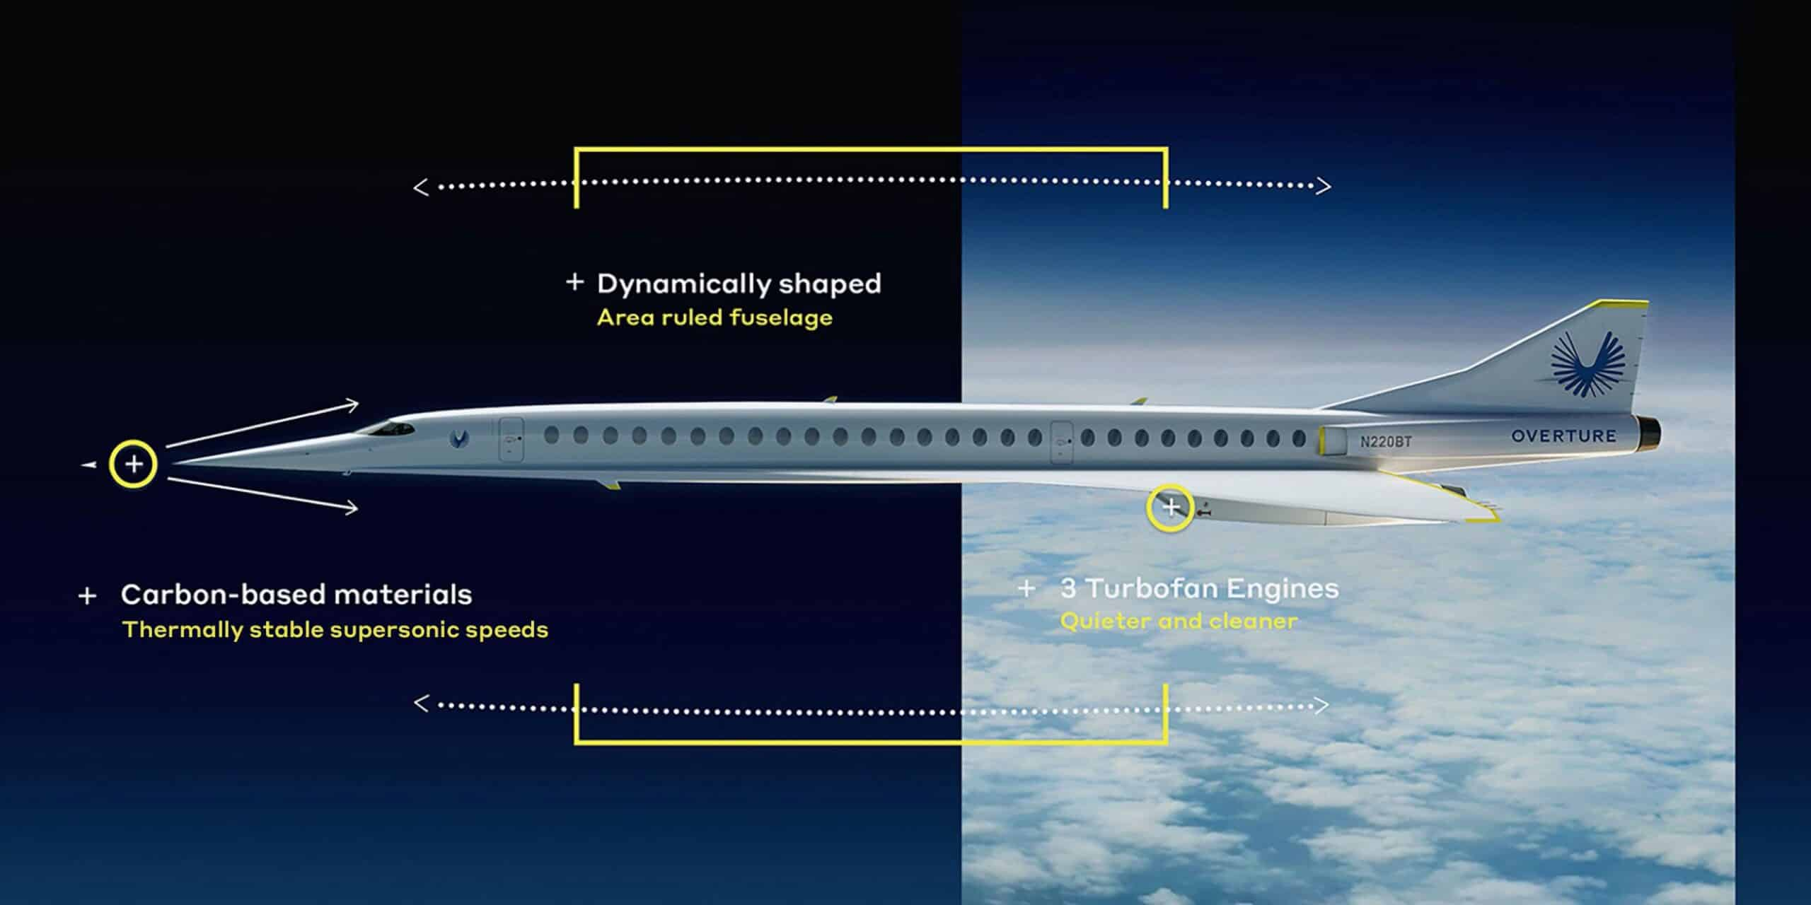
Challenges in supersonic aircraft development

Slide 7
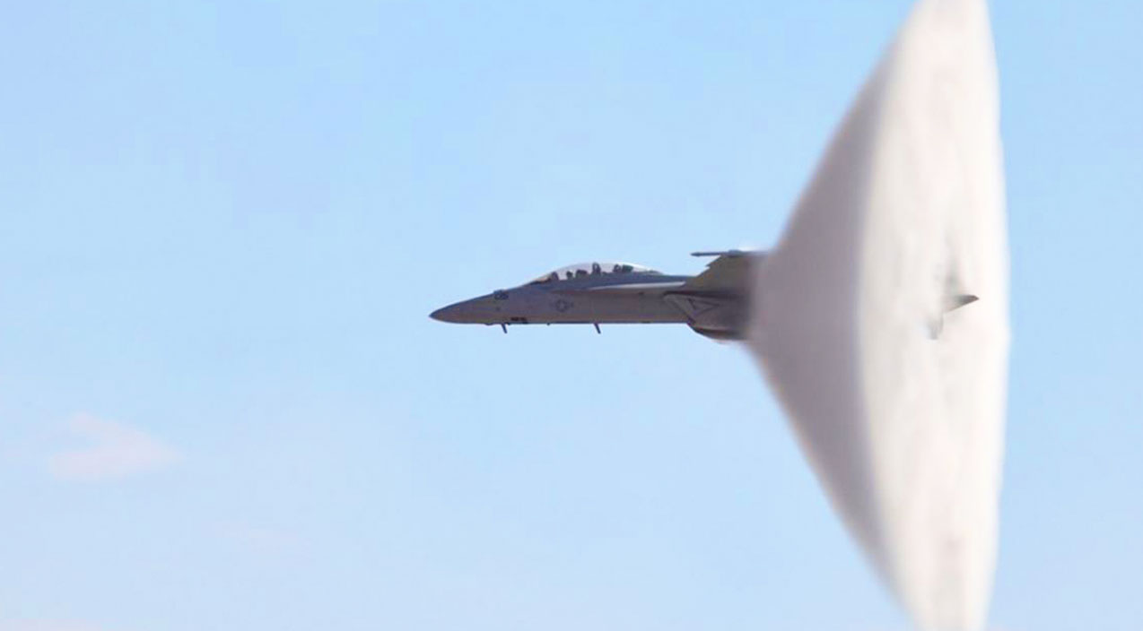
Thank you for your attention

