Slide 1
SAINT: probabilistic scoring of affinity purification–mass spectrometry data
Hyungwon Choi, Brett Larsen, Zhen-Yuan Lin, Ashton Breitkreutz, Dattatreya Mellacheruvu, Damian Fermin, Zhaohui S Qin, Mike Tyers, Anne-Claude Gingras & Alexey I Nesvizhskii
Major Lab Journal Club 1/12/2021
Isaac Plutzer

Slide 2
Card Game to Model AP-MS
Kings Deck
Joker Deck 1
Joker Deck 2
18 Cards per deck
4 Kings in the Kings deck
1 Joker (Fake King) in other decks
Randomly draw 10 cards with replacement
Count the number of Kings (or jokers) drawn
K
K
K
K
J
J

Slide 3
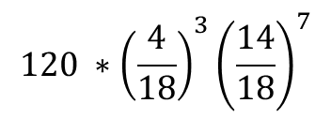
If I choose a random deck, what is the probability that I draw 3 Kings in 10 cards?
Kings Deck
Joker Deck 1
Joker Deck 2
18 Cards per deck
4 Kings in the Kings deck
1 Joker (Fake King) in other decks
Randomly draw 10 cards with replacement
Count the number of Kings (or jokers) drawn
K
K
K
K
J
J
$$120 ∗{\left(\frac{4}{18}\right)}^{3}{\left(\frac{14}{18}\right)}^{7}$$

Slide 4
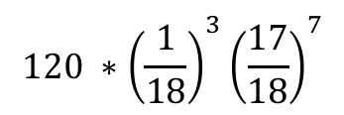
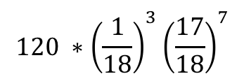
If I choose a random deck, what is the probability that I draw 3 Kings in 10 cards?
Kings Deck
Joker Deck 1
Joker Deck 2
18 Cards per deck
4 Kings in the Kings deck
1 Joker (Fake King) in other decks
Randomly draw 10 cards with replacement
Count the number of Kings (or jokers) drawn
K
K
K
K
J
J
$$120 ∗{\left(\frac{4}{18}\right)}^{3}{\left(\frac{14}{18}\right)}^{7}$$
$$120 ∗{\left(\frac{1}{18}\right)}^{3}{\left(\frac{17}{18}\right)}^{7}$$
$$120 ∗{\left(\frac{1}{18}\right)}^{3}{\left(\frac{17}{18}\right)}^{7}$$

Slide 5



If I choose a random deck, what is the probability that I draw 3 Kings in 10 cards?
Kings Deck
Joker Deck 1
Joker Deck 2
18 Cards per deck
4 Kings in the Kings deck
1 Joker (Fake King) in other decks
Randomly draw 10 cards with replacement
Count the number of Kings (or jokers) drawn
K
K
K
K
J
J
$$120 ∗{\left(\frac{4}{18}\right)}^{3}{\left(\frac{14}{18}\right)}^{7}$$
$$120 ∗{\left(\frac{1}{18}\right)}^{3}{\left(\frac{17}{18}\right)}^{7}$$
$$120 ∗{\left(\frac{1}{18}\right)}^{3}{\left(\frac{17}{18}\right)}^{7}$$
$$P(X=3|Kings)$$
$$P(X=3|Joker)$$
$$P(X=3|Joker)$$

Slide 6

If I choose a random deck, what is the probability that I draw 3 Kings in 10 cards?
Kings Deck
Joker Deck 1
Joker Deck 2
18 Cards per deck
4 Kings in the Kings deck
1 Joker (Fake King) in other decks
Randomly draw 10 cards with replacement
Count the number of Kings (or jokers) drawn
K
K
K
K
J
J
$$120 ∗{\left(\frac{4}{18}\right)}^{3}{\left(\frac{14}{18}\right)}^{7}$$
$$120 ∗{\left(\frac{1}{18}\right)}^{3}{\left(\frac{17}{18}\right)}^{7}$$
$$120 ∗{\left(\frac{1}{18}\right)}^{3}{\left(\frac{17}{18}\right)}^{7}$$
$$P(X=3|Kings)$$
$$P(X=3|Joker)$$
$$P(X=3|Joker)$$
$$P\left(X=3\right)=\frac{1}{3}P\left(X=3 | Kings\right)+ \frac{2}{3}P(X=3|Joker)$$

Slide 7
If I choose a random deck, what is the probability that I draw 3 Kings in 10 cards?
Kings Deck
Joker Deck 1
Joker Deck 2
18 Cards per deck
4 Kings in the Kings deck
1 Joker (Fake King) in other decks
Randomly draw 10 cards with replacement
Count the number of Kings (or jokers) drawn
K
K
K
K
J
J
$$120 ∗{\left(\frac{4}{18}\right)}^{3}{\left(\frac{14}{18}\right)}^{7}$$
$$120 ∗{\left(\frac{1}{18}\right)}^{3}{\left(\frac{17}{18}\right)}^{7}$$
$$120 ∗{\left(\frac{1}{18}\right)}^{3}{\left(\frac{17}{18}\right)}^{7}$$
$$P(X=3|Kings)$$
$$P(X=3|Joker)$$
$$P(X=3|Joker)$$
$$P\left(X=3\right)=\frac{1}{3}P\left(X=3 | Kings\right)+ \frac{2}{3}P(X=3|Joker)$$
$$P\left(X\right)= π_{K}P\left(X | Kings\right)+\left(1−π_{K}\right)P(X|Joker)$$

Slide 8
The SAINT Model for Spectral Counts
$$P\left(X\right)= π_{K}P\left(X | Kings\right)+\left(1−π_{K}\right)P(X|Joker)$$

Slide 9
The SAINT Model for Spectral Counts
$$P\left(X\right)= π_{K}P\left(X | Kings\right)+\left(1−π_{K}\right)P(X|Joker)$$
Equation 1:
$$P\left(X_{ij} | ∙\right)=π_{T}P\left(X_{ij} | λ_{ij}\right)+\left(1−π_{T}\right)P\left(X_{ij} | κ_{ij}\right)$$

Slide 10
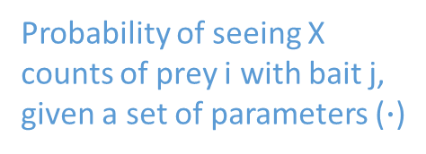
The SAINT Model for Spectral Counts
$$P\left(X\right)= π_{K}P\left(X | Kings\right)+\left(1−π_{K}\right)P(X|Joker)$$
Probability of a True interaction
Equation 1:
$$P\left(X_{ij} | ∙\right)=π_{T}P\left(X_{ij} | λ_{ij}\right)+\left(1−π_{T}\right)P\left(X_{ij} | κ_{ij}\right)$$
Probability of seeing X counts of prey i with bait j, given a set of parameters ($∙$)
Probability of seeing X counts of prey i with bait j, in the case of a True interaction
Probability of seeing X counts of prey I with bait j, in the case of no true interaction

Slide 11
Returning to the card game: If I count 3 ‘King hits’ in my sampling, what is the probability that I was sampling from the Kings deck?
Kings Deck
Joker Deck 1
Joker Deck 2
18 Cards per deck
4 Kings in the Kings deck
1 Joker (Fake King) in other decks
Randomly draw 10 cards with replacement
Count the number of Kings (or jokers) drawn
K
K
K
K
J
J

Slide 12
Returning to the card game: If I count 3 ‘King hits’ in my sampling, what is the probability that I was sampling from the Kings deck?
Kings Deck
Joker Deck 1
Joker Deck 2
18 Cards per deck
4 Kings in the Kings deck
1 Joker (Fake King) in other decks
Randomly draw 10 cards with replacement
Count the number of Kings (or jokers) drawn
K
K
K
K
J
J
We know (from earlier): P(X=3|Kings)
We want to get: P(Kings|X=3)

Slide 13
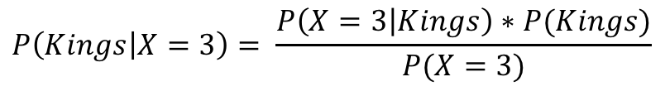
Returning to the card game: If I count 3 ‘King hits’ in my sampling, what is the probability that I was sampling from the Kings deck?
Kings Deck
Joker Deck 1
Joker Deck 2
18 Cards per deck
4 Kings in the Kings deck
1 Joker (Fake King) in other decks
Randomly draw 10 cards with replacement
Count the number of Kings (or jokers) drawn
K
K
K
K
J
J
We know (from earlier): P(X=3|Kings)
We want to get: P(Kings|X=3)
Bayes Rule:
$$P\left(Kings | X=3\right)= \frac{P\left(X=3 | Kings\right)∗P(Kings)}{P(X=3)}$$

Slide 14
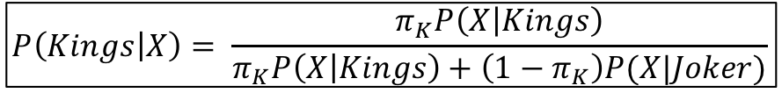
Returning to the card game: If I count 3 ‘King hits’ in my sampling, what is the probability that I was sampling from the Kings deck?
Kings Deck
Joker Deck 1
Joker Deck 2
18 Cards per deck
4 Kings in the Kings deck
1 Joker (Fake King) in other decks
Randomly draw 10 cards with replacement
Count the number of Kings (or jokers) drawn
K
K
K
K
J
J
We know (from earlier): P(X=3|Kings)
We want to get: P(Kings|X=3)
Bayes Rule:
$$P\left(Kings | X=3\right)= \frac{P\left(X=3 | Kings\right)∗P(Kings)}{P(X=3)}$$
$$P\left(Kings | X\right)= \frac{π_{K}P\left(X | Kings\right)}{π_{K}P\left(X | Kings\right)+\left(1−π_{K}\right)P(X|Joker)}$$

Slide 15
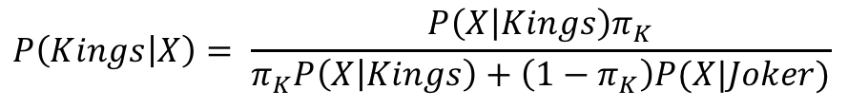
SAINT scores are the probability of a true interaction.
$$P\left(Kings | X\right)= \frac{P\left(X | Kings\right)π_{K}}{π_{K}P\left(X | Kings\right)+\left(1−π_{K}\right)P(X|Joker)}$$

Slide 16
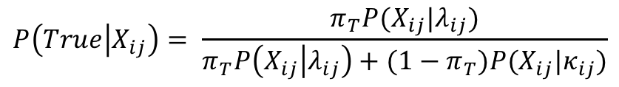
SAINT scores are the probability of a true interaction.
$$P\left(Kings | X\right)= \frac{P\left(X | Kings\right)π_{K}}{π_{K}P\left(X | Kings\right)+\left(1−π_{K}\right)P(X|Joker)}$$
Equation 6:
$$P\left(True | X_{ij}\right)= \frac{π_{T}P(X_{ij}|λ_{ij})}{π_{T}P\left(X_{ij} | λ_{ij}\right)+{(1−π}_{T})P(X_{ij}|κ_{ij})}$$

Slide 17
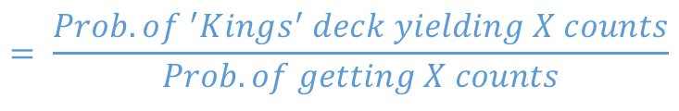
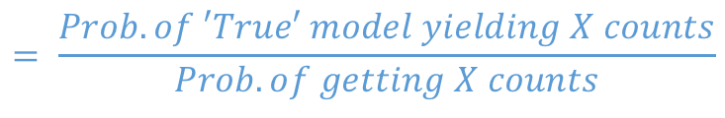
SAINT scores are the probability of a true interaction.
$$P\left(Kings | X\right)= \frac{P\left(X | Kings\right)π_{K}}{π_{K}P\left(X | Kings\right)+\left(1−π_{K}\right)P(X|Joker)}$$
$$= \frac{Prob. o{f }^{′}Kings^{′} deck yielding X counts}{Prob. of getting X counts}$$
Equation 6:
$$P\left(True | X_{ij}\right)= \frac{π_{T}P(X_{ij}|λ_{ij})}{π_{T}P\left(X_{ij} | λ_{ij}\right)+{(1−π}_{T})P(X_{ij}|κ_{ij})}$$
$$= \frac{Prob. of ′True′ model yielding X counts}{Prob. of getting X counts}$$

Slide 18
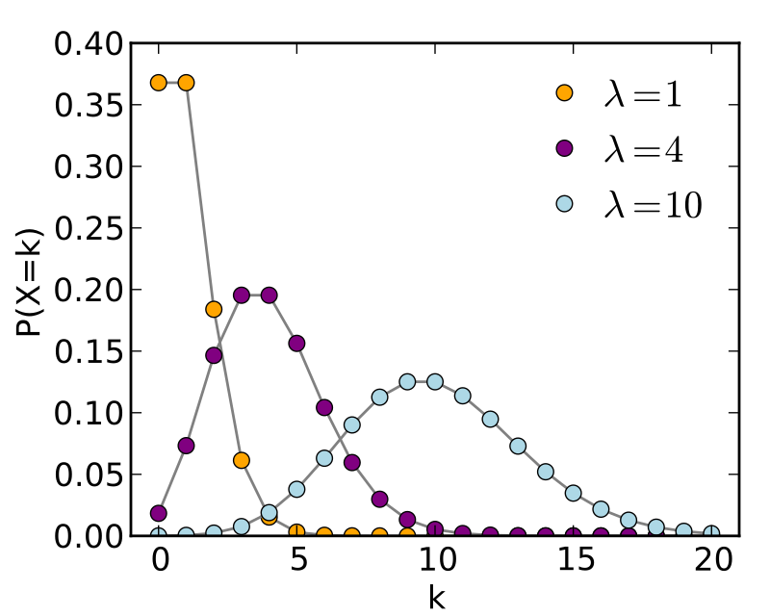
The Poisson distribution represents an infinitely large deck that we get to sample an infinite number of times.
Non-interacting with bait
Slide from earlier pres.
Significantly interacting with bait

Slide 19

The mean counts parameter for the Poisson distributions are based on sequence length of the proteins and their spectral counts from the data.
Equations 3 and 4:
$$\log\left(κ_{ij}\right)=\log\left(l_{i}\right)+\log\left(c_{j}\right)+γ_{0}+μ_{i}$$
$$\log\left(λ_{ij}\right)=\log\left(l_{i}\right)+\log\left(c_{j}\right)+β_{0}+α_{bj}+α_{pi}$$

Slide 20

The mean counts parameter for the Poisson distributions are based on sequence length of the proteins and their spectral counts from the data.
Average abundance of contaminants
Equations 3 and 4:
$$\log\left(κ_{ij}\right)=\log\left(l_{i}\right)+\log\left(c_{j}\right)+γ_{0}+μ_{i}$$
Deviation from $γ_{0}$ for this bait
Sequence length of prey
Poisson Parameter
Coverage of the bait
$$\log\left(λ_{ij}\right)=\log\left(l_{i}\right)+\log\left(c_{j}\right)+β_{0}+α_{bj}+α_{pi}$$
Abundance of bait
Average abundance of preys across all true interactions
Abundance of prey

Slide 21
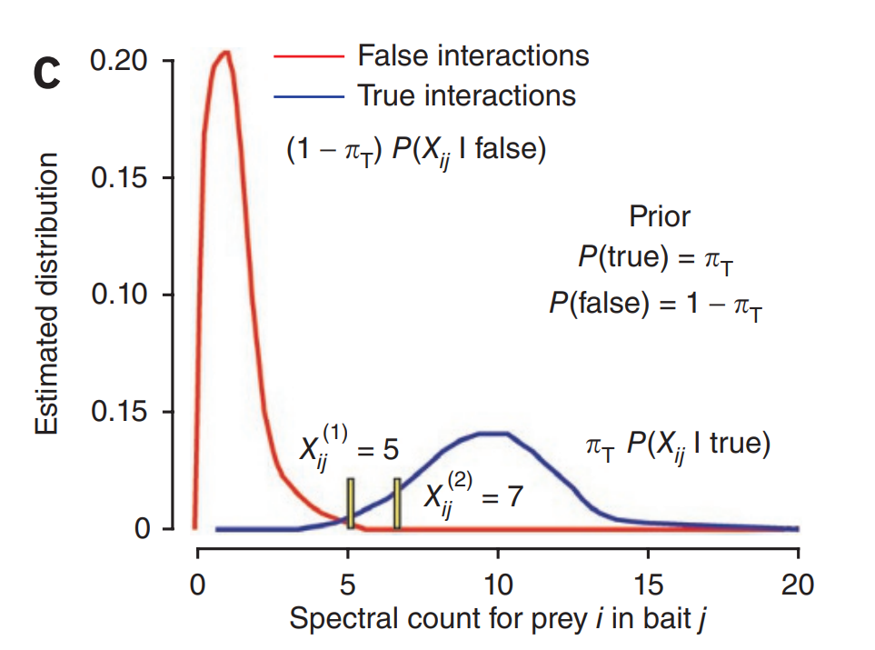
SAINT estimates two Poisson distributions for each Bait/Prey pair.
$$P\left(X_{ij} | ∙\right)=π_{T}P\left(X_{ij} | λ_{ij}\right)+\left(1−π_{T}\right)P\left(X_{ij} | κ_{ij}\right)$$

Slide 22

Parameters for the probability model are unknown and need to be estimated from spectral counts data.
$$\log\left(κ_{ij}\right)=\log\left(l_{i}\right)+\log\left(c_{j}\right)+γ_{0}+μ_{i}$$
$$\log\left(λ_{ij}\right)=\log\left(l_{i}\right)+\log\left(c_{j}\right)+β_{0}+α_{bj}+α_{pi}$$

Slide 23
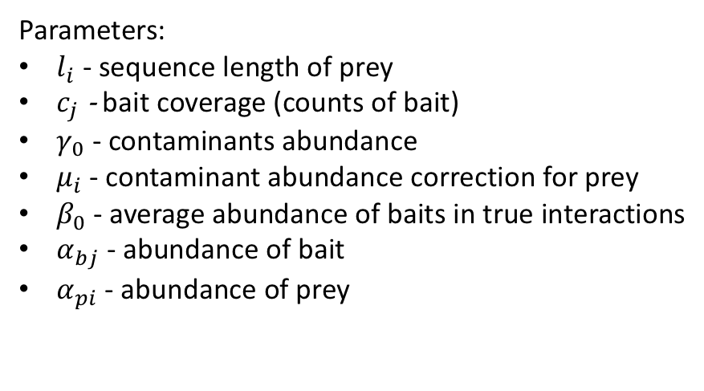
Parameters for the probability model are unknown and need to be estimated from spectral counts data.
$$\log\left(κ_{ij}\right)=\log\left(l_{i}\right)+\log\left(c_{j}\right)+γ_{0}+μ_{i}$$
$$\log\left(λ_{ij}\right)=\log\left(l_{i}\right)+\log\left(c_{j}\right)+β_{0}+α_{bj}+α_{pi}$$
Parameters:
$l_{i}$ - sequence length of prey
$c_{j}$ - bait coverage (counts of bait)
$γ_{0}$ - contaminants abundance
$μ_{i}$ - contaminant abundance correction for prey
$β_{0}$ - average abundance of baits in true interactions
$α_{bj}$ - abundance of bait
$α_{pi}$ - abundance of prey

Slide 24
Parameters for the probability model are unknown and need to be estimated from spectral counts data.
$$\log\left(κ_{ij}\right)=\log\left(l_{i}\right)+\log\left(c_{j}\right)+γ_{0}+μ_{i}$$
Baits
X₁₁ |  | … |  | X_{1j}
… |  | … |  | …
X_{i1} |  | … |  | X_{ij}
$$\log\left(λ_{ij}\right)=\log\left(l_{i}\right)+\log\left(c_{j}\right)+β_{0}+α_{bj}+α_{pi}$$
Parameters:
$l_{i}$ - sequence length of prey
$c_{j}$ - bait coverage (counts of bait)
$γ_{0}$ - contaminants abundance
$μ_{i}$ - contaminant abundance correction for prey
$β_{0}$ - average abundance of baits in true interactions
$α_{bj}$ - abundance of bait
$α_{pi}$ - abundance of prey
Preys

Slide 25


Parameters for the probability model are unknown and need to be estimated from spectral counts data.
????????
?????????
?????????
? Cards per deck
? Kings in the Kings deck
? Jokers (Fake Kings) in other decks
? Decks containing Kings and ? decks containing jokers
K
K

Slide 26
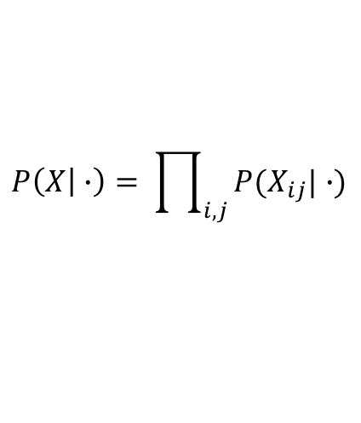
The best parameters are the parameters that maximize the likelihood of getting the observed data.
Baits
$$P\left(X | ∙\right)= \prod_{i,j}{P(X_{ij}|∙)}$$
X₁₁ |  | … |  | X_{1j}
… |  | … |  | …
X_{i1} |  | … |  | X_{ij}
Preys

Slide 27
The best parameters are the parameters that maximize the likelihood of getting the observed data.
Baits
$$P\left(X | ∙\right)= \prod_{i,j}{P(X_{ij}|∙)}$$
X₁₁ |  | … |  | X_{1j}
… |  | … |  | …
X_{i1} |  | … |  | X_{ij}
The probability of seeing the = observed bait-prey matrix
The product of the probabilities of seeing each observed element
Preys

Slide 28
The best parameters are the parameters that maximize the likelihood of getting the observed data.
Baits
$$P\left(X | ∙\right)= \prod_{i,j}{P(X_{ij}|∙)}$$
X₁₁ |  | … |  | X_{1j}
… |  | … |  | …
X_{i1} |  | … |  | X_{ij}
The probability of seeing the = observed bait-prey matrix
The product of the probabilities of seeing each observed element
Preys
We can find the optimal values for the parameters by sampling from this distribution and finding the maximum.
See: Gibbs Sampling + MCMC

Slide 29
The best parameters are the parameters that maximize the likelihood of getting the observed data.
$$P\left(X | ∙\right)= \prod_{i,j}{P(X_{ij}|∙)}$$
Parameter 2
The probability of seeing the = observed bait-prey matrix
The product of the probabilities of seeing each observed element
We can find the optimal values for the parameters by sampling from this distribution and finding the maximum.
See: Gibbs Sampling + MCMC
Parameter 1

Slide 30
The best parameters are the parameters that maximize the likelihood of getting the observed data.
$$P\left(X | ∙\right)= \prod_{i,j}{P(X_{ij}|∙)}$$
Parameter 2
The probability of seeing the = observed bait-prey matrix
The product of the probabilities of seeing each observed element
We can find the optimal values for the parameters by sampling from this distribution and finding the maximum.
See: Gibbs Sampling + MCMC
Parameter 1

Slide 31
The best parameters are the parameters that maximize the likelihood of getting the observed data.
$$P\left(X | ∙\right)= \prod_{i,j}{P(X_{ij}|∙)}$$
Parameter 2
The probability of seeing the = observed bait-prey matrix
The product of the probabilities of seeing each observed element
We can find the optimal values for the parameters by sampling from this distribution and finding the maximum.
See: Gibbs Sampling + MCMC
Parameter 1

Slide 32
The best parameters are the parameters that maximize the likelihood of getting the observed data.
$$P\left(X | ∙\right)= \prod_{i,j}{P(X_{ij}|∙)}$$
Parameter 2
The probability of seeing the = observed bait-prey matrix
The product of the probabilities of seeing each observed element
We can find the optimal values for the parameters by sampling from this distribution and finding the maximum.
See: Gibbs Sampling + MCMC
Parameter 1

Slide 33
The best parameters are the parameters that maximize the likelihood of getting the observed data.
$$P\left(X | ∙\right)= \prod_{i,j}{P(X_{ij}|∙)}$$
Parameter 2
The probability of seeing the = observed bait-prey matrix
The product of the probabilities of seeing each observed element
We can find the optimal values for the parameters by sampling from this distribution and finding the maximum.
See: Gibbs Sampling + MCMC
Parameter 1

Slide 34
The best parameters are the parameters that maximize the likelihood of getting the observed data.
$$P\left(X | ∙\right)= \prod_{i,j}{P(X_{ij}|∙)}$$
Parameter 2
The probability of seeing the = observed bait-prey matrix
The product of the probabilities of seeing each observed element
We can find the optimal values for the parameters by sampling from this distribution and finding the maximum.
See: Gibbs Sampling + MCMC
Parameter 1

Slide 35
The best parameters are the parameters that maximize the likelihood of getting the observed data.
$$P\left(X | ∙\right)= \prod_{i,j}{P(X_{ij}|∙)}$$
Parameter 2
The probability of seeing the = observed bait-prey matrix
The product of the probabilities of seeing each observed element
We can find the optimal values for the parameters by sampling from this distribution and finding the maximum.
See: Gibbs Sampling + MCMC
Parameter 1

Slide 36
The best parameters are the parameters that maximize the likelihood of getting the observed data.
$$P\left(X | ∙\right)= \prod_{i,j}{P(X_{ij}|∙)}$$
Parameter 2
The probability of seeing the = observed bait-prey matrix
The product of the probabilities of seeing each observed element
We can find the optimal values for the parameters by sampling from this distribution and finding the maximum.
See: Gibbs Sampling + MCMC
Parameter 1

Slide 37
The best parameters are the parameters that maximize the likelihood of getting the observed data.
$$P\left(X | ∙\right)= \prod_{i,j}{P(X_{ij}|∙)}$$
Parameter 2
The probability of seeing the = observed bait-prey matrix
The product of the probabilities of seeing each observed element
We can find the optimal values for the parameters by sampling from this distribution and finding the maximum.
See: Gibbs Sampling + MCMC
Parameter 1

Slide 38
The best parameters are the parameters that maximize the likelihood of getting the observed data.
$$P\left(X | ∙\right)= \prod_{i,j}{P(X_{ij}|∙)}$$
Parameter 2
The probability of seeing the = observed bait-prey matrix
The product of the probabilities of seeing each observed element
We can find the optimal values for the parameters by sampling from this distribution and finding the maximum.
See: Gibbs Sampling + MCMC
Parameter 1

Slide 39
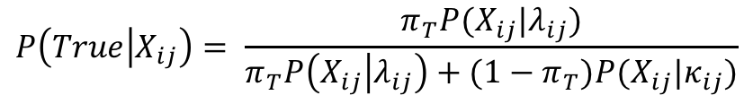
SAINT estimates the probability of a bait-prey pair having a ‘true’ interaction.
Baits
Baits
X₁₁ |  | … |  | X_{1j}
… |  | … |  | …
X_{i1} |  | … |  | X_{ij}
P₁₁ |  | … |  | P_{1j}
… |  | … |  | …
P_{j1} |  | … |  | P_{ij}
$$P\left(True | X_{ij}\right)= \frac{π_{T}P(X_{ij}|λ_{ij})}{π_{T}P\left(X_{ij} | λ_{ij}\right)+{(1−π}_{T})P(X_{ij}|κ_{ij})}$$
Preys
Preys

Slide 40
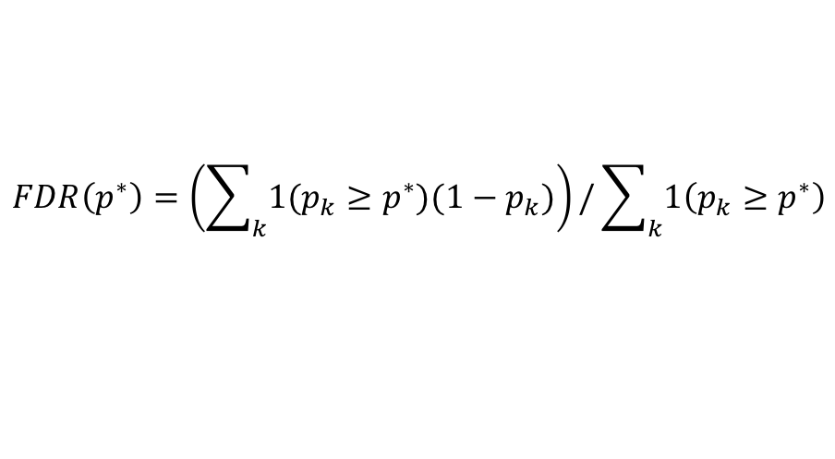
The false discovery rate is calculated by summing the ‘False’ probabilities above a certain threshold.
$$FDR\left(p^{∗}\right)=\left(\sum_{k}{1(p_{k}≥p^{∗})(1−p_{k})}\right)/\sum_{k}{1\left(p_{k}≥p^{∗}\right)}$$
Summed up probabilities of Not True interaction above p* threshold
Total number of pairs above p* threshold

Slide 41
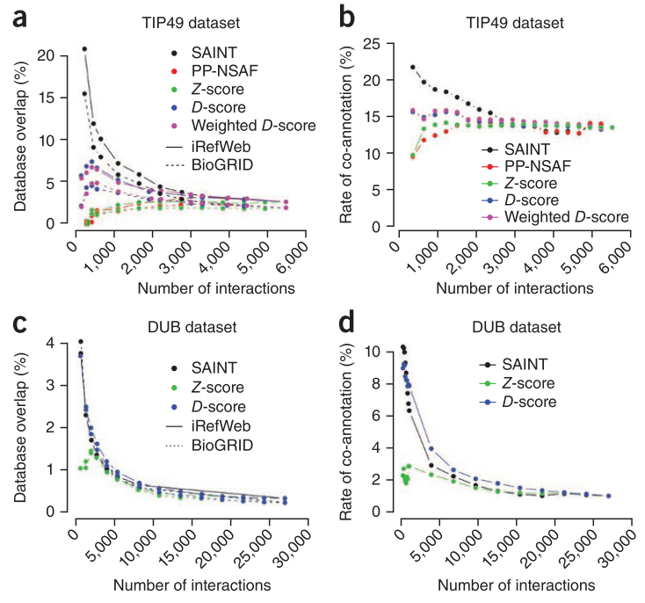

Slide 42
Summary
Baits
Baits
X₁₁ |  | … |  | X_{1j}
… |  | … |  | …
X_{i1} |  | … |  | X_{ij}
P₁₁ |  | … |  | P_{1j}
… |  | … |  | …
P_{j1} |  | … |  | P_{ij}
Preys
Preys

Slide 43
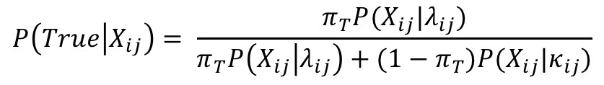
Summary
Baits
Baits
Bayes Rule:
X₁₁ |  | … |  | X_{1j}
… |  | … |  | …
X_{i1} |  | … |  | X_{ij}
P₁₁ |  | … |  | P_{1j}
… |  | … |  | …
P_{j1} |  | … |  | P_{ij}
$$P\left(True | X_{ij}\right)= \frac{π_{T}P(X_{ij}|λ_{ij})}{π_{T}P\left(X_{ij} | λ_{ij}\right)+{(1−π}_{T})P(X_{ij}|κ_{ij})}$$
Preys
Preys
Maximum Likelihood parameter estimation

