Slide 1
SAINT: probabilistic scoring of affinity purification–mass spectrometry data
Hyungwon Choi, Brett Larsen, Zhen-Yuan Lin, Ashton Breitkreutz, Dattatreya Mellacheruvu, Damian Fermin, Zhaohui S Qin, Mike Tyers, Anne-Claude Gingras & Alexey I Nesvizhskii
Major Lab Journal Club 1/12/2021
Isaac Plutzer

Slide 2
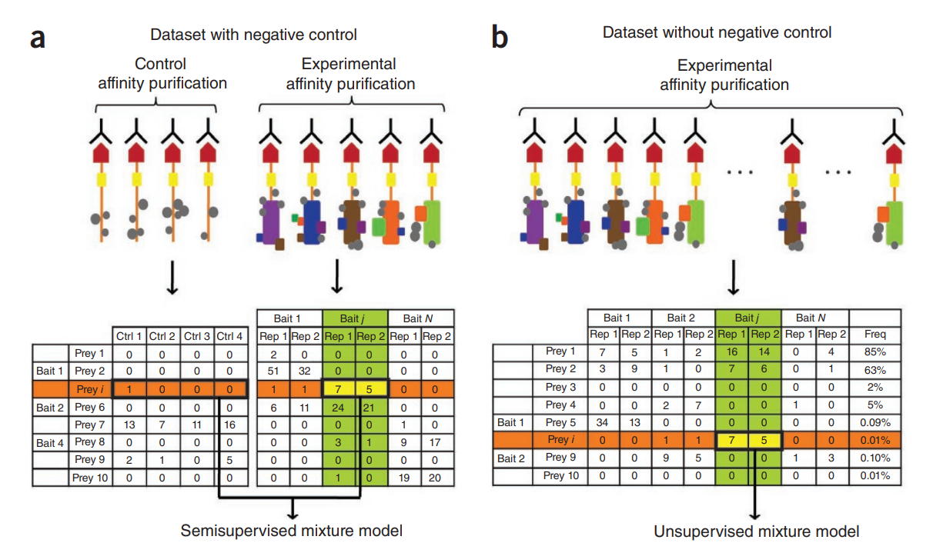
SAINT estimates the probability of a bait-prey pair having a ‘true’ interaction.

Slide 3
SAINT estimates the probability of a bait-prey pair having a ‘true’ interaction.
Baits
Baits
X₁₁ |  | … |  | X_{1j}
… |  | … |  | …
X_{i1} |  | … |  | X_{ij}
P₁₁ |  | … |  | P_{1j}
… |  | … |  | …
P_{j1} |  | … |  | P_{ij}
Preys
Preys

Slide 4
Card Game to Model AP-MS
Kings Deck
Joker Deck 1
Joker Deck 2
18 Cards per deck
4 Kings in the Kings deck
1 Joker (Fake King) in other decks
Randomly draw 10 cards with replacement
Count the number of Kings (or jokers) drawn
K
K
K
K
J
J

Slide 5

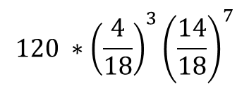

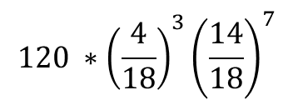


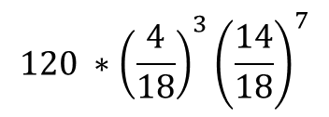
If I choose a random deck, what is the probability that I draw 3 Kings in 10 cards?
Kings Deck
Joker Deck 1
Joker Deck 2
18 Cards per deck
4 Kings in the Kings deck
1 Joker (Fake King) in other decks
Randomly draw 10 cards with replacement
Count the number of Kings (or jokers) drawn
K
K
K
K
J
J
$$120 ∗{\left(\frac{4}{18}\right)}^{3}{\left(\frac{14}{18}\right)}^{7}$$
$$120 ∗{\left(\frac{4}{18}\right)}^{3}{\left(\frac{14}{18}\right)}^{7}$$
$$120 ∗{\left(\frac{4}{18}\right)}^{3}{\left(\frac{14}{18}\right)}^{7}$$
$$P(X=3|Kings)$$
$$P(X=3|Joker)$$
$$P(X=3|Joker)$$
$$P\left(X=3\right)=\frac{1}{3}P\left(X=3 | Kings\right)+ \frac{2}{3}P(X=3|Joker)$$
$$P\left(X\right)= π_{K}P\left(X | Kings\right)+\left(1−π_{K}\right)P(X|Joker)$$

Slide 6
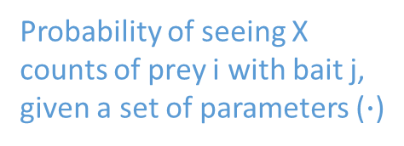
The SAINT Model for Spectral Counts
$$P\left(X\right)= π_{K}P\left(X | Kings\right)+\left(1−π_{K}\right)P(X|Joker)$$
Probability of a True interaction
Equation 1:
$$P\left(X_{ij} | ∙\right)=π_{T}P\left(X_{ij} | λ_{ij}\right)+\left(1−π_{T}\right)P\left(X_{ij} | κ_{ij}\right)$$
Probability of seeing X counts of prey i with bait j, given a set of parameters ($∙$)
Probability of seeing X counts of prey i with bait j, in the case of a True interaction
Probability of seeing X counts of prey I with bait j, in the case of no true interaction

Slide 7
The Poisson distribution represents an infinitely large deck that we get to sample an infinite number of times.
Slide from earlier pres.

Slide 8


The mean counts parameter for the Poisson distributions is based on sequence abundance data and spectral counts.
Average abundance of contaminants
Equations 3 and 4:
$$\log\left(κ_{ij}\right)=\log\left(l_{i}\right)+\log\left(c_{j}\right)+γ_{0}+μ_{i}$$
Deviation from $γ_{0}$ for this bait
Sequence length of prey
Poisson Parameter
Coverage of the bait
$$\log\left(λ_{ij}\right)=\log\left(l_{i}\right)+\log\left(c_{j}\right)+β_{0}+α_{bj}+α_{pi}$$
Abundance of bait
Average abundance of preys across all true interactions
Abundance of prey

Slide 9
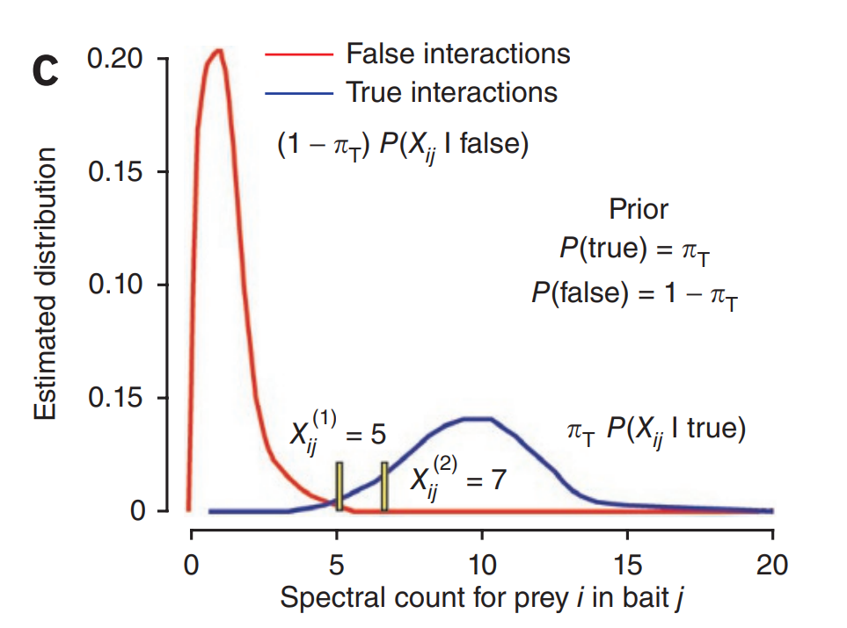
SAINT estimates two Poisson distributions for each Bait/Prey pair.
$$P\left(X_{ij} | ∙\right)=π_{T}P\left(X_{ij} | λ_{ij}\right)+\left(1−π_{T}\right)P\left(X_{ij} | κ_{ij}\right)$$

