Slide 1
Campus Second-hand Book Trading System
Group Member: James, Anthony, Walker, Henry, Damon, Jay

Slide 2
Background
The current second-hand book trading market, mostly through the intermediary to achieve second-hand book transactions. This has indeed achieved a certain effect, but there are still serious shortcomings. First of all, the intermediary often pushes down the quotation and earns the difference. The price of the student's book is often lower than the price of the second-hand book bought, and the student's interests are damaged. Secondly, there is a defect in the intermediary market that the book information lags. The students can only be in the semester. Inquiries and transactions can only be made after the end of the acquisition with the intermediary.

Slide 3
What our system do？
The purpose of our system is to provide Sias students with a second-hand book trading platform. It is mainly divided into functional modules such as student login, book information management, information inquiry, forum exchange and feedback.

Slide 4
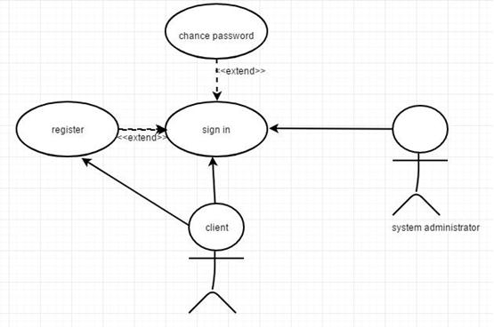
Function: Register
1.The most important four parts of the registration page are the registration E-mail, enter usrsname, confirmation password and registration button.
2. The user enters the mailbox, password and confirmation password respectively, then clicks the registration button to complete the registration.
3. then, it will determine whether the user has input information in the above parts, and then to determine whether the format of the email is correct whether the contents of the password and the confirmation password are the same.

Slide 5
Function: Register
When the user's input is correct, then confirm and activate the mailbox. After the client will pass the user's input to the server. When the server gets the information, it will judge whether the format of the information meets the requirement again. After being correct, it will compare the information obtained with the information in the database. If there is duplication, it will prompt that the front-end mailbox has been registered. If there is no duplication, it will deposit the information in the database and prompt the front-end to register successfully.

Slide 6
Function: Search book
When users have target books, they need to search for the target books in the website. Enter the keywords of the target book in the search box.

Slide 7
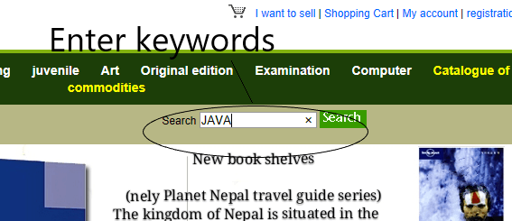
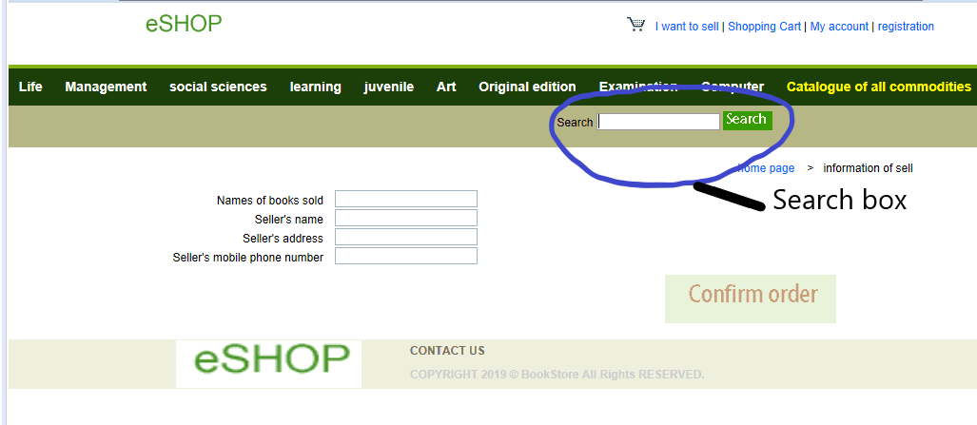
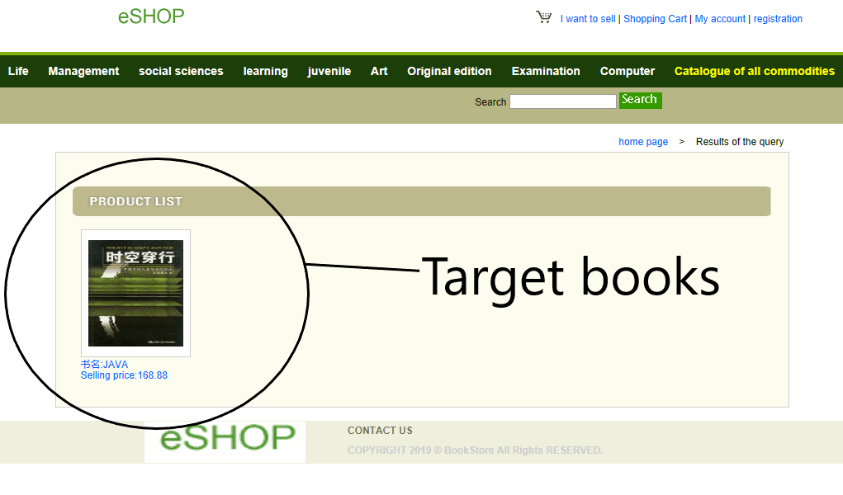
Demonstration process:

Slide 8
Function：View the information of books
When you search for the target book, you need to browse the information related to the book. Such as version, author, price, etc.

Slide 9
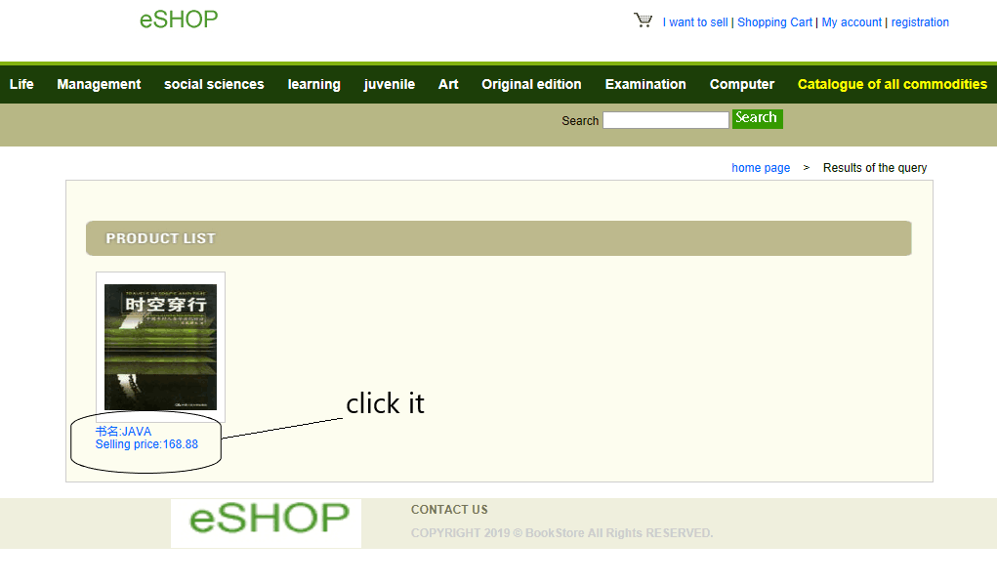
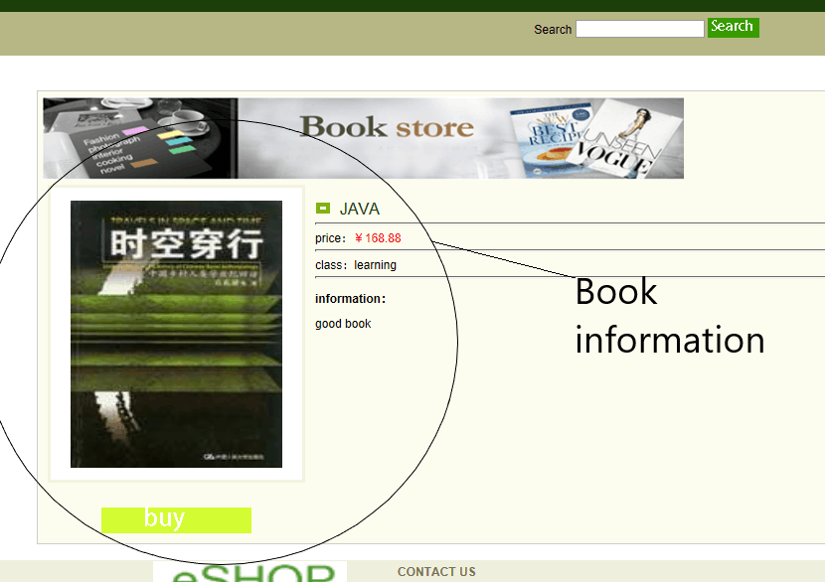
Demonstration process:

Slide 10
Function：Make an order
When you find a book you like, you can click on it and add it to your shopping cart.

Slide 11
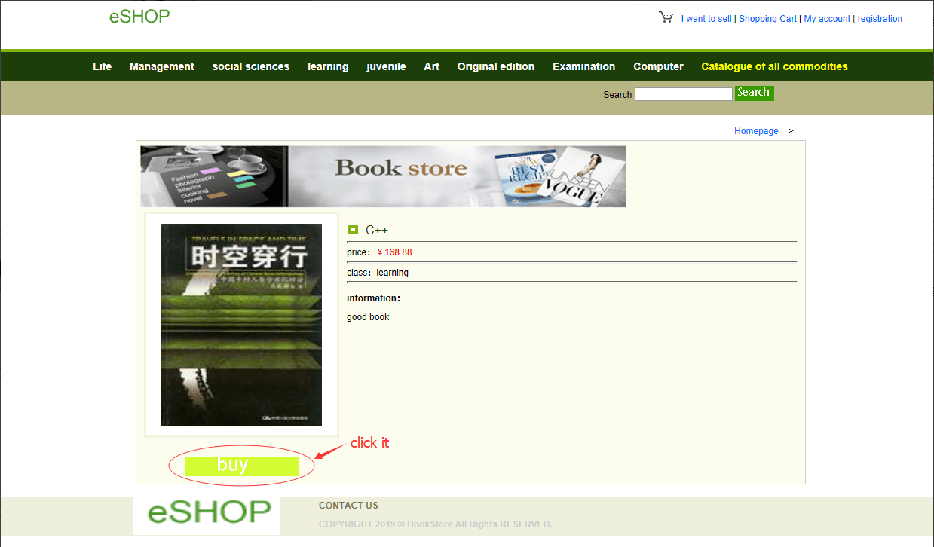
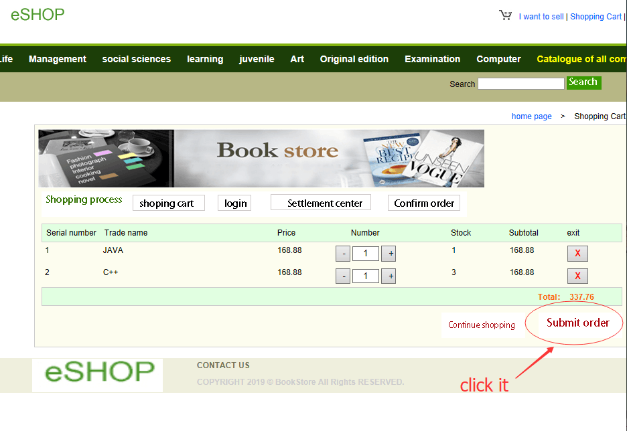
Demonstration process:
1
2

Slide 12
Function：Shopping cart management
If you have already added your favorite book to the shopping cart, you can modify the quantity, shipping address, name, mobile number and other information here, and then confirm the order and submit the order.

Slide 13
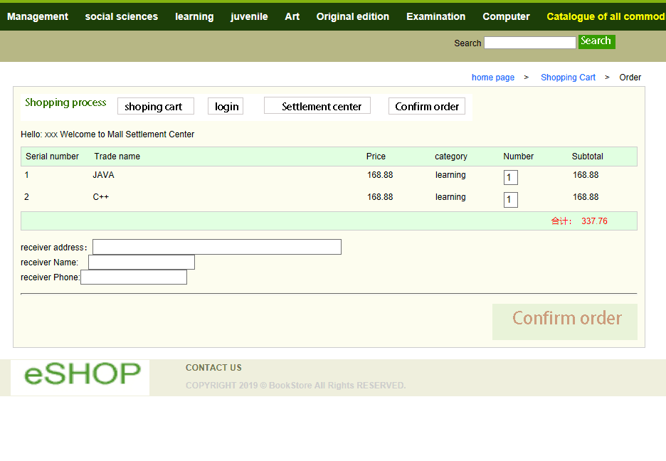
Demonstration process:

