Slide 1
Assignment 2 (Page Interaction Scenario)
SCSJ4483
2016/2017-2

Slide 2
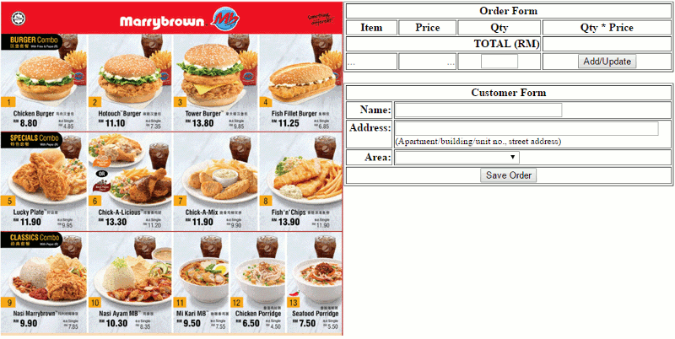
Default page content when “assignment2.html” file is opened by user.

Slide 3
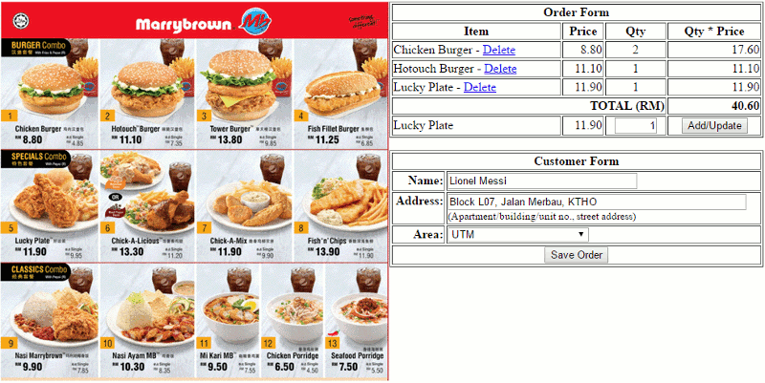
The user may complete the order and customer
forms and then click the “Save Order” button.

Slide 4
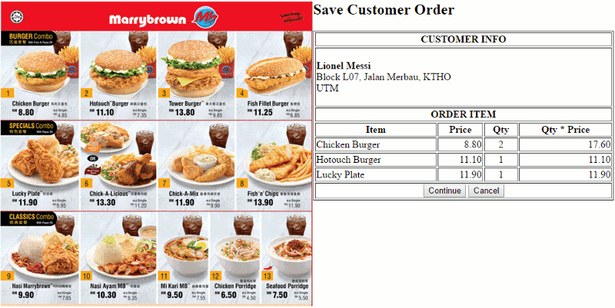
The user can proceed or cancel the save order operation
by clicking the “Continue” or “Cancel” button.

Slide 5
Retrun to previous page when the “Cancel” button is clicked by the user.

Slide 6
The user can edit the item to be ordered (delete Hotouch Burger).

Slide 7
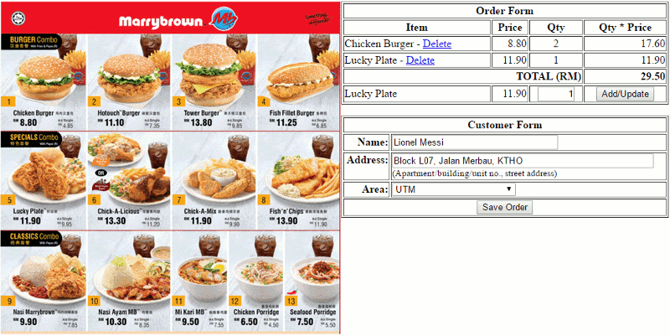
The user can edit the item to be ordered (delete Hotouch Burger).

Slide 8
Click the “Save Order” button again.

Slide 9
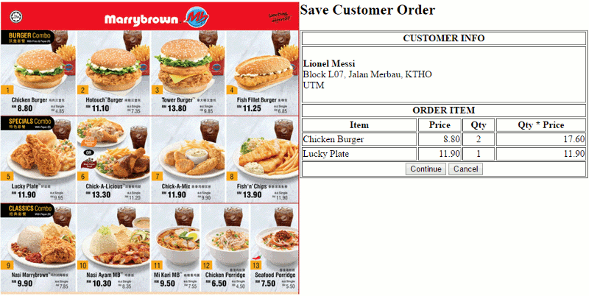
Click the “Continue” button to proceed with the save order operation.

Slide 10
Back to default page content when “assignment2.html” file was initially
opened by the user.
At this stage, customer order info has been send to and saved into the database by “save_order.php” script resided at the server side via AJAX/JSON service.

Slide 11
The save order operation should record the order info into two (2)
database tables with tables’ structure are as shown below:
Table name: customer
+-------------+-------------+------+-----+---------+----------------+
| Field | Type | Null | Key | Default | Extra |
+-------------+-------------+------+-----+---------+----------------+
| id_customer | int(11) | NO | PRI | NULL | auto_increment |
| name | varchar(50) | NO | | NULL | |
| address | varchar(50) | NO | | NULL | |
| area | varchar(50) | NO | | NULL | |
+-------------+-------------+------+-----+---------+----------------+
Table name: order
+-------------+-------------+------+-----+---------+----------------+
| Field | Type | Null | Key | Default | Extra |
+-------------+-------------+------+-----+---------+----------------+
| id_order | int(11) | NO | PRI | NULL | auto_increment |
| id_customer | int(11) | NO | | NULL | |
| item | varchar(50) | NO | | NULL | |
| price | float | NO | | NULL | |
| qty | smallint(6) | NO | | NULL | |
+-------------+-------------+------+-----+---------+----------------+

Slide 12
The content of “customer” and “order” tables after customer order info has been
successfully saved into the database:
Table name: customer
select * from `customer`;
+-------------+--------------+-------------------------------+------+
| id_customer | name | address | area |
+-------------+--------------+-------------------------------+------+
| 1 | Lionel Messi | Block L07, Jalan Merbau, KTHO | UTM |
+-------------+--------------+-------------------------------+------+
Table name: order
select * from `order`;
+----------+-------------+----------------+-------+-----+
| id_order | id_customer | item | price | qty |
+----------+-------------+----------------+-------+-----+
| 1 | 1 | Chicken Burger | 8.8 | 2 |
| 2 | 1 | Lucky Plate | 11.9 | 1 |
+----------+-------------+----------------+-------+-----+

