Slide 1
Introduction to C#
Building your first application

Slide 2
Lesson Plan
Installing Visual Studios 2019 Community
Basic Vocabulary Needed for C#
Understanding Visual Studios 2019 Development Environment
Cloning a Repository
Creating a Hello World Program
Learning about built-in Types and Variables
Working with Strings
Working with Dates and Times
Making Decisions in Your Program
Implementing Logical Expressions

Slide 3
Lesson Plan Cont.
Looping Based on a Logical Expression
Looping a Known Number of Times
Working with Arrays and Collections
Looping Through Members of a Collection
Defining and Calling Methods
Understanding Classes and Objects
Working with Scope and Accessibility Modifiers
Encapsulation and Object-Oriented Design
Understanding Namespaces
Introducing LINQ
When and How to use Exceptions
Testing Your Code
Common Patterns and Antipatterns

Slide 4
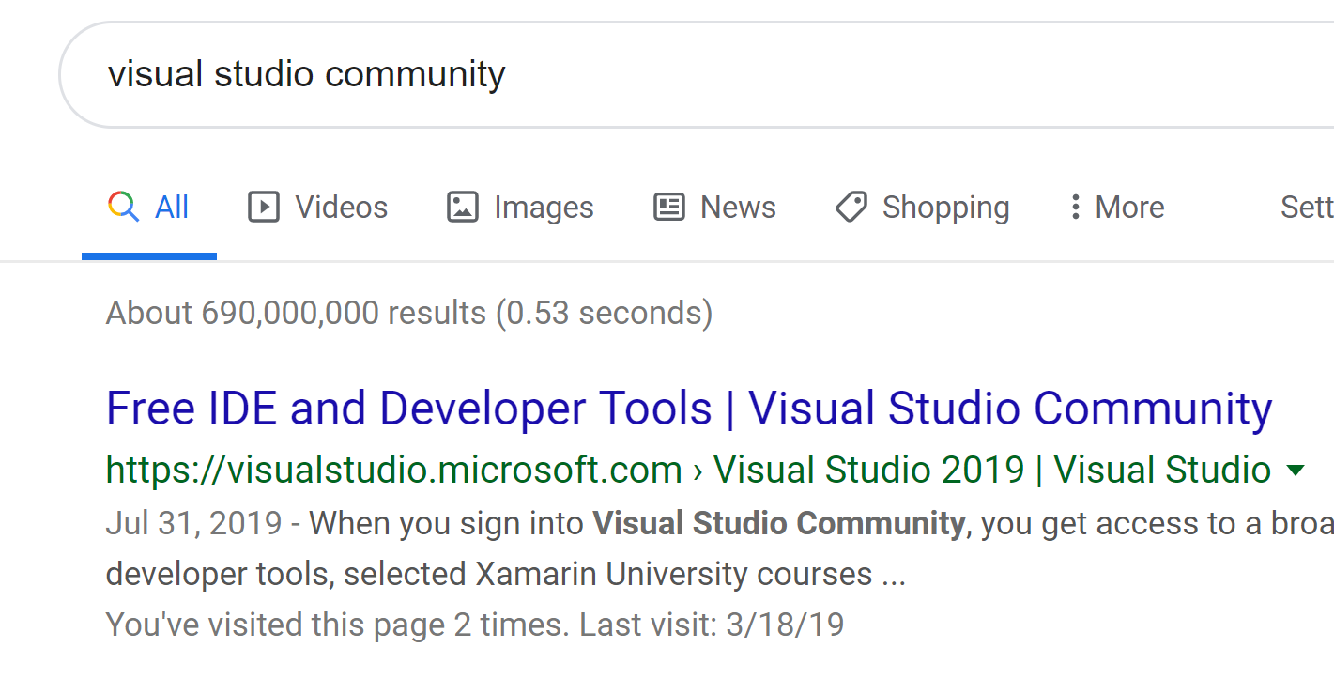
Installing Visual Studios 2019 Community
Perform a Google Search for “Visual Studios Community”
Click on the “Free IDE and Development Tools” link

Slide 5
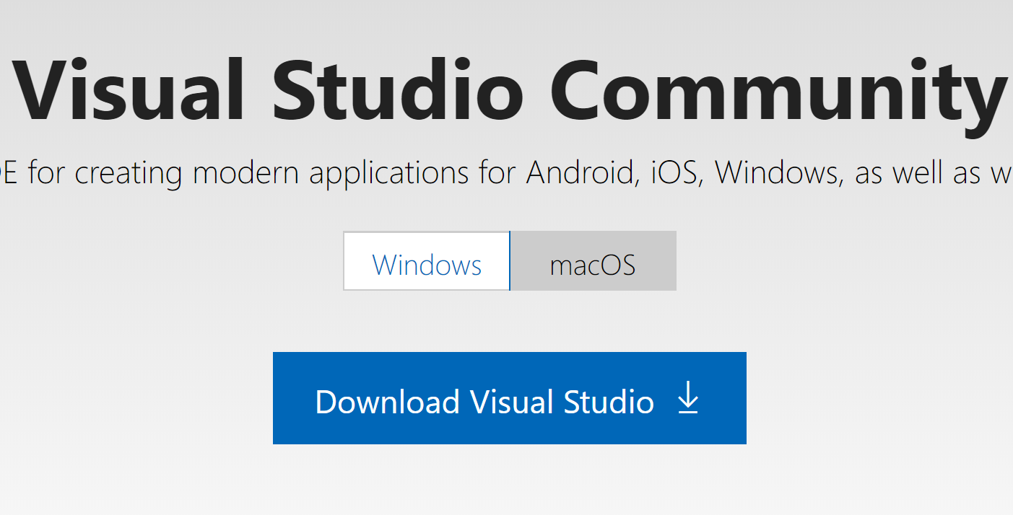
Microsoft Website Download Link
Click on the “Download Visual Studio” link
After download completion (about 5 seconds)
Open the downloaded file to begin the installation
When asked for permission select “YES”

Slide 6
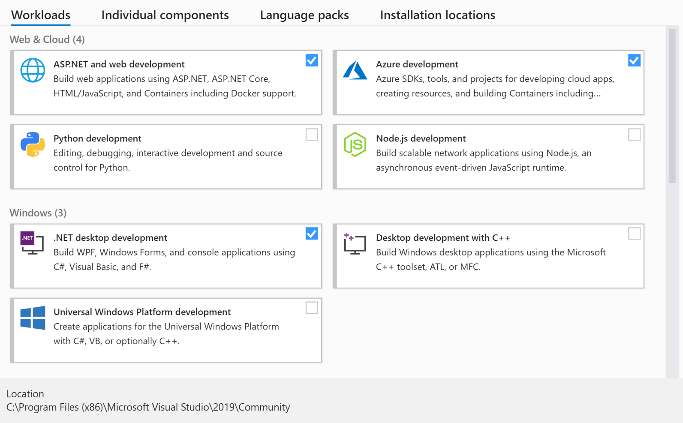
Visual Studios Install Settings
Ensure that each above options are selected
Do NOT select install at this time as there are more options to select.

Slide 7
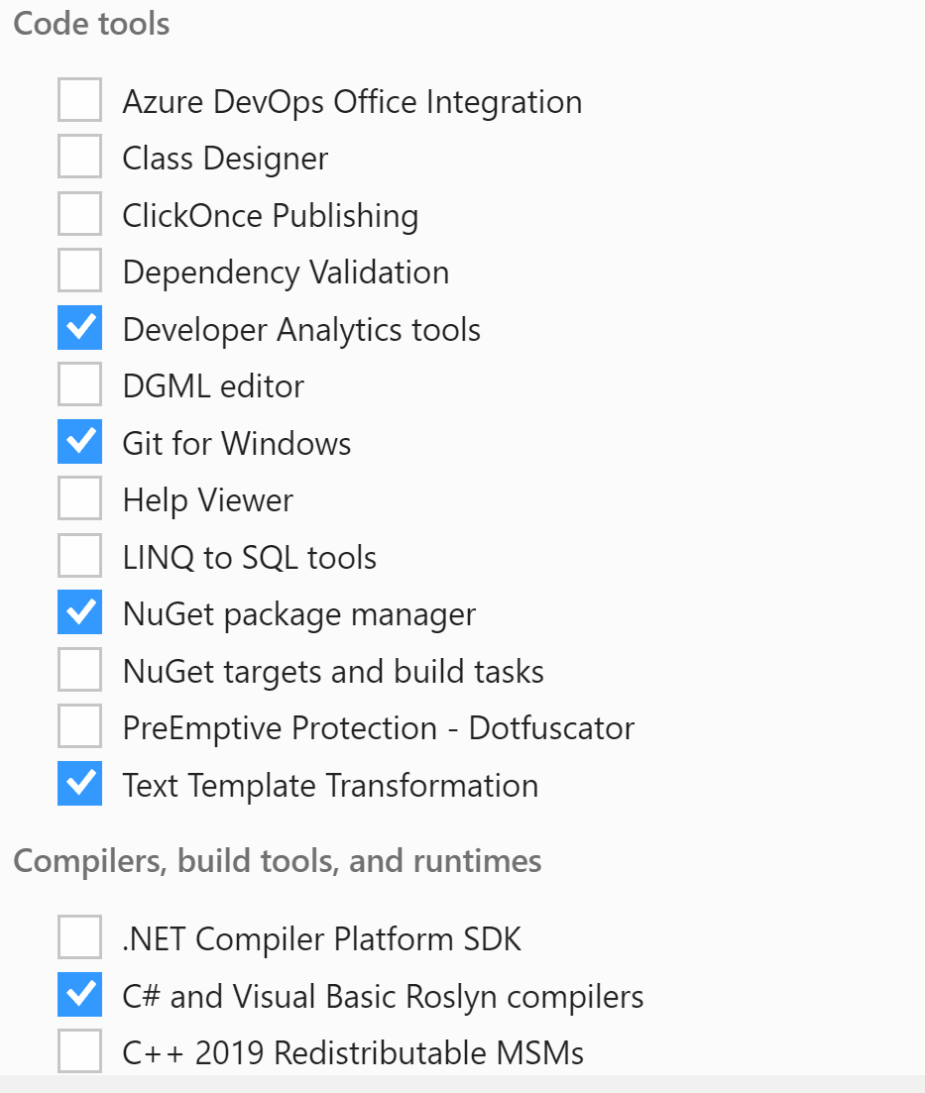
Visual Studios Code Tools
Ensure that each above options are selected
Do NOT select install at this time as there are more options to select.

Slide 8
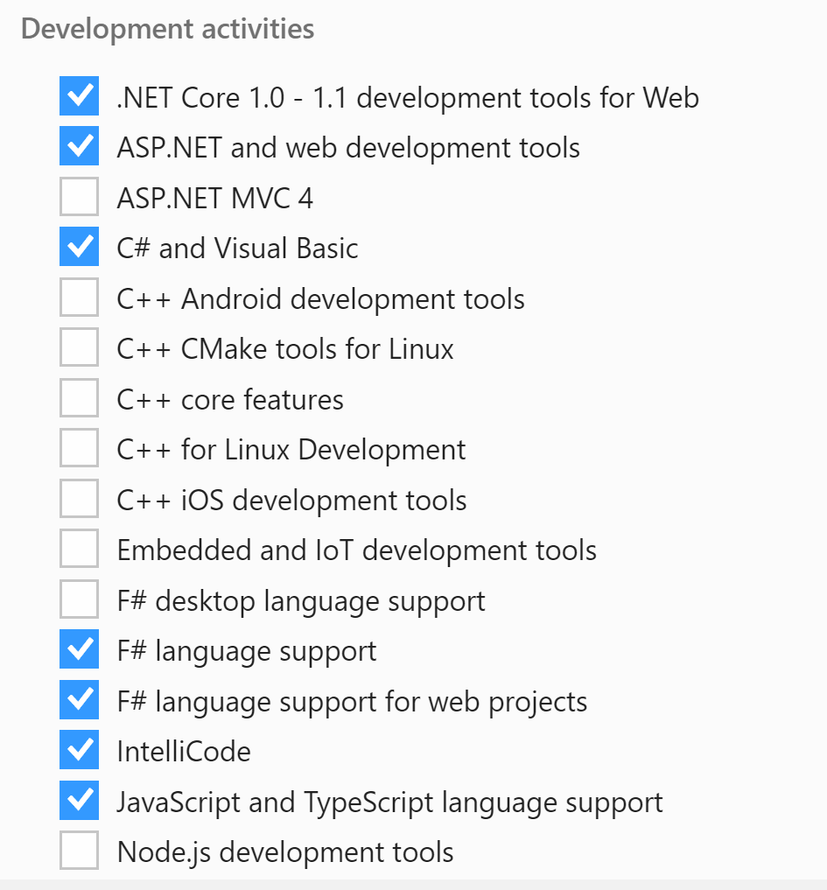
Visual Studios Development Activities
Ensure that each above options are selected
NOTE: .NET Core 1.0-1.1 is not selected by default.

Slide 9
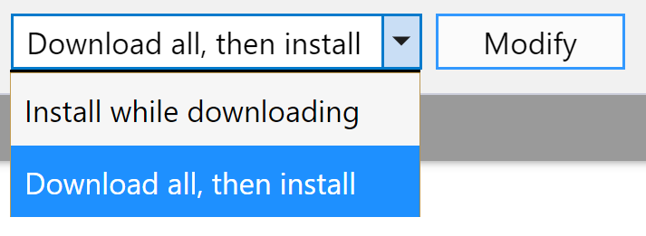
Visual Studios Begin Installation
Once all options have been selected, ensure “Download all, then install” is selected.
Select the “Install” button
NOTE: Due to already having this installed, my version shows “Modify”, however new installs will show “Install”

Slide 10
Basic Vocabulary Needed for C# Development
Algorithm (noun): a step-by-step procedure to achieve a specific goal. Can be implemented with code. Example: I used the quicksort algorithm to sort the array alphabetically.
Argument (noun): a value that is passed into a function when it is called. Arguments are said to be “passed” into a function, and functions are said to “take” arguments. Also known as a “parameter.” Example: That function takes two arguments.
Array (noun): a type of value that contains a sequence of other values. Example: I put all our names into an array of strings.
Assignment (noun): the act of putting a value into a variable. Example: I assigned the number 22 to the age variable.

Slide 11
Basic Vocabulary Needed for C# Development
Brackets (noun): characters often used to surround text. The different types of brackets are:
Parenthesis/parens/round brackets: ( )
Curly brackets/braces: { }
Angle brackets: < >
Square brackets: [ ]
The bracket at the beginning is called the “opening” or the “left” bracket. The bracket at the end is called the “closing” or “right” bracket. Example: Your code won’t compile because you forgot a closing bracket.
Bug (noun): a mistake in a program. Example: There must be a bug because the output is wrong.
Call (verb): to run the code in a function. Also referred to as “running,” “executing,” or “invoking” a function. For the noun, see function call. Example: I called the rand function and it returned 42.

Slide 12
Basic Vocabulary Needed for C# Development
Class (noun): a type that can be defined by the programmer. Classes are defined in order to create objects of that class. See object. Example: I made a Person class that holds a person’s name and age.
Comment (noun): arbitrary text written around code, but which is never run, and is generally ignored by the computer. Used to leave notes and documentation for people who read the code later. Also used to stop code from running (see comment out). Example: I wrote comments in my code so I could understand it later.
Comment Out (verb): to turn code into a comment so that it does not get run. Example: I commented out this line of code, and it doesn’t crash any more.
Compiler (noun): a program that converts code into an executable, and checks that the syntax is correct. Sometimes compilers convert code into other code. Example: The compiler is giving me an error, so I must have incorrect syntax somewhere.

Slide 13
Basic Vocabulary Needed for C# Development
Constant (noun): a variable that never changes its value. Example: The PI constant has the value 3.14.
Crash (verb): to cause a running program to stop due to an error. Example: I tried to divide a number by zero, which made the program crash.
Data Structure (noun): a value that contains other values. Example: Arrays are one kind of data structure.
Debug (verb): to investigate and fix bugs. Example: I spent all day debugging a complicated error.
Declaration (noun): code that declares that something exists – usually a variable, function or a class. A declaration might not fully define the thing it is declaring. E.g. a constant may be declared to exist, without actually defining what it’s value is. Not all programming languages allow for declarations. Example: My code won’t compile because I wrote a function declaration, but I forgot to write the actual function.

Slide 14
Basic Vocabulary Needed for C# Development
Definition (noun): code that fully implements something – usually a variable, functionor a class. The code that implements a class is called the “class definition.” The code that implements a function is called the “function definition.” Example: The function wasn’t doing what I expected, so I had a look at its definition.
Double (noun): a float that can represent a wider range of numbers than a normal float. Short for “double-precision floating-point number.” See float. Example: The number was so tiny I had to use a double instead of a float
Execute (verb): Synonym for run. Example: I can’t execute my program because it won’t compile.
Executable (noun): a program, usually a single file, ready to be run. Example: Give me the executable so I can try out your program.

Slide 15
Basic Vocabulary Needed for C# Development
Float (noun): a type of value that represents numbers with fractional parts. Short for “floating-point number”. Example: The value 3.14 is a float.
Function (noun): a piece of code that is not run until it is called. Functions take zero or more arguments. When a function finishes running, it returns a return value back to the code that called it. Example: I wrote a function that takes an array of numbers as an argument, and returns the average.
Function Call (noun): code for calling a function. Function calls specify which function to call, and all of the arguments that the function requires. The result of a function call is a return value. Not all functions have a return value. Example: The function call add(1,2,3) returns the value 6.
Implement (verb): to write all the code to complete something – usually a function or a class. Example: I finished implementing those functions.

Slide 16
Basic Vocabulary Needed for C# Development
Instance (noun): Synonym for object. Example: I created an instance of the Person class.
Instance Variable (noun): a variable that is attached to an object. Also known as a “member variable” or just a “member.” Example: On the tom object, I assigned the value "Tom Dalling" to the name instance variable.
Instantiate (verb): to create an object from a class. Example: I instantiated an object of the Person class.
Integer (noun): a type of value that represents whole numbers. For fractional numbers, see float. Example: 42 is an integer value.

Slide 17
Basic Vocabulary Needed for C# Development
Interpreter (noun): a program that runs code. For languages that are not compiled, the source code is run directly by an interpreter. Compiled programming languages do not usually have an interpreter. Example: I installed the Ruby interpreter so I can run my Ruby code.
Invoke (verb): Synonym for call. Example: I invoked the function with the wrong arguments, and it crashed.
Iterate (verb): Synonym for loop. Example: I iterated over all the values in the array.
Loop (noun): a piece of code that runs itself repeatedly. Commonly used to run a piece code for every value in an array. Also known as “iteration”. Example: The code loops until the user types in “quit.”

Slide 18
Basic Vocabulary Needed for C# Development
Member Function (noun): Synonym for method. Example: This class has three member functions.
Member Variable (noun): Synonym for instance variable. Example: This class has two member variables.
Method (noun): a function that is attached to an object. Methods belong to, and are defined in, a class. Also known as a “member function.” Example: The length method returns the number of characters in a string object.
Nested (adjective): contained within something like itself. E.g. a nested array is an array that is inside another array, and a nested class is a class defined inside the definition of another class. Example: I used a nested loop to loop over a grid – the outer loop for the x coordinate, and the inner loop for the y coordinate.

Slide 19
Basic Vocabulary Needed for C# Development
Object (noun): a value created from a class. E.g. If you want to represent your family in code then you might make a class called FamilyMember, and create several objects from that class – one object for each person in your family. Objects usually contain other values inside instance variables, and have methods attached to them. E.g. each FamilyMember object might have a name instance variable. Objects combine the concept of variables and functions into a single value. Also known as an “instance.” Example: I make the enemy move by changing the position instance variable of the enemy object.
Object-Oriented (adjective): designed using objects. Example: Ruby is an object-oriented programming language because all values are objects in Ruby.
Parameter (noun): Synonym for argument. Example: That function takes two parameters.

Slide 20
Basic Vocabulary Needed for C# Development
Parenthesis (noun): A type of bracket. Example: Lisp-like programming languages use a lot of parenthesis in their syntax.
Procedure (noun): Synonym for function. Example: That procedure takes two arguments.
Program (noun): a full piece of software that is ready to be run. Usually an executable. Example: I wrote a program that keeps track of my todo list.
Read (verb): to retrieve input data values from an external source – usually from a file. Can refer to retrieving data over a network, such as the internet. The opposite of writing. Example: I read the contents of file into a string.

Slide 21
Basic Vocabulary Needed for C# Development
Return (verb): to immediately stop a called function from running, possibly providing a return value. A function automatically returns once all of its code has been run. However, the code in the function definition can force the function to return at any point. Example: If the array is empty, the function returns early without running the rest of its code.
Return Value (noun): the value that results from a completed function call. Example: The return value of the rand function is a random float between 0.0 and 1.0.
Run (verb): to perform the instructions written in code or an executable. Code is a set of instructions, and “running” code is when the computer actually performs those instructions. To “run” a function means to call that function (see call). Example: I wrote a new feature, and ran the code to check that it works.

Slide 22
Basic Vocabulary Needed for C# Development
String (noun): a type of value that represents text. The word “string” derives from the phrase “string of characters.” E.g. The string "cat" is a string (a.k.a. sequence) of the characters ‘c’, ‘a’, and ‘t’. Example: I represented my name as a string in the code.
Syntax (noun): the grammatical rules of a programming language. Every programming language has different syntax. Syntax determines whether code is written correctly or incorrectly, and is enforced by the compiler or interpreter. Code will not compile or run unless the syntax is correct. Example: I forgot to write the brackets, so the compiler gave me a syntax error.

Slide 23
Basic Vocabulary Needed for C# Development
Type (noun): the kind or category of a value. Every value has a type.
The value 5 is of the integer type.
The value 5.2 is of the float type.
The value "cat" is of the string type.
Simple types, like integers, are usually provided by the programming language. The programmer can define more complicated types using classes. The type of an object determines what methods and instance variables are attached to that object. Example: I got a crash because the variable contained the wrong type of value – I thought it would be an integer, but it was actually a string.
Value (noun): a piece of data that can be contained inside a variable. Every value has a type. Values represent information, in a way that code can work upon.
Example: My program asks a user for the year they were born, then uses that value to calculate their age.

Slide 24
Basic Vocabulary Needed for C# Development
Variable (noun): a named container for a single value. Variables are not values themselves, they are merely containers for values. Putting a value into a variable is referred to as assignment. Variables are named after the fact that their value can vary – a different value can be assigned to a variable at any time. Example: I assigned the string value "Tom" to the name variable.
Write (verb): to send output data values to an external destination – usually to a file. Can refer to sending data over a network, such as the internet. The opposite of reading. Example: The program writes all its data to a file before it quits, so it can read the data back again next time it is run.

Slide 25
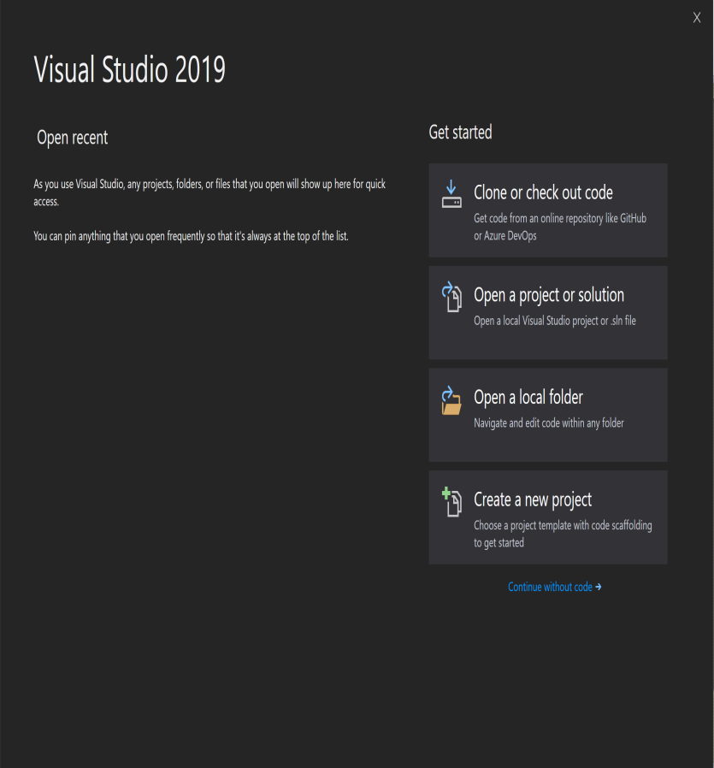
Visual Studios Startup Screen

Slide 26
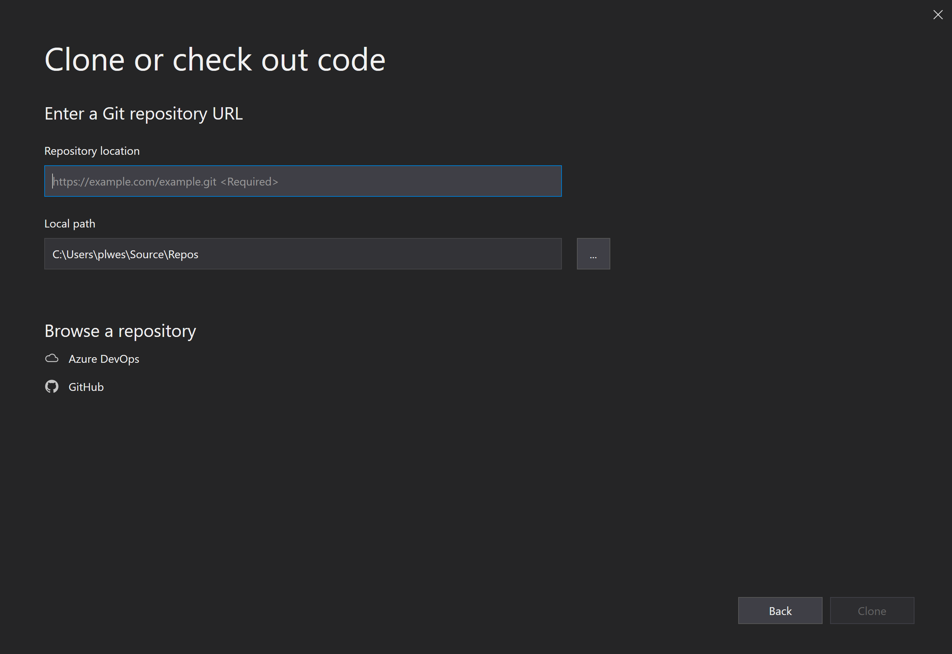
Cloning a Repository
https://github.com/plwest-atmark/Aug31.git

Slide 27
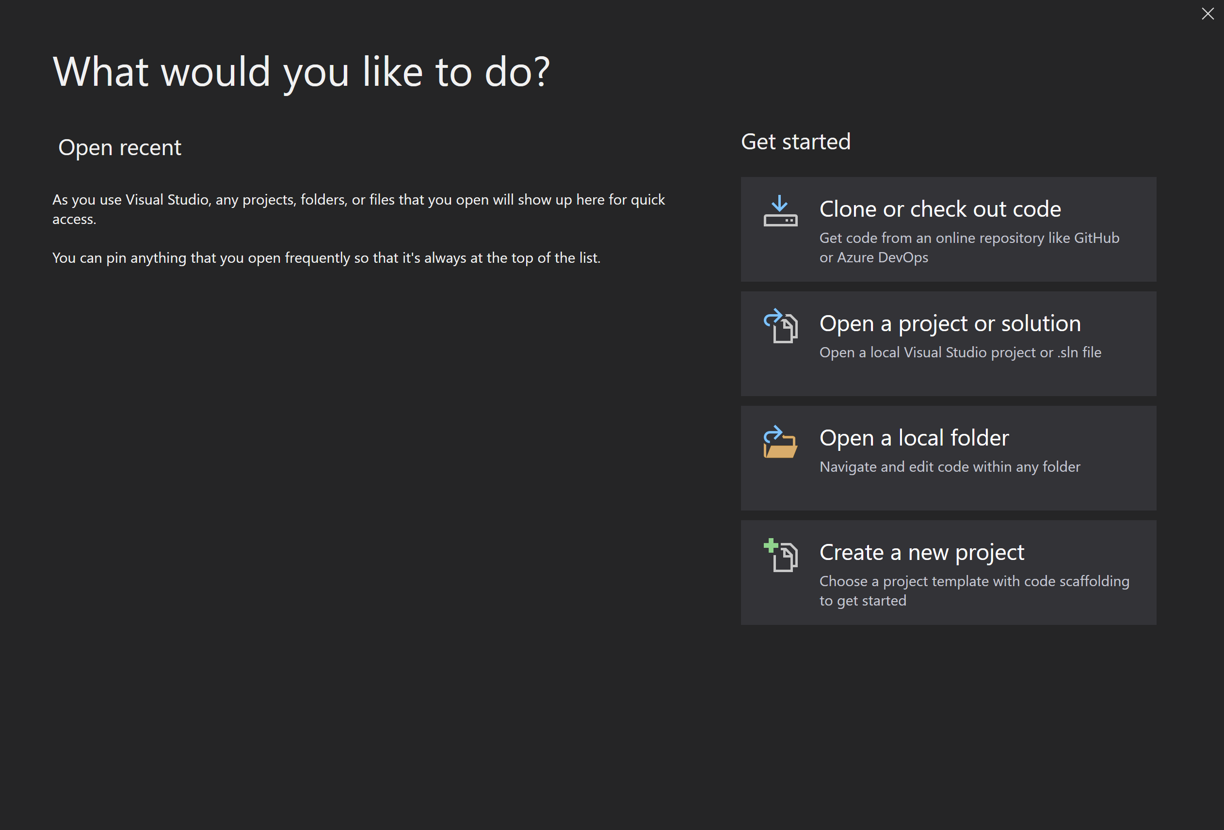
Cloning a Repository

Slide 28
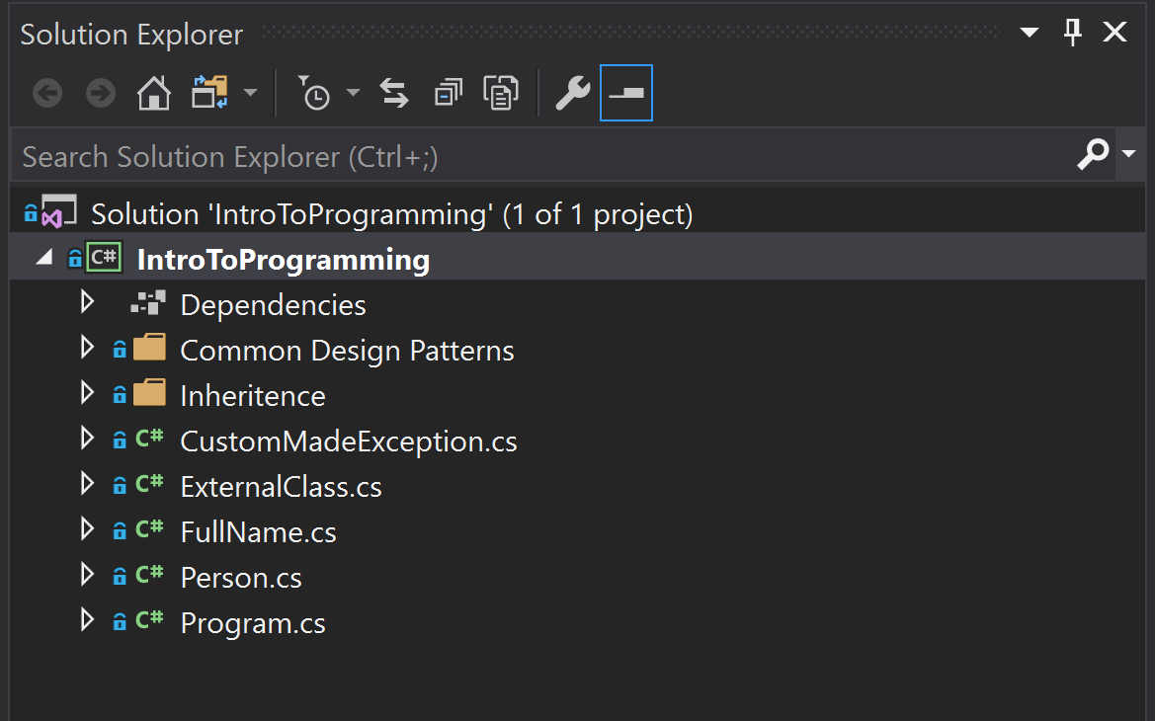
Visual Studio Solution Explorer

Slide 29
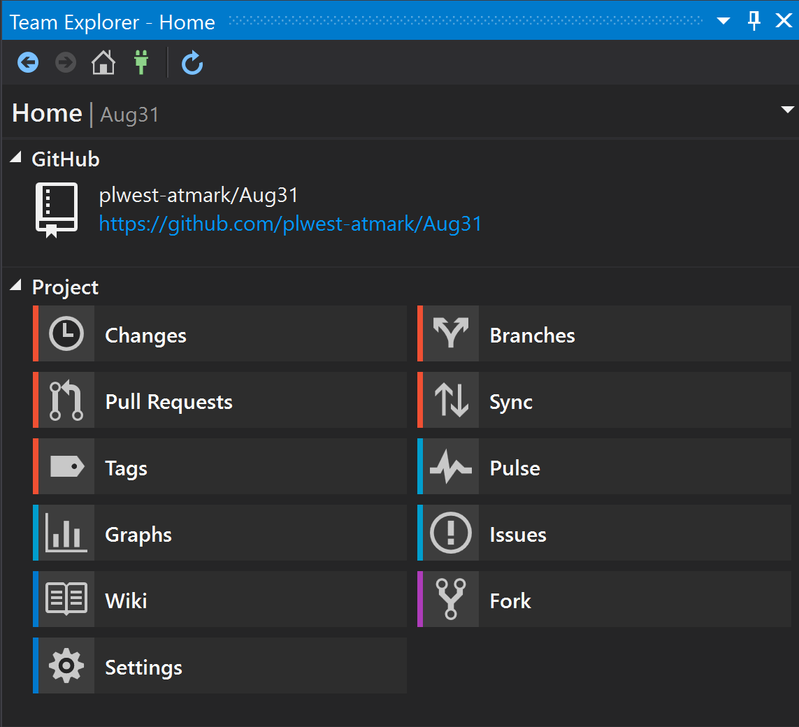
Visual Studio Team Explorer

Slide 30
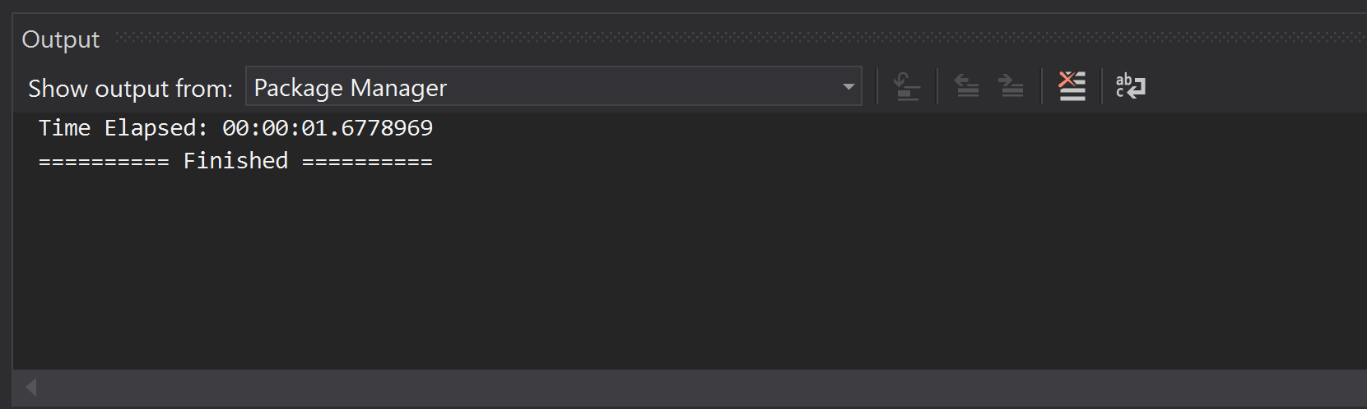
Visual Studio Output Window
Output window will display important information about the application during Build Actions and during Debugging Actions.
This window will also be used to provide feedback created by you during the running of your application. This is done with Tracing and Debugging outputs.

Slide 31
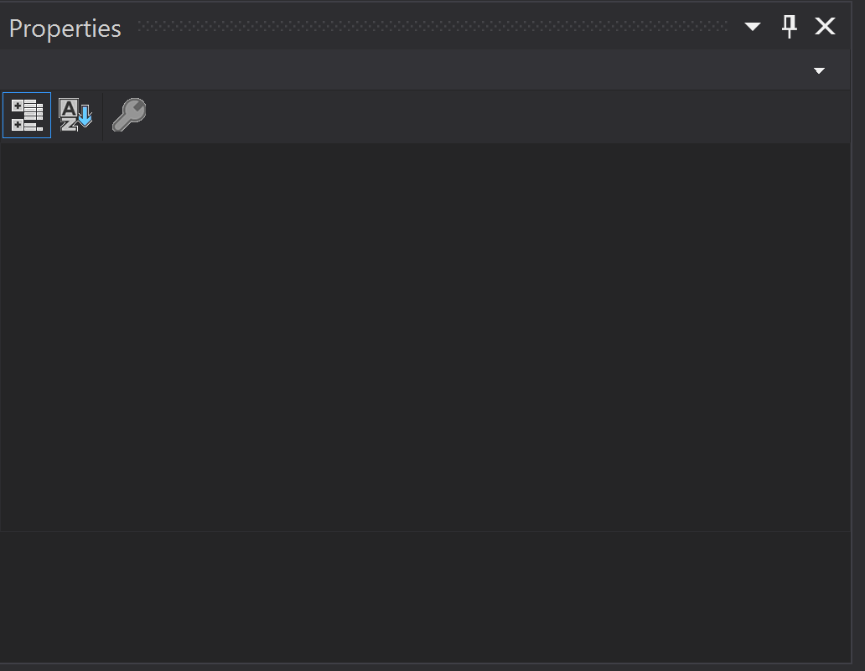
Visual Studio Properties Window
Output window will display important information the properties of User Interface components. During console applications this is not a very active window. However, when we moved to MVP and Web Application Development, this will become a very important window. For now, just remember that it is there and in the next lesson we will utilize it more.

Slide 32
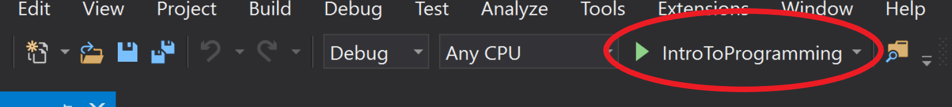
Running the Console Application
This toolbar is utilized to “Run” the program. It will act in a similar manner as double clicking on an application that is installed on a computer.
The two settings to the right of the green arrow are as follows:
Debug – This is a setting to attach a debugger to the program or run the program without debugging.
Any CPU – This is a setting to target “Any CPU”, “x32”, or “x64”. This becomes relevant when applications begin to utilize a large amount of RAM as an operating system that is “x32” has a maximum RAM limitation of 3GB. “x64” operating systems are not limited by this.
Shortcut Key: F5
S

Slide 33
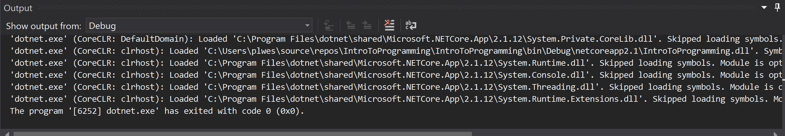
Visual Studio Output Window (Good build)
Note that after “Running” the application the Output Window now shows a considerable amount of information. Due to the nature of a Console Application, most of the debugging setup is skipped as it is not relevant and not necessary. However, if there are errors, this is where they would show.

Slide 34
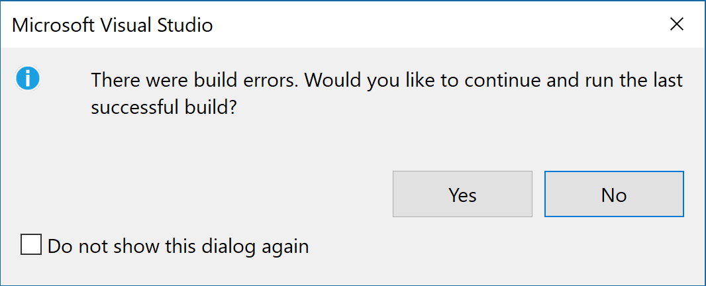
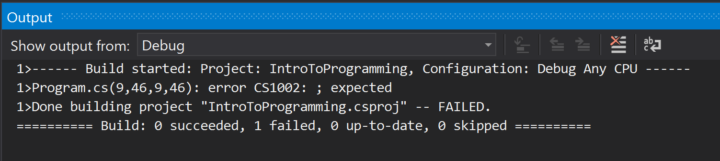
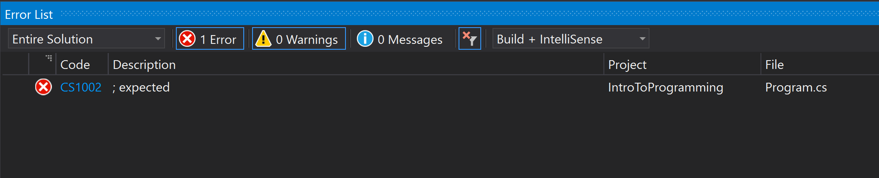
Visual Studio Output/Error Windows (Failed Build)

Slide 35
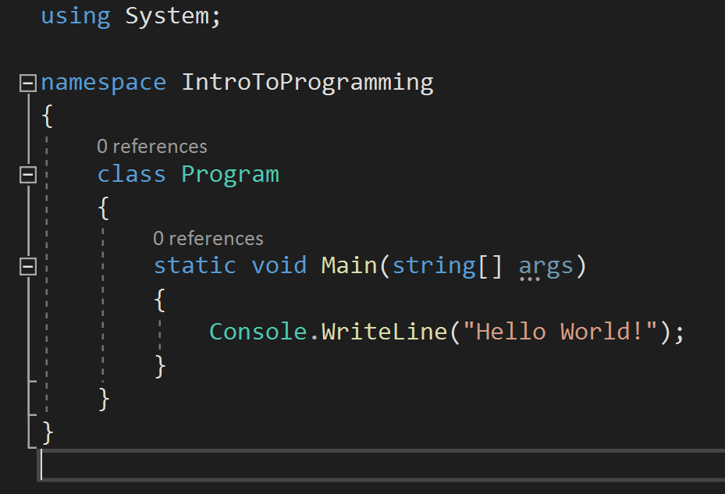
Basic Program Breakdown
The using keyword has three major uses:
The using statement defines a scope at the end of which an object will be disposed.
The using directive creates an alias for a namespace or imports types defined in other namespaces.
The using static directive imports the members of a single class.

Slide 36
Basic Program Breakdown
The namespace keyword is used to declare a scope that contains a set of related objects.
You can use a namespace to organize code elements and to create globally unique types.

Slide 37
Basic Program Breakdown
The Main method is the entry point of a C# application.
When the application is started, the Main method is the first method that is invoked.
There can only be one entry point in a C# program. (This is an exception, but is beyond the scope of this class)

Slide 38
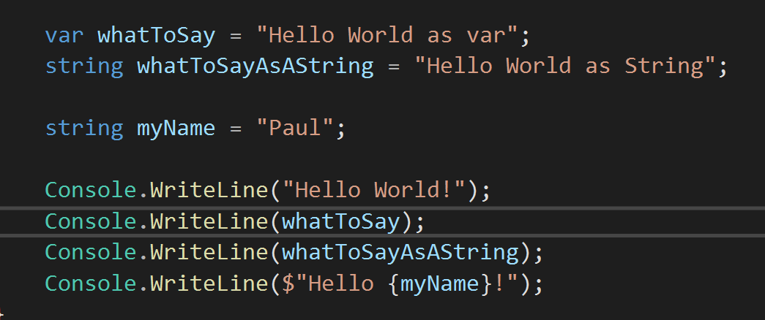
Introduction to Variables (var and string)
var keyword can be used to create a “variable” that is made into the type on the right side of the “=“.
string is used to STRONLY type a variable. This means that what is on the right side MUST be a string.
The “$” in “Console.WriteLine($”Hello {myName}!”);”allows for easy access to variables to make more complicated and dynamic strings.

Slide 39
Introduction to Variables (var and string)
var keyword can be used to create a “variable” that is made into the type on the right side of the “=“.
string is used to STRONLY type a variable. This means that what is on the right side MUST be a string.
The “$” in “Console.WriteLine($”Hello {myName}!”);”allows for easy access to variables to make more complicated and dynamic strings.

Slide 40
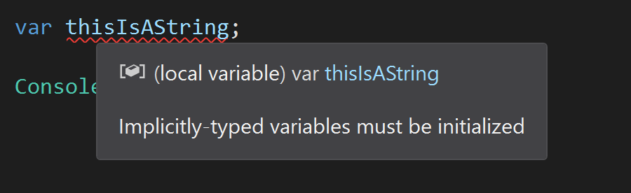
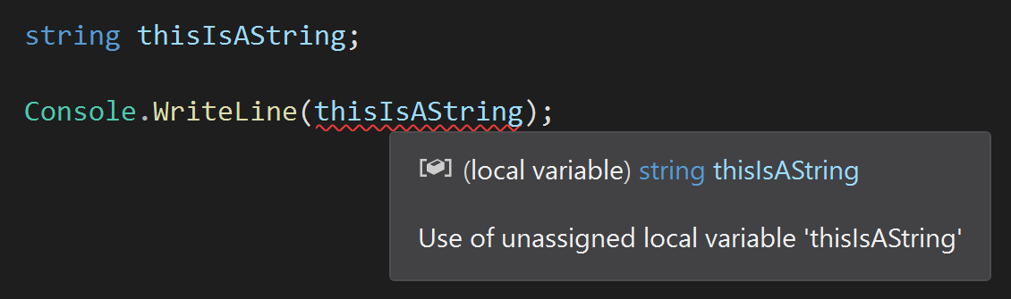
Introduction to Variables (var and string)
1
2
When specifying a var, it MUST have something assigned to it. This tells the “compiler” what “type” the var is going to be.
If a strongly typed variable is declared, then it must be assigned a value before it is used.

Slide 41
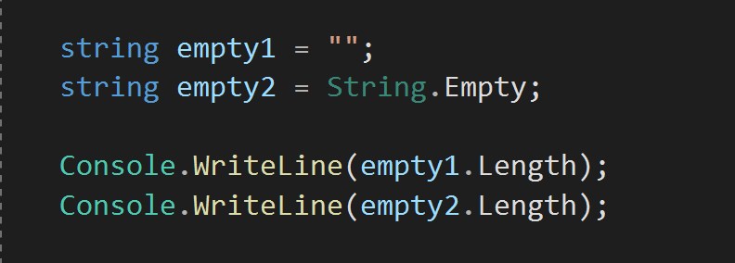
Strings with No Length
If a string that is not NULL needs to be created, there are two ways
Assign the string a value of “”
Assign the string a value of “String.Empty”

Slide 42
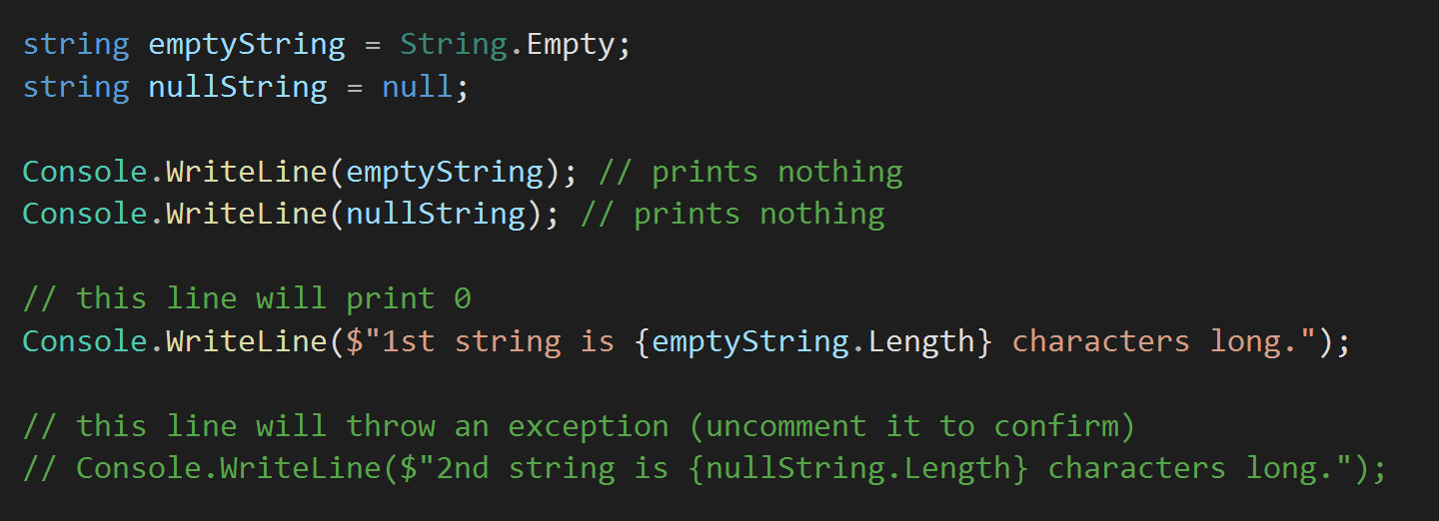
Zero Length VS Null String
Note that we cannot use the “.Length” command on a null string.
Run the program with the 2nd string line commented out, then run it with the 2nd string uncommented. The second will return a null exception.

Slide 43
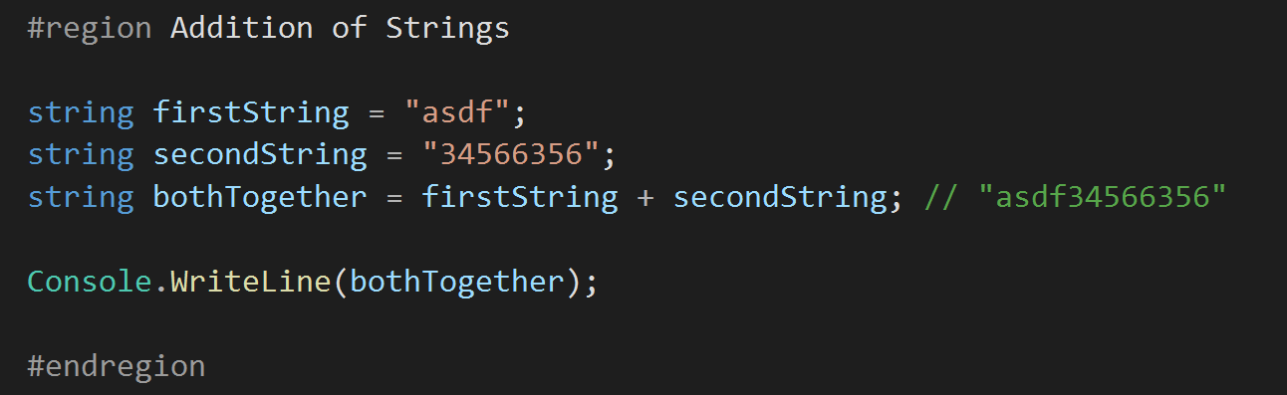
Addition of Strings
Additions will place two strings together.
Note that subtraction, multiplication and division will not work with strings.

Slide 44
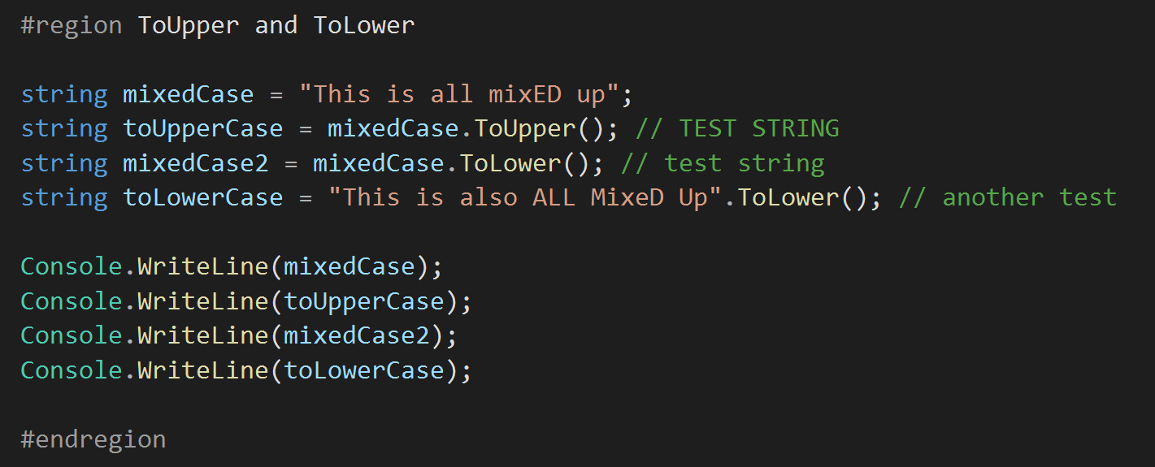
String.ToUpper() and String.ToLower
Strings can be formatted in different ways with different commands
ToUpper() – will make all characters UPPERCASE.
ToLower() – will make all characters lowercase.

Slide 45
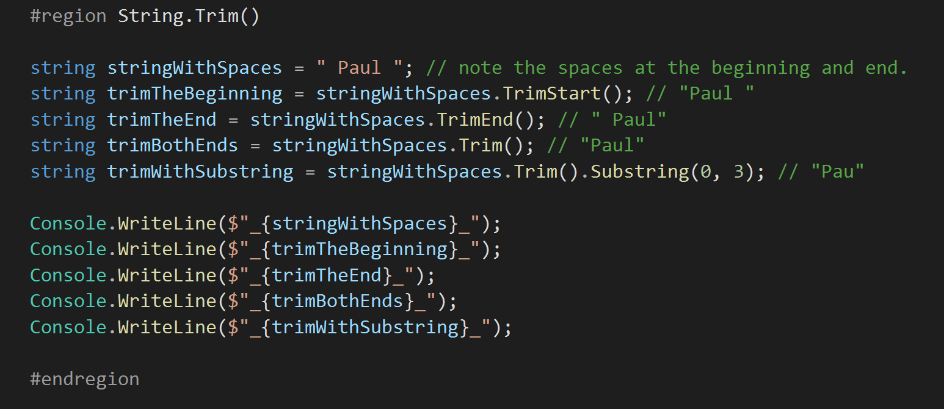
TrimStart(), TrimEnd(), Trim() and Substring(start, length)
Strings can be trimmed on either or both ends to ensure no whitespace is present.
Parts of strings can be extracted to get specific parts. Please note that the second argument is the LENGTH of the string you want and not the ending index.

Slide 46
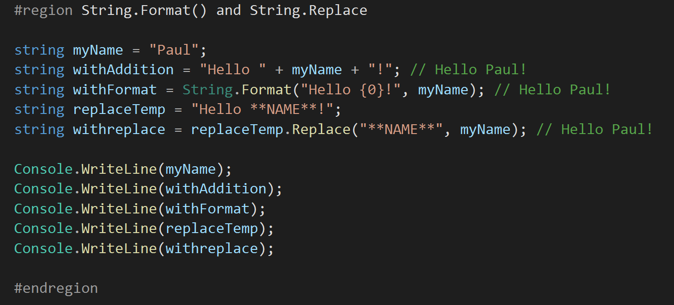
String.Format(string, string), String.Replace(string, string)
Format(string, string) can be used to create complex statements that take variables to replace the “indexes”.
Index starts with {0} and there must be the same number of variables and indexes. Thus, String.Format(“Hello {0} and {1}”, myName); will error.
Format(string, string) can be used to replace specific parts of a string with a different string. Avoid using this at all costs as it can be difficult to get correct and can cause unwanted errors in larger applications.

Slide 47
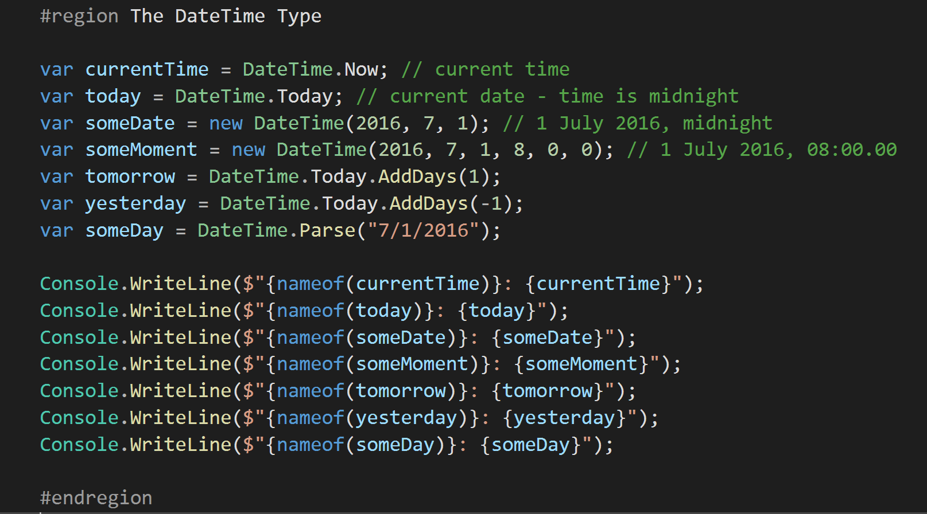
The DateTime Type
DateTime is a built in DataType for C#
It allows for easy access to commonly used Date and Time functionality

Slide 48
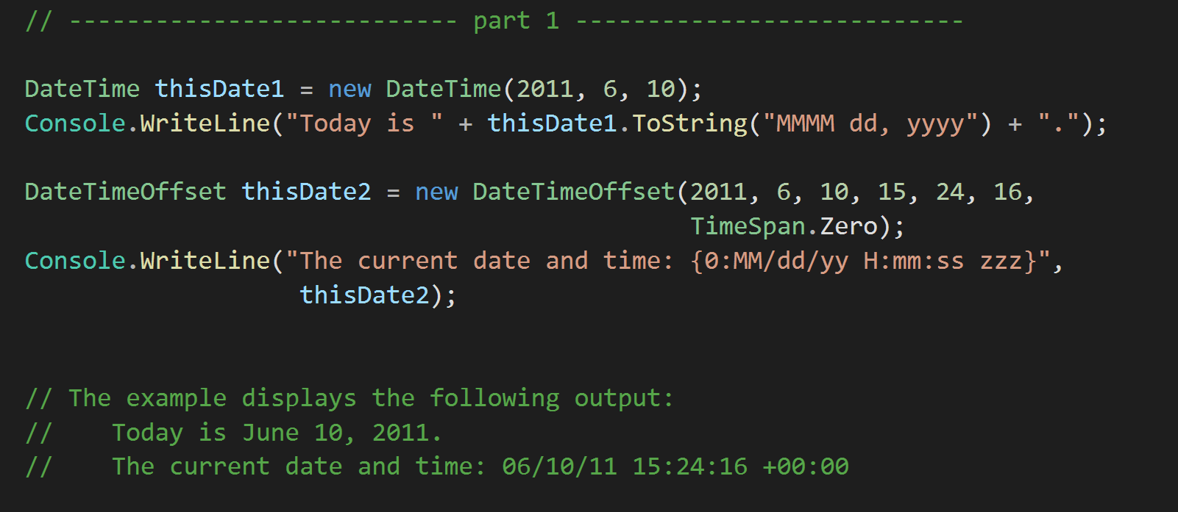
Formatting Dates and Times
When using a DateTime variable with the ToString Method, we can format the final outcome of the date in many ways. This is the most commonly used way of formatting string based outputs that contain dates.

Slide 49
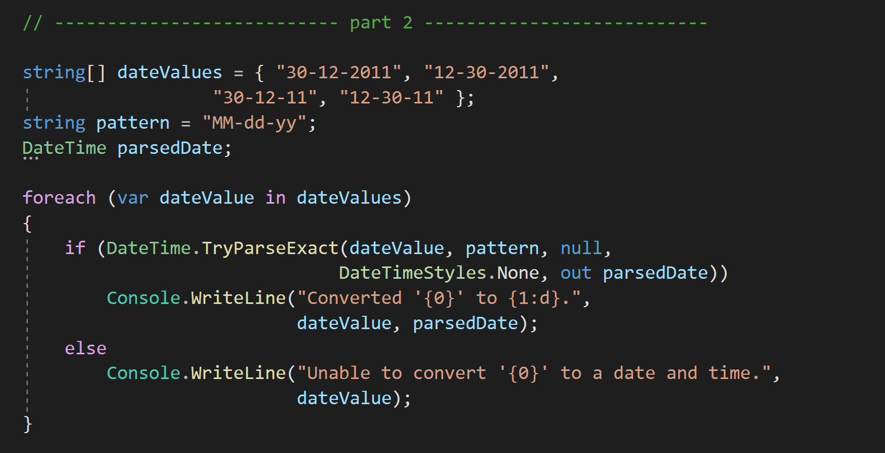
Formatting Dates and Times
Since different regions of the world format their dates differently, it’s also important to be able to “ATTEMPT” to parse a date that may fail. The “TryParseExact” is a method that we can use for this.
If successful, the “out parsedDate” will contain the formatted date and a true value will be returned from the method. If it fails, the “out parsedDate” will remain null and the method will return false.
This allows us to use this method in a logical expression to determine how to parse dates, or throw exceptions or handle the date in another manner.

Slide 50
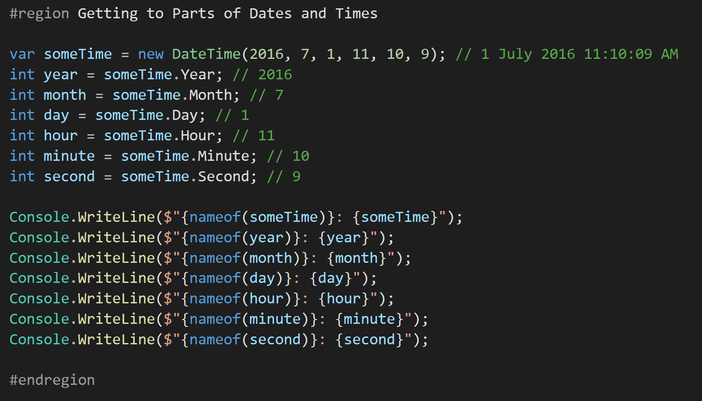
Getting to Parts of Dates and Times
It can be very handy to be able to pick out a particular part of a DateTime. We do not always need the entire date, but only a portion of the DateTime variable.
This also converts the return of the DateTime part into an int variable type that can be used to do Mathematical calculations for a date.

Slide 51
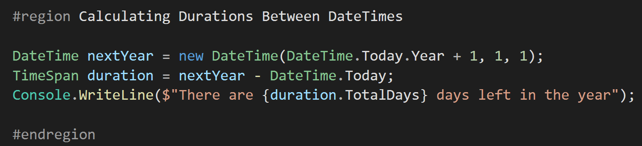
Calculating Durations Between DateTimes
There will be times that calculating the interval between times is important. This is a valuable tool when doing analytics that are based on timeframes.

Slide 52
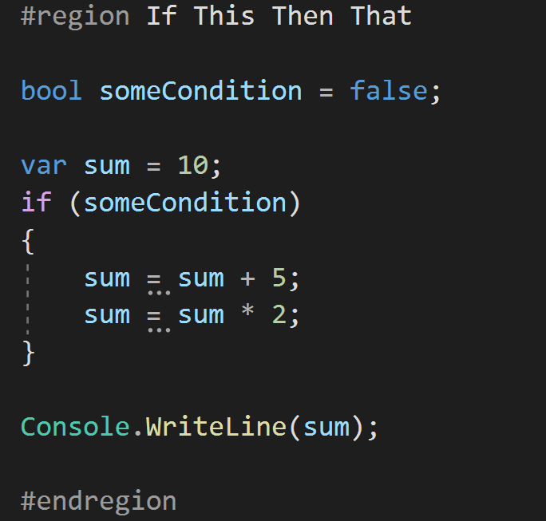
If This… Then DO That!
The most basic of conditional statements is the “if” statement.
It allows us to make a logical decision based on a condition. In the case above, if “someCondition = true” then the code inside the if { } will be executed.

Slide 53
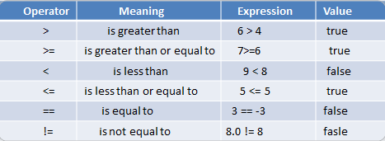
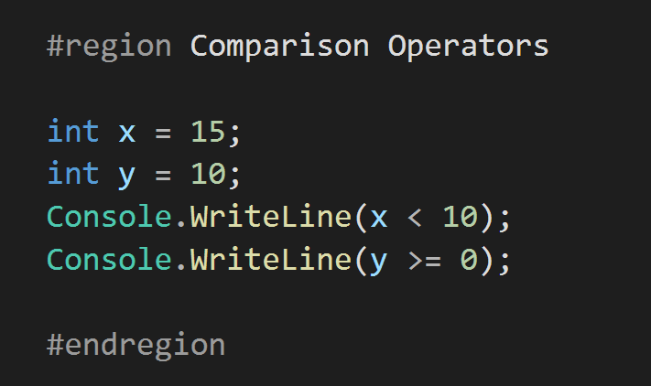
Comparison Operators
When comparing two items Comparison Operators are utilized.
The table above express a direct relation between the two objects being compared.
These are NOT limited to just int but can be used to compare any two objects, even Classes and complex objects.

Slide 54
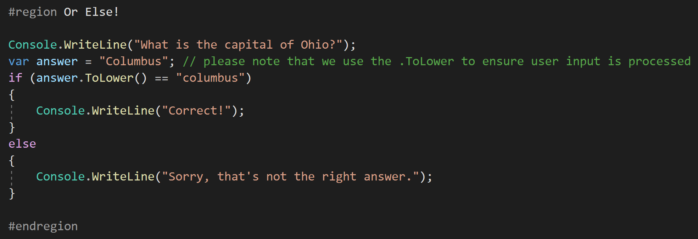
Or Else!
To extend the “if” statement to allow for a clause condition, the “else” statement is used.
This means that if the “if” condition is met, the “if” code will be executed. If it is not met, the “else” code will be executed.

Slide 55
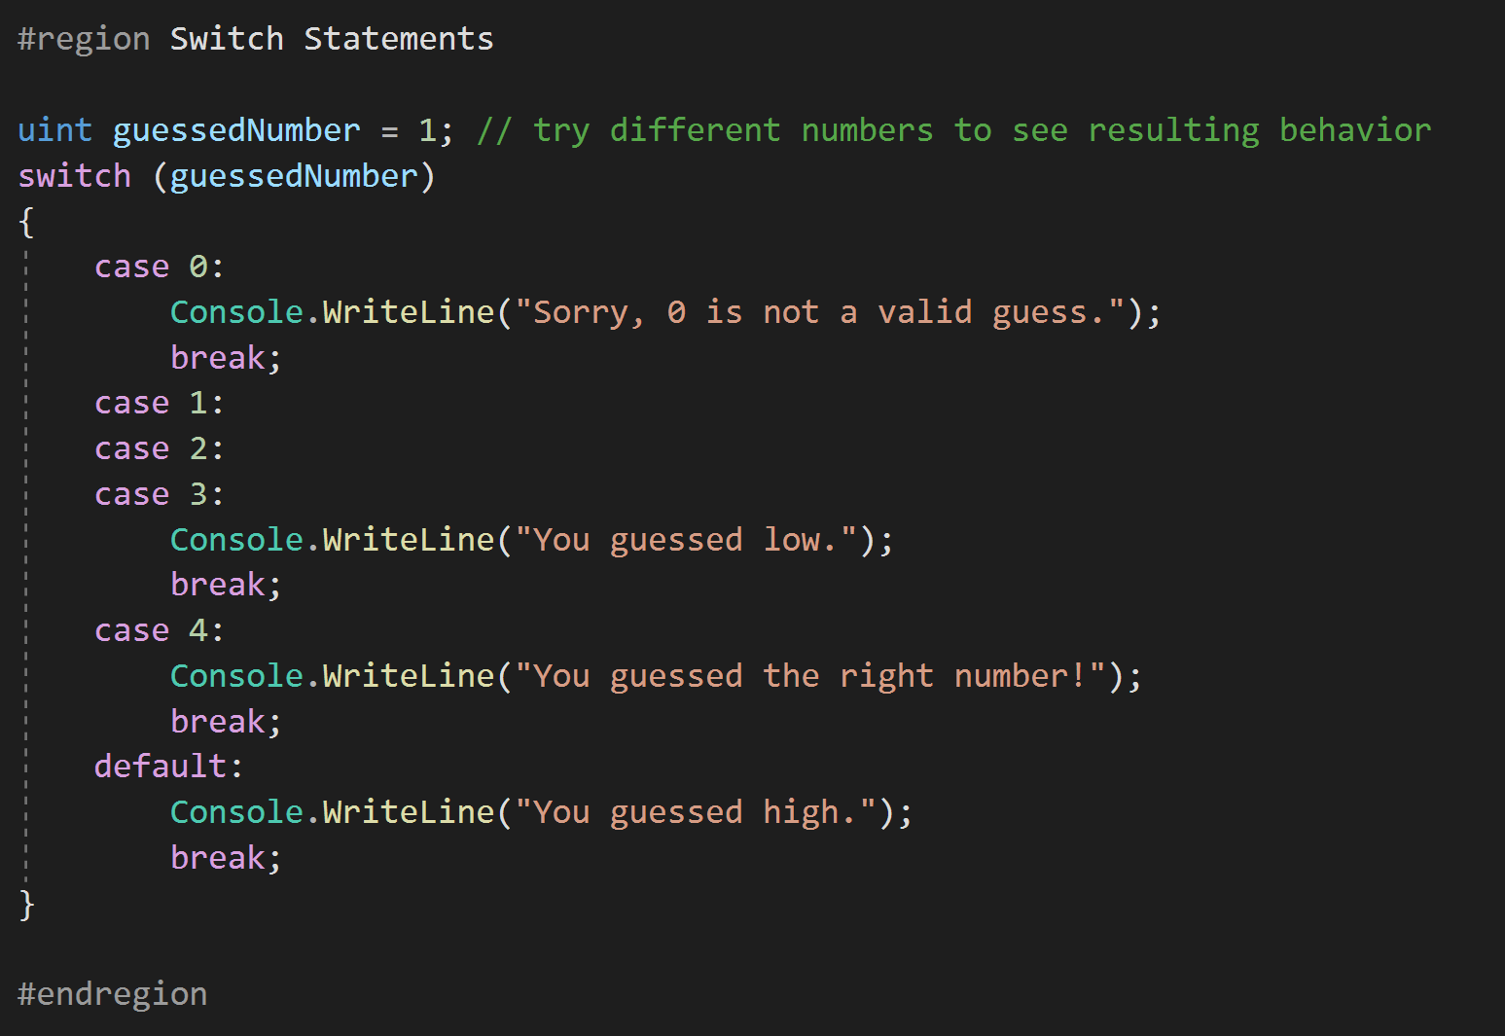
Switch Statements
When there are multiple “states” that need to be checked to determine the final block of code that needs to run, the “switch” statement is used.
This allows for different value conditions for a specific condition.

Slide 56
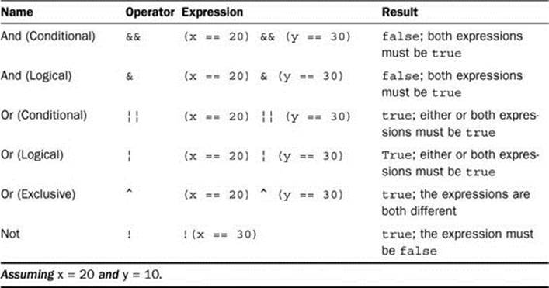
Logical(Conditional) Operators
When making complex logical decisions, Logical Operators are used. They are composed of simple operations that check the “True/False” state of both the left and right side and return a value according to the operator in use.
These are used widely when two separate larger operations are preformed and the results of those operations return a bool value. The two operations results will then be used to make a logical decision in a conditional statement such as an “if..else” statement.

Slide 57
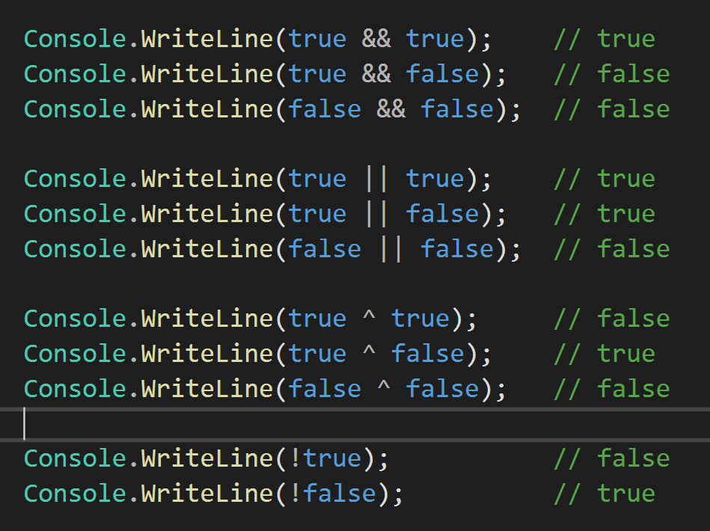
Logical(Conditional) Operators
Results from basic True/False bool values used with the Logical Operators

Slide 58
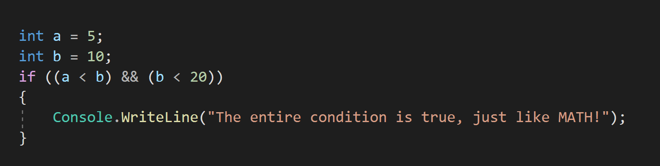
Logical(Conditional) Operators
Basic examples of the Logical Operators in use to determine if something should be written to the Console.

Slide 59
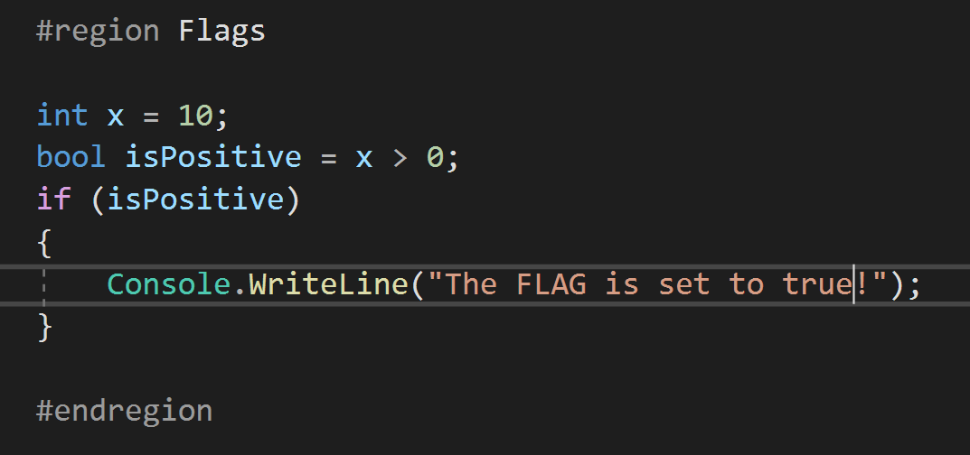
Flags (i.e. bool variables)
Many times bool variables are used as “FLAGS” or “SWITCHES” to turn on and off specific blocks of code at specific times.

Slide 60
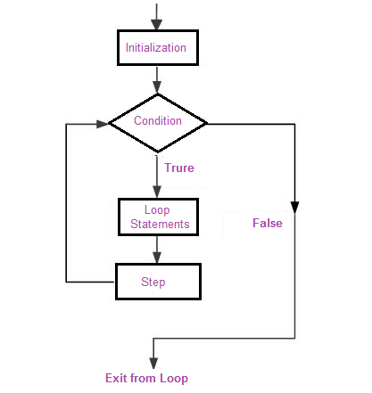
Looping Based on a Logical Expression
Being able to execute a specific block of code repeatedly given specific conditions is necessary.
Let’s say we need to print a list of items. Instead of writing a line of code for each item (which we may not know how many items there really are), we use looping and conditionals to solve a complex problem in a simple way.

Slide 61
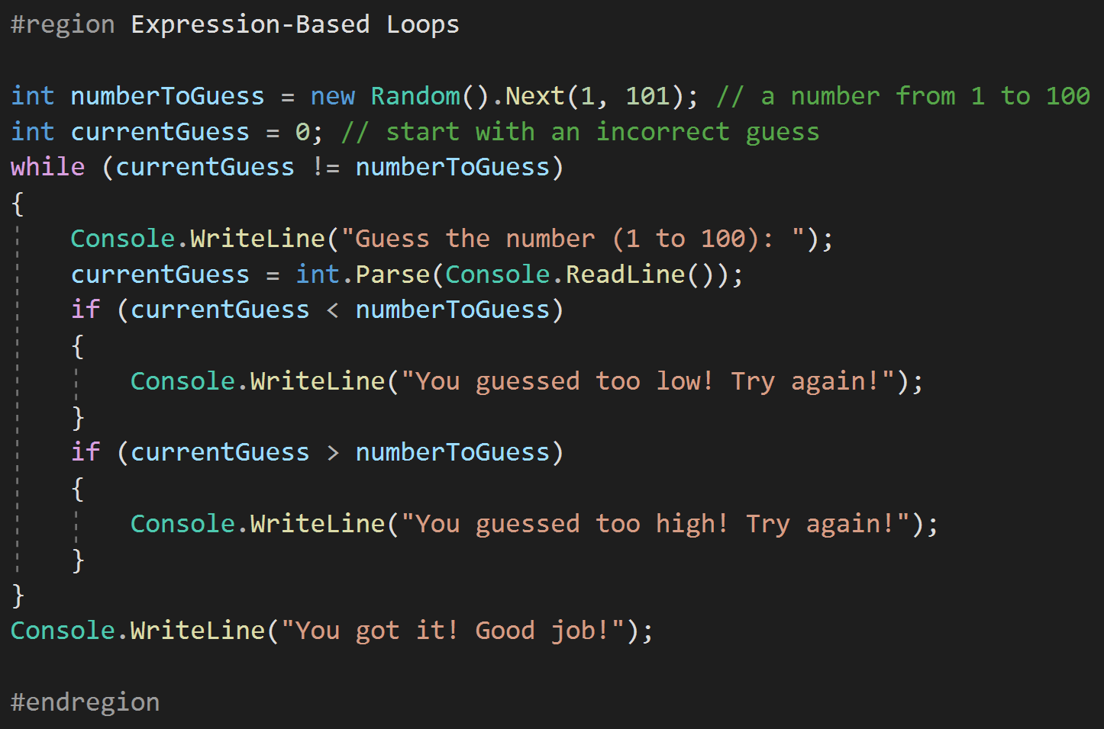
Expression-Based Loops
The while loop is used to ensure that an operation is performed until a condition is met, and then the operation stops.
The while can be placed at the beginning or the end of the loop. When placed at the end, the loop statements will be executed at least one time.

Slide 62
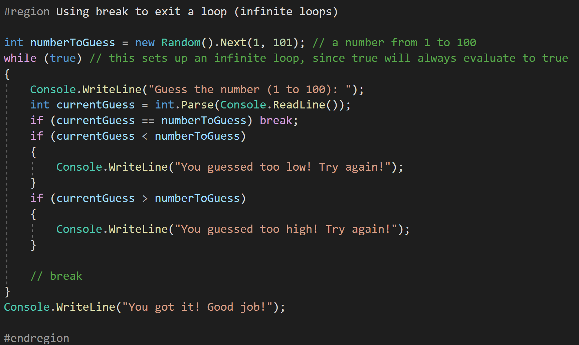
Using break to exit a loop (infinite loops)
A potential hazard with loops and conditions is when the condition never reaches a state of “false”. This will create an infinite loop.
The break statement can be used to forcefully exit a loop statement block.
Break is not typically used, but good programming practices ensure conditions will be met, or a final condition will always result to ensure loop termination.

Slide 63
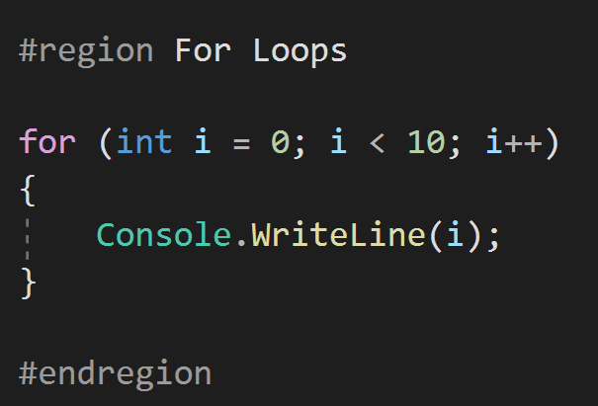
For Loops – When we want to do something (n) number of times.
A simple statement that executes the code between the {} when “i“ is from 0-9 (10 times due to the “off by one” problem).

Slide 64
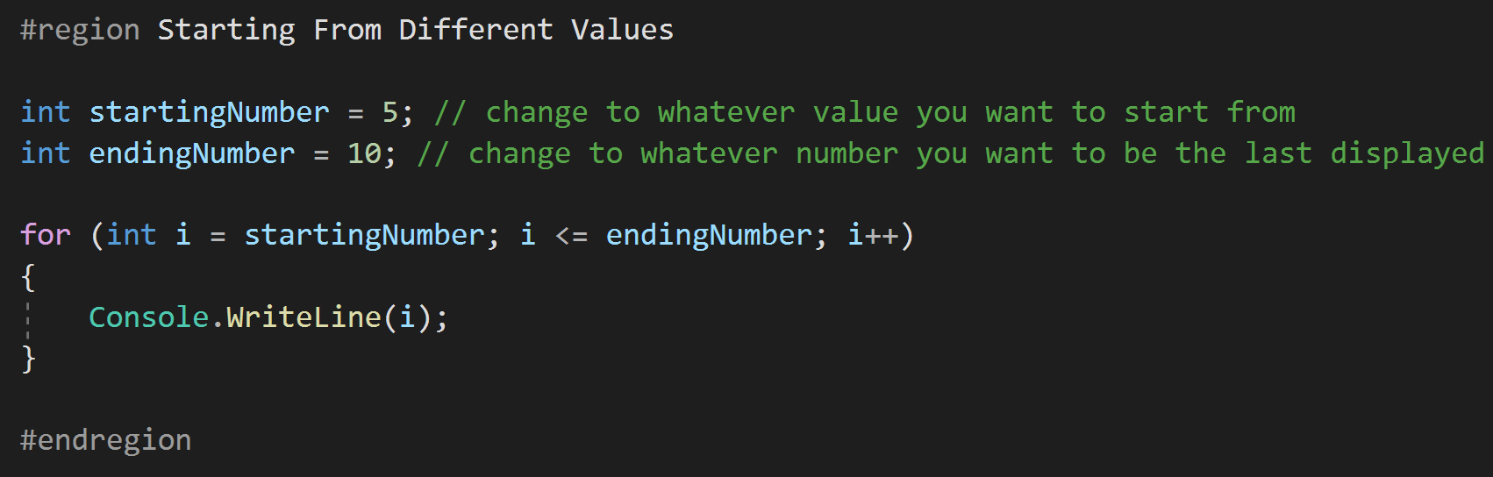
Starting From Different Values
We are not limited to starting at 0, but can use all types of numbers and variables to setup the conditions for a for loop.
This is not limited to just creating the variable in the loop start, but can be used with variables outside the scope of the loop as well.

Slide 65
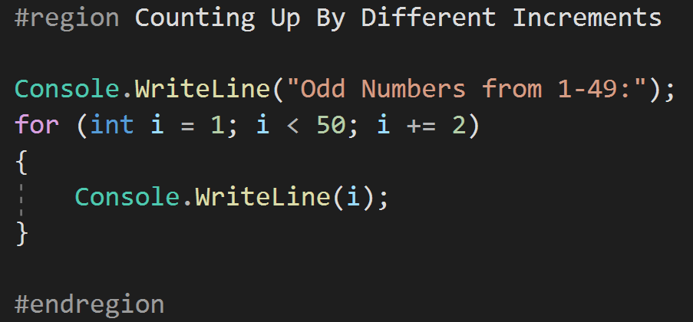
Counting Up By Different Increments
We are not restricted in the operation used to increase our count variable, but can create complex algorithms if necessary to function as a counter.

Slide 66
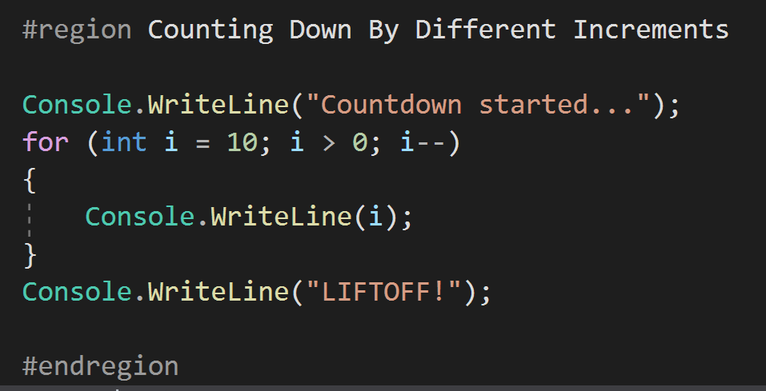
Counting Down By Different Increments
We can also count down. Again, the counting algorithm can be of any variety as long as we use good practices to ensure that the “middle” condition will be met at some point so the loop does not become infinite.

Slide 67
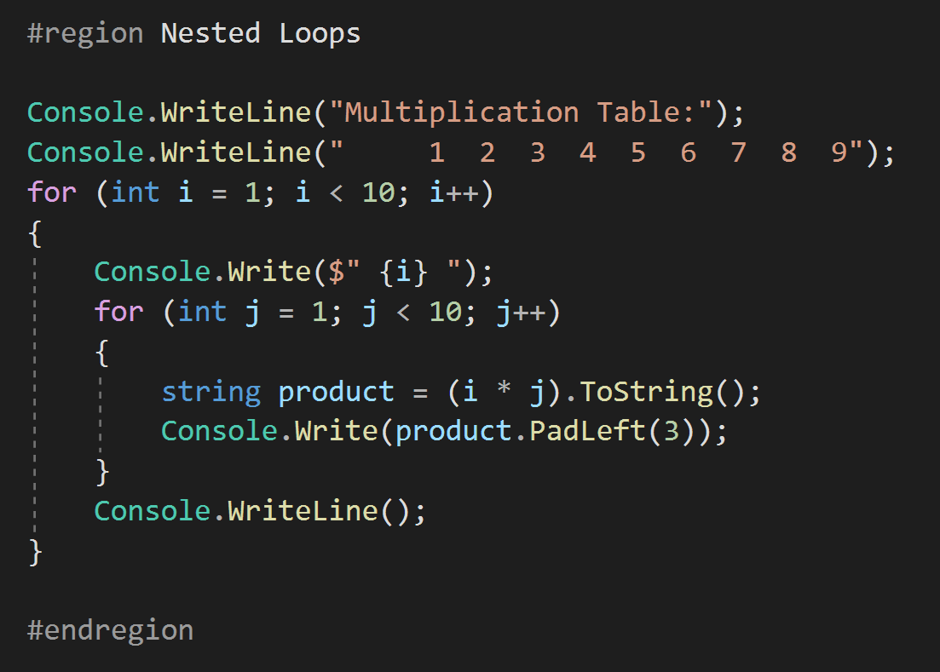
Nested Loops
Loops can be placed inside other loops to create complex operations.
This can be good, but nesting too many loops is a bad practice and difficult to debug.
The only restriction is that the scope of a variable must be assigned to a specific loop. In the case above, “i“ is used for the outer loop and “j” is used on the inner loop. This is a standard practice to start with “i“ and move up the English alphabet.

Slide 68

Creating Arrays
An array is a programming “object” or construct to store a series of the same type of object. These can be integers, strings, other arrays, or any type of class.
Object is the “BASE” class of all things created in .Net, and this means an array can store a list of ANYTHING, even a list of programs themselves.

Slide 69

Multi-Dimensional Array
Arrays are not limited to one dimension such as a shopping list for groceries.
Arrays can be any number of dimensions and are used extensively with mathematical operations in linear algebra where multiple variables can be tracked for Matrix calculations.
In this example, we create a 2-dimensional array. The array physically would be 2 columns with 6 rows.
Example 2 in the code shows the use of a 3 dimensional array. Anything beyond 3 dimensions is hard to represent physically, but mathematically it is viable.

Slide 70

Working with Arrays
Working with arrays is straightforward. To access a “cell” we need only select the appropriate index.
With multi-dimension arrays there is a hazard of mixing up which index is which and getting the wrong value.

Slide 71

Arrays and Strings
There are many operations that we can use when we have arrays of string values.
Two of the most common are Split and Join, however, there are others that may be used depending on the situation. We will cover these as needed through the rest of the course.

Slide 72

Creating Lists
Lists are very similar to Arrays, but offer many more functions such as sorting, removal and insertion.
Due to the additional “overhead” that lists have they do perform slower than Arrays, however, under 90% of all cases the performance reduction will not be a factor in determining to use them over an Array.
Lists will be the most commonly used “Collection” used in C# and .Net

Slide 73

Working with Lists
As stated before there are many additional operations that can be performed on Lists over Arrays.
This makes them the ideal “Collection” to use for many storage operations.
Note the difference between the Array.Length and the List.Count (this can confuse new programmers when they are working with both Lists and Arrays)

Slide 74


Working with Lists (ForEach)
Two important operations that are commonly used with Lists are the foreach and String.Join(string, List<type>).
These are built into the List Class and are one of the many features that Lists have that Arrays do not.

Slide 75

Other Options (for)
We are not limited to the foreach method of processing a List, but can again use the for loop with the “Count” of the List we are wanting to loop through.

Slide 76

Other Options (while)
We are not limited to the foreach method of processing a List, but can again use a while look with the “Count” of the List we are wanting to loop through.

Slide 77


Declaring and Calling Methods
Declaring a method is as simple as creating a “signature” and writing what the method does.
Calling the method is as simple as having another part of code use the “signature” created to execute the code in the method.

Slide 78


Declaring and Calling Methods with return types (Includes Overloaded Methods)
Some methods will return a value after performing an operation.
The “type” of variable returned is the “return type”
Remember, .Net is a “strongly” typed language. Everything needs a type.

Slide 79

Lambda Expressions
Lambda expressions are shortcuts for doing simple operations either through a “Func” or “Action”
A “Func” will have 2 arguments, the first is the input and the second is the return type
An “Action” will have only 1 argument and will have no return type.
Both “Func” and “Action” are types and can be passed to methods through arguments. This can allow for dynamic internal execution of code based on what is passed to a method. This is a more advanced topic than this lesson and will be covered in more detail in later lessons.

Slide 80

Lambda Expressions (Part 2)
Lambda expressions can also be used directly to create new “Func” or “Action” variables. This means that with proper construction complex and dynamic methods can be created from smaller pieces with little work.
In this example we use two small “Func” to create a more complex “Func”. The possibilities are endless, especially when we consider we can pass these as arguments to other methods that can be used to construct large operations based on the state of a given system.

Slide 81


Extension Methods
Extension methods are used to extend the functionality of the classes in .Net to provide functionality that will be used repeatedly without having to write the same code many times.
In the example, we have extended the int type to add 5 with the .PlusFive() extension method.
Note the signature of the extension method… (this int input);
Extension methods are declared outside of other classes and are always static.

Slide 82

LINQ Operations
LINQ (Language Integrated Query) is uniform query syntax in C# and VB.NET to retrieve data from different sources and formats. It is integrated in C# or VB, thereby eliminating the mismatch between programming languages and databases, as well as providing a single querying interface for different types of data sources.
Basically, it’s SQL for .Net, we can perform many operations on Lists with LINQ.
Count, Any, All, Where, Skip, Take, and Select are common operations.

Slide 83

LINQ Operations

Slide 84

LINQ Operations
With LINQ we can perform many demanding operations inline to create code that is easily readable.
One of the characteristics of a good programmer is that comments are considered to be secondary. This is because the code will be written in such as way that the code itself is the comments. With LINQ we can make it even easier for someone that did not write the code to read the code and understand what it does without comments.
Writing code that is readable like an instruction manual is considered a good practice, so naming conventions are VERY IMPORTANT!

Slide 85

LINQ Finding One Item in Collections firstOrDefault
firstOrDefault – This will allow us to select the first (or only) item in a list created from a LINQ statement.
We use firstOrDefault when you know that you will need to check whether there was an element or not. In other words, when it is legal for the sequence to be empty. You should not rely on exception handling for the check.
Note, setting up default values for Lists is beyond the scope of this lesson, but will be covered at a later time in this course.

Slide 86
LINQ Finding One Item in Collections lastOrDefault
lastOrDefault – This will allow us to select the last(or only) item in a list created from a LINQ statement.
We use lastOrDefault when we need to find the last element in a collection that matches a condition. We get either the last matching element or the default value.
Note, setting up default values for Lists is beyond the scope of this lesson, but will be covered at a later time in this course.

Slide 87

LINQ Finding One Item in Collections singleOrDefault
singleOrDefault – This will allow us to select the ONLY item in a list created from a LINQ statement.
This statement is used when ONLY one result from a LINQ is expected.
IF more than one result is retured from the LINQ, singleOrDefault will throw and exception.
This is used almost exclusively when a default value has been established. Therefore no exceptions will be thrown.
Note, setting up default values for Lists is beyond the scope of this lesson, but will be covered at a later time in this course.

Slide 88

LINQ Conversion of Lists
Using LINQ we can convert one type of List to either another type of List or an Array.
This can be used when we want to perform heavy operations on a large list without the performance hit from using a List to do the operation.
First, Convert the List to an Array
Then, perform the desired operation
Finally, remove the reference to the Array if it is no longer needed (for memory resource reasons)

Slide 89

Exception Handling Basic Try/Catch
It is always good to ensure we do not make mistakes in our code, handling exceptions is an important part of ensuring that a program does not “CRASH”
NOTE: We want to avoid exception handling by creating clean code that does not “crash” due to the large amount of computer resources that it takes to create an exception. Therefore, situations where try/catch blocks are in loops are not considered good practices.

Slide 90
Exception Handling Basic Try/Catch
It is always good to ensure we do not make mistakes in our code, handling exceptions is an important part of ensuring that a program does not “CRASH”
NOTE: We want to avoid exception handling by creating clean code that does not “crash” due to the large amount of computer resources that it takes to create an exception. Therefore, situations where try/catch blocks are in loops are not considered good practices.

Slide 91

Exception Handling Throwing Exceptions again (Bubbling up)
Using “nesting” we can “bubble up” and exception from deep within the execution of a program to the top most layer.
With the current example it is difficult to understand, but when many classes and methods are being executed one after another, it can be important not to lose which method or class is at fault for creating an error. “Bubbling up” can help with this, but needs to be considered as a potential bad practice if done extensively.

Slide 92

Exception Handling Custom Exceptions
As a programmer we can “throw” our own exception at any time. This can sometimes be used to ensure critical parts of a system operate as expected and when they do not, a custom exception can be created and thrown. This will be used to help pinpoint error location and help with ensuring easy maintenance on a system.

Slide 93

Exception Handling Finally Block
The finally block of a “try/catch/finally” will ALWAYS execute, even if an exception is not thrown.
This is critical for performing some actions that MUST take place regardless of if a block of code fails and throws and exception.
For example, freeing up and disposing of resources that could be critical for a system.
Another example would be to ensure that a system returns to a certain state after an operation, even if the operation was not successful.
Also, there are times when even within the catch block another exception occurs unexpectedly. The finally block will ensure that a set of code is always ran, no matter what.
The ONLY exception is a frozen system where the operation of the entire application has stopped.

Slide 94

Exception Handling Exception Filtering
Multiple catch blocks can be used to provide “filtering” to exception handling. This means that we can handle different exception types differently.
NOTE: There is a hierarchy of exception types that must be followed when setting up the different catch block order, else we may get unexpected results.
The order of these exceptions are not part of this lesson and should be researched independently if needed for real-world code.

