Slide 1
PIP2IT_Feb2019
Tracewin 5mA, 100k

Slide 2
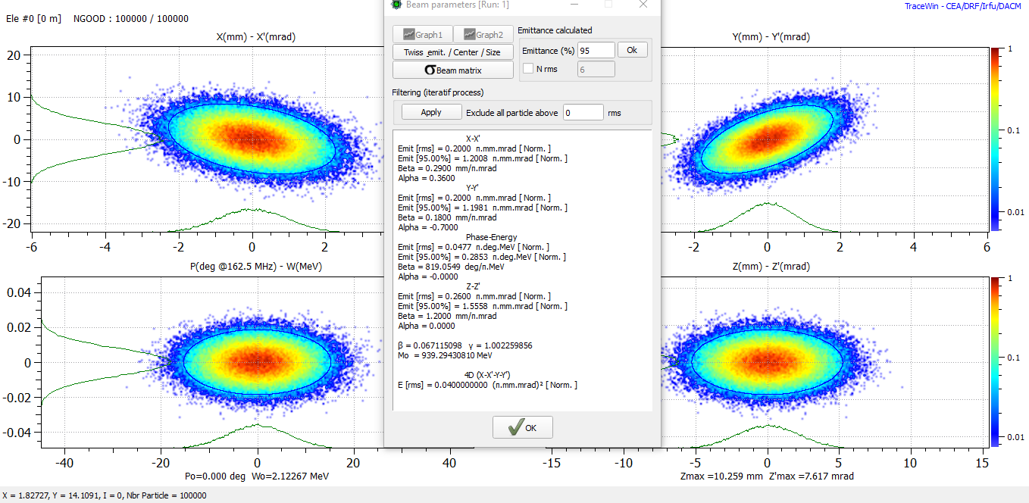
Input Distribution. 6D Gaussian. 5mA.

Slide 3
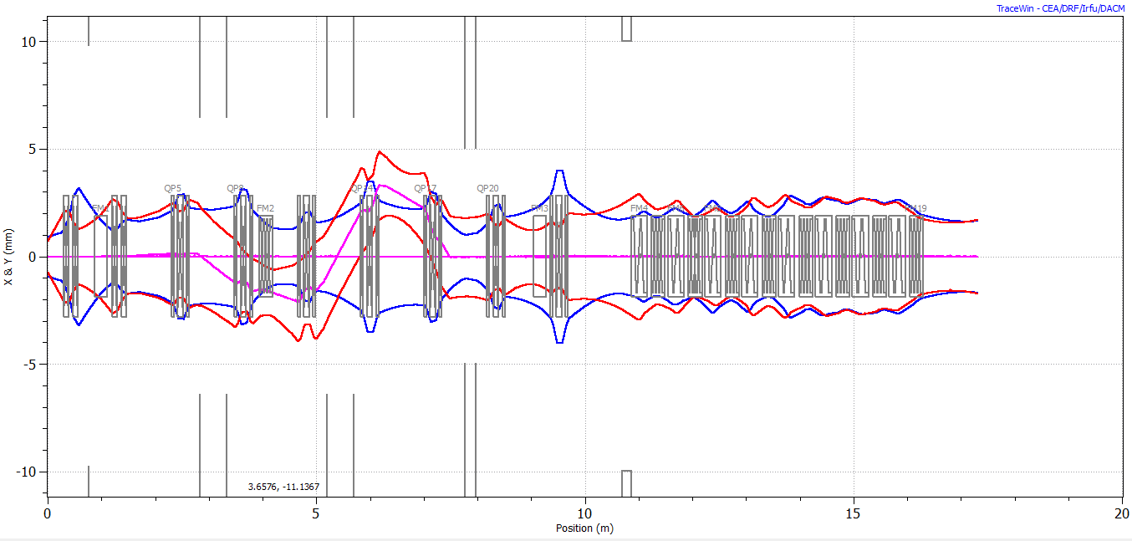
Envelope. With kickers on.

Slide 4
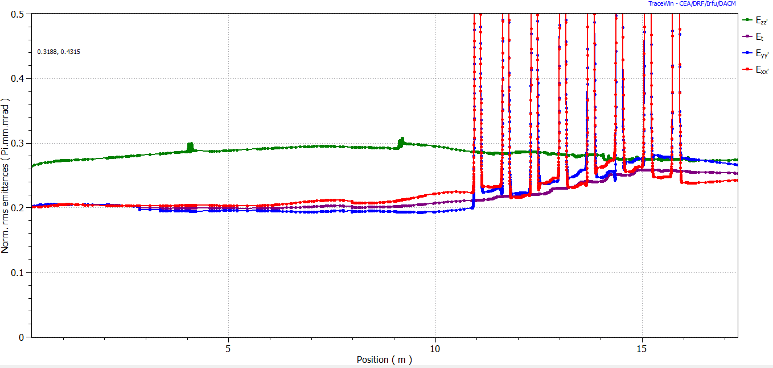
Emittance

Slide 5
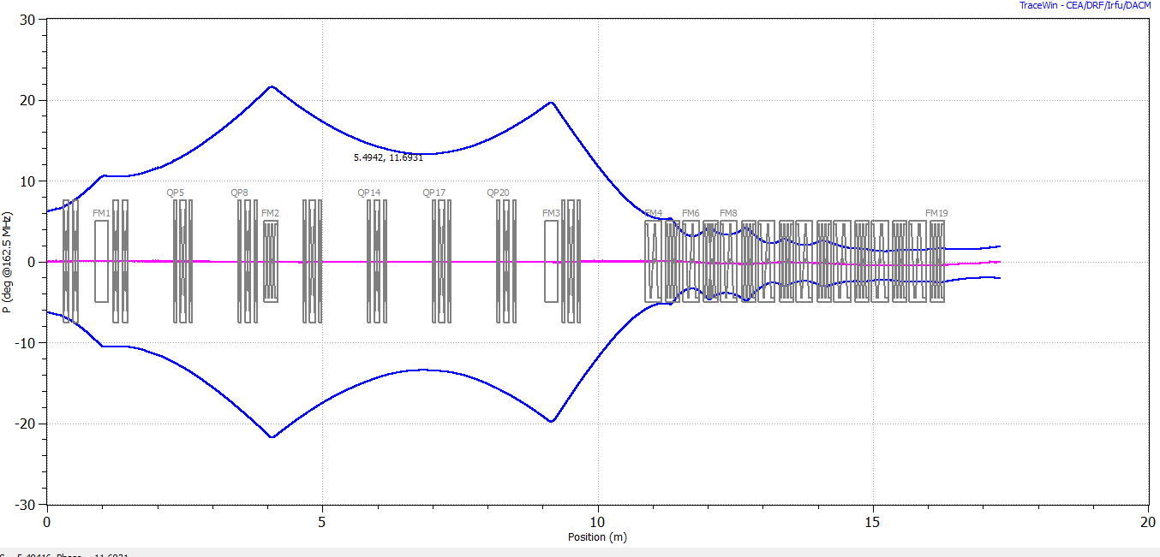
RMS bunch length

Slide 6
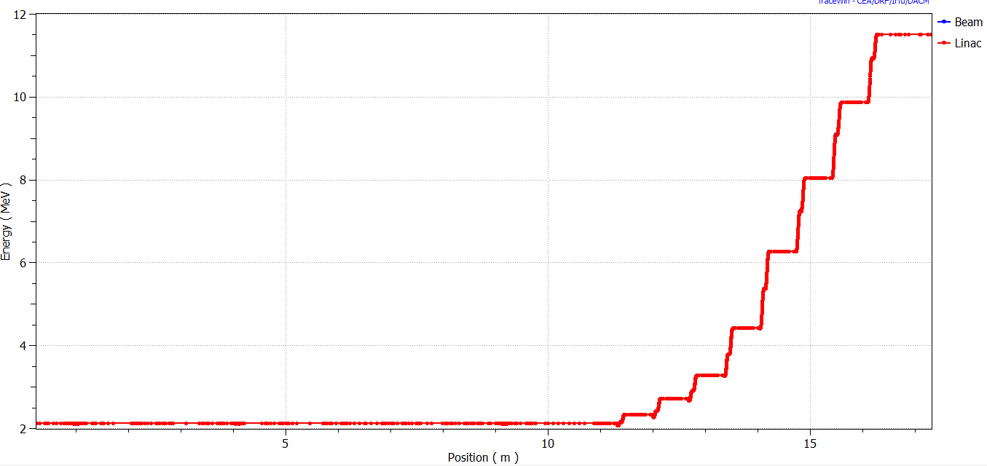
Energy

Slide 7
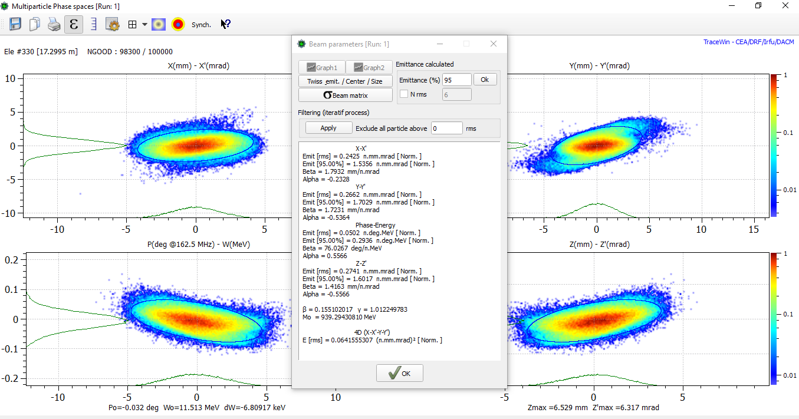
Output distribution. HEBT dump.

