Slide 1


MSc Thesis: Outline and Ideas

Slide 2




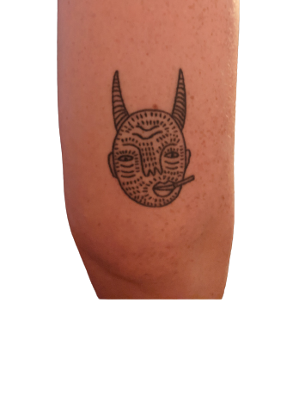




Where have I been?
2017 – Valenzano Lab
2018 – Biochemistry BSc
2019/20 – Coffee, Tattoos, Coding

Slide 3
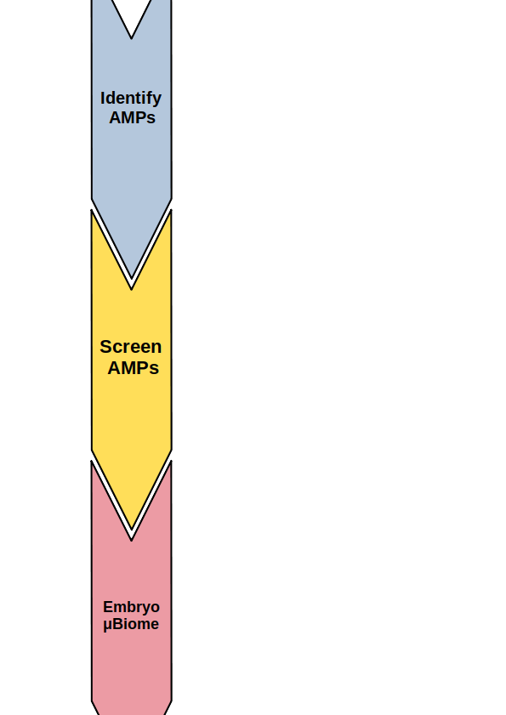
MSc Thesis Projects
1. Bioinformatic identification of Antimicrobial Peptides (AMPs)
2. Screening of AMPs v killifish microbiota isolates
3. Embryonic microbiota and AMPs
Notes:
1. Phylogentic response to immunisation
2. Vertical transfer of microbiota and immune states
3. Arabidopsis co-housing with killifish (development of model)
4. Multi-kingdom community dynamics
5. Microbiota Transfer - Antibody diversity & AMP expression

Slide 4
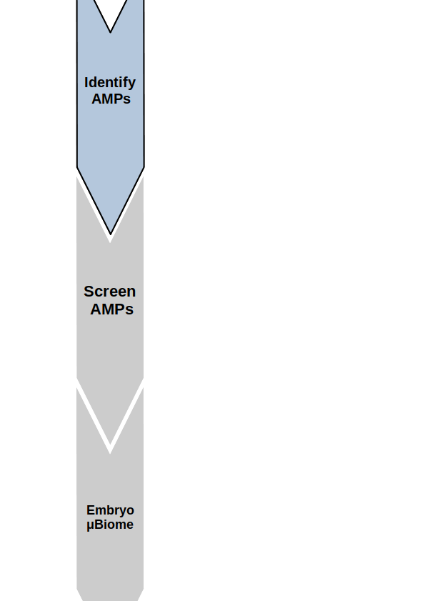
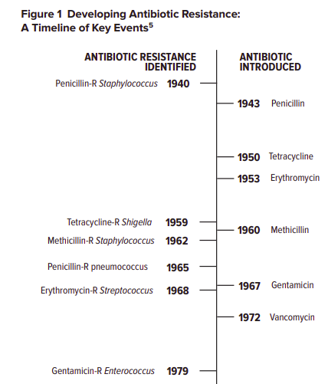
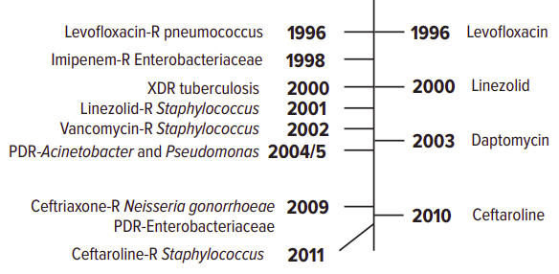
Antibiotic Resistance Crisis
1. Overuse & Misuse
2. Lack of new drug development
Notes:
The Antibiotic Resistance Crisis
Part 1: Causes and Threats
C. Lee Ventola, MS

Slide 5
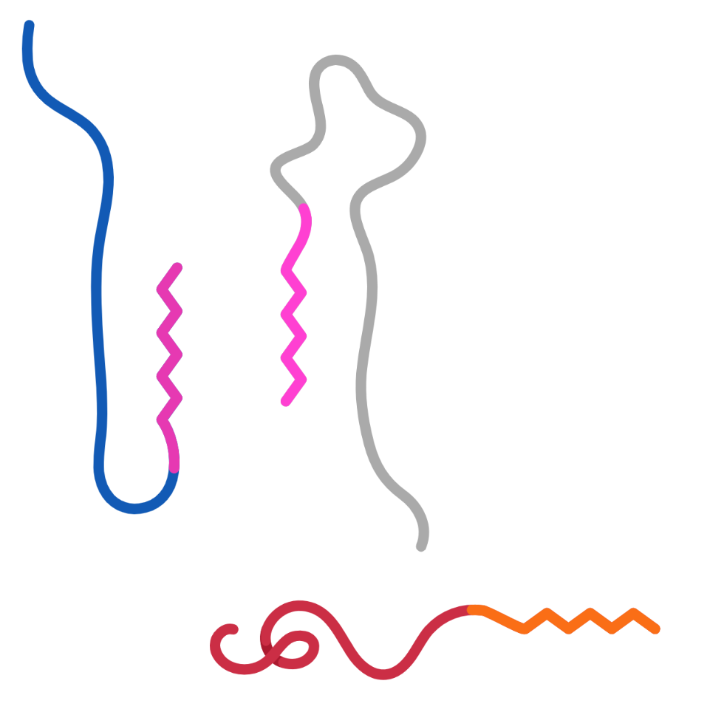
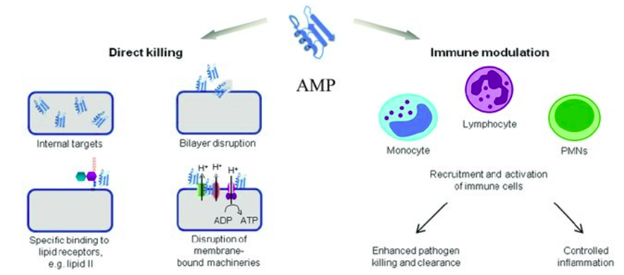
Antimicrobial Peptides: What Are They?
Direct killing
Immune Modulation (Indirect killing)
10-60 AAs
Notes:
Ulm, H.; Wilmes, M.; Shai, Y.; Sahl, H.-G. Antimicrobial Host Defensins—Specific Antibiotic Activities and
Innate Defense Modulation. Front. Immunol. 2012, 3, 249. [CrossRef] [PubMed]
Antimicrobial Peptides: Diversity, Mechanism of Action and Strategies to Improve the Activity and Biocompatibility In Vivo

Slide 6




Why use Killifish to study AMPs?
1. Unique evolutionary perspective
2. External fertilisation/ Annual
3. Untapped resource

Slide 7
1. Identifying AMPs: Questions
1.1 Does AMP diversification across killifish phylogeny follow genetic distance?
1.
1.2 Are there subfamilies of AMPs that expand/contract across killifish phylogeny?
1.3 Do environmental factors (e.g rain/drought) correlate with AMP evolution?
Notes:
1.4 Does AMP expression change with age? Need transcriptome
1.5 Can we measure AMP diversity? Does AMP diversity change with age?
1.6 Selection – do species select actively/differently from a shared pool?

Slide 8
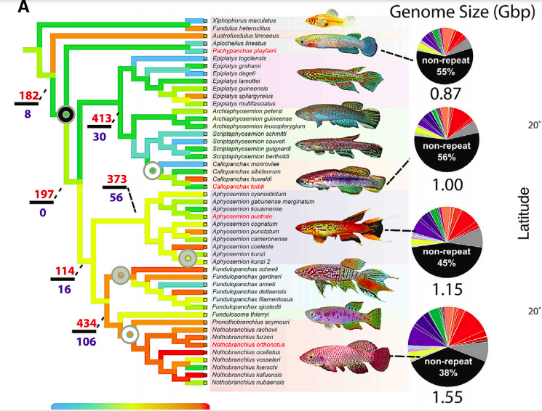
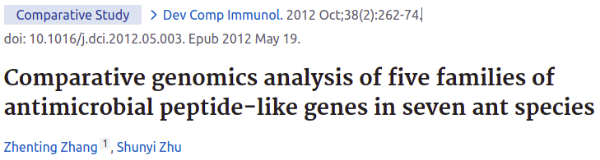
Available Datasets – 46 genomes
Re-sequenced (n=41)
Fully assembled (n=5)
RNAseq datasets
Cui et al, 2019
Notes:
Nothobranchius, orthonotus, rachovii, and Pachypanchax playfairii, Aphyosemion Australe. - why only these 5? fully sequenced, 41 re-seq.

Slide 9
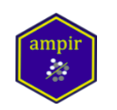
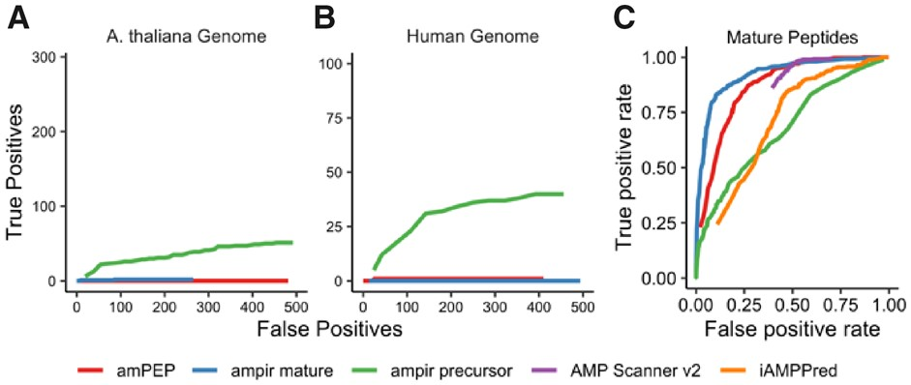
AMPIR:
AntiMicrobial Peptide prediction In R
Fingerhut et al., 2020
Notes:
Performance of ampir compared with three existing AMP prediction models: iAMPpred, AmPEP and AMP Scanner v2. Results for iAMPpred are not shown for parts A and B because it was impractical to run on large numbers of sequences. (A) and (B) are scaled so that the limits of the y-axis show the full complement of known AMPs in each genome (291 for A.thaliana and 101 for human), and the limits of the x-axis are restricted to emphasize behaviour in the low false-positive regime because this is most relevant in whole genome scans. (C) is a receiver operating characteristic (ROC) curve based on a 20% fraction of the ampir_mature dataset that was reserved for evaluation
Alternative to ampir = supervised ML based on physicochemical properties e.g. iAMPpred, AmPEP, AMP Scanner
-Genome > full-length protein precursor scan

Slide 10
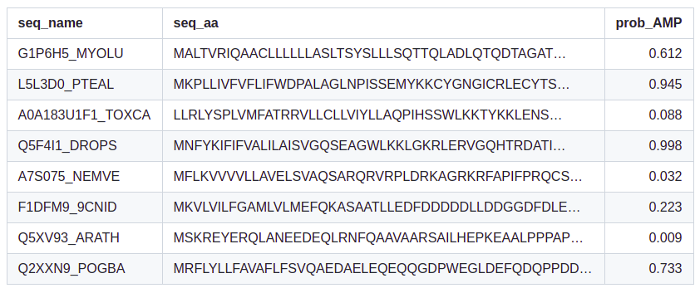
AMPIR Workflow: Genome >> Predicted AMPs
Genome >
Images from https://github.com/Legana/ampir
Fingerhut et al., 2020

Slide 11
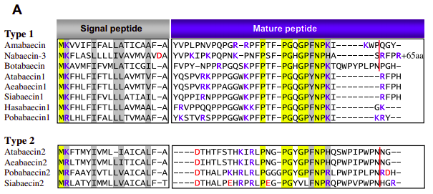
AMPIR Output and Analyses
1. Test for branch-specific positive/negative selection, or neutral evolution
2. Gene family expansion/contraction
3. AlphaFold – differential analysis
Fingerhut et al., 2020

Slide 12
1. Identifying AMPs: Outline
1.1 Identify AMPs from genomes w/ AMPIR
1.2 Analyse from evolutionary perspective
1.3 Analyse AMPs from RNAseq

Slide 13
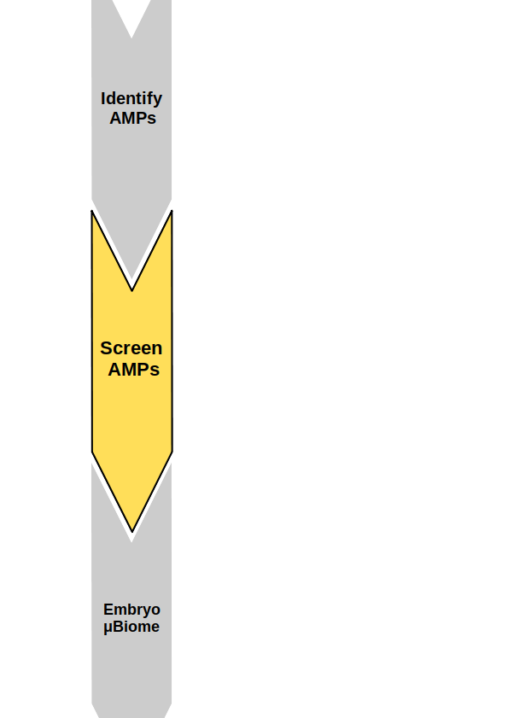
2. Screening AMP function: Questions
2.1 What is the specificity of AMPs for specific killifish gut microbes?
2.2 Do AMPs retain effectiveness in microbial community context?
2.3 Do killifish gut microbes have pro/anti-microbial activity?

Slide 14
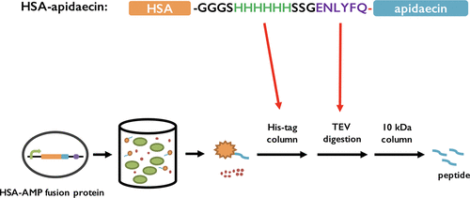
Synthetic AMPs can be produced in Saccharomyces cerevisiae
Cao et al., 2018

Slide 15
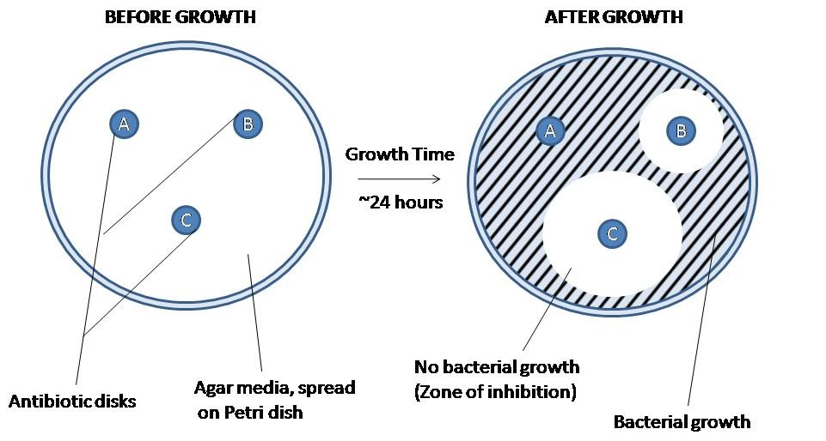
Screening AMP function: Agar Diffusion Method

Slide 16
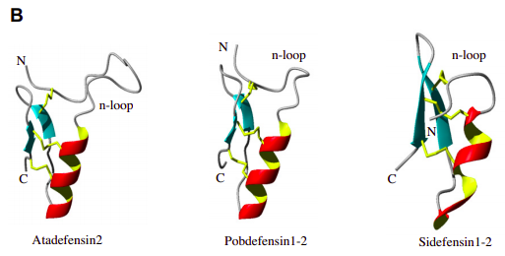
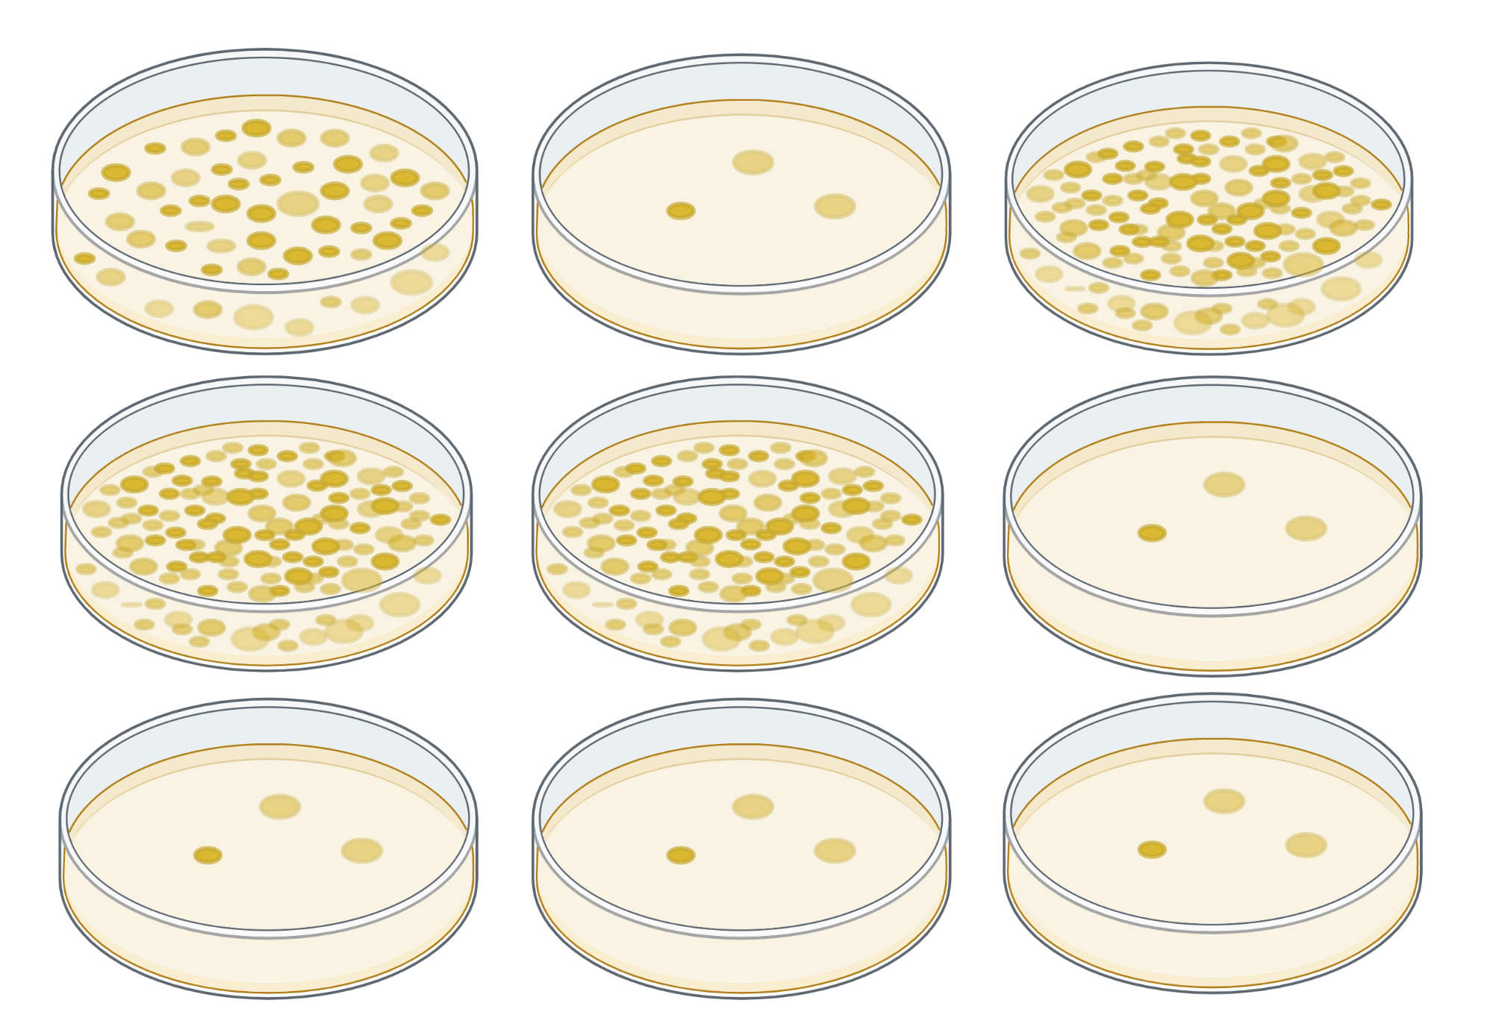
Killifish Isolate #1
Killifish Isolate #2
E.coli, Plant Isolates, Human Isolates, etc
AMP 0001
AMP 0002
AMP 0003

Slide 17
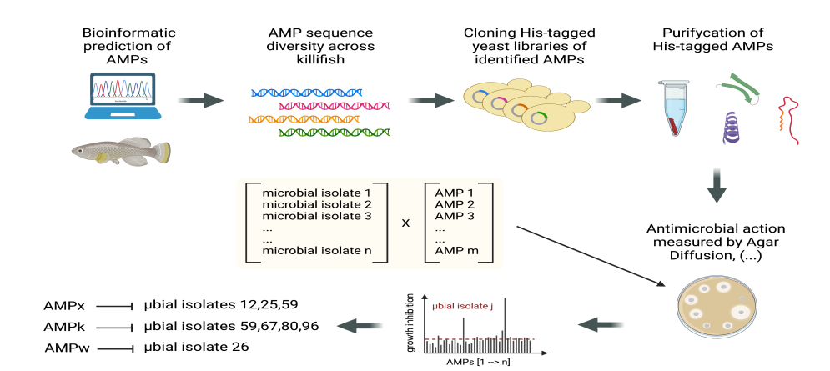
Identify AMPs >> Screen AMPs
Valenzano, unpublished

Slide 18
2. Screening AMPs: Outline
2.1 Optimising S.C protein expression protocol
2.2 Selection of AMPs/Microbial Isolate targets
2.3 Small-scale test screen
2.4 Large-scall full screen

Slide 19
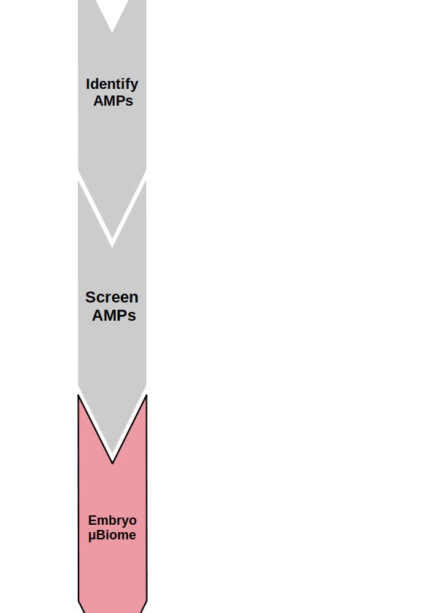
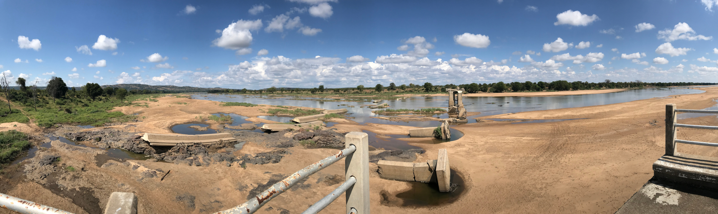
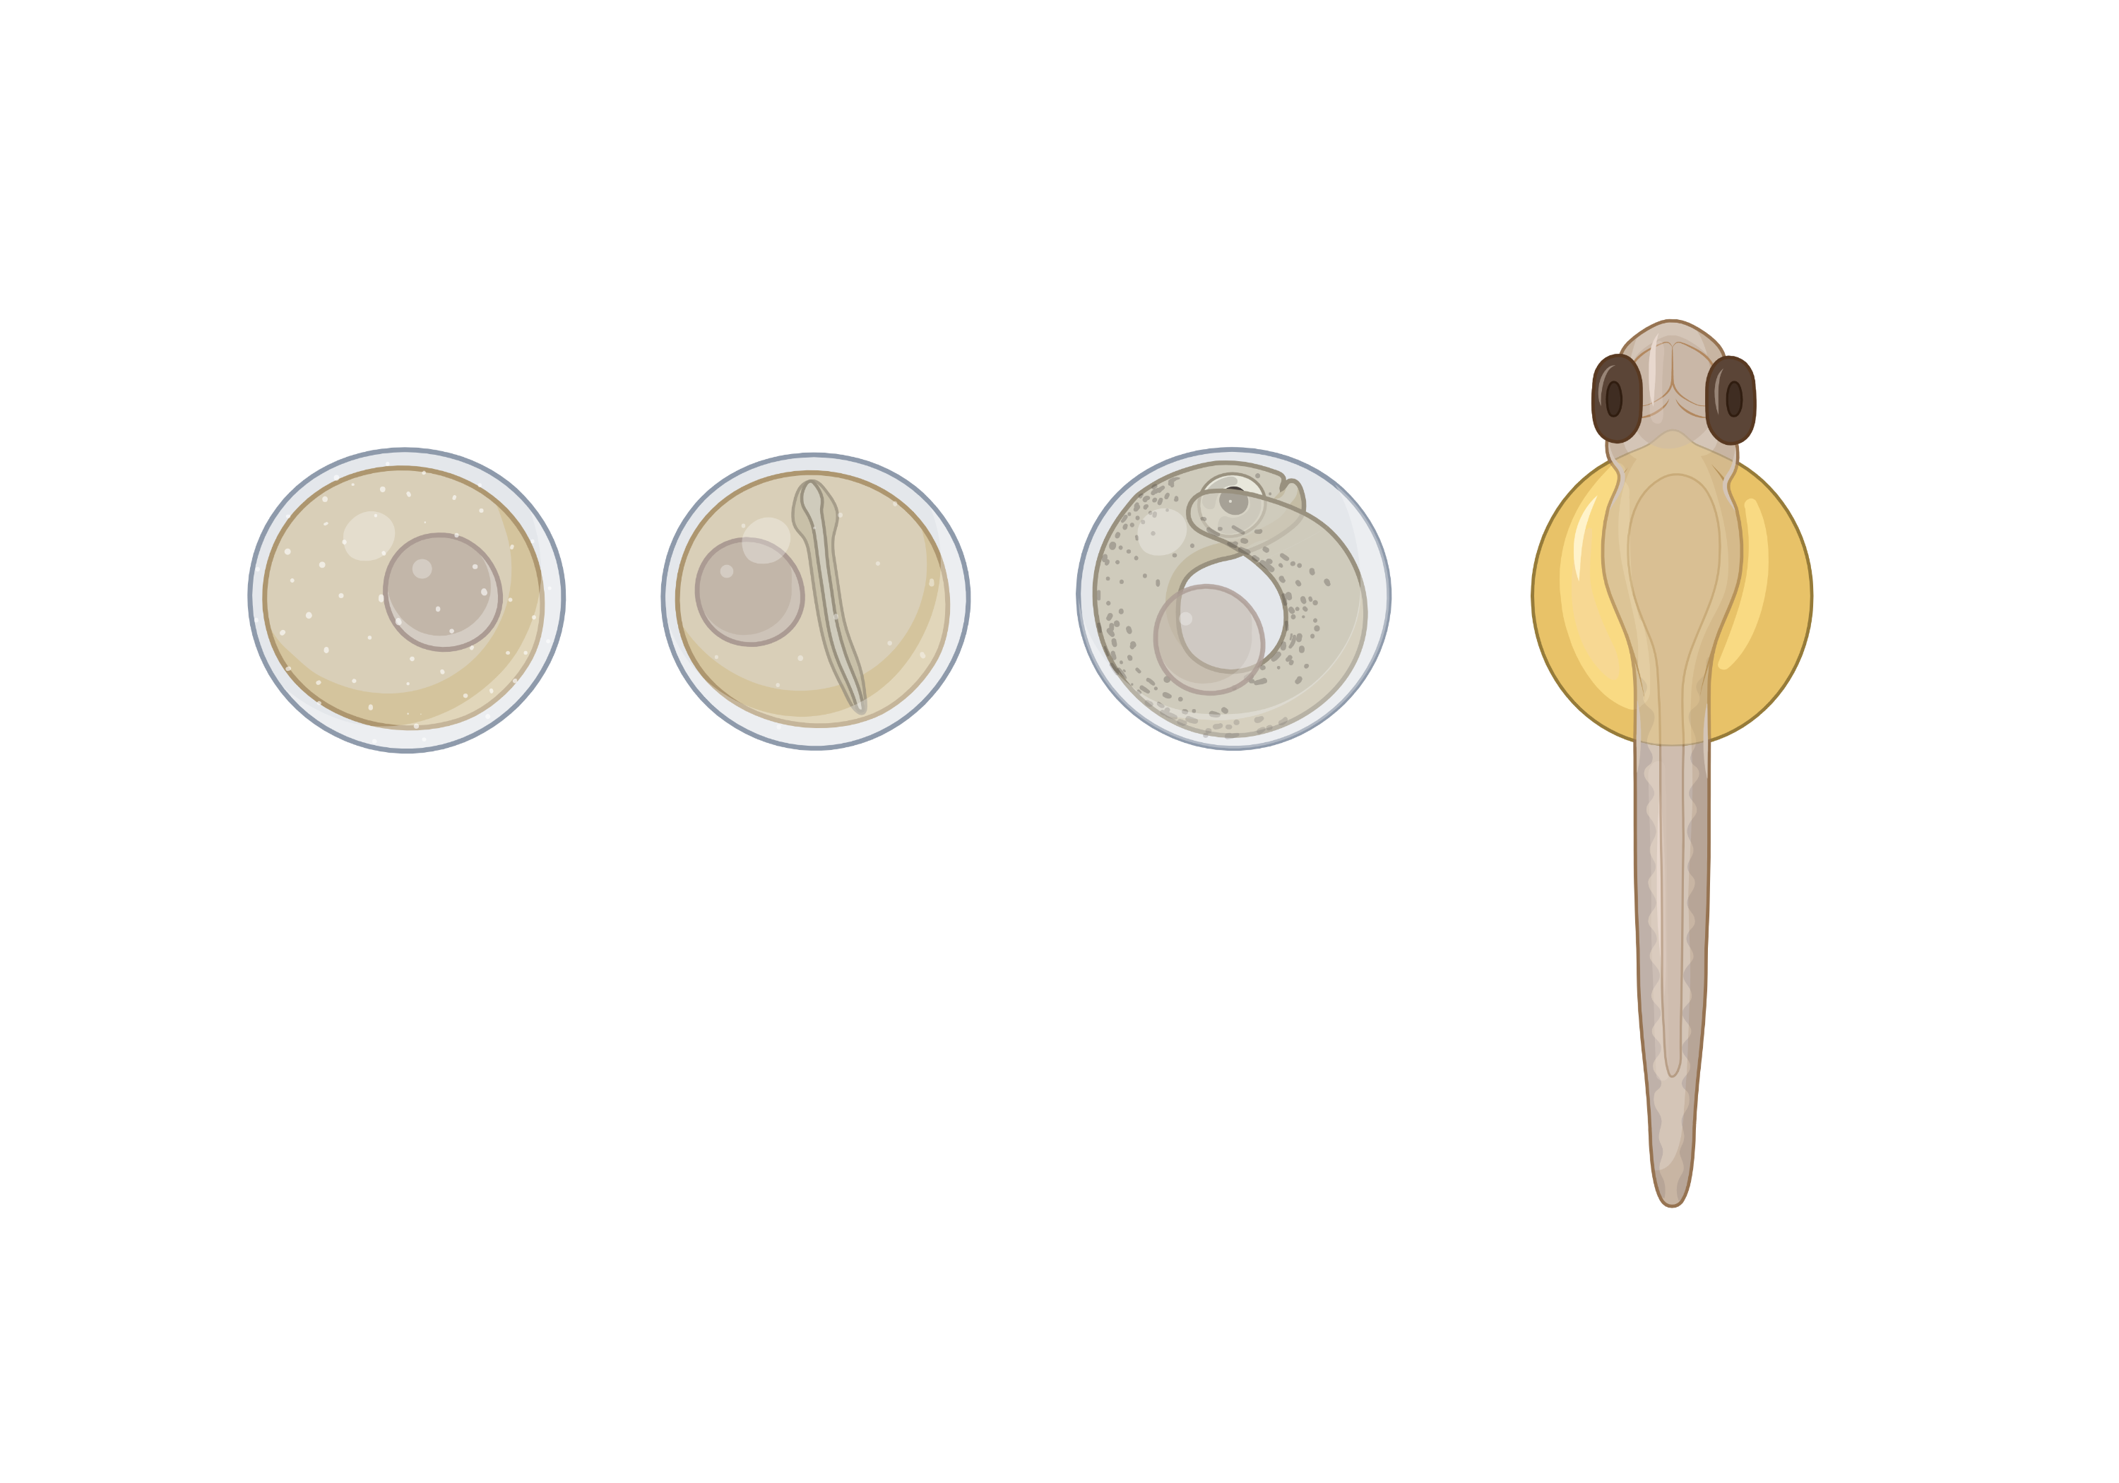
3. Embryo microbiome and AMPs

Slide 20
3. Early microbiome and anti-microbials: Questions
3.1 Which microbes are present in each embryonic developmental stage?
3.2 Which AMPs are present in the embryo? Are maternal AMPs present?
3.3 Can we introduce AMPs into embryos to alter microbiome or protect
against infection?

Slide 21
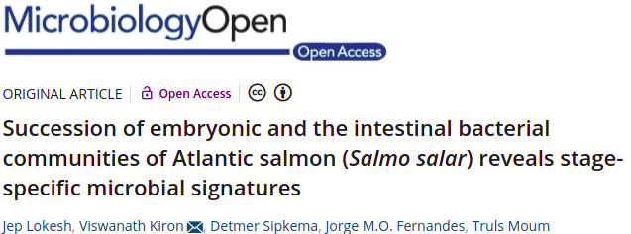
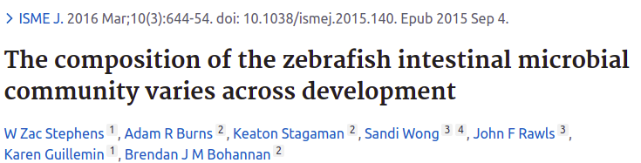
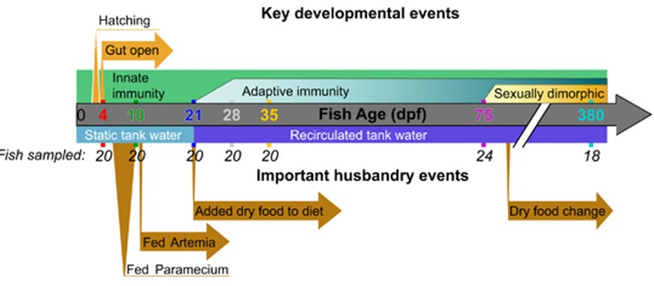
Zebrafish and Salmon microbiome varies across development
Stephens et al., 2016

Slide 22
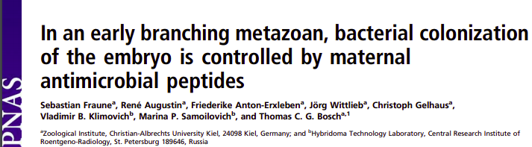
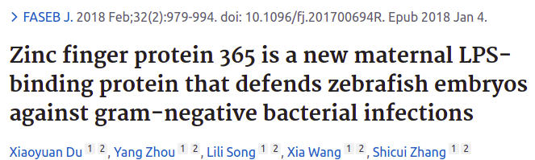
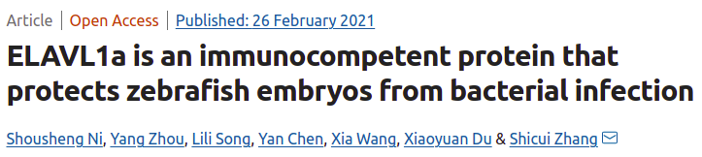
Externally Fertilized Embryos Need More Protection:
Maternal peptides

Slide 23
Microbiome Sequencing and RNAseq
n=30 at each stage
Microbiome sequencing, RNAseq, Proteomics (?)

Slide 24
3. Embryo microbiome and anti-microbials: Outline
3.1 Choice and maintenace of breeding pairs (species, age, etc.)
3.2 RNAseq, microbiome sequencing, aligning with developmental stages
3.3 Data analysis
3.4 Injection of synthesised AMPs to alter early microbiome

Slide 25
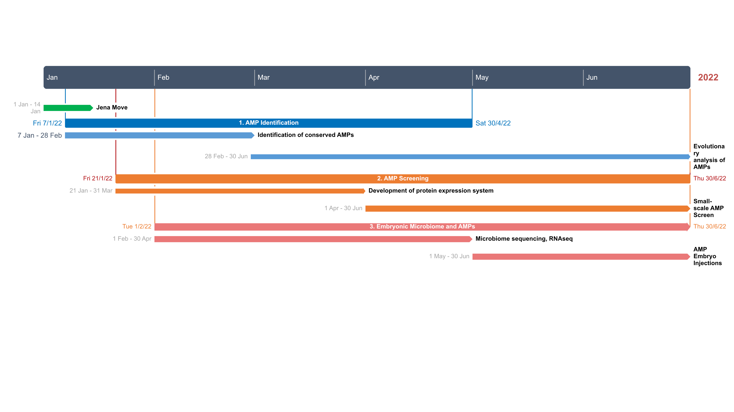
MSc Thesis Timeline

Slide 26
Thanks for listening, and your input :-)

