Slide 1
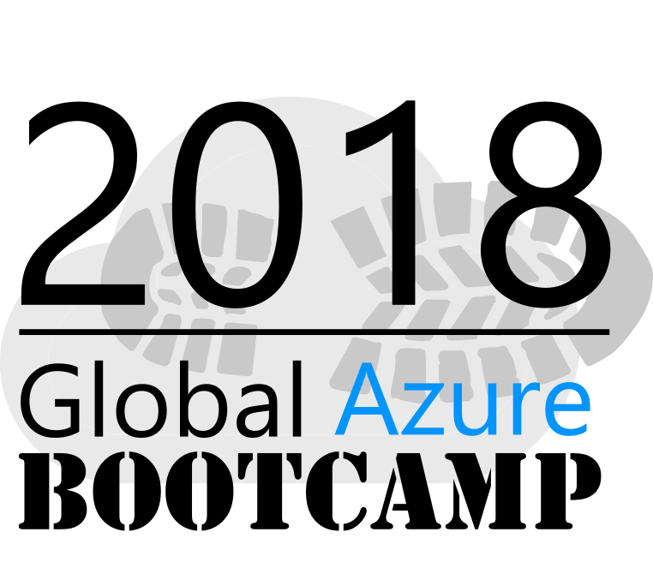
Welcome to the
Manchester, NH
April 21, 2018

Slide 2
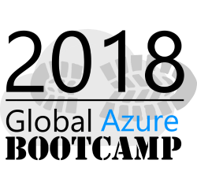







A BIG thank-you to the 2018 Global Sponsors!

Slide 3



Another BIG thank-you to local sponsors!

Slide 4
Speaker Links
GAB stuff | github.com/plzm/gab18
Azure stuff | github.com/plzm/azure
NH Cloud | meetup.com/NHCloud
LinkedIn | pelazem

Slide 5
Azure Resource Management
Patrick El-Azem
Cloud Solution Architect
Microsoft

Slide 6
Topics
Resource Model
Azure Resource Manager and Providers
Identity and Access Management
Resource Management and Operations
Resource Organization
REST API
Azure Portal
Powershell
Azure Resource Manager Templates
Azure CLI
SDKs and Dev tools
Tags and Policies

Slide 7
Resource Model
Physical: Regions – Av Zones – Data Centers – Stamps – Clusters – Racks – Update/Fault Domains – Fabric
Azure Resource Providers (RPs)
Storage, Compute, Networking, Containers, Cognitive Services, etc.
Run on ARM fabric
Azure Resource Manager (ARM)
Allocates resources, manages lifecycle
REST API for resource management
Other tools/frameworks wrap the ARM REST API

Slide 8
Identity and Access Management
Azure access requires authentication/authorization
Uses Azure Active Directory (AAD) tenant
Tenant is like AD domain on premise (aka directory)
Can create new AAD tenant, or sync on-prem AD to AAD (SSO)
Azure security = Role-Based Access Control (RBAC)
Built-in roles, e.g. Owner, Contributor, etc.
Also can define custom roles
RBAC is additive parent → child
Cannot remove from child resources!

Slide 9
Resource Organization / RBAC
Subscription: billing, security boundary
--Resource Group: security, management boundary
--Resource: individual security
(Preview: Management Groups above Subscriptions for large Azure presences)
RBAC assignments are additive parent → child
Subscription → Resource Group → Resource
Cannot remove parent’s RBAC from a child!
Subscription: minimal RBAC
Resource Group: manage RBAC here
Resource: manage RBAC if needed, better at Resource Group

Slide 10
Resource Organization
Subscription
Each subscription requires exactly one AAD tenant
An AAD tenant can be associated with many subscriptions
Design
Driven by business and technical needs
Example… subscription per environment (Dev, Test, Prod), customer, department, …
Consult Microsoft docs, whitepapers on cloud strategy and governance
Resource Group (RG)
Group related resources into purpose-specific RGs
No “god” RGs with “all our VMs in one place”!
Put shared resources into their own RG (e.g. common network resources)
→ Improved security and manageability
Use ARM tags and policies

Slide 11
REST API
ARM exposes a REST API for resource management
All the other tools wrap this API
Can use API directly – but tools/SDKs are easier
docs.microsoft.com/rest/api/resources/
Example: create/update a Resource Group
docs.microsoft.com/rest/api/resources/resourcegroups/createorupdate

Slide 12
Azure Portal
portal.azure.com
Web app for Azure: manage, deploy, monitor, and more
Try/learn in the portal
For recurring/automatable tasks prefer other tools
Demo: portal tour
Demo: create Resource Group + Resources; add tags, policy
Demo: portal automation script (Azure’s “File-Save As”)
What’s included
What do I do with these?

Slide 13
Powershell
Full set of Azure management cmdlets
Install Azure Powershell locally, or use in portal Cloud Shell
Local: docs.microsoft.com/powershell/azure/install-azurerm-ps
Must-know for certification 70-533!
Demo: review sample Powershell scripts
Demo: deploy a VM
Note the associated Azure resources – NIC, PIP, disks, etc.
Demo: clean up VM and associated resources

Slide 14
Azure Resource Manager (ARM) Templates
JSON template for Resource deployments
Declarative, not imperative/procedural
Azure manages the order in which Resources are created
Can specify dependencies (e.g. VM depends on NIC) to affect order
Elements: Parameters, Variables, Resources, Outputs
Start with quick-starts, automation script exports, existing templates
Trackable in Azure portal (Resource Group → Deployments)
See More Information (end of deck)

Slide 15
ARM Templates 2
docs.microsoft.com/azure/azure-resource-manager/resource-group-authoring-templates
Tooling: any JSON editor – but:
Visual Studio Code: JSON schema support, Intellisense-style help
Visual Studio: Resource Group template
Good practice: separate files for definition, parameter values
Demo: Virtual Network, Subnet, Network Security Group
Demo: Virtual Machine – deploy (note auto-shutdown!)
Demo: Virtual Machine Scale Set

Slide 16
Azure Command-Line Interface (CLI)
Prefer command line? Azure CLI is for you!
docs.microsoft.com/cli/azure/
Cross-platform (Windows, Linux, MacOS)
Azure CLI on Ubuntu Bash on Windows 10…. ☺
Cloud Shell in Azure portal
Tip: “az interactive” for Intellisense-style help!
Demo: az interactive – az login – az vm list

Slide 17
SDKs and Dev Tools
Visual Studio 2017
Visual Studio installer → Azure development workload
Extensions! Tools → Extensions and Updates → Browse “Azure”
Visual Studio Code: Azure extensions
Extensions → Search “Azure”
SDKs: docs.microsoft.com/azure/#pivot=sdkstools
SDKs for .NET, Java, Python, Ruby, Node.js, Go
SDKs for client operations (e.g. read/write files to Azure storage) as well as management (e.g. create Azure storage accounts)

Slide 18
Tags and Policies
Tags: free-form key-value pairs
Useful for management, bill analysis, bill-back
docs.microsoft.com/azure/azure-resource-manager/resource-group-using-tags
Policies: enforce rules and actions on resources
Example rules: allowed or disallowed resource types; allowed VM sizes; many more
Example actions: audit (but allow)… or deny outright
docs.microsoft.com/azure/azure-policy/azure-policy-introduction

Slide 19
Get Started
If you don’t have Azure… azure.com/free
Deploy your first template: docs.microsoft.com/azure/azure-resource-manager/resource-manager-create-first-template
Customize templates from the quick start (see More Information)
Build something in the portal, get automation script, edit artifacts to be more generic, repeatable, fully parameterized
No substitute for hands-on! Learn good Resource Group practices – try, fail, learn, rinse/repeat
We have to get it right the first time ← NO NO NO!!
Consider going for the 70-533 certification as a “forcing function”

Slide 20
More Information
Azure Foundation
docs.microsoft.com/azure/architecture/cloud-adoption-guide/adoption-intro/overview
ARM Documentation →
docs.microsoft.com/azure/azure-resource-manager
ARM Templates Quickstart →
github.com/Azure/azure-quickstart-templates
Microsoft Professional Program for Cloud Administration →
academy.microsoft.com/professional-program/tracks/cloud-administration

