Slide 1
More AI for your App (Still No PhD Needed)
Abstract
Add AI functionality to apps by integrating Azure AI Cognitive Services. We will dive into three specific use cases.
Granite State Code Camp :: 2019

Slide 2
Who am I?
Patrick El-Azem
Cloud Solution Architect, Microsoft
LinkedIn: pelazem
Github: plzm
CloudNH: meetup.com/CloudNH
This session: aka.ms/gscc19
2018 session: aka.ms/gscc18
Notes:
Unless otherwise noted, content in this presentation is originally created by me. You are free to repurpose/reuse it as needed; attribution is much appreciated ☺

Slide 3
Session title - ?
Why “More” and “Still”?
Today follows my 2018 session “Add AI to your App Today”
Last year covered basics; today’s session goes deeper
Audience: developers/architects where AI needs > AI expertise… and/or “build AI from scratch” won’t work

Slide 4
Summary / Recap
AI “from scratch” build/deploy/maintain is difficult and costly
→ AI PaaS/SaaS services: you focus on scenarios and integration, service provider on build/deploy/maintain AI services
Microsoft Azure Cognitive Services
AI APIs; each provides a specific AI capability
Examples: speech to text, face recognition, custom vision, many more
Integrate via REST API or SDKs
Consult last year’s session for more info
You decide: does AI service do what we need? → Domain expertise

Slide 5
Scenarios
Today we will examine real world scenarios:
Personalized Recommendations
Form Recognition
Custom Vision
Use Case
AI Service
Implementation / Demo

Slide 6
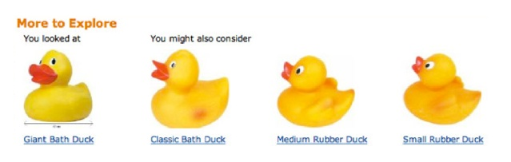
Personalized Recommendations

Slide 7
Use Case
Show me personalized recommendations for what to do next
→ Personalized = relevant, compelling
Problems – HOW DO YOU…
Know what’s relevant to me?
Keep up with changing demographics?
Handle new customers/visitors?
Know how accurate your recommendations are?
Create an algorithm with input: me and output: recommendations?
Get historical data to train/test an algorithm?
Deploy/maintain this and make it easy to integrate?
Notes:
Regarding 1-4:
Heuristics are at risk of missing important parts of the data if our approach is wrong. Our rules could be wrong – and will likely be difficult to update. We may create rules that are inherently/accidentally biased.
As an obviously over-simplified, contrived example: what if I wrote a method to get recommendations for next purchases based on what people with the same first initial bought today? If I did that, there’s a slight chance I might get it right… but I don’t have data to support this correlation, and moreover I’m guessing or proceeding from my own preconceived notion.
And how do I keep updating something like this to account for changing demographics, new customers, and other changes? How do I know if my recommender is accurate, and if visitors like its recommendations? How do I start with something that’s somehow ready for the first visitor to use it? What if I don’t have purchase history time series data, or other historical knowledge of the user population – i.e. what if I have to start from scratch?
How do I build and deploy something like this? I want to avoid mingling it into a general app or site – that way lies spaghetti ball monolith maintainability hell – so I have to make it discoverable and able to be easily integrated into other apps.

Slide 8
Azure AI Cognitive Service: Personalizer
Docs, API Reference
REST API + SDKs (.NET, Go, Node, Python)
How does it work?
You pass a context and choices to the API
API returns your choices, ranked by contextual relevance
You present the ranked choices to your user
You watch what the user does with the choices
Based on the user’s action, you send feedback to the API
The API learns from your feedback and improves ongoing
Notes:
The Personalizer service is implemented using unsupervised machine learning algorithms, specifically Reinforcement Learning.
In supervised ML, we have training and test data we can use to prepare an ML algorithm to work on new data. In unsupervised ML, we don’t have training data. Reinforcement Learning algorithms are designed to take feedback on their output, and to use that continual feedback loop to continuously improve and retrain. The goal is for the algorithm to get better and better over time by learning from reality.
Personalizer takes a context that you are responsible for assembling. This is essentially a set of data about the situation; for example, it could be user demographics (be careful about PII), environmental data (weather, time of day, location, etc.), current view or area, and so on. The idea is to tell the Personalizer service as much as you can about the situation. You don’t need to pick out those pieces of the data that predict what a user will do; the Personalizer service will do this by retraining itself ongoing.
Along with the context, Personalizer takes a list of choices to rank for this context. You are responsible for assembling this list. This should not be your entire product catalog, for example; you have to curate the set of all possible choices down to a set that is manageable for both an RL algorithm as well as a human being. After all, you wouldn’t present a human being a list of 1,000 next choices, right? So narrow the list. Personalizer states a cap of 50 choices. 10%-20% of that would be a good start, I think.
Given the context and the choices (as well as an event ID you’ll use later), Personalizer returns the choices ranked by relevance, from most to least.
After you present the ranked list of recommendations, you will need to tell Personalizer how well it did. Typically, you will need to observe user behavior, and calculate a Reward score based on that. Reward scores are in a range from zero to one. You are responsible for calculating the reward score. You can consider basing it on a number of observed behaviors, such as:
Did the user follow the top recommendation?
Did the user follow any of the recommendations (if you chose to display more than one)?
How long did it take for the user to do something? Perhaps a longer delay to act lowers the reward score?
Did the user do something with the recommendation, like clicking a social share button which implies the recommendation was not only good, but worth sharing?
Once you calculate a reward, send it back to the Personalizer service along with the event ID you sent with the initial context and choices, so that Personalizer can correlate the feedback (the Reward score you calculated) to the specific context and choices. This is the data Personalizer needs to retrain itself.

Slide 9
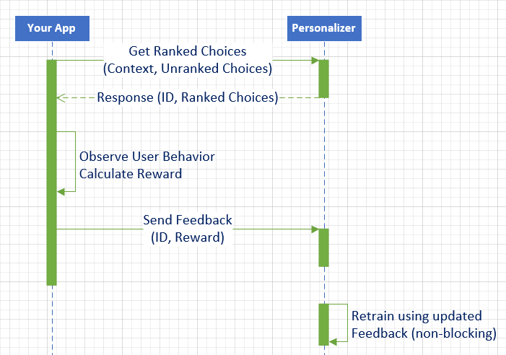

Slide 10
Demo
Test application: generates contexts and actions
Runs each {context+actions} through Personalizer API
Calculates reward for each recommendation
Sends reward to Personalizer API
Splits into segments and pauses for API retraining
Calculates segment scores so we can see trend
You can get this code and test/adjust/experiment
Vary run settings in Common.cs, lines 18-21
https://github.com/plzm/azure-cognitive/tree/master/PoCs/Personalizer-Recommendations

