Slide 2
Centralized Error Handing
Nikhil Bora
Ashim Ghosh
Chirag Rupani
Sagar Karmarkar
29 December 2014

Slide 3
Importance of centralized error handling
Lack of an integrated view of the errors may provide a false pretense of stability.
Checking module wise log files for any failures in the systems is very difficult and extremely resource intensive.
Traceability and re-introduction of the data that caused the error or the data that could not get processed due to the error is often cumbersome.
A statistical analysis of these errors may also be provided at the end of the month or year to determine defects and improve the infrastructure and applications running in the organization.
Notes:
High level discussion about the architects.
In PubMatic from 2 years, we are contributed with design and review.

Slide 4
Approach
Why?
Who will benefit?
What?
How?
Notes:
High level discussion about the architects.
In PubMatic from 2 years, we are contributed with design and review.

Slide 5
Why?
Why ?
Better usability - To make life easy [more predictable and manageable] for Engineers [Dev. and QA], End users, Deployment Engineers, Support Engineers.
Rise in revenue - Expect to have less number of non-English customer service calls with i18n compliant [handle multiple languages and cultural conversations] errors.
Notes:
High level discussion about the architects.
In PubMatic from 2 years, we are contributed with design and review.

Slide 6
Who will benefit from this?
Engineers
Managers
Customers

Slide 7
What?
i18n compliant error handling framework which handles multiple languages.

Slide 8
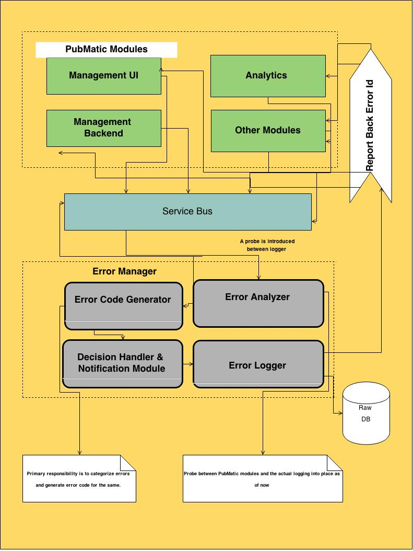
Architecture

Slide 9
How?
A service bus which enables different modules to participate [objects and probes] and enable common communication language between modules.
A web server exposing REST APIs, capturing errors, generating unique error codes from client [PubMatic modules] and maintain the same in DB [MySQL]
Error Capturer - Read runtime errors before they are logged in existing error log files.
Error Categorizer - Categorization of error [Module wise – AdServer, Management UI, ML, etc.], Databases, Network, Operating Systems level and maintain the same in DB [MySQL].
Notification Module – Notify concerned stakeholders.

Slide 10
Code Insight

Slide 11
Future Enhancement
Check for valid product errors, log defects and try to rectify/fix.
Error Data Analysis and Machine Learning [prediction of errors]
Various analytics can be run on centrally stored errors.
Trends, patterns and root cause analysis can be done.

Slide 12
Thank You

