Slide 1
Swrve

Slide 2
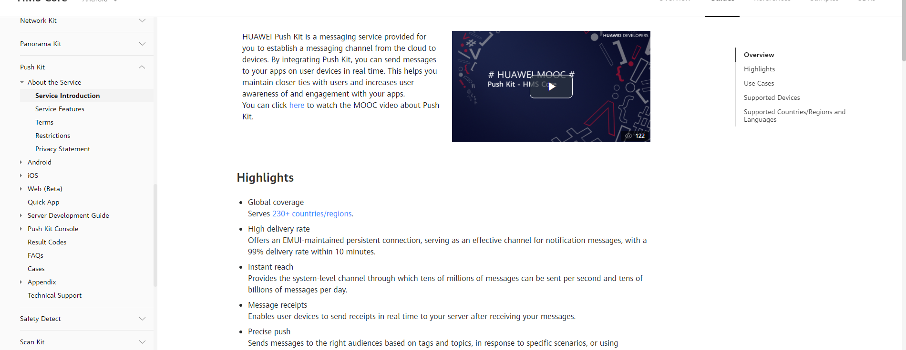
Huawei Push Kit Link
https://developer.huawei.com/consumer/en/hms/huawei-pushkit/

Slide 3
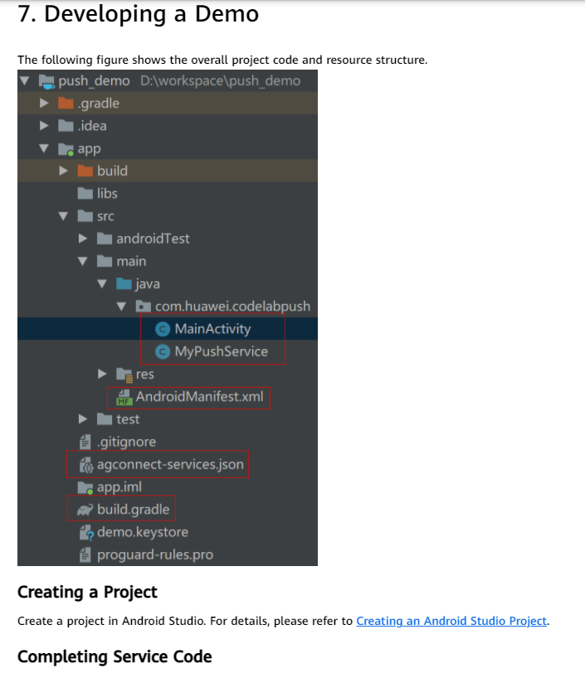
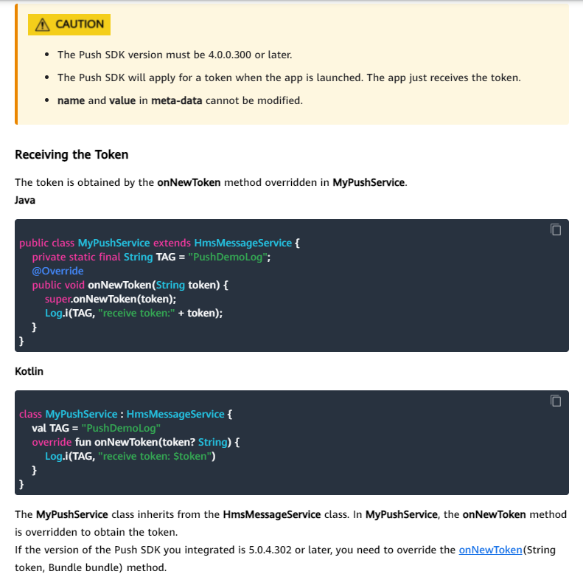
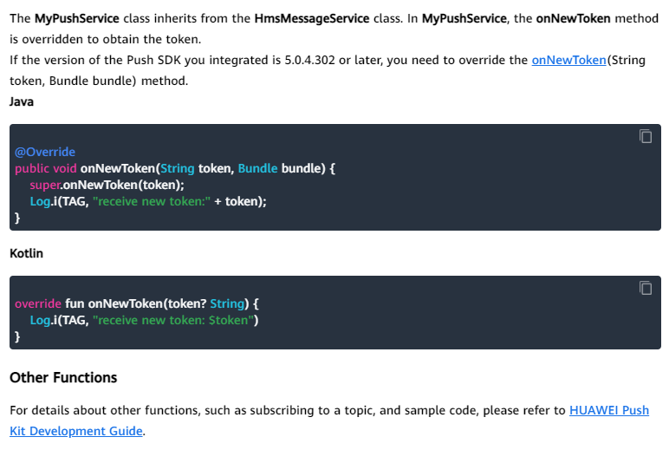
Push server integration steps
Follow the codelab here to integrate Push Kit: https://developer.huawei.com/consumer/en/codelab/HMSPushKit/index.html#0

Slide 4
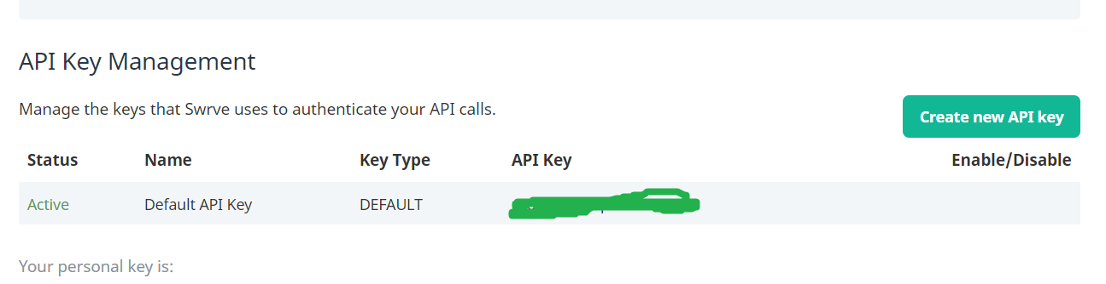
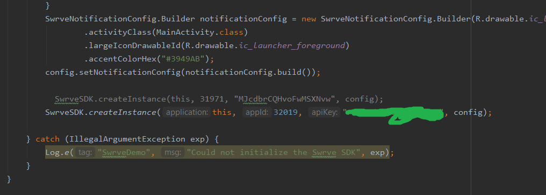
To integrate swrve:
Enter your developer console
Create new app and project set under this. You will also need to change the package name, refactor as needed and be sure that it is correct. Put the agconnect-services.json in the proper place, you will be overwriting the original file.
Follow steps here to set up the HMS app and project page properly: https://developer.huawei.com/consumer/en/doc/HMSCore-Guides-V5/android-config-agc-0000001050170137-V5
Go to swrve dashboard and go to settings->integration settings. Find your API key
Use this API key for the SwrveSDK.createInstance

Slide 5
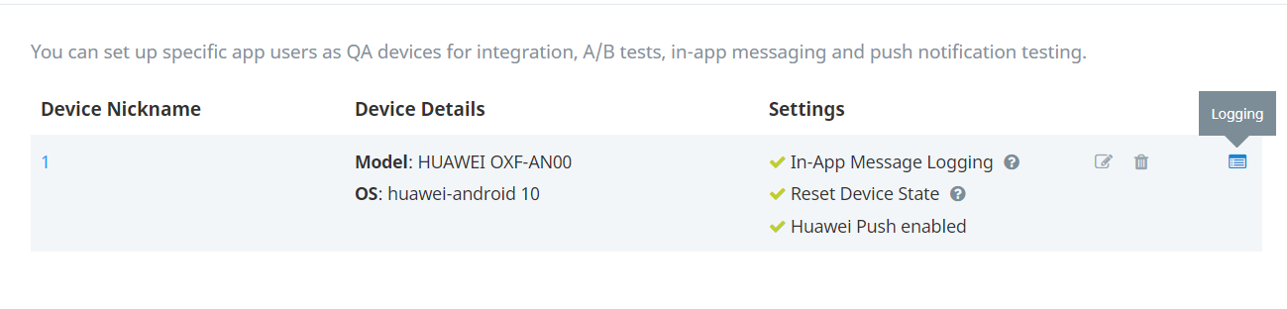
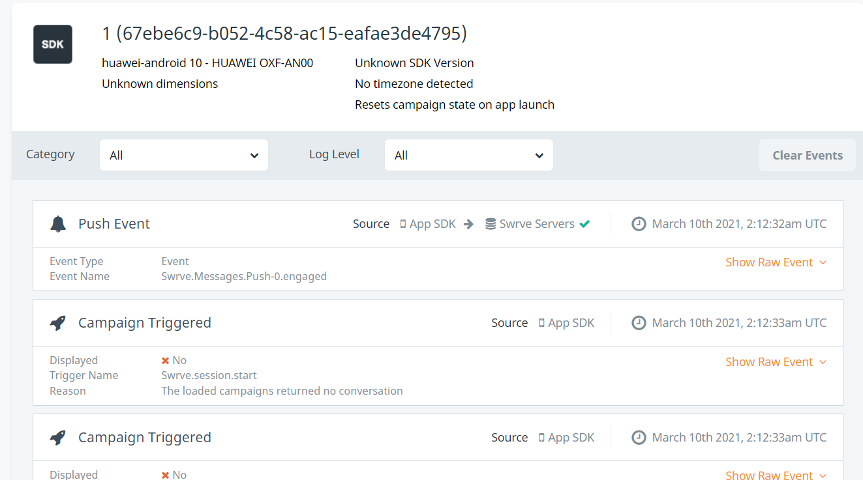
Run app on your device.
After a while, go into the swrve dashboard and go to Settings-> QA devices. Press add QA device on the top right side and press "Yes, I have opened app". Register all devices present under different names.
Go into each device log and find the one that actually has logs recorded
If a QA device does not have logs, that is not the one that is listening to logs, and may be deleted safely.
Go into application again and press on "Huawei Push Message Demo" and return 1 layer. Press get token. If the token is successful, exit application and reset the application. If it is throwing errors, you may not have set the sha-256 code properly.
Go back to the QA device on swrve, the settings now should say that "Huawei push enabled". If it does not, allow a few hours for it to fully register. Restart your device as well to ensure this step.
You should be able to use your QA device to obtain campaign messages and notifications now.

Slide 6
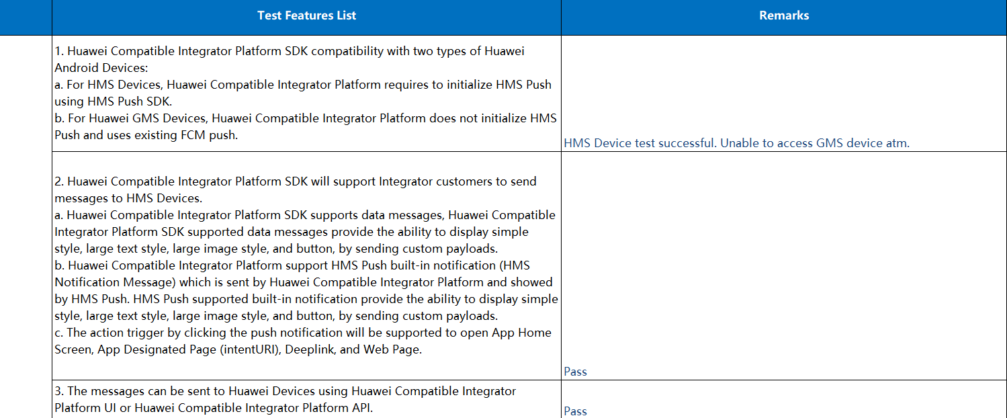
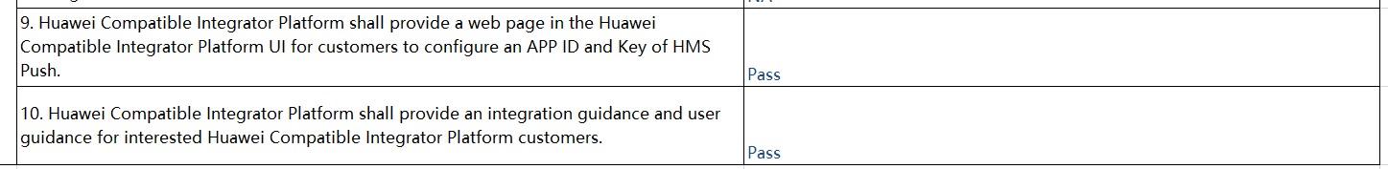
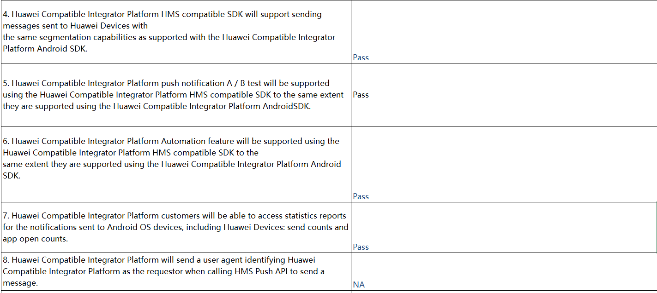
Acceptance test detail
*Tests listed as NA or has remarks other than pass was checked and confirmed by other testers.

Slide 7
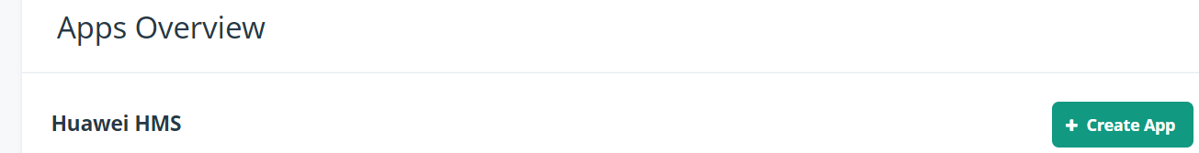
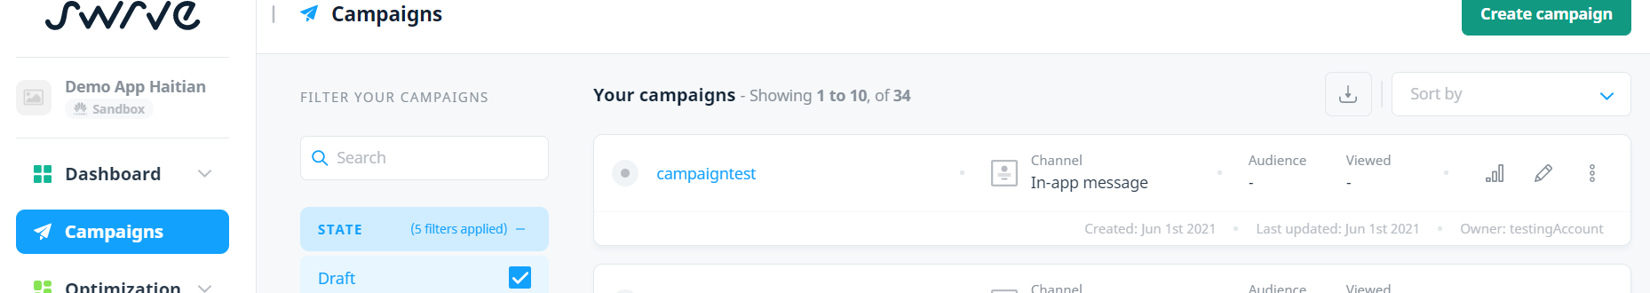
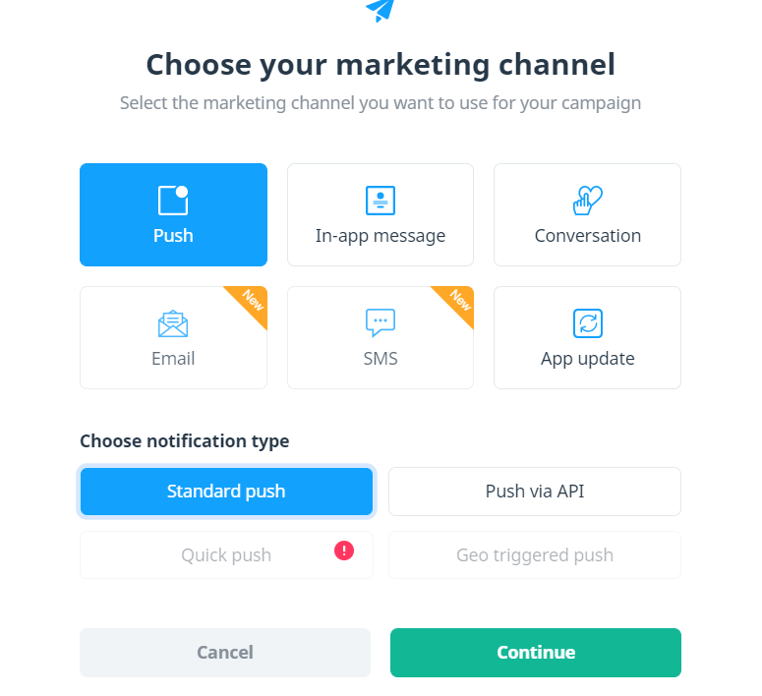
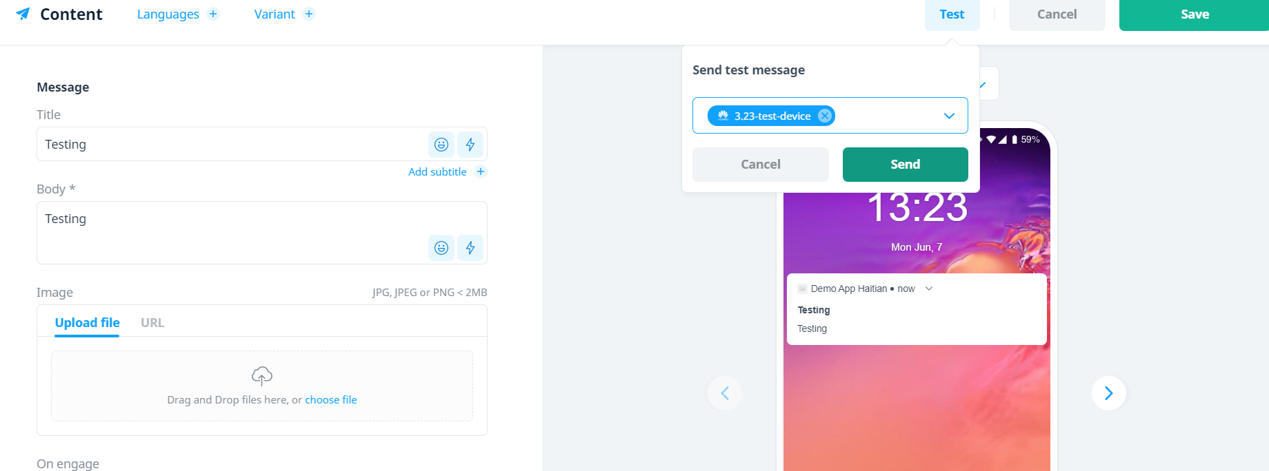
Using 3rd party vendor’s dashboard to verify push messages
On the swrve dashboard, create your application with the correct settings.
Create a push notification campaigns under the campaign tab.
Under content, you can test the message.
Once you start the campaign, check again if the message is received by the device, make sure that the device is connected and using the application.
New devices can take up to 12-24 hours to be registered fully, so take this into mind when verifying messages

