Slide 1
Closing the CPM course
Preparing for the written exam
Notes:
Welcome to the first lecture of the project management course.
Today we are going to explore what constitutes the project management context by introducing the concepts that define the rationale for projects and project management.
Then we will see how these concepts help us define and implement the key project management processes.

Slide 2
Context – Course grading
final online test using the Exam platform
duration 1.5 hours, composed of a set of three exercises/problems, min 10 pts to pass.
20
Capstone project team work
8
BC
33
Optional oral exam
+/-3
Accelerated learning bonus
2
fulfill all requirements within the end of the term, including passing the written test at first two term’s dates

Slide 3
Context – Online test
Why? Validate achievement of learning outcomes: Students to demonstrate that they can:
Select and implement traditional techniques to manage a project
Prove ability in business evaluation and project financing
Develop a project charter and business case
Plan scope, cost and resources.
Prepare and track a project detailed schedule using both deterministic and probabilistic techniques and related professional project planning software tools
Track progress, monitor and control successful accomplishment of project’s objectives of time, cost and quality.
Use rigorous managerial methods for decision making in complex case scenarios. Identify, assess and respond to project risks
What? a set of three exercises/problems with open-ended questions or multiple-choice questions

Slide 4
Context – Test
How? To be defined
When? See portal

Slide 5
Context – Online test
How-much? how do we grade exercise and questions?
Exercise are open ended: we do evaluate methods rather than final numerical results - Please detail the logical steps you take to reach the solution
Questions are close ended: we do evaluate right answers.

Slide 6
Sample Ex. – Outline
Select and implement traditional management techniques to manage a project
Prove ability in business evaluation and project financing
Develop a project charter and business case
Plan scope, cost and resources.
Prepare and track a project detailed schedule using both deterministic and probabilistic techniques and related professional project planning software tools
Track progress, monitor and control successful accomplishment of project’s objectives of time, cost and quality.
Use rigorous managerial methods for decision making in complex case scenarios. Identify, assess and respond to project risks

Slide 7
Sample Ex. – Develop a project charter and a project plan
Pretend to be working as a Project Manager for a construction company. You won a contract to build a cableway facility for a ski resort managing company. You are asked to prepare a Project Charter including a project plan created using a Project Planning software tool such as MSProject, ProjectLibre or another suitable package. Please make your educated guess to provide information included in all sections of the Project Charter.
The facility will be composed of the following parts:
A bottom departure station,
an arrival station at the top of the hill,
two piles erected in top of the corresponding foundations, numbered as 1 and 2;
the engine system installed after the departure station is complete,
the cable, which is laid down at the end after all components are installed.
1 2
2
1

Slide 8
Sample Ex. – Develop a project charter and a project plan
Below are the durations of each individual task, when performed by one team. You have no more than 3 teams that can be used (maximum available units). All tasks can be performed by 1 or more teams (if you make use of more than 1 team to perform a single task, please consider a no loss of productivity, for example: 1 team takes 2 weeks = 2 teams take 1 week).
The labour rate is 5K$/week per team. Overhead cost is 10k$/week.
Expected deliverables:
Project Charter file in word, text, pdf or similar
Project Planning file (MSProject, ProjectLibre or other).
TASK NAME | DURATION [week] | MATERIAL COST [K$]
Departure station | 2 | 100
Arrival station | 3 | 80
Foundation 1 | 1 | 10
Pile 1 | 1 | 20
Foundation 2 | 1 | 10
Pile 2 | 2 | 20
Engine system | 2 | 50
Cable laying | 1 | 30

Slide 9
Sample Ex. – Develop a project charter
Project Charter
Project Name:
Project Description:
Project Manager:
Project Sponsor:
Business Case:
Expected Goals/Deliverables:
Risks and Constraints:
Milestones:
Team Members:
Solution file: 8.2_project_charter.docx

Slide 10
Sample Ex. – Develop a project plan
Project Plan
Scope:
4.3.11 Define scope: given
4.3.12 Create work breakdown structure: optional
4.3.13 Define activities: given
Resource:
4.3.16 Estimate resources: given
4.3.17 Define project organization: establish resource engagement
Time:
4.3.21 Sequence activities: to be done
4.3.22 Estimate activity durations: given
4.3.23 Develop schedule: optimize
Cost:
4.3.25 Estimate costs: given, direct and indirect
4.3.26 Develop budget: to be done

Slide 11

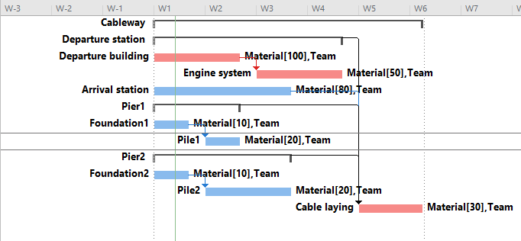
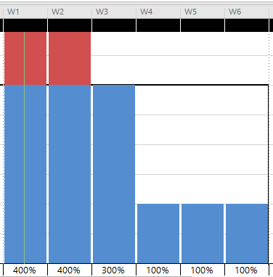
Sample Ex. – Develop a project plan
4.3.12 Create work breakdown structure: optional
4.3.17 Define project organization: establish resource engagement
4.3.21 Sequence activities: to be done
4.3.29 Assess risks: to be done

Slide 12
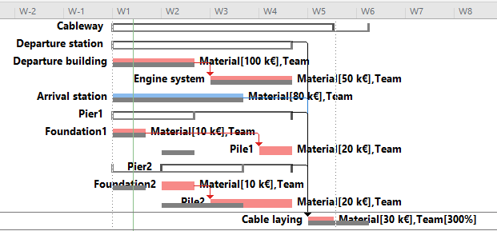
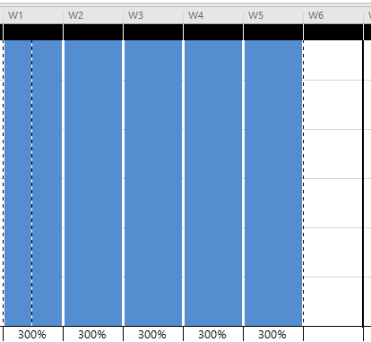
Sample Ex. – Develop a project plan
4.3.23 Develop schedule: optimize
Smooth or level?
Heuristic: shortest highest slack last

Slide 13
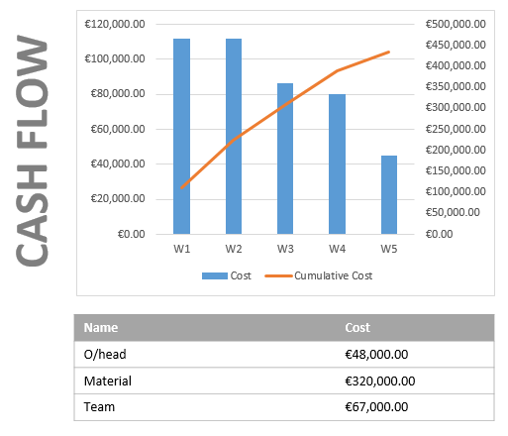
Sample Ex. – Develop a project plan
4.3.26 Develop budget: to be done

Slide 14
Sample Ex. – Monitoring
AS the PM of the cableway project project, Your boss asks you to estimate the profit that your project would net at completion, based on current performance. What would you answer?
The project, as described in the chart below, has budgeted cost totalling 435 k€ and 5-week scheduled duration. The contract provides for the contractor to be compensated a lump-sum 544 k€ firm fixed price. A penalty worth 5k€/week is agreed upon the contract.

Slide 15
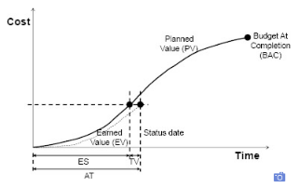
Sample Ex. – Monitoring
Solution
Refer to Monitoring
Key formulas
ES = (AT-1) + (EV – PVc) / (PVc+1 – PVc)
CPI = EV / AC
SPI($) = EV / BV
SPI(t) = ES / AT
Use revise estimate approach: most conservative!
CEAC = AC + (BAC – EV) / CPI
TEAC = AT + (PD – ES) / SPI(t)

Slide 16
Sample Ex. – Monitoring

Slide 17
Sample Ex. – Contracting
Suppose to be the CEO of the ski resort company. You are asked by the Board of Directors to evaluate an alternative contract organization to build the new Cableway.
Consider that you manage a small resort, with little yearly capital expenditure and don’t have in-house specialized technicians.
On the other hand, take note that globally in the ropeway industry there are no more than 5 player and that the leader has a market share approaching 40% globally, with a turnover in excess of 1bn€.
What would you suggest with regard to the delivery system, payment scheme and award method? Briefly justify your decision in writing.

Slide 18
Sample Ex. – Contracting
Key concept of contracting
Scope: choose combination
The contractor is much better fitted to handle the complexity of the context, has good financial ways, especially given the context of ski resort operator as battered by the pandemic. However, they cannot handle the specifics of the local resort market : Turnkey
Payment scheme: Firm fixed price, no advance. Contractor finance repaid during operations.
Award: negotiation. Difficult to exercise client power.

Slide 19
Sample Ex. – Initiating
Suppose to be the CEO of the ski resort company. You and the Board of Directors are debating about the business case and questioning whether to authorize the project or not. Please provide your recommendation to help management decide. Support your recommendation with appropriate data analysis.
The business case presents the following preliminary estimates:
Total capital expenditure 1,000 k€
Revenue per year 200 k€
Operating cost per year 70 k€
Inflation rate 0%
Corporate tax rate 30%
Cost of equity 10% annual
Cost of debt 5% annual
Capex period 1 year
Expected period of operations 15 years

Slide 20
Sample Ex. – Initiating
Key concept of business casing
Financial viability: NPV
“Bankability”: pretax DSCR > 1.2

Slide 21
Sample Ex. – Initiating

