Slide 1
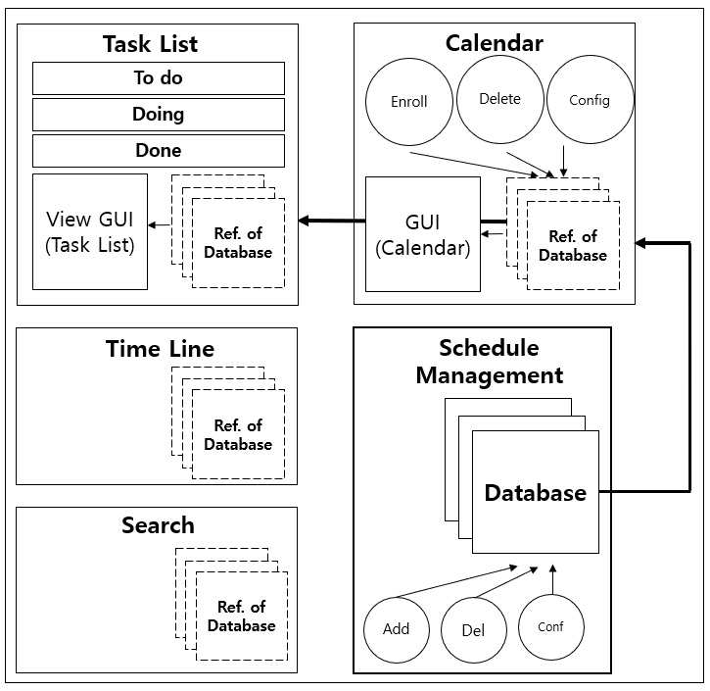

Task List
Calendar
To do
Enroll
Delete
Config
Doing
Done
View GUI
(Task List)
GUI
(Calendar)
Ref. of
Database
Ref. of
Database
Time Line
Schedule
Management
Firebase Database
View GUI
(Time Line)
Ref. of
Database
Database
Database
Search
Synchronize
Search
Ref. of
Database
Add
Del
Conf

Slide 2
DB Manager
Firebase Database
Sync Developer/
SM, Cal, TaLi Tester
Schedule
Management
Schedule Manager
Developer/TL,DB Tester
Firebase Database
Song
Junho
Lee
Jaehong
Database
Database
Project Manager
Calendar Deveoper/
TL,DB Tester
Calendar
Time Line Developer/
SM, Cal, TaLi Tester
Time Line
GUI
(Calendar)
Kim Seongmin
Kim
Sebin
Ref. of
Database
View GUI
(Time Line)
Ref. of
Database
Task List Developer/
TL,DB Tester
Task List
To do
View GUI
(Task List)
Choi
Jihyeok
Doing
Ref. of
Database
Done

