Slide 1
House Price Prediction

Slide 2

Group Members:-
SEA138 Pratik Mulik
SEA142 Rohit Zha
SEA148 Saurav Gupta

Slide 3
Introduction
Problems faced during buying a house:
Buying a house is a stressful thing.
Buyers are generally not aware of factors that influence the house prices.
Many problems are faced during buying a house.
Hence real estate agents are trusted with the communication between buyers and sellers as well as laying down a legal contract for the transfer. This just creates a middleman and increases the cost of houses.

Slide 4
They believe that it depends upon:
The square foot area
Neighbourhood
The no. of bedrooms
But it depends upon many factors also……such as:
No. of storage
Area outside the house
Rooms on one floor

Slide 5
Project summary
Our project is a machine learning app, based on certain specification of your future home it will try to guess the most accurate price.
Information such as state, city, area, stores.

Slide 6
Technology Used
1. Machine learning:
Tom Mitchell provides explained: “A computer programme is said to learn from experience E with respect to class of tasks T and performance measure P, if its performance at tasks in T, as measured by P, improves with experience E.”
Example: Playing checkers.
E = The experience of playing many games of checkers
T = The task of playing checkers.
P = The probability that the programme will win the next game.

Slide 7
Example Predicting whether the given object is pen or pencil??
E = The experience of predicting many pens and pencil.
T = The task of predict pen or pencil
P = The probability that of whether it is a pen or pencil

Slide 8
In general, any machine learning problem can be assigned to one of two broad classification: Supervised learning and unsupervised learning.
Supervised Learning:-
In supervised learning, we are given a data set and already know what our correct output should look like, having the idea that there is relationship between the input and the output. Supervised learning problems are categorized into “regression” and “classification problem.
In a regression problem, we are trying to predict results within a continuous, output, meaning that we are trying to map input variables to some continuous function.
In a classification problem, we are instead trying to predict results in a discrete output. In other words, we are trying to map input variables into discrete categories.

Slide 9
Unsupervised Learning:-
Unsupervised learning allows us to approach problems with little or no idea what our results look like. We can derive structure from data where we don’t necessarily know the effect of the variables. We can derive this structure by clustering the data based on relationship among the variables in the data. With unsupervised learning there is no feedback based on the prediction results.

Slide 10
Tool used
PYTHON
GOOGLE COLLABATROY
KAGGLE DATASET

Slide 11
HOW IT WORKS ?
Collecting Data:- First step was to collect data we collected data from different sources & merged together to form our training data set.
Then We Trained The module using machine learning algorithm which in this case is multiple linear regression.
Based on the generated graphs we predict the cost of the house.

Slide 12
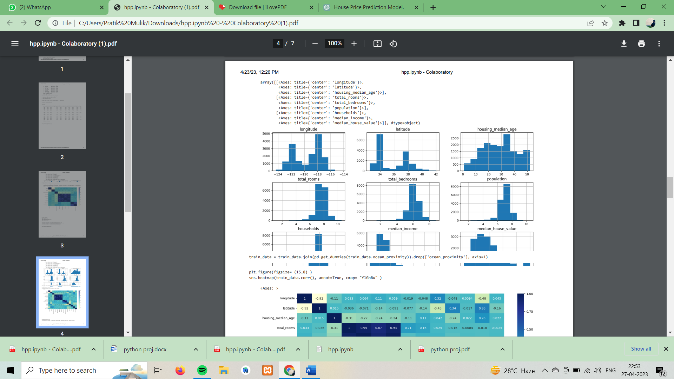
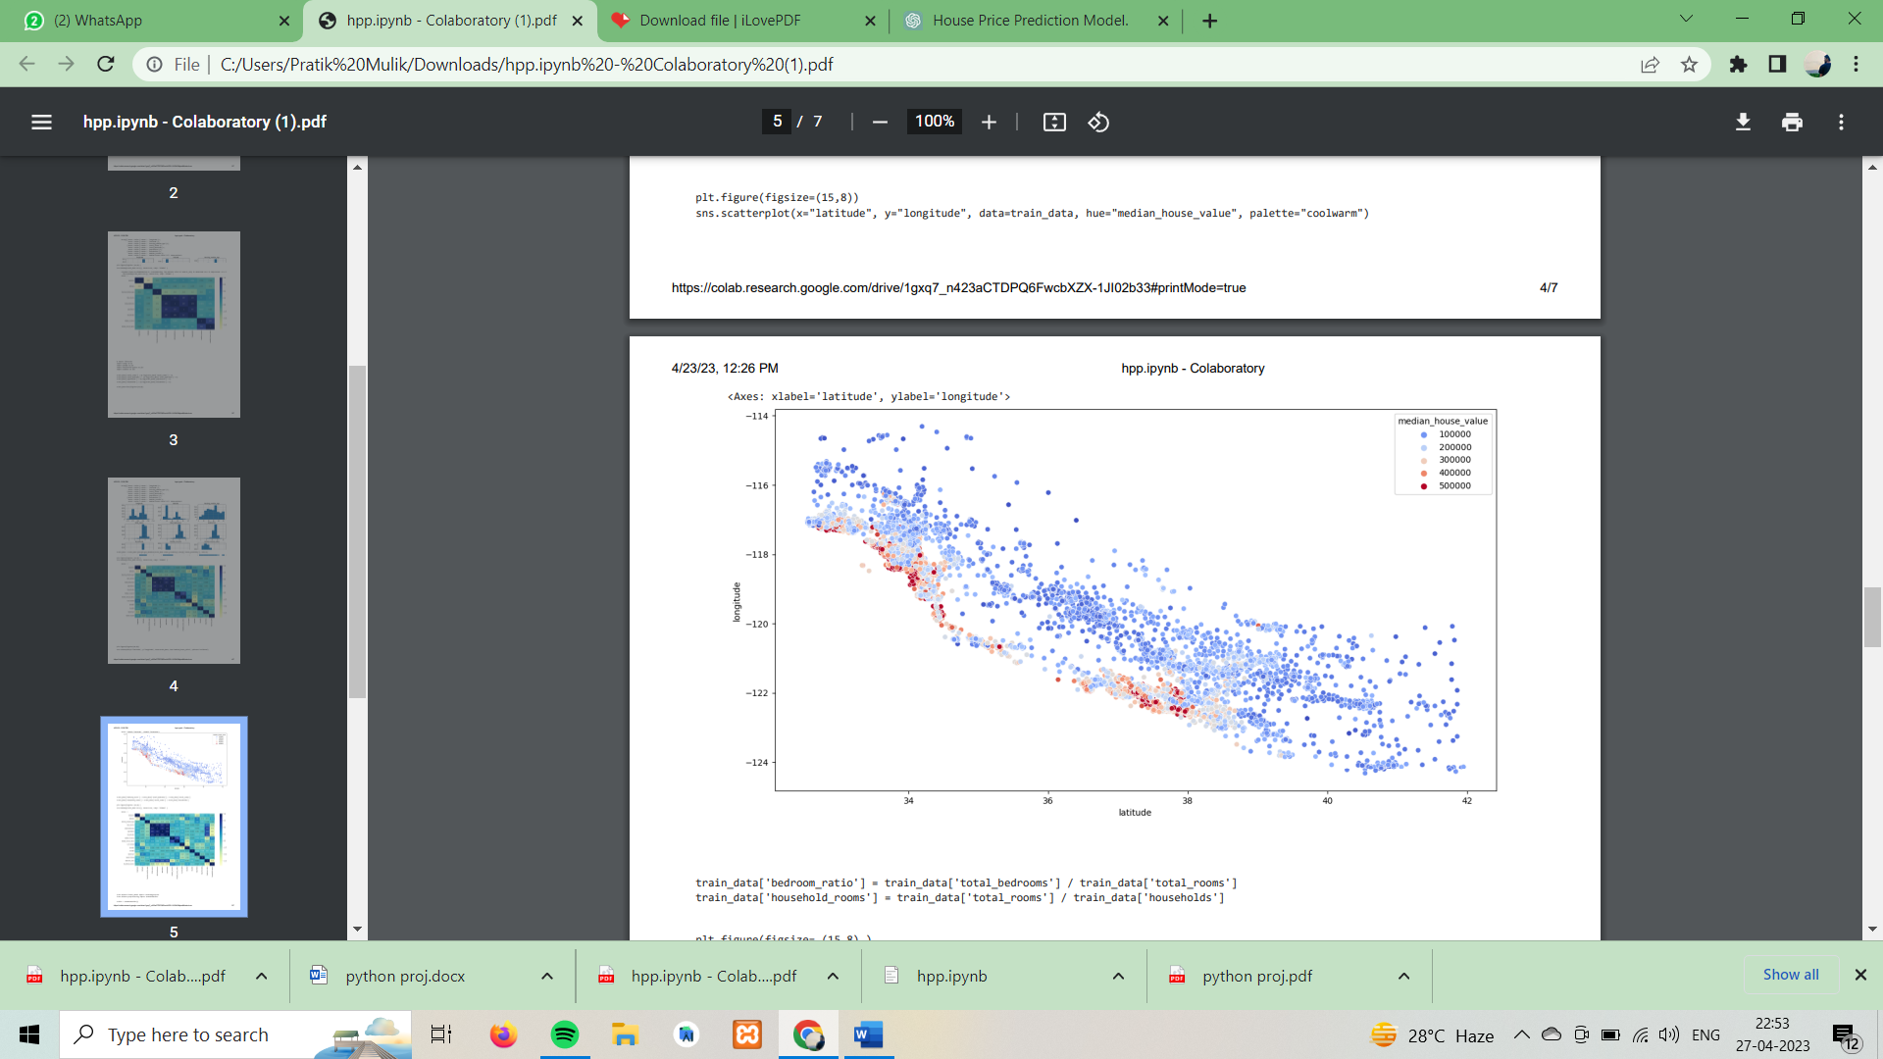
Result:-

Slide 13
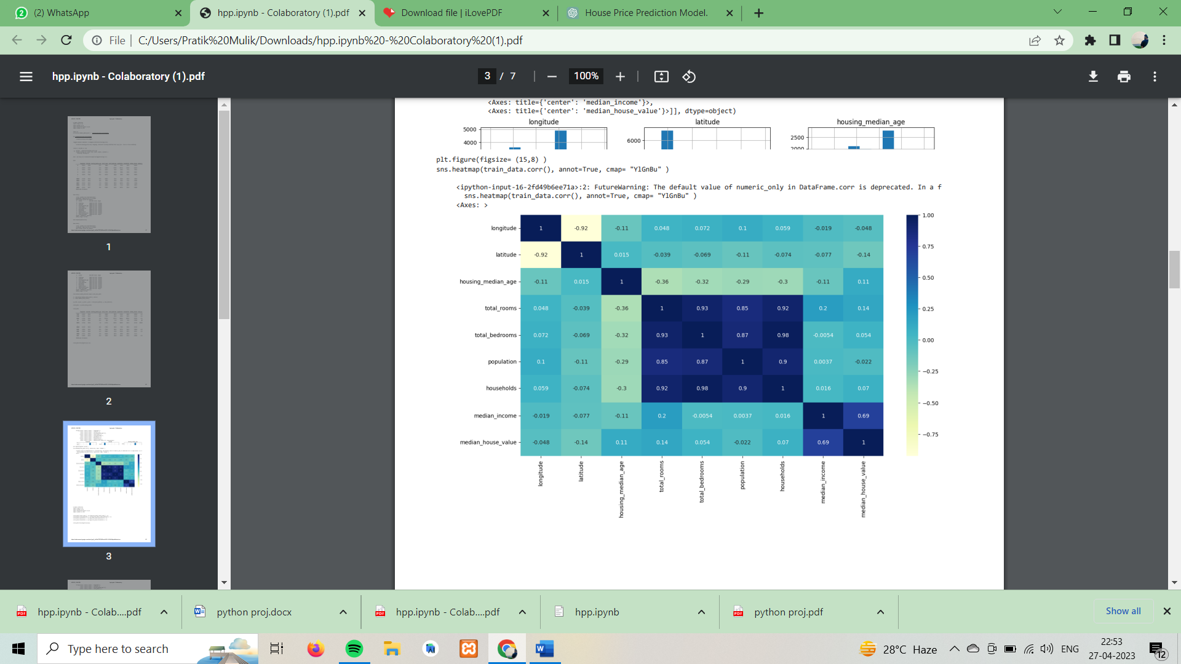

Slide 14
Conclusion:-
In conclusion, house price prediction is an important problem in real estate markets that can be addressed using machine learning models. By leveraging historical data and relevant features, such as location, size, and market trends, machine learning models can provide accurate predictions of house prices, which can be used by various stakeholders, including homebuyers, sellers, real estate agents, and investors.
The success of a house price prediction model depends on several factors, including the quality and quantity of data, the choice of features, the selection of a suitable machine learning model, and the appropriate training and validation procedures. Additionally, effective communication and collaboration with stakeholders are essential for ensuring that the model meets the specific needs and goals of the project.

