Slide 1
Assignment Day 4 | 23rd August 2020
Question 1:Find out the mail servers of the following domain
Question 2: Find the locations, where these email servers are hosted.
Domain Type TTL Answer
WIPRO
wipro-com.mail.protection.outlook.com. A 10 104.47.124.36
wipro-com.mail.protection.outlook.com. A 10 104.47.126.36
IBM
mx0b-001b2d01.pphosted.com. A 1800 148.163.158.5
mx0a-001b2d01.pphosted.com. A 1800 148.163.156.1

Slide 2
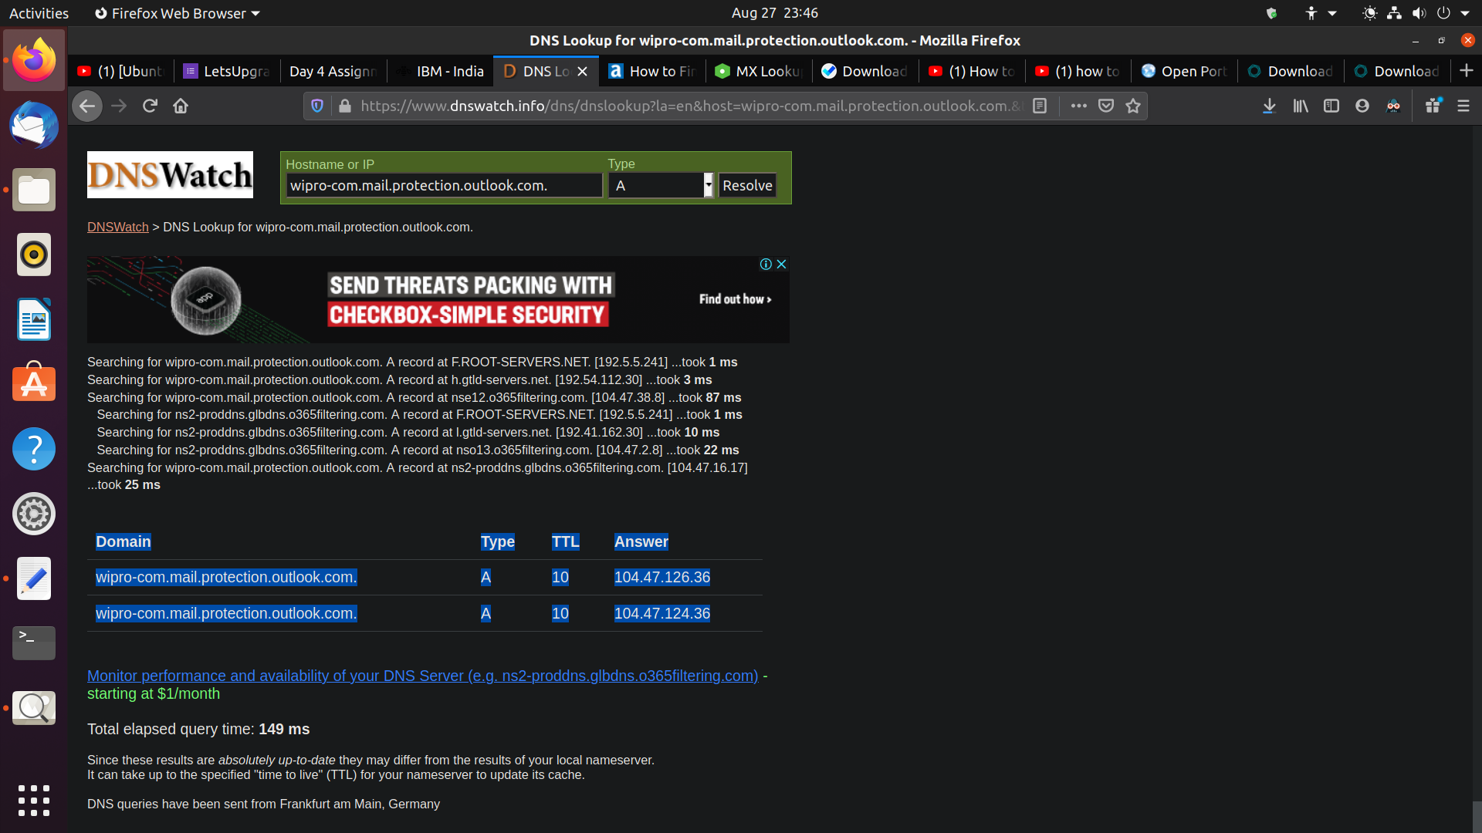
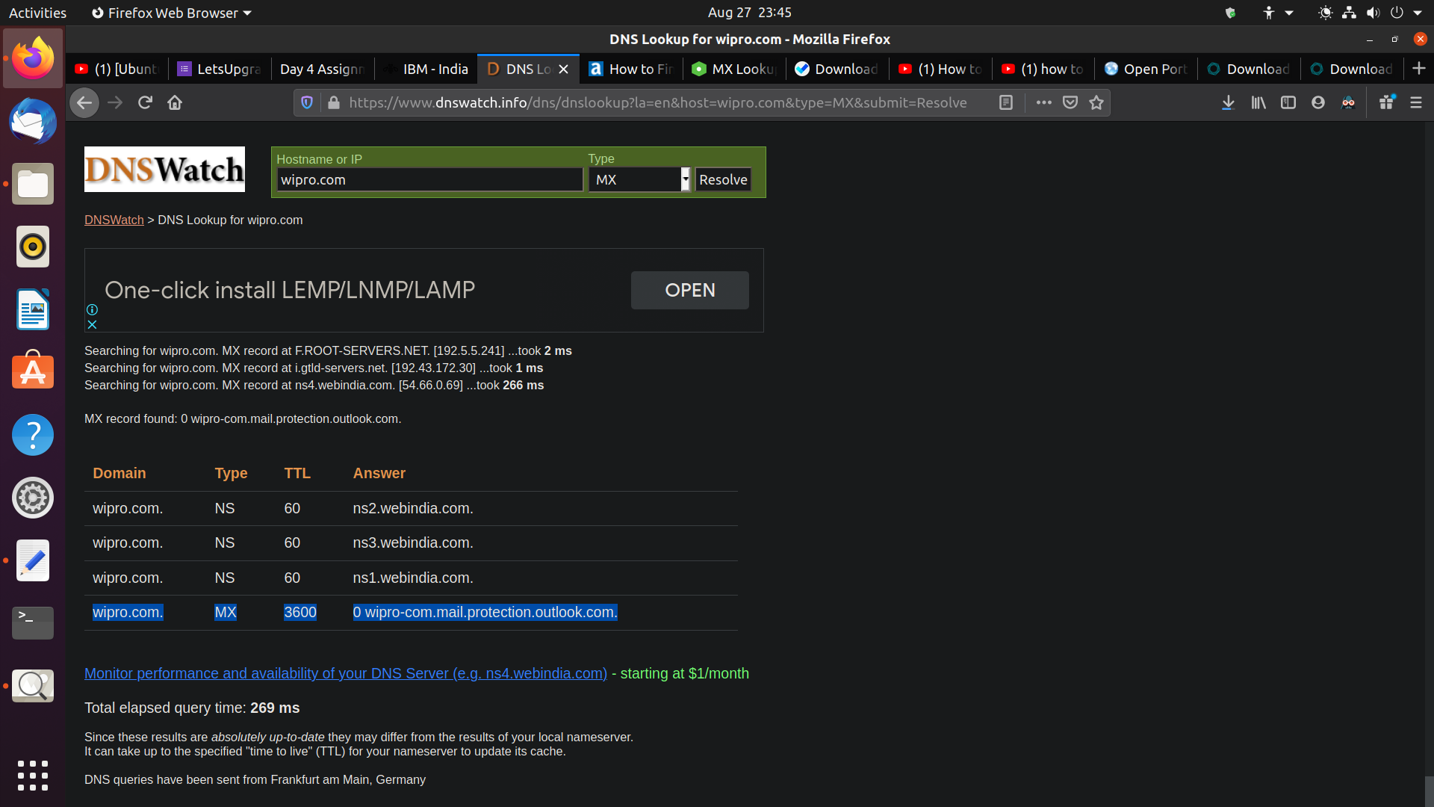

Slide 3
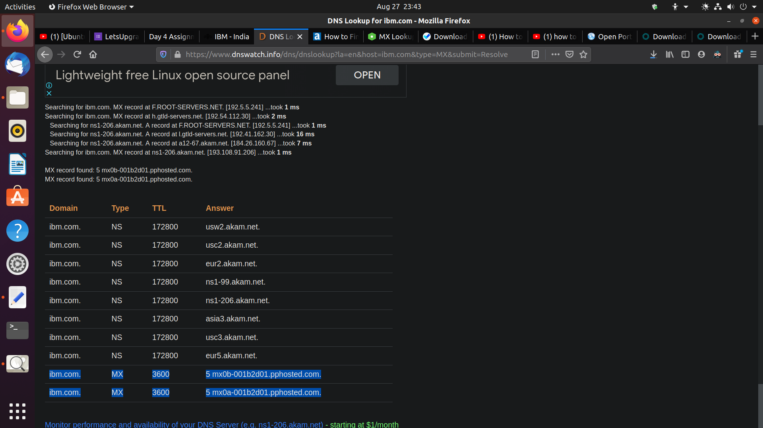
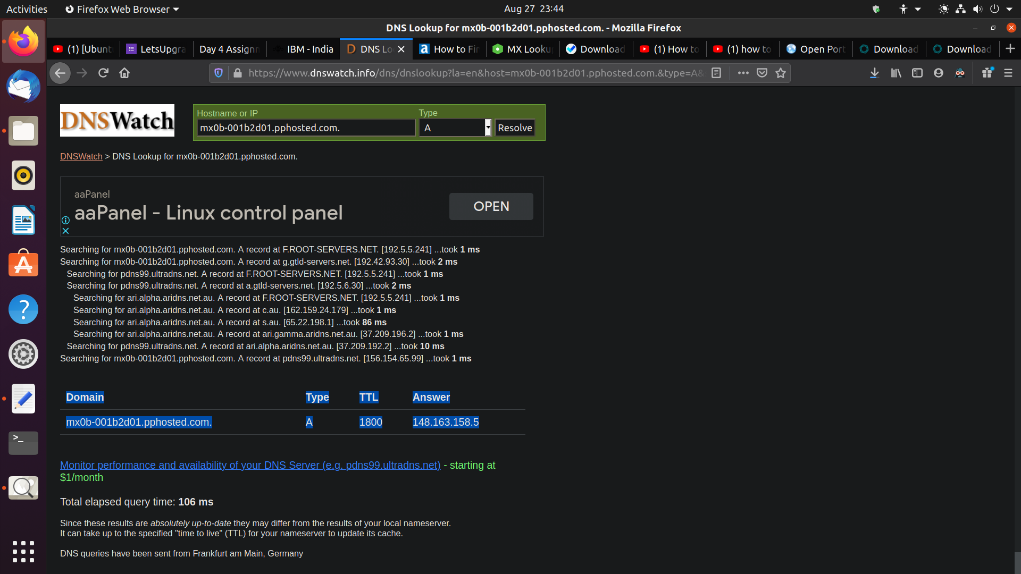

Slide 4
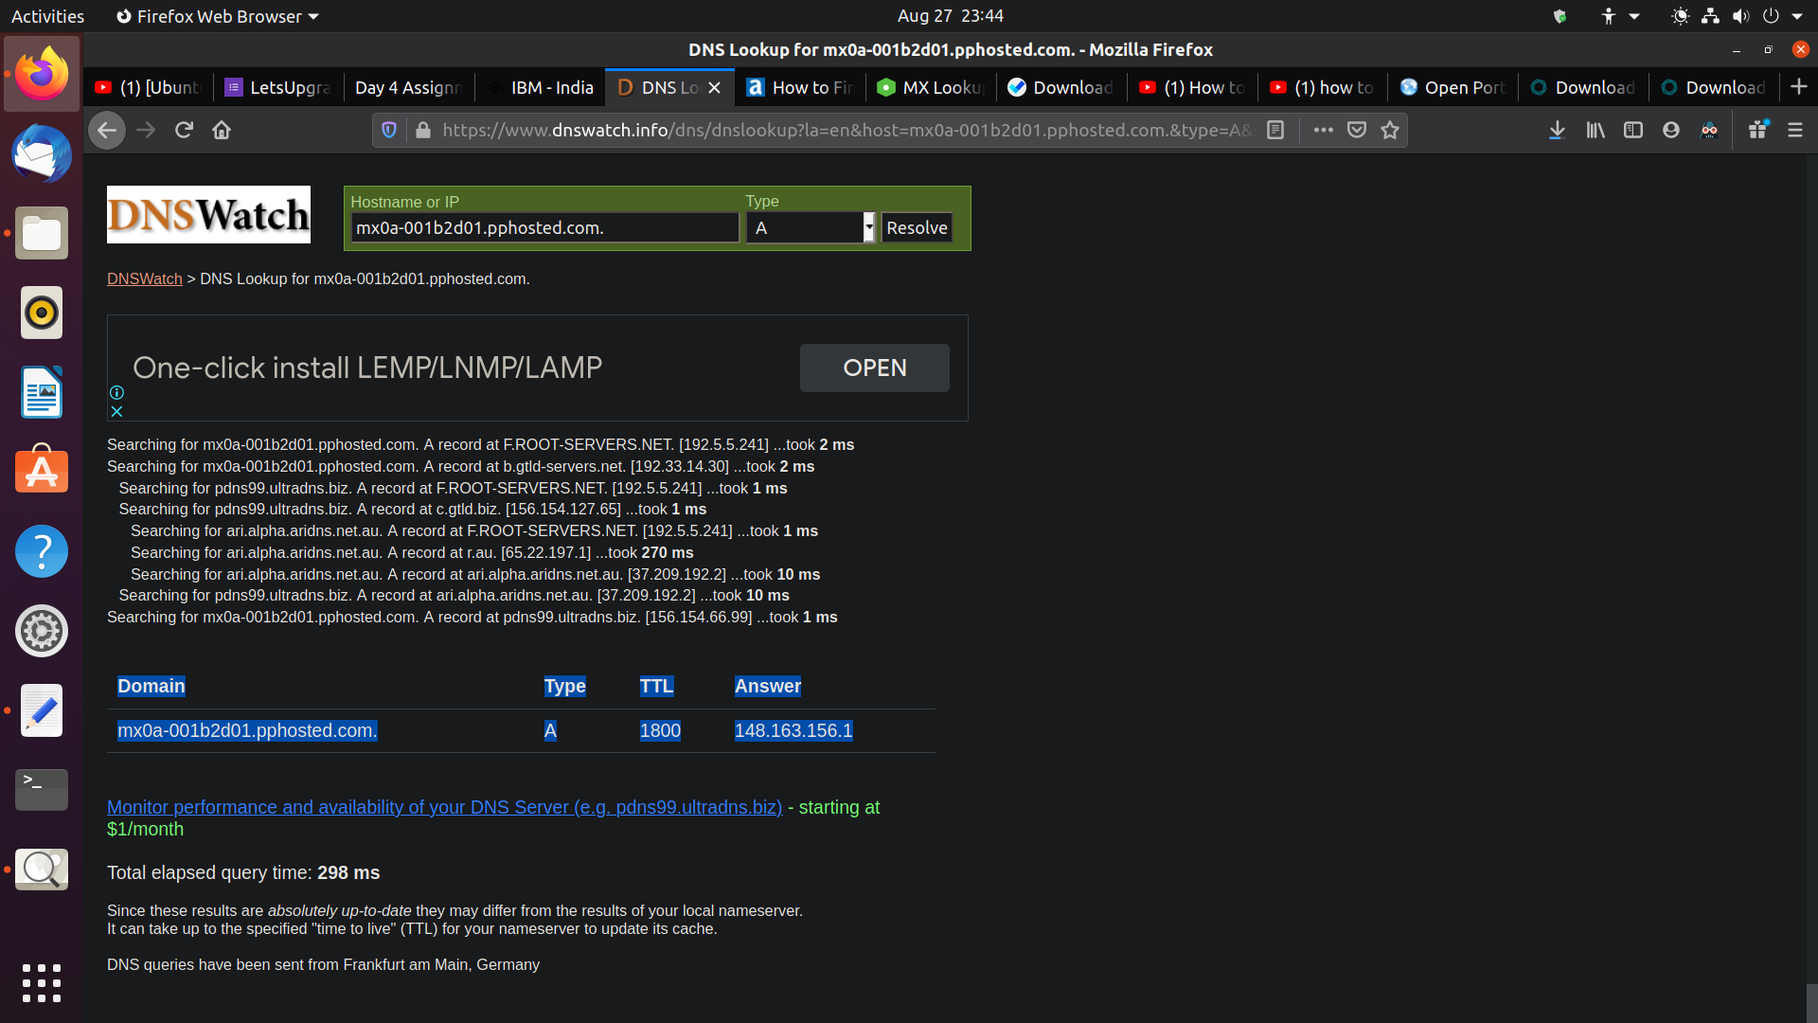

Slide 5
Question 3:Scan and find out port numbers open 203.163.246.23
Port Scanning Results
Port Type Status Service
80 TCP Filtered http
21 TCP Filtered ftp
22 TCP Filtered ssh
23 TCP Filtered telnet
25 TCP Filtered smtp
53 TCP Filtered domain
80 TCP Filtered http
110 TCP Filtered pop3
111 TCP Filtered rpcbind
135 TCP Filtered msrpc
139 TCP Filtered netbios-ssn
143 TCP Filtered imap
389 TCP Filtered ldap

Slide 6
443 TCP Filtered https
445 TCP Filtered microsoft-ds
587 TCP Filtered submission
1025 TCP Filtered NFS-or-IIS
1080 TCP Filtered socks
1433 TCP Filtered ms-sql-s
3306 TCP Filtered mysql
3389 TCP Filtered ms-wbt-server
5900 TCP Filtered vnc
6001 TCP Filtered X11:1
6379 TCP Filtered redis
8080 TCP Filtered http-proxy

