Slide 1
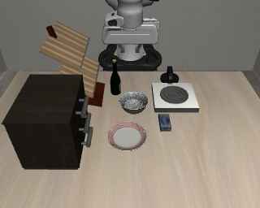
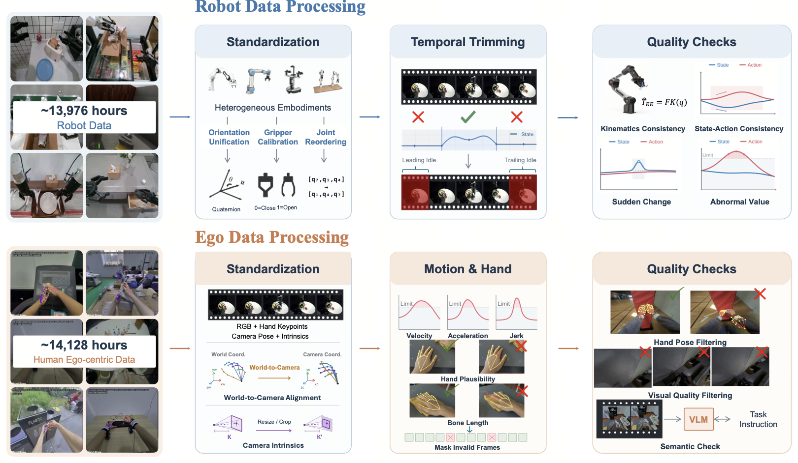
Robot demonstrations
Episode preparation & annotation
Standardization
Atomic Segmentation
Clip to Typed Call
1 Infer operation from state changes
approach + close + lifted object = pick
Embodiment & coordinate mapping
start t
contact
finish c
2 Bind references and contract
Base frame
Gripper
Joint order
scene: bowl arm: right result: held
approach
close
lift
3 Serialize validated string slots
pick(object="bowl",
target="above_table",
arm="right", completion="held")
“Put the bowl on the plate”
RGB + robot state + actions
One pick primitive
Synchronized episode
Completion event defines c
Ambiguous evidence goes to review
Pose units Open / close Joint mapping
Endpoint geometry + event keyframes replace the function body
Current observation
Terminal Pose
Event Keyframes
Action Alignment
pick: pregrasp / close / lift
z
x
y
pregrasp
closed
lifted
Actions realize event progression
End state: object held
a
a
a
a
a
a
Query: (pᶠ, Rᶠ)
move: endpoint
Different atoms,
different events
valid actions
mask boundary
t = start of this training window
Where the primitive finishes
arrived
{oₜ, sₜ, Pᵗˣᵗ, Xᶠ, Iᶠ, Aₜ}
Split episodes before sampling
One pose per arm
Event roles, timestamps and validity masks
Variable event count
Notes:
Design reference: user-provided robot-data-processing-editable.pptx, editable slide 2. Original robot silhouettes and calibration illustration retained as visual reference assets. LIBERO frames are from local source demonstration put_the_bowl_on_the_plate__seed11/source.mp4, not AtomVLA predictions. The pick interval shown is an illustrative re-annotation of approach/closure/lift into one typed primitive. The action curves come from its source_trace.npz. Method content follows sec/3_method.tex in the current manuscript. No dataset size or new empirical result is claimed.

