Slide 1
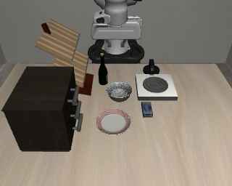
AtomVLA Framework
Discrete atomic call
Terminal pose
Primitive-specific imagined keyframes
Dense action chunk
pick(object="bowl",
target="above_table",
arm="right",
completion="held")
pᶠ, Rᶠ
z
x
one per arm
y
pregrasp
closed
lifted
move: end
motion + gripper commands
Q
Q
Q
Program Expert
Action Query
Future Imagination
Action Expert
Name + string arguments
Terminal geometry
Event keyframes replace the procedural body
Continuous control
Shared MoT attention [ context ; program ; Query / state ; image tokens ; action tokens ]
Q
Q
Q
VLM context Hₜ
Pᵗˣᵗ
Learned queries
VAE + noisy keyframe tokens
State prefix + noisy actions
current RGB + instruction
text CE
endpoint pose loss
event roles + order + camera masks
action flow loss
“Put the bowl
on the plate”
One terminal pose
Joint image / action denoising
Query predicts position and orientation
Action tokens read Query, state and visual tokens
Current state sₜ
Each primitive selects its meaningful events
Frames illustrate the representation, not model outputs
Notes:
Design reference: user-provided aw0-framework-recreated(1).pptx, editable slide 2. The expert band, code example region, image output strip, token rows, and shared-attention band retain the reference composition. Removed pure/hybrid code-execution sidebar. AtomVLA content follows current sec/3_method.tex: the text head emits discrete names and string arguments, Query predicts one terminal pose per active arm, and future imagination substitutes for an executable function body. Image/action experts jointly denoise concatenated streams; the top frames do not imply staged image-only rollout or multiple Query waypoints. Visual examples and action curve derive from a local LIBERO source demonstration, not AtomVLA generated predictions. Pick illustrates pregrasp, closure, lift; move illustrates its endpoint. These demonstration frames illustrate event roles, not verified automated annotations or generated predictions. The number of events depends on the primitive and current phase, not a fixed uniform temporal grid.

