Slide 1
Regret-Optimal and Stability-Enhanced Online Sampling of the Wiener Process for Remote Estimation over an Unreliable Channel with Unknown Statistics
Miao Pan, Haoyue Tang, Jiayu Pan, Tie Qiu, and Jianwei Yin
Presenter: Jiayu Pan
Northeastern University, China
1
1
Notes:
Timing: 0:42
Script:
Good morning everyone. Today I will present our work on regret-optimal and stability-enhanced online sampling of the Wiener process for remote estimation over an unreliable channel with unknown statistics. The central question is simple: if a sensor observes a continuously evolving source, but the communication channel has random delay and packet loss that we do not know in advance, how should the sensor decide when to sample and transmit? Our answer is an online threshold-learning algorithm that converges to the offline MSE-optimal policy, achieves minimax-optimal regret rates, and becomes significantly more stable after Polyak-Ruppert averaging.
Rehearsal cue:
开场要慢，突出三个关键词：unknown statistics, unreliable channel, regret-optimal.

Slide 2
Roadmap
Key idea: learn the optimal signal-aware sampling policy under an erasure channel with a random delay
1
System Model
Signal-aware sampling, erasure channel, random delay
Given channel statistics: Threshold-based sampling from stopping-time and free-boundary analysis
2
Model Based Solution (Existing Work)
Unknown channel statistics: Robbins-Monro threshold finding with a frequency constraint
3
Model Free Online algorithm (Our Work)
4
Guarantees
Regret-optimal convergence
and PR-enhanced stability
2
Notes:
Timing: 0:48
Script:
I will structure the talk in four parts. First, I will motivate why we care about MSE-oriented remote estimation rather than only the age of information. Second, I will introduce the model and explain why the optimal threshold becomes implicit when transmissions can fail. Third, I will present our online learning framework: Robbins-Monro stochastic approximation learns the optimal parameter, and Polyak-Ruppert averaging improves finite-sample stability. Finally, I will summarize the theoretical guarantees and simulation results. The main message is that we can learn an MSE-optimal sampling rule online, without estimating the full delay distribution.
Rehearsal cue:
这一页是路线图，给听众建立预期，不要展开技术细节。

Slide 3

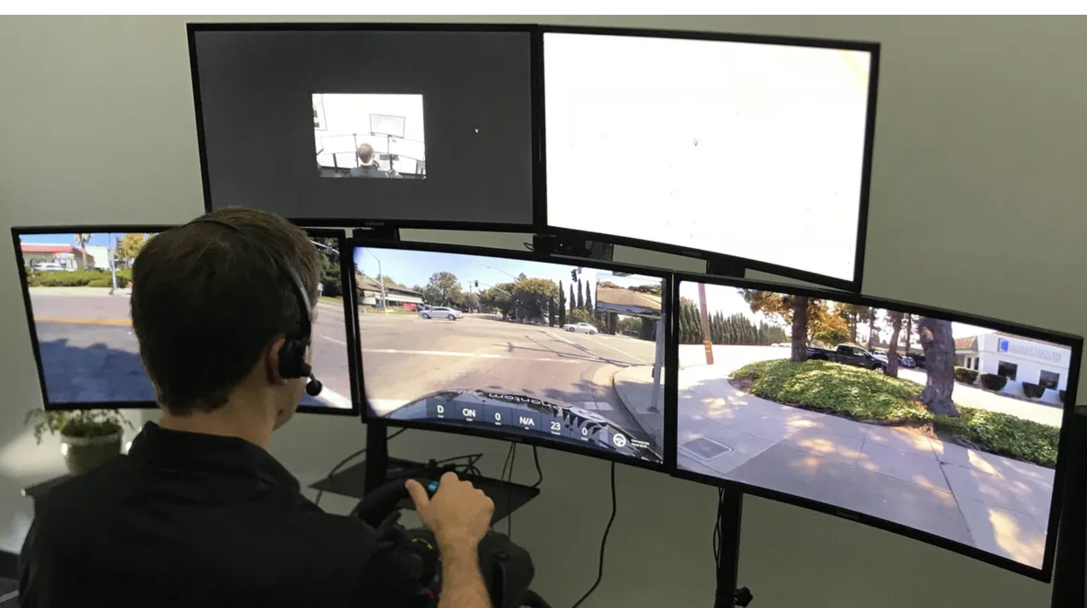
Motivation
Remote estimation should optimize reconstruction quality, not only information freshness.
A receiver needs accurate real-time estimates of a continuously changing state
Real-time Signal
(Pedestrian Intention)
Sample
(Vehicle)
Receive
(Remote Estimation)
Edge
Channel
Cloud
Applications
Sampling too often wastes energy and channel resources
remote health monitoring • GPS tracking • drone control
Sampling too late causes large estimation error
Design target
minimize long-term average MSE under sampling budget
3
Notes:
Timing: 1:06
Script:
Many networked systems rely on timely and accurate status updates. Examples include remote health monitoring, GPS tracking, and drone control. In these applications, the receiver is not only interested in whether the latest packet is fresh; it needs to reconstruct a time-varying physical state. If the source keeps evolving after the last received sample, the estimation error grows. A sensor could sample aggressively to reduce this error, but that consumes energy and communication resources. Therefore, the problem is a trade-off: sample early enough to control estimation error, but not so frequently that the system violates resource constraints.
Rehearsal cue:
强调 AoI 和 MSE 的区别：freshness 是间接指标，MSE 是估计质量。

Slide 4





System Model and Objective
The estimator sends the feedback only when a packet is successfully delivered.
Sensor
Unreliable channel
Remote estimator
observes Wiener process $W_{t}$
random delay$, packet drop$
piecewise-constant estimate
ACK / NACK feedback before the next attempt
Source: One-dimensional Wiener process W_t
Goal: minimize long-term average MSE under a sampling-frequency constraint
Objective
Constraint
minimize time-average MSE
average sampling rate ≤ $f_{max}$
4
Notes:
Timing: 1:12
Script:
We model the source as a scalar Wiener process. The sensor samples the process and sends a timestamped packet to a remote estimator. The channel is unreliable: each transmission attempt can fail with probability alpha, and each attempt also experiences a random delay. The sensor receives feedback after each attempt, so it knows whether the attempt succeeded or failed before taking the next sample. The receiver always uses the freshest successfully delivered sample as the MMSE estimate. The optimization objective is the long-term average MSE at the receiver, subject to a maximum average sampling frequency. This constraint captures practical limitations such as energy budget and channel load.
Rehearsal cue:
这一页要把符号说清楚：W_t, D, α, MSE, f_max。

Slide 5

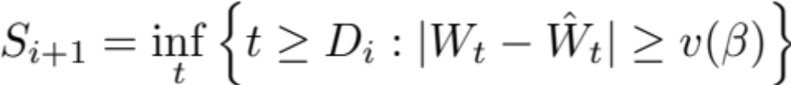
Optimal Offline Sampling Policy: Simple and Threshold-based
Theorem 1: When the channel statistics are known (Offline), an optimal sampling policy is given by
(Instantaneous)
Estimation error
Optimal threshold
Easy to compute
A simple solution from a complex problem
Each sampling time is “homogeneous”
  Takes the sample when the instantaneous estimation error exceeds the threshold
  The optimal threshold remains constant, independent of
    Estimation error of the instant the sampler receives the feedback
    Feedback of the last transmission (success or fail)
However, how to learn the optimal sampling policy when the channel statistics are unknown (Online)?
J. Pan, Y. Sun, and N. B. Shroff, ACM Sigmetrics, 2024
4
Notes:
Timing: 1:12
Script:
We model the source as a scalar Wiener process. The sensor samples the process and sends a timestamped packet to a remote estimator. The channel is unreliable: each transmission attempt can fail with probability alpha, and each attempt also experiences a random delay. The sensor receives feedback after each attempt, so it knows whether the attempt succeeded or failed before taking the next sample. The receiver always uses the freshest successfully delivered sample as the MMSE estimate. The optimization objective is the long-term average MSE at the receiver, subject to a maximum average sampling frequency. This constraint captures practical limitations such as energy budget and channel load.
Rehearsal cue:
这一页要把符号说清楚：W_t, D, α, MSE, f_max。

Slide 6
The Online Problem is Hard
C1
C2
Implicit threshold
Random packet drops
The threshold is not closed form with packet drop, even for the offline case
Causes heterogeneous value functions
C3
C4
Unknown delays
Noisy updates
Unknown expected delay causes heterogeneous value functions
Heterogeneous value functions induce the learning algorithm to have high variance and poor stability
6
Notes:
Timing: 1:12
Script:
There are four sources of difficulty. First, when packet loss is present, the optimal threshold is implicit. It is defined by a free-boundary matching condition and an infinite recursion over possible failed transmissions. Second, because the number of failed transmissions before success is random, the value functions are not simply identical copies of a single stage cost. Third, the delay distribution is unknown, so even if the offline characterization is available, the sensor cannot directly compute the oracle threshold. Finally, a natural online solution is stochastic approximation, but the classical Robbins-Monro method can be unstable when the stochastic observations have large variance. Our framework addresses these issues jointly.
Rehearsal cue:
不要把 challenge 讲成纯数学难点，要连接到 unknown and unreliable。

Slide 7
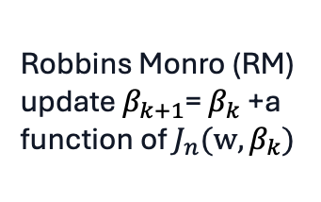
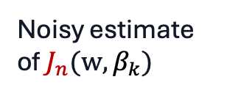
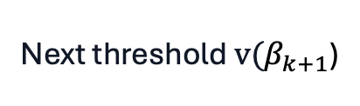
Solution to the Online Case
Robbins Monro (RM) update $β_{k+1}$= $β_{k}$ +a function of $J_{n}(w, β_{k})$
Observed delays
and increments
Noisy estimate
of $J_{n}(w, β_{k})$
Next threshold $v(β_{k+1}$)
Optimal threshold function
Easy to compute
Related works on online sampling: n=1
Our work: n=1,2,…(5 is sufficient in simulation)
7
Notes:
Timing: 1:24
Script:
The online strategy does not try to learn the complete delay distribution. Instead, it directly learns the scalar parameter beta star that determines the optimal sampling threshold. In each frame, the system observes realized delays and Wiener increments. These observations produce a noisy estimate of the value function equation. Robbins-Monro stochastic approximation then updates beta in the direction that drives the expected value toward zero. This is important because it reduces the problem from learning an entire policy under unknown channel statistics to learning one scalar parameter that controls a threshold policy. The policy remains interpretable, and the learning procedure is lightweight enough for online use.
Rehearsal cue:
突出 low-dimensional learning：不是 RL 黑盒，而是结构化在线学习。

Slide 8
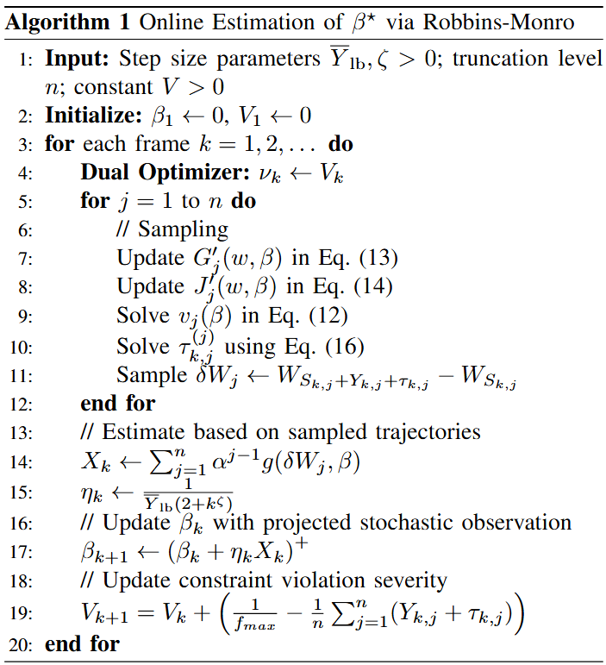
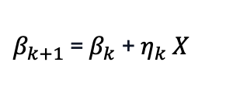
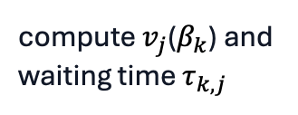
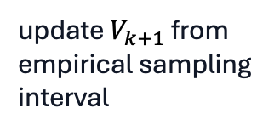
Algorithm 1: Robbins-Monro Online Sampling
j=1 to n
1
2
Threshold solve
Trajectory
compute $v_{j}$($β_{k}$) and waiting time $τ_{k,j}$
observe random delay and Wiener increment
4
3
Budget update
RM update
update $V_{k+1}$ from empirical sampling interval
$β_{k+1}$ = $β_{k}$ + $η_{k}$ $X$
Interpretation
The policy remains threshold-based, while learning adapts the threshold from the data stream.
8
Notes:
Timing: 1:30
Script:
Algorithm 1 combines threshold sampling with online stochastic approximation. At the beginning of each frame, the algorithm has a current beta estimate and a constraint-violation variable. The violation variable acts as a dual correction, so that the effective parameter used for sampling is beta minus nu. Given this value, the sampler solves the current threshold and chooses the waiting time. After the transmission attempts, the algorithm observes stochastic quantities from the realized trajectory and constructs X_k. Then beta is updated by a projected Robbins-Monro step. Finally, the violation variable is updated according to whether the empirical sampling interval satisfies the frequency constraint. Therefore, the same algorithm jointly learns the MSE-optimal threshold and enforces the long-term sampling constraint.
Rehearsal cue:
公式 β 更新一定要读出来，这是算法的核心。

Slide 9
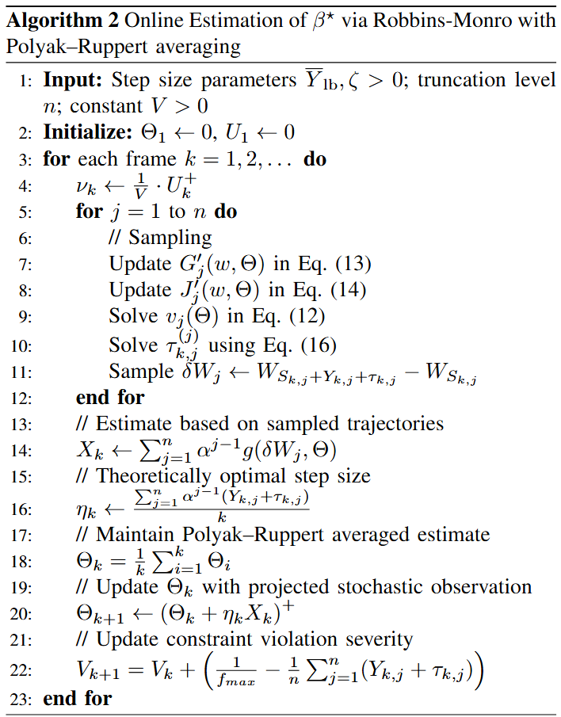

Stability Enhancement: Polyak-Ruppert Averaging
Variance reduction makes the online policy usable in finite time (more practical in simulation).
Problem
Plain RM converges asymptotically but can fluctuate heavily under random delays and failures.
Solution
Average iterates to form a stabilized estimate used by the next decision.
PR estimate
$$Θ_{k} = \frac{1}{k}\sum_{i=1}^{k}{β_{i}}$$
Step size
$η_{k}$ = P/k
9
Notes:
Timing: 1:12
Script:
Although Robbins-Monro is asymptotically correct, its finite-sample behavior can be noisy. This is especially true in our setting, where random delays and failed transmissions create high-variance observations. To stabilize the update, we use Polyak-Ruppert averaging. Instead of relying only on the most recent beta iterate, we average the iterates and use the averaged estimate as the stabilized parameter. The important point is that averaging does not change the asymptotic target; it still converges to beta star. But it reduces variance and allows a more aggressive step-size design. This is why the PR version converges faster and behaves more smoothly in the simulations.
Rehearsal cue:
说明 PR averaging 是稳定器，不是换目标函数。

Slide 10
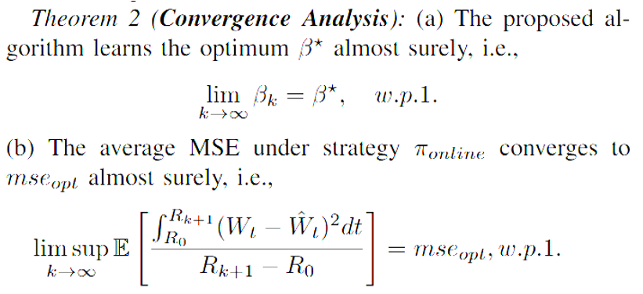
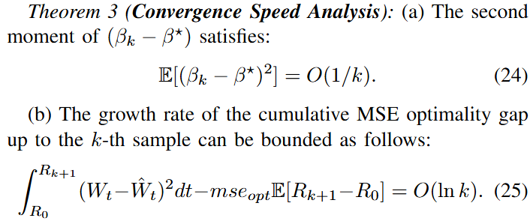
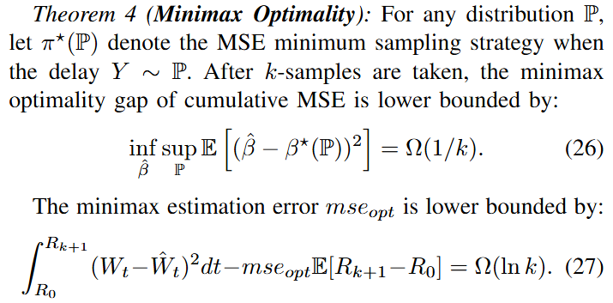
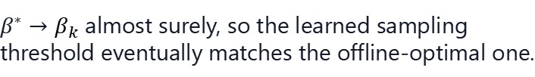
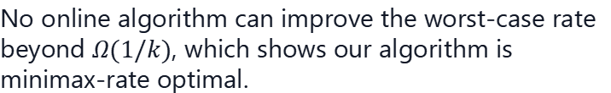
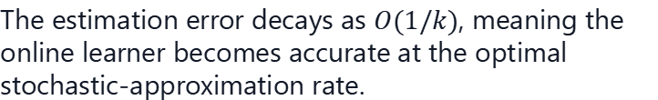
Theoretical Guarantees
The algorithm is not only convergent - it is rate-optimal.
Convergence
Achieves tight Lower bound
$β^{∗}→β_{k}$ almost surely, so the learned sampling threshold eventually matches the offline-optimal one.
Rate
The estimation error decays as $O(1/k)$, meaning the online learner becomes accurate at the optimal stochastic-approximation rate.
No online algorithm can improve the worst-case rate beyond $Ω(1/k)$, which shows our algorithm is minimax-rate optimal.
10
Notes:
Timing: 1:36
Script:
The analysis provides three main levels of guarantee. First, consistency: the learned beta converges almost surely to the offline optimal beta star, and the average MSE converges to the offline optimum. Second, convergence rate: the mean-square estimation error of beta decays as O of one over k, and the cumulative MSE optimality gap grows only logarithmically in k. Third, optimality: using Le Cam's two-point method, the paper proves a minimax lower bound showing that no online algorithm can have a better worst-case one-over-k estimation rate. For the PR-averaged version, the analysis further establishes asymptotic normality and variance decay, which explains the improved empirical stability.
Rehearsal cue:
这一页是理论贡献，慢一点，突出 upper bound 和 lower bound 匹配。

Slide 11
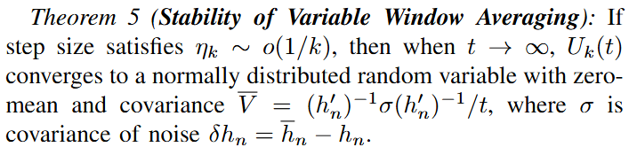
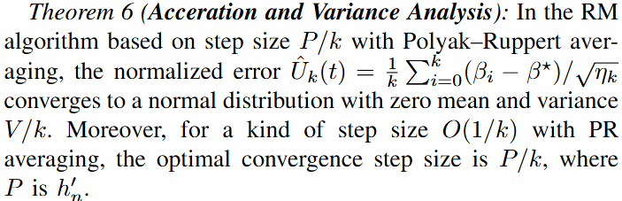
Theoretical Guarantees
The algorithm is not only rate-optimal but also with high stability
Stability
Accleration
without PR averaging: the error $U_{k}(t)$ is much larger
Variable-window averaging smooths noisy RM updates.
The averaged error becomes asymptotically zero-mean, and its variance decays as $1/t$.
PR averaging allows a larger $O(1/k)$ step size while keeping the averaged estimate stable.
The normalized error under PR averaging has variance $V/k$, meaning the estimate becomes increasingly concentrated around $β^{∗}$.
11
Notes:
Timing: 1:36
Script:
The analysis provides three main levels of guarantee. First, consistency: the learned beta converges almost surely to the offline optimal beta star, and the average MSE converges to the offline optimum. Second, convergence rate: the mean-square estimation error of beta decays as O of one over k, and the cumulative MSE optimality gap grows only logarithmically in k. Third, optimality: using Le Cam's two-point method, the paper proves a minimax lower bound showing that no online algorithm can have a better worst-case one-over-k estimation rate. For the PR-averaged version, the analysis further establishes asymptotic normality and variance decay, which explains the improved empirical stability.
Rehearsal cue:
这一页是理论贡献，慢一点，突出 upper bound 和 lower bound 匹配。

Slide 12
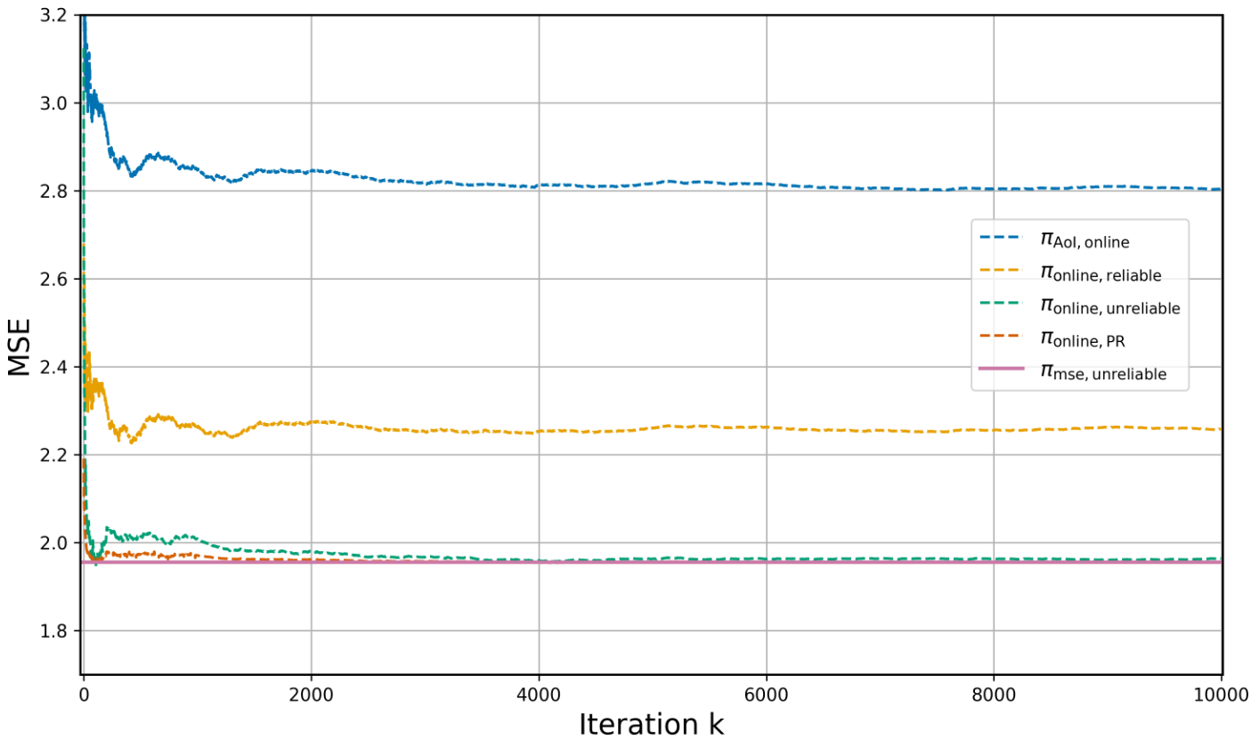
Result I: MSE Converges to the Offline Optimum
The PR version converges faster and more smoothly.
Observation 1
Signal-aware policies outperform AoI-only sampling.
Observation 2
Ignoring unreliability leaves a visible MSE gap.
Verify whether the proposed online policies can learn the offline-optimal MSE performance under unknown delay statistics and unreliable transmissions.
Observation 3
RM+PR reaches the offline optimum faster than RM.
12
Notes:
Timing: 1:06
Script:
The first result concerns MSE convergence without the sampling-frequency constraint. The reported trend is clear. Signal-aware policies achieve lower MSE than the AoI-based policy, because they optimize reconstruction quality rather than only freshness. The method designed for reliable channels is also suboptimal when the channel is actually unreliable, which shows the importance of modeling packet loss. Both proposed online policies converge toward the offline MSE-optimal policy. In addition, the PR-averaged version reaches the optimum faster and has smoother trajectories, which is consistent with the stability analysis.
Rehearsal cue:
讲图时按从差到好：AoI → reliable-channel baseline → RM → RM+PR/offline。

Slide 13
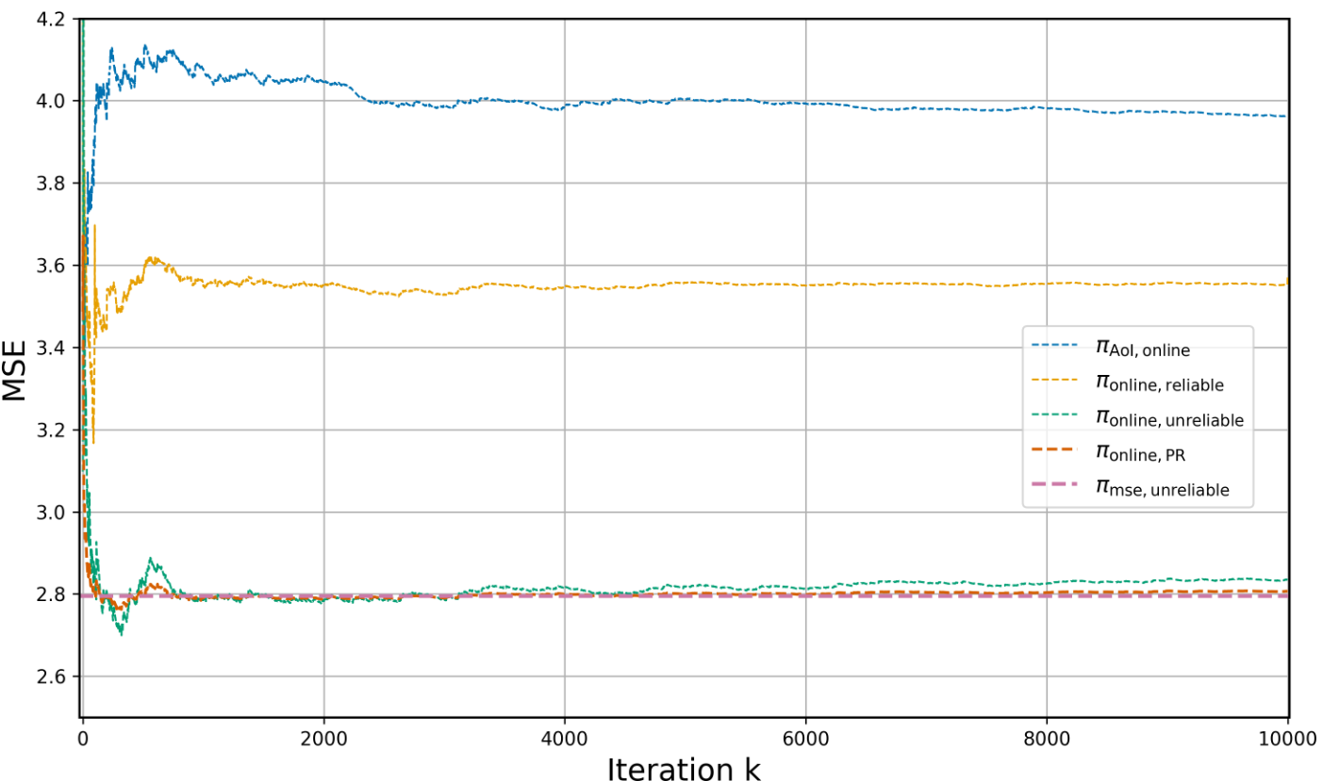

Result II: MSE Converges with Constraint
The PR version converges faster and more smoothly with constraint.
Accuracy
MSE remains close to the offline optimum under the constraint.
Budget
The average interval approaches $f_{max}$
Purpose
To evaluate whether the proposed online policies can still approach the offline-optimal MSE when the sampler is constrained by a maximum sampling frequency.
Stability
PR averaging reduces oscillation around the target.
13
Notes:
Timing: 1:06
Script:
The second result considers the sampling-frequency constraint. Under this constraint, the proposed online policies still converge toward the MSE optimum. More importantly, the average sampling interval approaches the target value defined by one over f_max. The PR-averaged method shows the most stable behavior around this target, with smaller oscillations and faster convergence. This is important in practice, because an online sampling algorithm must not only reduce estimation error; it must also respect long-term resource limits. The results show that the proposed approach can improve accuracy and constraint satisfaction at the same time.
Rehearsal cue:
把 frequency constraint 解释成资源预算，不是纯数学约束。

Slide 14
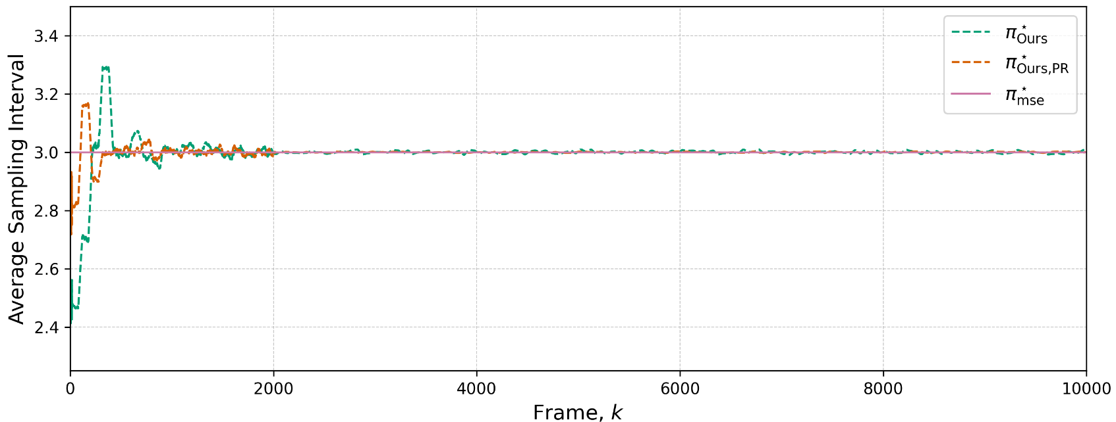

Result III: Stable Constraint Satisfaction
The same learning framework controls resource usage.
Stability improvement
PR averaging reduces oscillations in the learned threshold, leading to a smoother and more stable sampling interval curve.
Budget
The average sampling interval converges toward $1/f_{max}$.
Purpose
To check whether the proposed policies satisfy the long-term sampling frequency constraint and whether PR averaging improves constraint stability.
Fair MSE improvement
The MSE gain is not achieved by over-sampling. Instead, the policy improves estimation accuracy while still satisfying the sampling constraint.
14
Notes:
Timing: 1:06
Script:
The second result considers the sampling-frequency constraint. Under this constraint, the proposed online policies still converge toward the MSE optimum. More importantly, the average sampling interval approaches the target value defined by one over f_max. The PR-averaged method shows the most stable behavior around this target, with smaller oscillations and faster convergence. This is important in practice, because an online sampling algorithm must not only reduce estimation error; it must also respect long-term resource limits. The results show that the proposed approach can improve accuracy and constraint satisfaction at the same time.
Rehearsal cue:
把 frequency constraint 解释成资源预算，不是纯数学约束。

Slide 15

Key Takeaways
Four messages to remember.
Structure
Unknown statistics
Threshold policies reduce online control to scalar learning.
Learn $β^{∗}$ directly; no full delay-distribution estimation.
Optimality
Stability
O(1/k) matches the minimax lower bound.
PR averaging makes learning faster and smoother.
MSE-optimal sampling over unknown unreliable channels can be learned online with tight regret guarantees.
15
Notes:
Timing: 0:48
Script:
Let me summarize the key takeaways. First, the threshold structure is crucial. It allows us to convert a difficult online control problem into scalar parameter learning. Second, the method is distribution-oblivious: instead of estimating the delay distribution, it learns the parameter beta star directly from observed trajectories. Third, the learning rate is regret-optimal in the minimax sense. The upper bound achieved by the algorithm matches the lower bound for any online method under worst-case delay distributions. Finally, PR averaging makes the method more stable in finite samples, which is exactly what we need for unreliable channels.
Rehearsal cue:
这页可以作为结论前的总括，语气要有力。

Slide 16
Thank you
Questions?
Online threshold learning for MSE-optimal remote estimation
Handles unknown delay statistics and unreliable transmission
Minimax-optimal convergence plus PR-enhanced stability
For further detailed information, feel free to contact my former m.s. student Miao Pan 22351015@zju.edu.cn
17
Notes:
Timing: 0:12
Script:
To conclude, we proposed an online threshold-learning framework for MSE-optimal remote estimation over unreliable channels with unknown statistics. The algorithm is theoretically regret-optimal and empirically stabilized by Polyak-Ruppert averaging. Thank you, and I am happy to take questions.
Rehearsal cue:
最后一句直接抬头看观众。

