Slide 1
VERIRL: Boosting the LLM-based Verilog Code
Generation via Reinforcement Learning
Fu Teng, Miao Pan, Xuhong Zhang, Zhezhi He, Yiyao Yang, Xinyi Chai, Mengnan Qi, Liqiang Lu, Jianwei Yin

Slide 2

Background
Strict Syntax & Verification
Concurrency & Timing
Verilog has extremely low tolerance for syntax errors, and correctness must be validated through simulation.
Parallel execution and precise timing semantics exceed the linear generation capability of typical LLMs.
Pattern Memorization
Generalization
SFT-based models tend to memorize surface patterns rather than ensure executable correctness.
Models struggle to generalize to new tasks, complex circuits, or unseen module structures.

Slide 3

Challenges
Rise of RL for Code Generation
New RL-based approaches such as GRPO highlight the shift from pattern memorization to simulation-driven learning. They show promising directions but also expose key challenges.
02
Catastrophic Forgetting
Model easily overfits to recent rewards. Meanwhile, KL regularization from GRPO is not sufficient to stabilize learning.
01
Sparse & Noisy Rewards
Simulation feedback is often binary (pass/fail) and hard to obtain which leads to unstable reward modeling and poor training signals.

Slide 4
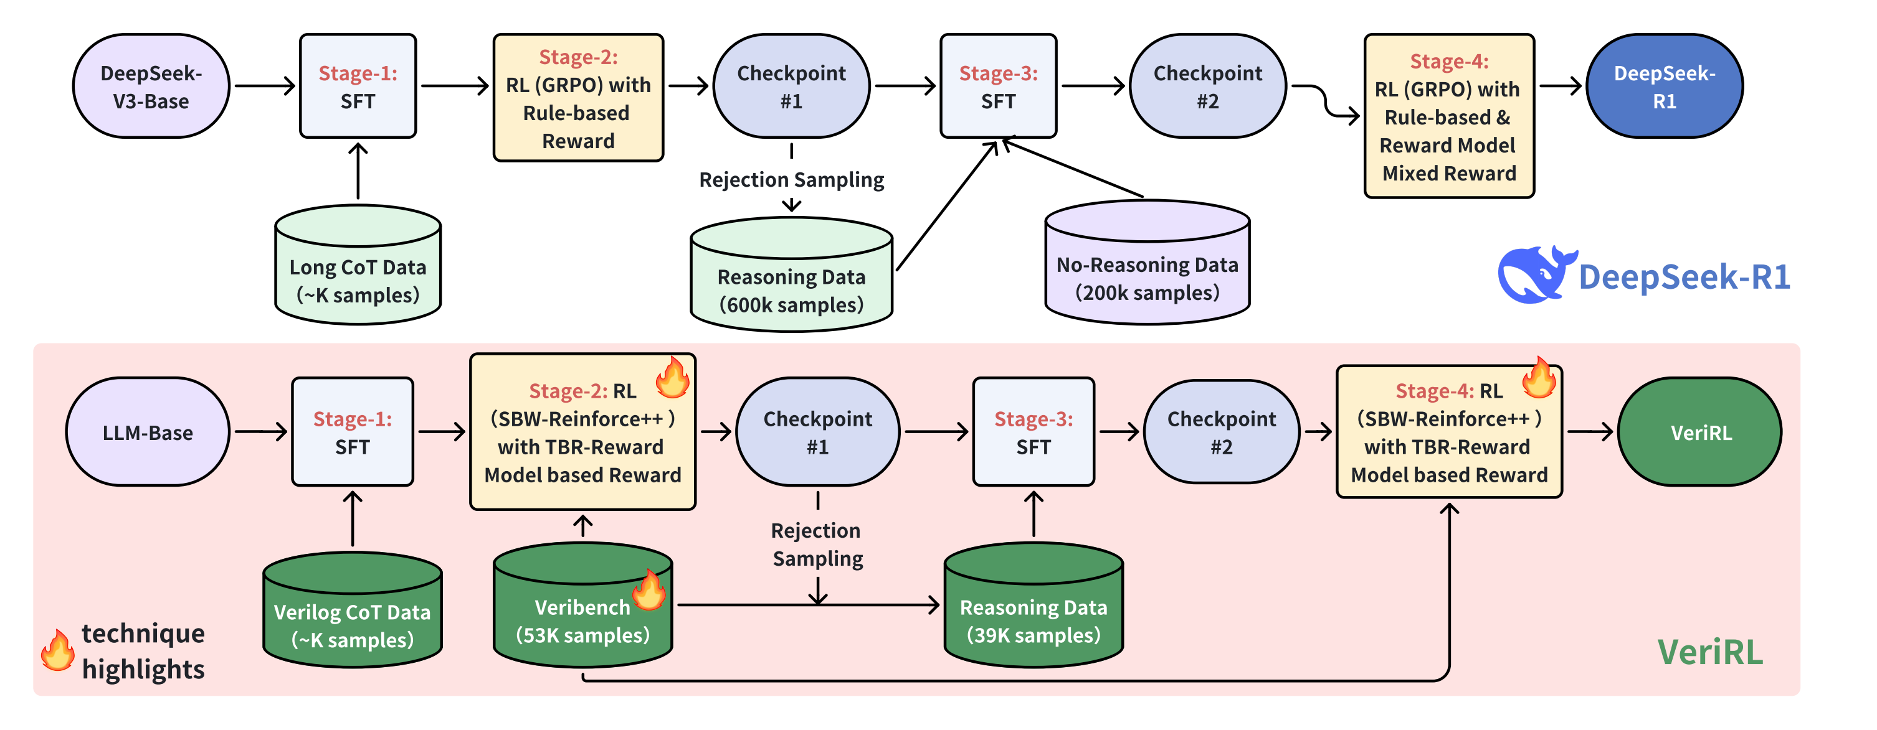
Overview of VERIRL Framework
1. Dense reward modeling with Trace-back based Rescore ensuring fine-grained functional feedback.
2. Rigorous sample filtering via Sample-balanced Weighting, yielding high-quality reasoning data for stable RL training.

Slide 5
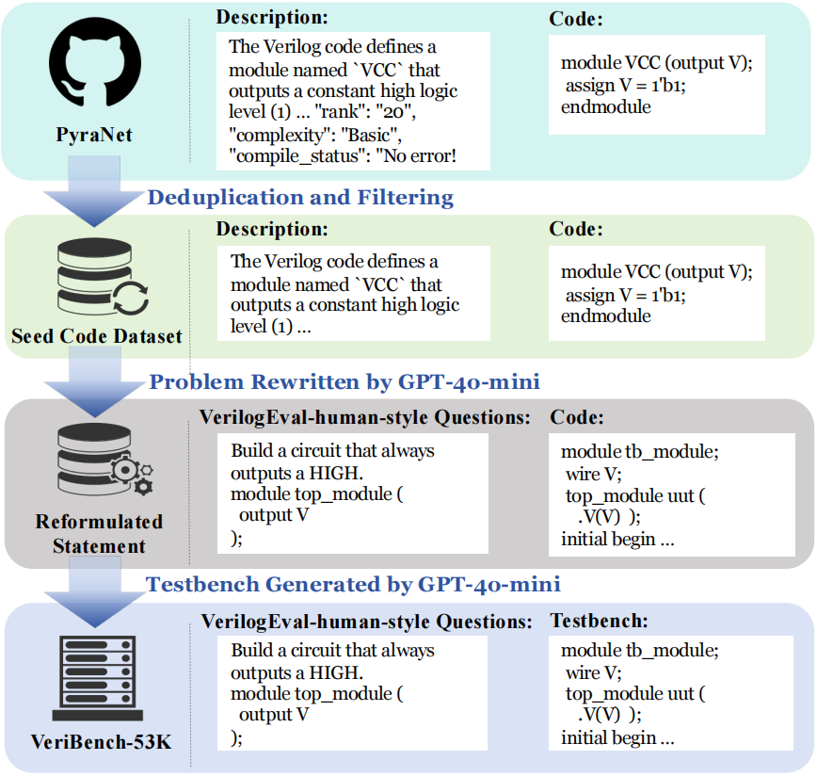
VeriBench-53K Dataset
1. Deduplication & Filtering
Start from PyraNet (700K problems) and then remove duplicates, non-compilable, and low-quality entries.
2. Problem Rewriting
Use GPT-4o-mini to convert functional descriptions → structured, VerilogEval-style questions.
3. Testbench Generation
GPT-4o-mini generates 5–10 diverse testbenches per problem, which enables simulation-based correctness checking.

Slide 6
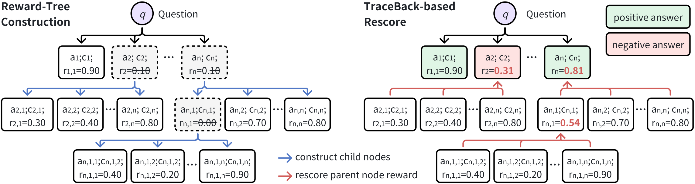
Trace-back based Rescore
1. Reward-tree construction: generate multiple answers, flag low-reward ones, refine via self-reflection.
2. TbR: rescore parent nodes by averaging child rewards, backpropagating improvements.
3. Preference pair selection: choose answer pairs with large reward gaps (Δ>0.4, positive>0.8).

Slide 7
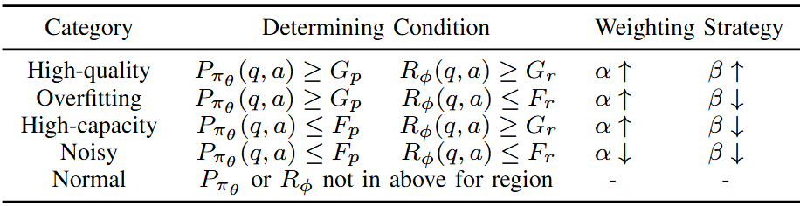
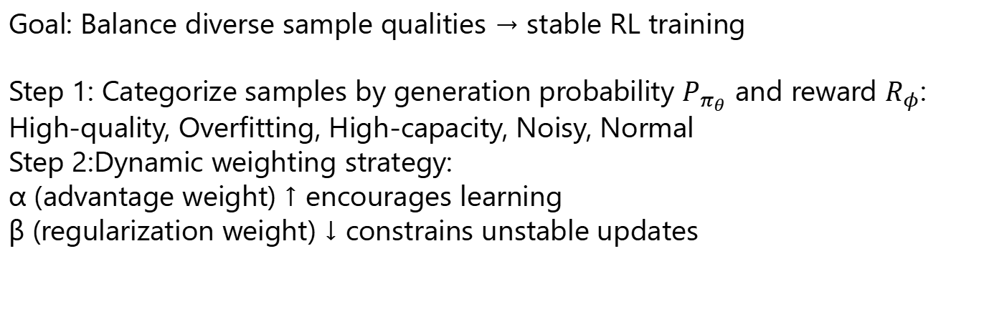
Sample-balanced Weighting
Goal: Balance diverse sample qualities → stable RL training
Step 1: Categorize samples by generation probability $P_{π_{θ}}$ and reward $R_{φ}$​: High-quality, Overfitting, High-capacity, Noisy, Normal
Step 2:Dynamic weighting strategy:
α (advantage weight) ↑ encourages learning
β (regularization weight) ↓ constrains unstable updates

Slide 8
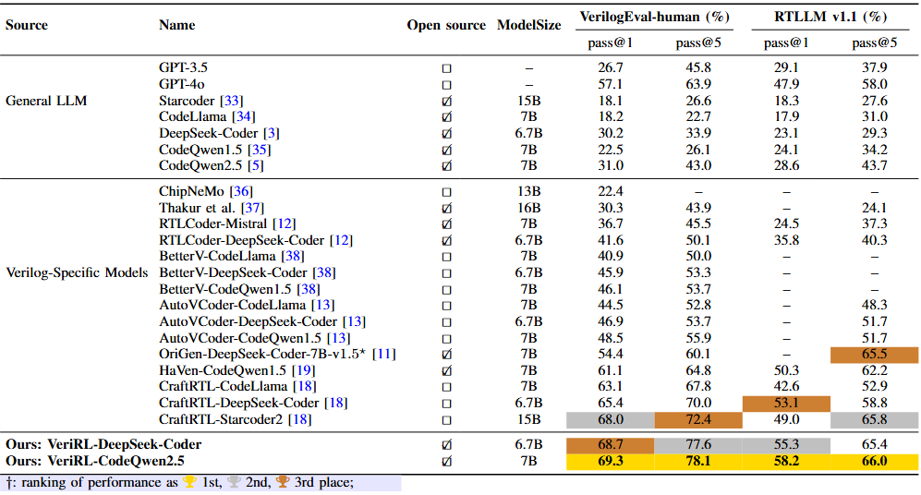
Main Result
VerilogEval-Human: 69.3% (pass@1), 78.1% (pass@5)
RTLLM v1.1:
58.2% (pass@1), 66.0% (pass@5)
Our VeriRL achieves SOTA on both benchmarks and outperforms prior best Verilog-specific models.

Slide 9
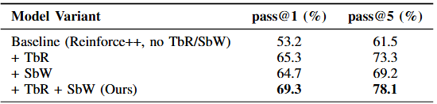
Ablation Study
Ablation Study on VerilogEval v1
Baseline (Reinforce++ only): 53.2% / 61.5%
+ TbR: +12.1% pass@1 → leverages partially correct samples
+ SbW: +11.5% pass@1 → stabilizes training via adaptive weighting
+ TbR + SbW (Ours): 69.3% / 78.1% → complementary gains

Slide 10
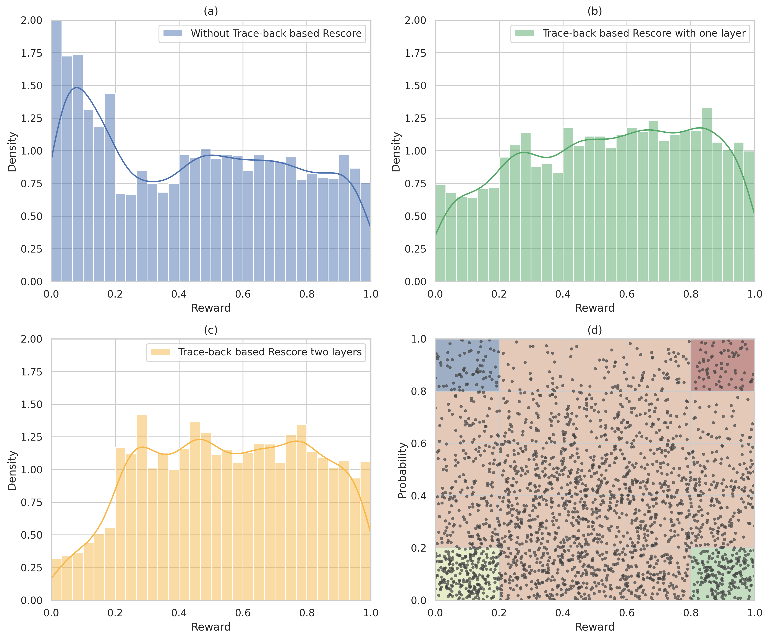
Analysis Experiment
Analysis of TbR & SbW
Trace-back Rescore:
Recovers partially correct samples → increases proportion of effective rewards.
Sample-balanced Weighting:
Re-weights sample categories → reshapes distribution for balanced and stable RL training.

Slide 11
Thanks

