Slide 1
Sampling the Ornstein-
Uhlenbeck Process
Core question
for Remote Estimation over an Unreliable Channel
When should the sampler wait, and when should it transmit?
Optimal Sampling | MMSE | Signal-Aware Remote Estimation
Presenter: Jiayu Pan
Goal: minimize long-term average estimation error under packet losses.
01
Notes:
Good morning everyone. Today I will present our work on sampling the Ornstein-Uhlenbeck process for remote estimation over an unreliable channel. The problem is simple to state: a sensor observes a continuously evolving stochastic signal, but the remote estimator can only update its estimate when a transmitted sample is successfully received. The channel has random delay and may lose packets. Therefore, the sampler must decide whether to sample immediately or wait until the current estimation error becomes sufficiently informative. Our objective is not just data freshness; it is the long-term average mean-square estimation error. The main message of this talk is that even under an unreliable channel and a more complex mean-reverting signal model, the optimal policy still admits a clean threshold structure, and this structure reveals a new phenomenon that does not appear in the Wiener-process case.

Slide 2
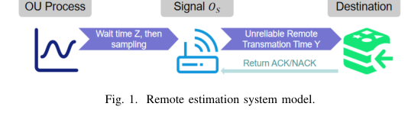
Background: Remote estimation under limited updates
Real-time systems need accurate estimates, not merely frequent packets
1
Sampler
Chooses a waiting time and samples the current signal state.
2
Unreliable channel
Adds random delay and independent packet failures.
In remote estimation systems, transmitting every observation is often infeasible because of limited channel capacity, energy budget, and sampling-rate constraints.
3
Remote estimator
Updates the estimate only after successful reception.
Design problem: convert scarce and unreliable update opportunities into minimum estimation error.
02
Notes:
Let me first introduce the background. In many real-time systems, such as autonomous driving clusters, telemedicine networks, and smart factories, the source continuously observes a time-varying status. However, sending every observation to the destination is impossible, because bandwidth, energy, and sampling frequency are all limited. The system therefore consists of three coupled components. First, the sampler decides when to generate the next sample. Second, the channel introduces random delay and independent transmission failures. Third, the remote estimator updates its estimate only when a packet is successfully delivered. This setting creates a nontrivial timing problem. Sampling too early may waste an update opportunity, but waiting too long can increase the estimation error. The central design question is how to use a limited number of unreliable transmissions to maintain an accurate real-time estimate.

Slide 3
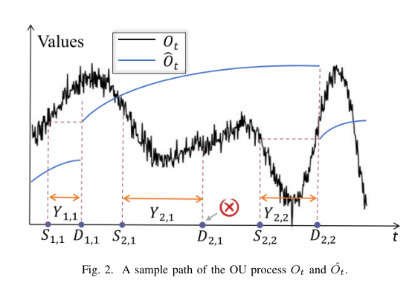
Motivation: Freshness is not the same as fidelity
AoI measures how old the latest update is; MMSE measures how wrong the estimate is
Age-based view
Focuses on the elapsed time since the latest received update.
Estimation-error view
Focuses on the gap between the true signal and the estimator.
For an OU process, mean reversion bounds the error growth, so the best sampling time depends on signal dynamics.
03
Notes:
Why do we use estimation error rather than only age of information? Age of information is a useful freshness metric, but it does not directly capture the stochastic evolution of the signal. The figure illustrates a sample path of the OU process and the corresponding remote estimate. The estimator is updated only at successful deliveries, so the actual error depends on both update timing and signal dynamics. For the OU process, the signal is mean-reverting: it tends to return toward a long-term mean instead of diffusing without bound. This means the estimation error has a very different behavior from the Wiener process. Therefore, a policy that is optimal for freshness, or even optimal for a Wiener signal, may be suboptimal for OU remote estimation. This is the key motivation for a signal-aware MMSE formulation.

Slide 4
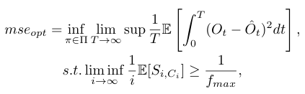
Problem formulation: Signal-aware optimal stopping
The sampler chooses stopping times to minimize long-term average MSE
System model
Source signal follows an OU process with mean reversion.
Each attempt has random delay Y and failure probability alpha.
After feedback, the source sends a newly sampled observation.
Objective
Minimize the time-average integral of squared estimation error, while satisfying a sampling-rate constraint.
Waiting time is a stopping time based on the observed process.
04
Notes:
The mathematical formulation is as follows. The source signal is modeled as an Ornstein-Uhlenbeck process, with parameters for mean reversion and volatility. At any time, the remote estimator uses the latest successfully delivered sample to form the conditional expectation of the signal. The performance metric is the long-term average mean-square estimation error. In addition, the paper imposes an average sampling-rate constraint, which is important in practical systems with energy or sensing limitations. The decision variable is the sampling policy, and more specifically the waiting time before each transmission attempt. Because the waiting time may depend on the observed sample path, it is naturally a stopping time. This makes the problem fundamentally different from a deterministic waiting-time optimization problem.

Slide 5
Technical challenges
The OU drift term and unreliable transmission jointly break simple value iteration
theta
alpha
proof
Mean-reverting signal
Failed transmissions
Global optimality
The OU drift term complicates the reward function and its derivative structure.
The estimator is not reset after a failed attempt, so the value function must be computed recursively.
Free-boundary conditions give a candidate policy, but global optimality still requires proof.
Desired outcome: a policy that is analytically optimal, computationally efficient, and structurally simple.
05
Notes:
There are three main technical challenges. The first challenge comes from the OU drift term. In the Wiener case, the signal has independent increments without mean reversion, while the OU process introduces exponential forgetting and a bounded stationary variance. This changes the reward function and makes derivative-based arguments more complicated. The second challenge is channel unreliability. If a transmission fails, the estimator is not updated, so future decisions are still coupled with the old estimation error. This requires an iterative value function rather than a one-shot calculation. The third challenge is optimality. The free-boundary method can suggest a threshold candidate, but it only provides necessary conditions. The paper therefore needs additional arguments to prove that the threshold policy is globally optimal and that the finite-horizon iterations converge.

Slide 6
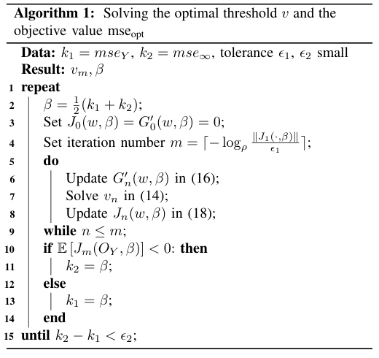
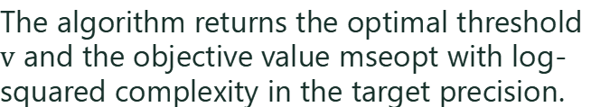
Method flow: From long-run average cost to a threshold
A four-stage derivation produces a low-complexity sampling rule
1
2
3
4
Renewal reduction
Parametric cost
Recursive stopping
Threshold solving
Rewrite long-run MSE by successful update cycles.
Use beta to linearize the fractional objective.
Represent packet loss through an alpha-discounted recursion.
Apply free boundary conditions and prove optimality.
Computational output
The algorithm returns the optimal threshold $v$ and the objective value mseopt with log-squared complexity in the target precision.
06
Notes:
The solution pipeline has four stages. First, the long-run average cost is reduced to a cost over a renewal cycle, where each cycle ends with a successful delivery. Second, the fractional objective is transformed into a parameterized linear cost using a beta parameter. The optimal beta is the root where the expected parameterized value equals zero. Third, packet loss is incorporated through a recursive formulation. Since the number of attempts until success is geometrically distributed, the failure probability alpha appears as a discount factor. Fourth, the resulting optimal stopping problem is solved through a free-boundary method, which leads to a threshold equation. The algorithm then alternates threshold computation and bisection search over beta. The important practical point is that the final computation is efficient: it only needs log-squared complexity with respect to the desired precision.

Slide 7
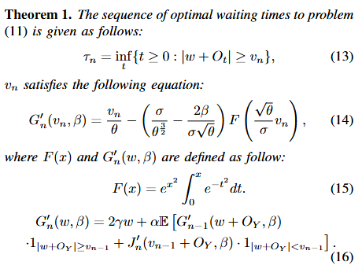
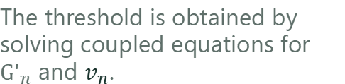

Theoretical I: The optimal policy is threshold-based
Sample when the absolute estimation error exits a safe region
Policy form
Wait while $|w + O_{t}|$ is below the threshold $v_{n}$.
Sample immediately once the estimation error crosses the boundary.
The threshold is obtained by solving coupled equations for ${G'}_{n}$ and $v_{n}$.
Key insight: unreliable transmission and OU dynamics increase analytical complexity, but the optimal decision rule remains simple.
07
Notes:
The first main theoretical result is that the optimal waiting time has a threshold form. Let w denote the current estimation error. The sampler observes the OU increment over time. As long as the absolute error remains below the threshold, the sampler keeps waiting. Once the absolute error crosses the threshold, the sampler generates a new sample and transmits it. This is intuitive: when the current estimate is still sufficiently accurate, using the channel immediately is not worthwhile; when the estimation error becomes large enough, a new sample is needed. The nontrivial part is that this simple structure remains optimal even with unreliable transmissions and OU mean reversion. The theorem also gives the equations needed to compute the threshold sequence. Later, linear convergence shows that this sequence converges to the final optimal threshold.

Slide 8
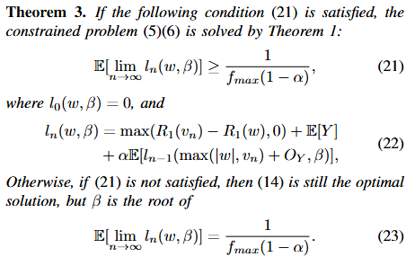
Theoretical II: Sampling-rate constraints keep the same structure
The threshold form survives, but beta is recalibrated to satisfy the constraint
If the unconstrained policy is feasible
The optimal solution is exactly the unconstrained threshold policy.
If the constraint is active
The threshold form is retained, while beta is selected so that the sampling-rate constraint holds with equality.
Practical meaning: the policy can trade estimation accuracy against energy or sensing limitations without changing its decision form.
08
Notes:
The second theoretical result extends the policy to the case with a sampling-rate constraint. This is important because real systems often limit how frequently a sensor can sample or transmit. The theorem states that if the unconstrained optimal policy already satisfies the minimum average inter-sampling time requirement, then nothing needs to be changed: it remains optimal. If the unconstrained policy samples too often, the policy structure still does not change. It is still a threshold policy. What changes is the beta parameter, which is recalibrated so that the sampling-rate constraint is met with equality. This is a useful result because it means the same computational framework can handle both unconstrained and constrained settings. From a system perspective, the threshold becomes a knob that balances estimation accuracy with resource consumption.

Slide 9

Theoretical III: A new OU-specific zero-wait regime
When the channel is highly unreliable, waiting no longer helps
Counterintuitive phenomenon
When the packet loss probability exceeds a critical threshold, the optimal threshold collapses to zero.
The optimal action becomes zero-wait sampling.
Why this is OU-specific
Contrast with Wiener
OU estimation error is bounded by the stationary variance, so excessive waiting has limited benefit under severe losses.
For a Wiener process, the analogous threshold condition does not create this zero-wait collapse.
09
Notes:
The third theoretical result is the most distinctive phenomenon in this paper. In signal-aware sampling, one may expect that waiting should always be useful when the current estimation error is small. However, for the OU process, the paper shows that when the packet loss probability is above a critical threshold, the optimal threshold becomes zero. In other words, the optimal policy collapses to zero-wait sampling. This is counterintuitive, but it has a clear explanation. The OU process has a stationary distribution, so the estimation error has an upper bound. When the channel is highly unreliable, the potential gain from waiting is dominated by the risk of losing future transmissions. It is better to transmit immediately whenever feedback is received. This phenomenon does not arise in the Wiener-process setting, where the error can grow without bound.

Slide 10
Simulation setup
Numerical evaluation validates the theory against representative baselines
Benchmarks
Parameters and goals
Optimal Policy: proposed signal-aware threshold policy.
Transmission delay follows a normalized lognormal distribution.
OU-Reliable Policy: ideal reliable-channel upper benchmark.
Larger delta means heavier-tailed delay behavior.
Age-Optimal Policy: freshness-oriented baseline.
Three studies vary delay tail, packet loss, and sampling limit.
Zero-Wait Policy: transmit immediately after feedback.
Metric: long-term average MMSE.
10
Notes:
The simulations compare the proposed optimal policy with three baselines. The first is the OU-reliable policy, which assumes a perfectly reliable channel and therefore serves as an ideal upper benchmark. The second is the age-optimal policy, which targets freshness rather than estimation error. The third is the zero-wait policy, which samples immediately after feedback. The transmission delay is modeled by a normalized lognormal distribution, which is commonly used to represent heavy-tailed delay behavior. Larger delta values indicate more variable delay distributions. The evaluation contains three separate experiments: the effect of the delay-tail parameter delta, the effect of packet loss probability alpha, and the effect of the sampling frequency limit. In all cases, the metric is the mean-square estimation error, so lower curves are better.

Slide 11
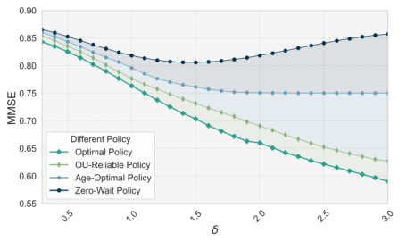
Experiment 1: Effect of heavy-tailed transmission delay
Purpose: test how policies react as the delay distribution becomes more variable
Experiment purpose
Vary delta in the lognormal delay distribution and observe the resulting MMSE.
Main observation
The proposed optimal policy achieves the lowest MMSE. Zero-wait deteriorates as delay variability increases.
Interpretation: deliberate waiting exploits OU temporal correlation, while zero-wait wastes updates under highly variable delays.
11
Notes:
The first experiment studies the effect of the lognormal delay parameter delta. The purpose is to test how each sampling policy behaves when transmission delays become more heavy-tailed and variable. The proposed optimal policy consistently produces the lowest MMSE among the policies shown. The age-optimal and reliable-channel baselines behave reasonably, but they are not as effective as the proposed signal-aware threshold rule. The zero-wait policy shows a different pattern: as delay variability increases, its estimation error becomes worse. This indicates that immediately transmitting after every feedback can be inefficient for OU signals. Because the OU process has temporal correlation and mean reversion, there are times when waiting for a more informative sample is beneficial. The proposed policy captures this tradeoff through the threshold mechanism, which explains the performance advantage in the figure.

Slide 12
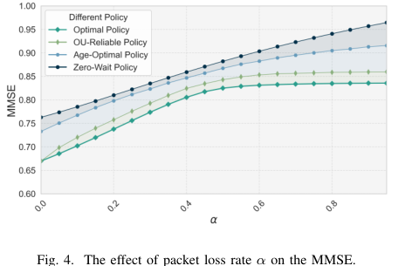
Experiment 2: Effect of packet loss probability
Purpose: test robustness when the communication channel becomes less reliable
Experiment purpose
Increase packet loss probability alpha and compare policy robustness.
Main observation
All policies degrade as alpha grows, but the proposed policy maintains the lowest MMSE.
Interpretation: adaptive waiting reduces wasted attempts and remains resilient under packet losses.
12
Notes:
The second experiment varies the packet loss probability alpha. The purpose is to evaluate robustness as the channel becomes increasingly unreliable. As expected, all policies experience higher MMSE when alpha increases, because successful updates become less frequent. However, the proposed optimal policy remains consistently below the baselines. This is important because the policy is not merely optimized for a reliable system; it explicitly accounts for failed transmissions in the recursive value function. The zero-wait policy degrades severely, because it transmits whenever possible without considering whether the sample is sufficiently valuable. The age-optimal policy also focuses on freshness rather than estimation accuracy. In contrast, the proposed strategy balances the current estimation error, the OU dynamics, and the risk of packet loss. This explains why it retains a clear advantage across the full range of alpha.

Slide 13
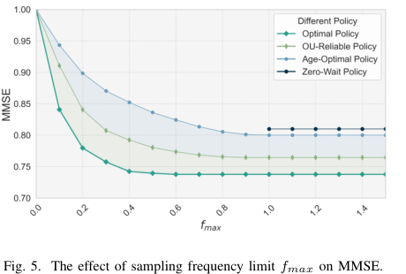
Experiment 3: Effect of sampling-frequency limit
Purpose: evaluate the constrained policy under practical sensing or energy limitations
Experiment purpose
Vary fmax to test how sampling-rate constraints affect MMSE.
Main observation
The optimal constrained policy achieves lower MMSE and becomes less sensitive once fmax is sufficiently large.
Interpretation: the threshold policy naturally supports resource-aware sampling without changing its basic form.
13
Notes:
The third experiment evaluates the sampling-rate constraint. Here the purpose is to understand how the maximum allowed sampling frequency affects estimation performance. When the sampling limit is very tight, all policies suffer because update opportunities are scarce and the MMSE is close to the OU upper range. As the allowable sampling frequency increases, the proposed constrained optimal policy quickly improves and reaches a stable low-error region. The zero-wait policy is only feasible under certain conditions and does not fully exploit the signal dynamics. The key takeaway is that the threshold policy is naturally resource-aware. Under an active constraint, the threshold and beta parameter adjust so that sampling is neither too frequent nor too sparse. This supports the theoretical result that the constrained problem preserves the same threshold structure while satisfying practical system limitations.

Slide 14
Takeaways
1
Problem
Remote estimation of an OU process over random-delay, lossy channels with sampling-rate constraints.
2
Method
Transform to recursive optimal stopping and solve the free-boundary threshold policy.
3
Theory
Prove threshold optimality, constrained optimality, linear convergence, and an OU-specific zero-wait regime.
4
Empirics
Simulations confirm lower MMSE under delay variability, packet loss, and sampling constraints.
Main message: a difficult stochastic sampling problem reduces to a simple, computable, and interpretable threshold rule.
14
Notes:
To conclude, this paper studies optimal sampling for remote estimation of an OU process over an unreliable channel. The problem is practically motivated by IoT and real-time monitoring systems where updates are limited, delayed, and sometimes lost. The technical contribution is to transform the long-term MMSE minimization problem into a recursive optimal stopping problem and solve it using free-boundary analysis. The resulting optimal policy is a threshold rule: wait while the estimation error is within a safe region and sample when it exits the region. The theory further handles sampling-rate constraints, proves convergence, and identifies a new OU-specific phenomenon: under sufficiently unreliable channels, the optimal threshold collapses to zero-wait sampling. Finally, the simulations validate the benefits under heavy-tailed delays, packet losses, and resource constraints. The main message is that even a complex stochastic communication problem can lead to a simple and interpretable sampling law.

