Slide 1
Case Study - Segment Customers based on Purchase History
Problem Statement
A leading women’s fashion retailer in the US has around 80 stores
Its main customer targeting happens through mailed catalogs the conversion of which is less than 1%
It aims to streamline its promotion strategy by targeting the right customer groups to improve conversion
Given the customer and purchase data, you need to segment these customers based on their purchase history
Data Description
Purchase Data – Last 1-year purchase details at customer-product level.
Customer Data – Customer history including details around their lifetime spend, frequency, mailing details etc.

Slide 2
Proposed Solution
RFM analysis
Lifetime Recency: How recently a customer has made a purchase
Lifetime Frequency: How often a customer makes purchases
Lifetime Monetary: How much a customer spends on purchases
K-means clustering
Involves grouping customers based on similarity in their purchase behavior, such as the frequency and recency of their purchases.
Once customer segments are identified based on their purchase behavior, we can tailor our promotion and marketing strategies to target these segments more effectively.

Slide 3
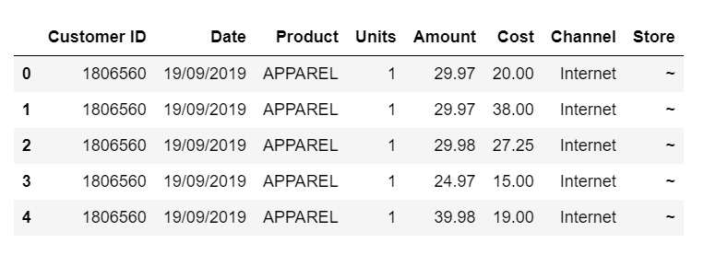
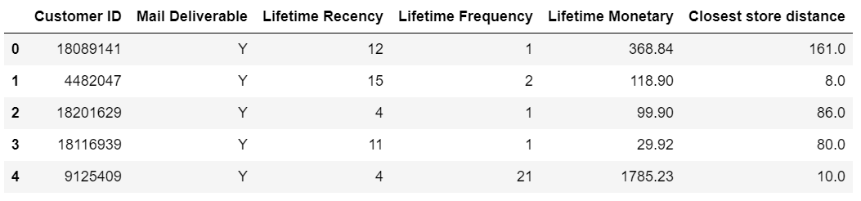
Data Overview
Customer data
Customer ID
Date
Product
Units
Amount
Cost
Channel
Store
Purchase data
Customer ID
Mail Deliverable
Lifetime Recency
Lifetime Frequency
Lifetime Monetary
Closest store distance

Slide 4
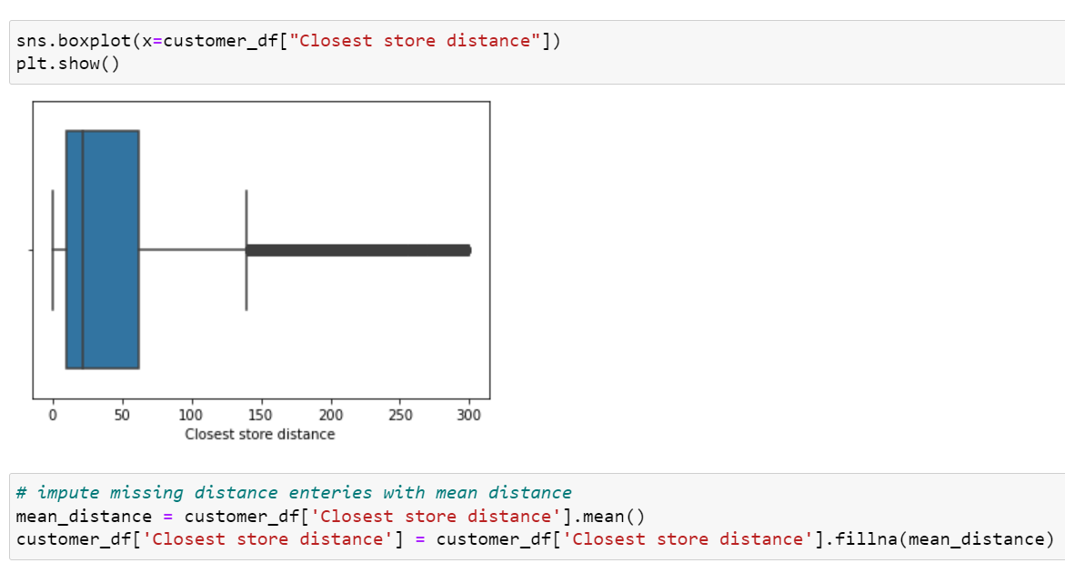
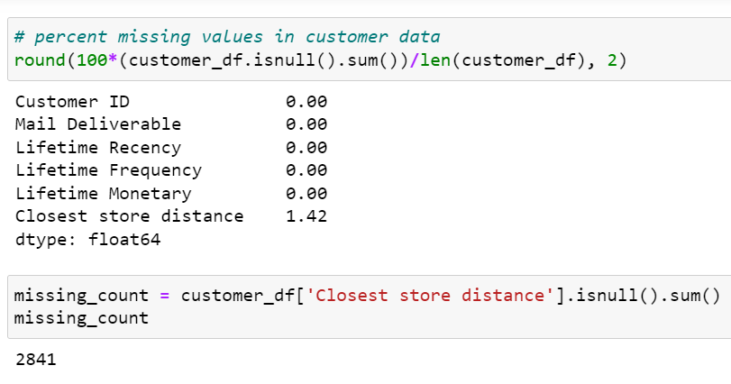
Data Preprocessing and Cleaning
Customer data
Missing values found in ‘Closest store distance column’
2841, nearly 1.4% of missing entries
Missing values imputed using mean = 43.91

Slide 5
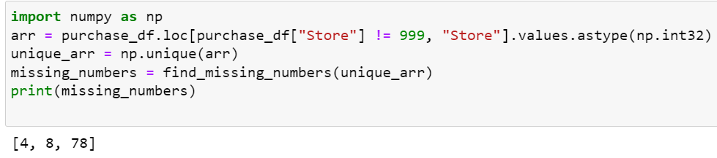
Purchase Data - No missing values in purchase data
Data inconsistencies observed
Store – Store number are in integer values; ‘~’ value present at occasions
Rectification – Replace ‘~’ by ‘999’, convert to integer datatype
Also found below stores numbers were missing – 4,8,78. Its is safe to assume that raw data had ‘~’ in place of 4,8,78. Which are now replaced by 999
Date – values as object data type should be date type
Rectification – Use pd.datetime() to get proper datetime datatype

Slide 6
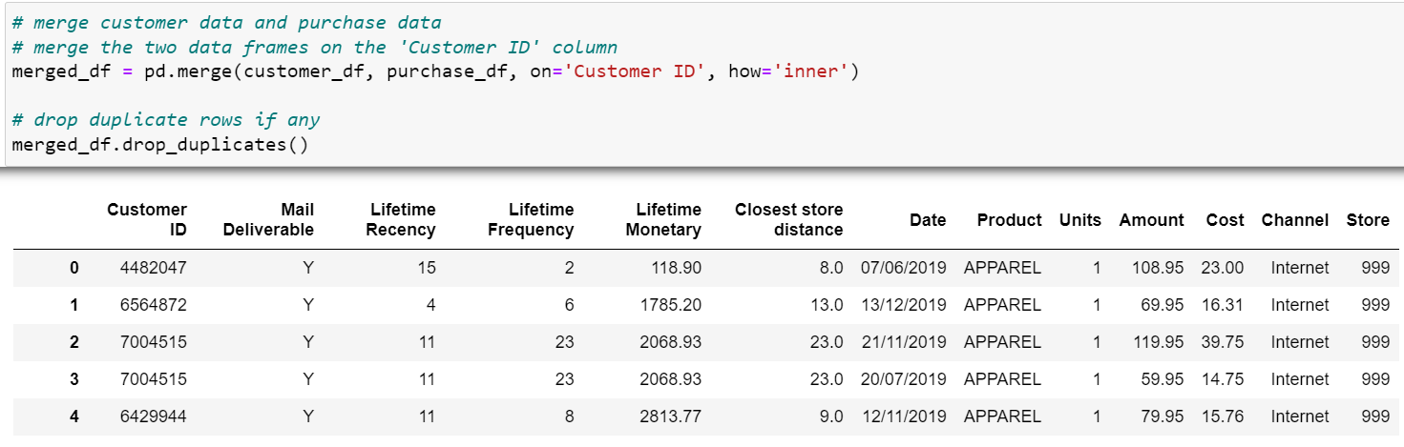
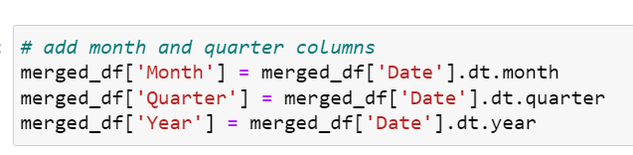
Merge Customer and Purchase data for EDA
For EDA purposes we combine both data sets using common column
‘Customer ID’
An inner join is performed to merge the datasets
New columns Month, Quarter, Year are procured using Date column

Slide 7
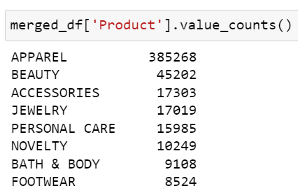
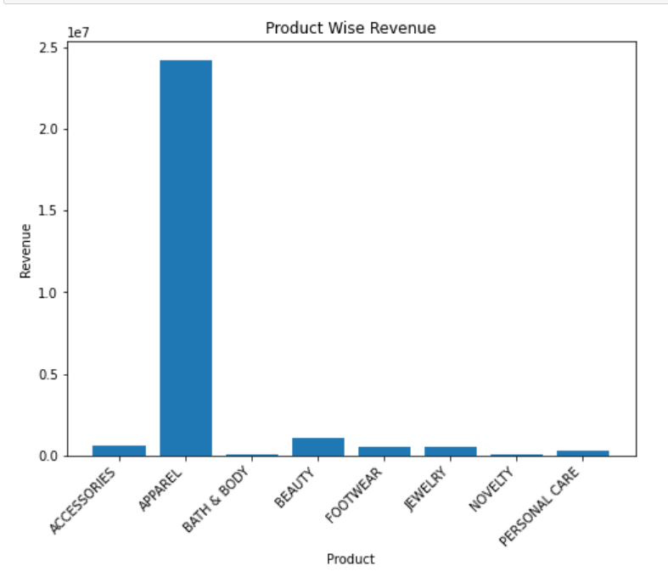
Variable Analysis - Product
8 distinct Product categories identified
APPAREL stands 1st in terms of quantity purchased
followed by BEAUTY Products
Revenue by Product
Evidently, more than 60% of revenue can be
attributed to Apparel

Slide 8
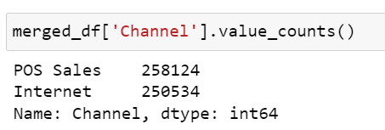
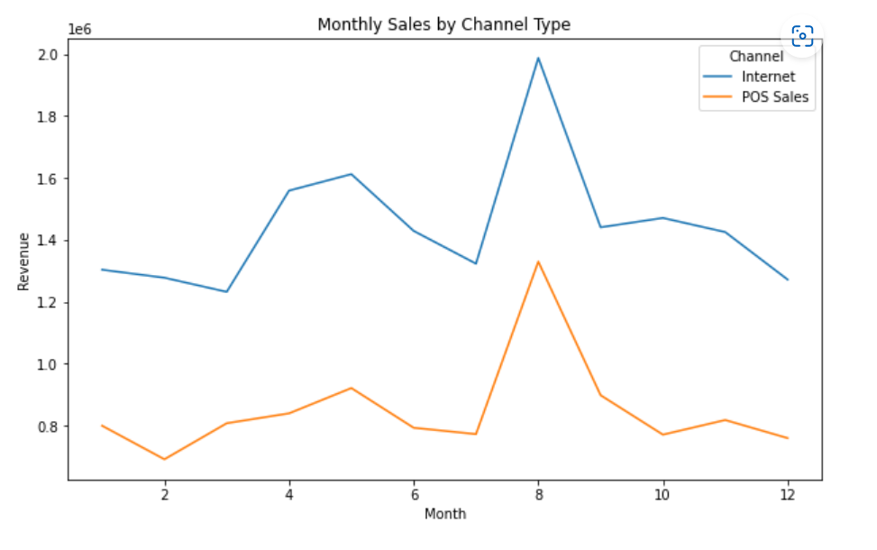
Variable Analysis - Channel
Two Channels identified – POS sales and Internet
The transaction volume was found to be approximately equal in the both the channels, 50% each
Monthly Sales/Revenue By Channel
Even though equal transaction count was
inferred , we can see for majority sales,
Internet was preferred channel, compared
to visiting the store and buying
Spike in both instances can be attributed to email catalogue promotional activity
This can be attributed to the mean store
distance which is approx. 43.91 miles or kms

Slide 9
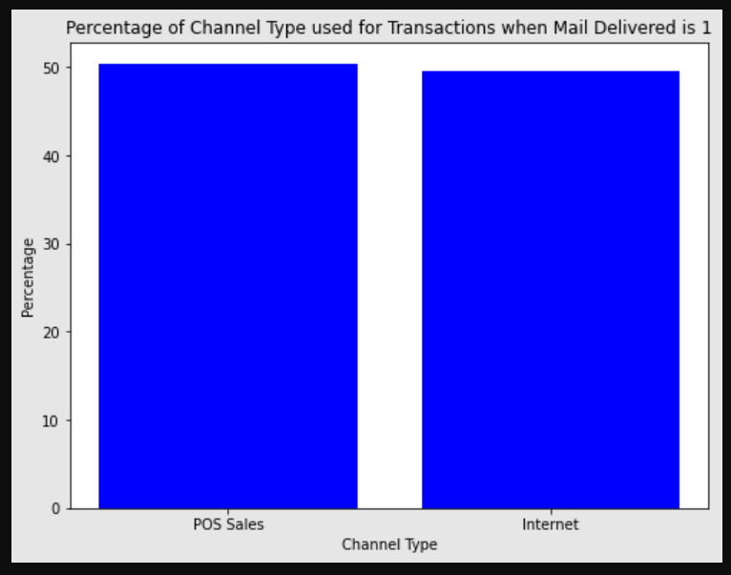
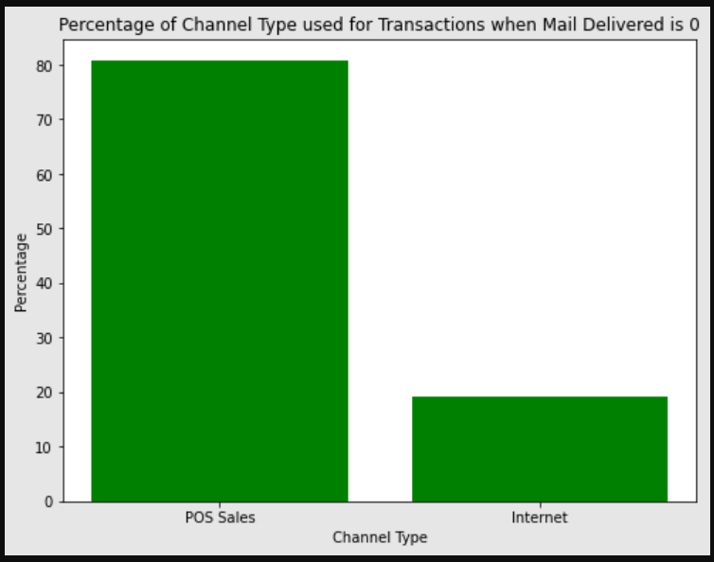
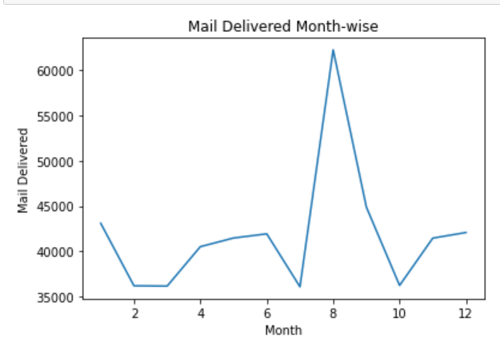
Customer Targeting – Mail catalogues
Mail catalogue delivered – Yes Mail catalogue delivered – No
A major downfall is seen when Targeting is not done via mail catalogues ,transactions volume via Internet is down by more than 40%
Monthly Email Catalogue delivery trend
More than 60k customers reached via email catalogues delivered
Spike seen has resulted in a positive way, the trend is
analogous with sales in August month
This should be continued with more effort, expecting to
see an uptick in Internet transactions and hence sales

Slide 10
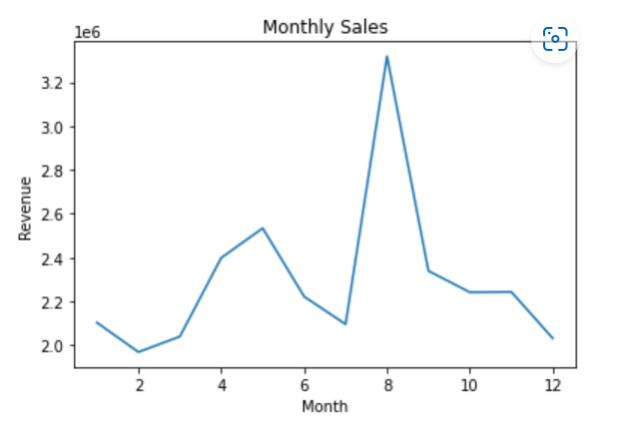
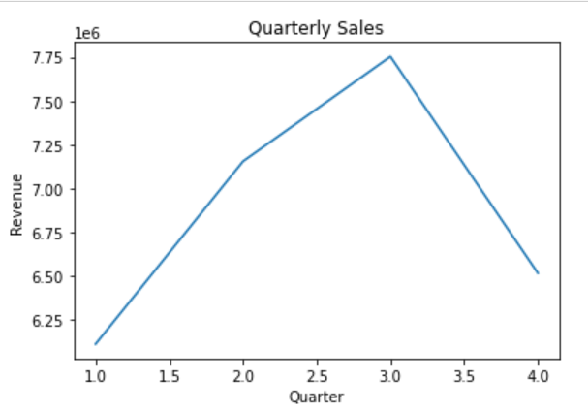
Aggregate the revenue and quantity at customer level for relevant time period along with the reason of time period selection
To aggregate revenue and quantity at the customer level, we need to first identify the relevant time period for analysis
Monthly:
Aggregating the data at the monthly level can provide insights into trends over time and seasonal variations.
Increasing trend of sales seen from Feb – May
Highest sales in August month !
Quarterly:
Aggregating the data at the quarterly level can provide a higher-level view of performance and may be useful for reporting purposes
Increasing Trend seen from Q1 to Q3, post that a steep decline is observed as one approached Q4

Slide 11
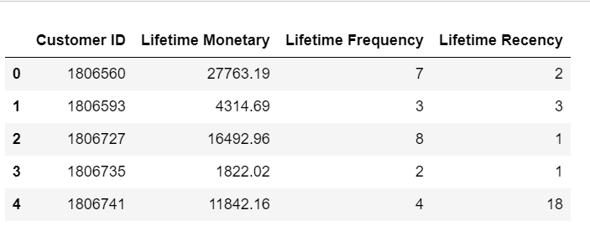
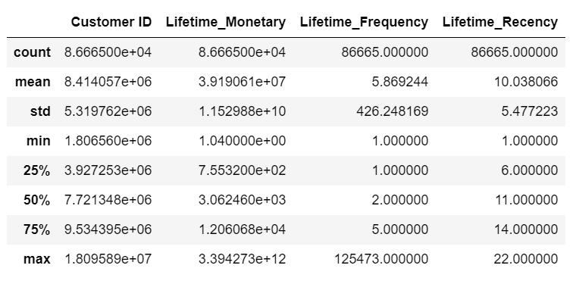
Data For Segmentation
Customer Level Recency, Monetary, Frequency data

Slide 12
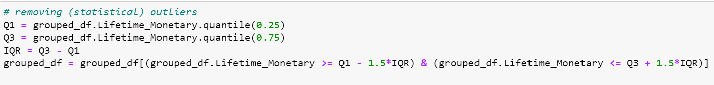
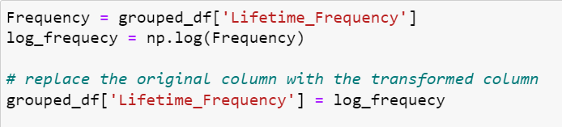
Outlier Handling
Inter Quartile Range(IQR) was used to check outliers in Lifetime_Recency, Lifetime_Monetary and Lifetime_Frequency
Also used data transformation technique to handle the outliers
Example – For Lifetime_Frequency, log of original values is used as a transformed set to make sure all values are in range
This has the effect of compressing large values and expanding small values. Helps to reduce the impact of outliers and make the distribution more symmetrical

Slide 13
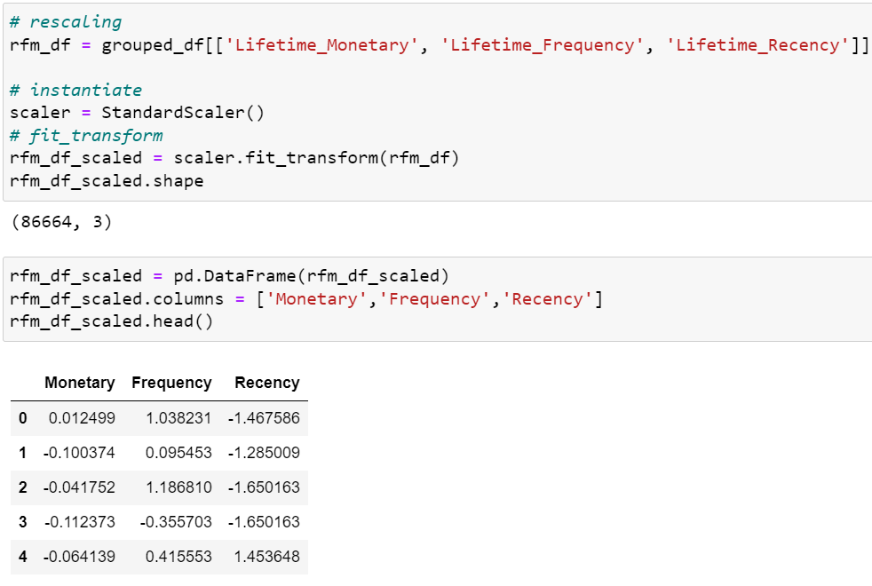
Data Scaling
Data scaling done using StandardScaler
If data features are not on the same scale, some features with larger values can dominate the distance calculation, which can result in the algorithm assigning more weight to those features
As a result, the clustering results may be biased towards the features with larger values.
By using StandardScaler to scale the data, all the features will be transformed to a common scale
This ensures that each feature is given equal importance in the distance calculation and the clustering results are not biased towards any feature

Slide 14
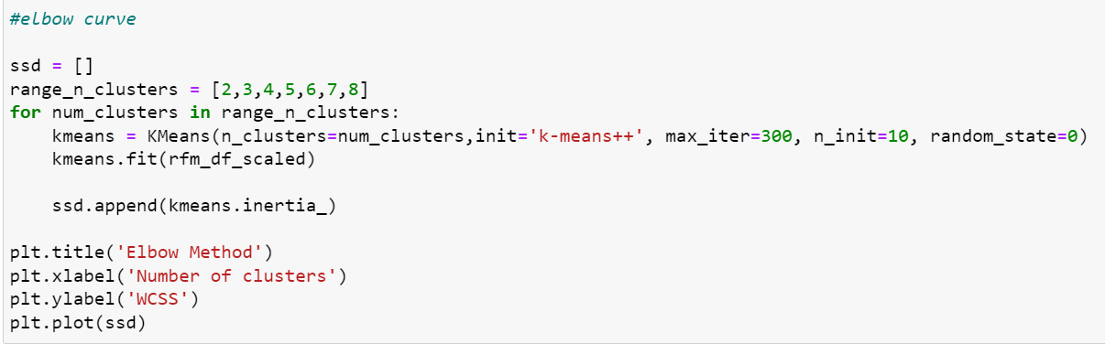
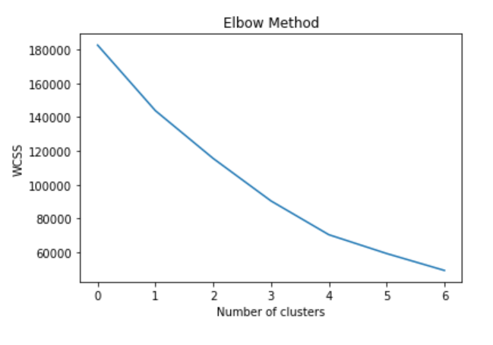
K-means Clustering
Choose the number of clusters (k) that the algorithm should find
We use “Elbow method” to identify optimal number of clusters
[2,3,4,5,6,7,8] clusters given as input, hence calculate Within Cluster Square Sum “WCSS”
Here it comes out as 4

Slide 15
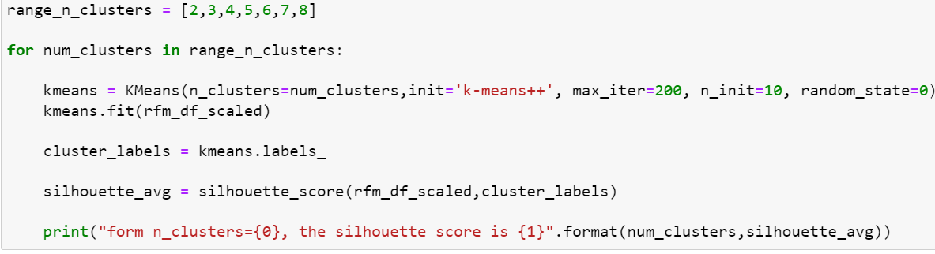
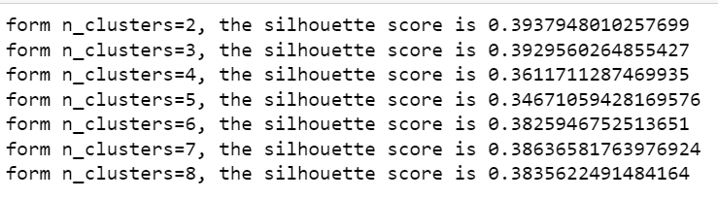
Silhouette analysis
The silhouette score ranges from -1 to 1
a score closer to 1 -> data point is well matched to its assigned cluster
score closer to -1 -> data point is poorly matched to its assigned cluster and better matched to other clusters.
score of 0 -> the data point is equally matched to both its assigned cluster and other clusters.
Silhouette score = ( b - a) / max(a, b)
a -> mean distance between a data point and all other data points in the same cluster
b -> mean distance between a data point and all data points in the nearest neighboring cluster.

Slide 16
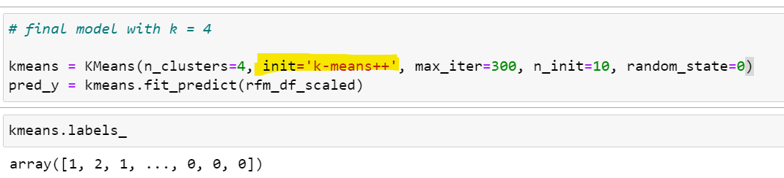
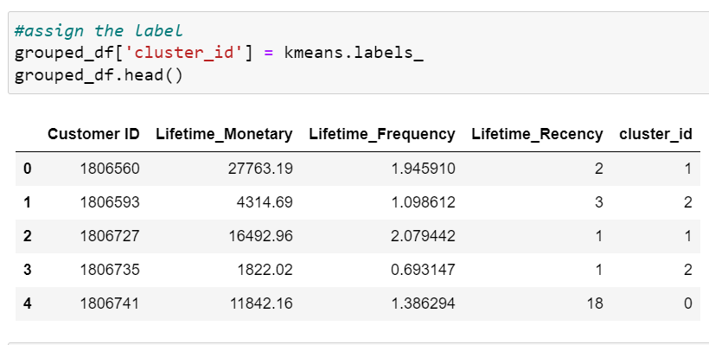
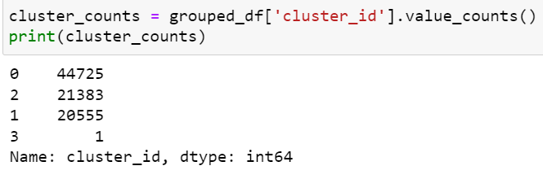
Final Model, with Clusters k = 4
The standard K-means algorithm randomly initializes the cluster centroids.
This can lead to suboptimal results, as the algorithm may get stuck in a local minimum.
Kmeans++, aims to avoid problem by using a smarter initialization method
Also improves performance of K-means

Slide 17
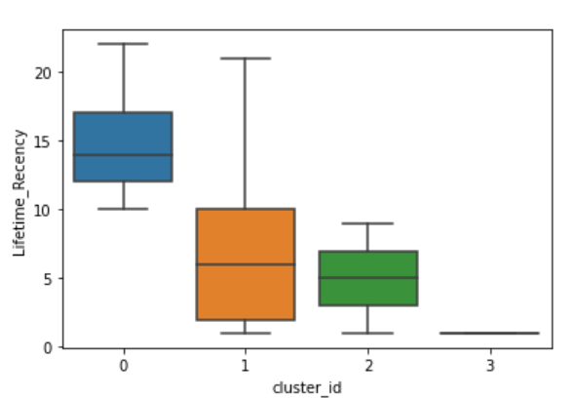
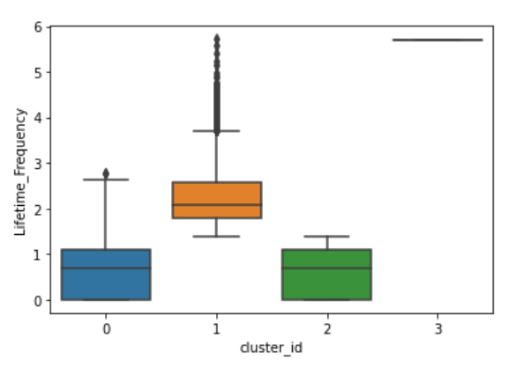
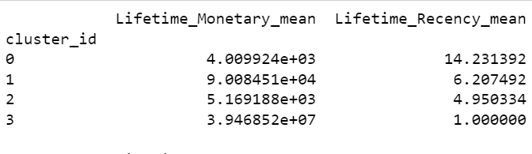
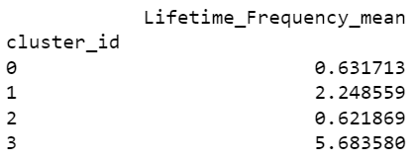
Cluster Statistics
Based on customer purchase history and cluster analysis we have 4 segments
cluster 0 -> Low Lifetime Monetary, Low Lifetime Frequency, and High Lifetime Recency
cluster 1 -> High Lifetime Monetary, High Lifetime Frequency, and Low Lifetime Recency
cluster 2 -> A higher Lifetime Monetary, Low Lifetime Frequency, Low Lifetime Recency
cluster 3 -> Low Lifetime Monetary, High Lifetime Frequency, Low Lifetime Recency

Slide 18
Segment Description, Customer Characteristics + Promo recommendations
Cluster 0 - Low Lifetime Monetary, Low Lifetime Frequency, and High Lifetime Recency
Customers here have a low purchasing power and make infrequent purchases.
Price-sensitive customers and often look for discounts and deals
Promotions that offer discounts, special deals, and free samples can be effective in attracting these customers and increasing revenue
Cluster 1 - High Lifetime Monetary, High Lifetime Frequency, and Low Lifetime Recency
Customers here have high purchasing power and make frequent purchases
Providing them with early access to new products or limited-time offers to create a sense of exclusivity and urgency
Less sensitive to price and value quality over price - Offering free shipping or other perks to encourage them to make larger purchases.
Promotions that focus on quality products, loyalty programs, and referral incentives can be effective in retaining these customers and increasing revenue
Cluster 2 - A higher Lifetime Monetary, Low Lifetime Frequency, Low Lifetime Recency
Customers here have purchasing power but are of conservative nature
Aim to Increase frequency by encouraging customers to make repeat purchases by offering loyalty programs, discounts, and promotions on subsequent purchases
Aim to Increase recency by encouraging customers to make purchases more frequently, reminding them about the benefits of the product and the promotions that are currently available
Sensitive to price, lookout for something valuable for long term in good amount
Use personalized marketing campaigns to target with tailored messaging and promotions.
Cluster 3 - Low Lifetime Monetary, High Lifetime Frequency, Low Lifetime Recency (Potential High Value Future)
Aim on increasing the Lifetime Monetary value
Offering incentives to spend more, discounts on higher value purchases or rewards for reaching certain spending milestones
Targeted marketing campaigns could be used to encourage customers to try higher priced products or to purchase complementary items to increase overall spend
Offer loyalty programs in this cluster to encourage repeat purchases and increase their Lifetime Recency value
This could help to build a stronger relationship with these customers and increase the likelihood of them becoming high value customers over time

