Slide 1
Physiology-Aligned Multiresolution Analysis
• for Patient-Independent Heart-Murmur Detection: a comparative study of wavelet and Fourier features
• Parth Mishra — National Institute of Technology Warangal
Notes:
This talk asks which part of a classical heart-sound pipeline carries the murmur information. Every number on these slides is generated from saved result tables by a script, and every hypothesis was pre-registered with a fixed decision rule.

Slide 2
Problem: what actually helps murmur detection?
• Murmurs are timed events: systolic or diastolic, between S1 and S2
• Question 1: does cardiac-cycle timing help?
• Question 2: does the time–frequency transform (wavelets vs Fourier) matter?
• Question 3: does a model transfer to an independent cohort?
• Caveat we test explicitly: expert segmentation at test time is an oracle
Notes:
Many murmur detectors segment each heart sound into cardiac cycles and use wavelet features. We separate the two ingredients, timing and transform, and we also ask how much a result depends on expert annotations that a deployed system would not have at test time.

Slide 3
Data: CirCor for development, ZCHSound for external testing
• CirCor DigiScope v1.0.3: 942 patients, 3,163 recordings, 4 sites
  – binary task: 874 patients (179 Present, 695 Absent), 816 subjects
  – expert S1 / systole / S2 / diastole annotations
  – 5 × 5 subject-grouped folds, fixed before any result
• ZCHSound (Jia et al., 2024): 941 clean recordings (408 CHD) + 318 noisy neonatal
  – labels are CHD diagnoses (VSD, ASD, PDA, PFO, NORMAL), not murmurs
Notes:
CirCor is the PhysioNet 2022 Challenge training set with expert murmur labels and segmentation. We use Present versus Absent and exclude Unknown. ZCHSound is an independent Chinese paediatric cohort labelled with congenital heart disease diagnoses, not murmurs, and it was never used for training, tuning or thresholds.

Slide 4
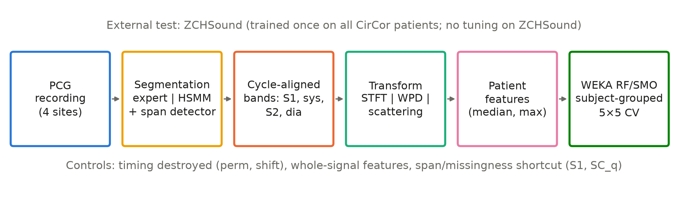
Pipeline and controls
• Segmentation: expert labels (oracle), LR-HSMM, or HSMM + learned span detector (E4, E4q)
Notes:
Each recording is segmented, band features are computed on a cycle-aligned grid, and patient vectors go to WEKA. The controls keep the same features but destroy the timing, or use whole-signal features, or give the baseline the same span information, so each contrast isolates one ingredient.

Slide 5
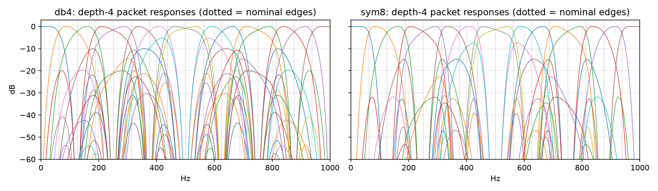
Representations: wavelet packets, STFT bands, scattering
• WPD db4, depth 4: 16 bands of 62.5 Hz at 2 kHz (packet responses below)
• STFT bands matched: same edges, time grid and dimension
• Scattering: kymatio, J = 6, Q = (8, 1), first and second order
• Features per band: systolic vs S1, systolic vs diastolic
Notes:
The wavelet packet transform splits the signal into 16 equal bands; the STFT bands are matched to the same edges and time grid, so wavelet against Fourier is a like-for-like contrast. Wavelet scattering adds a modulation layer and was pre-registered as a separate test.

Slide 6
WEKA: classifiers and a reproducible fold
• RandomForest -I 300 -K 0 -S 1 (primary); SMO, linear PolyKernel (secondary)
• Subject-grouped folds from Python, never WEKA row-wise CV
• Demo fold A_stft r0 f0: 699 train / 175 test patients; CLI = pipeline, exactly
• At 0.5: TN 131, FP 8, FN 19, TP 17
Screenshot placeholder
Preprocess tab
1_preprocess.png
Screenshot placeholder
RF options dialog
2_rf_options.png
Screenshot placeholder
Result buffer + confusion matrix
3_result_buffer.png
Notes:
All models are WEKA 3.9.7 classifiers called in batch. WEKA's own cross-validation is never used, because it splits rows and would put recordings of the same child in training and test. The command-line run of one fold reproduces the pipeline's predictions exactly, and the three Explorer screenshots will show the same fold in the GUI.

Slide 7
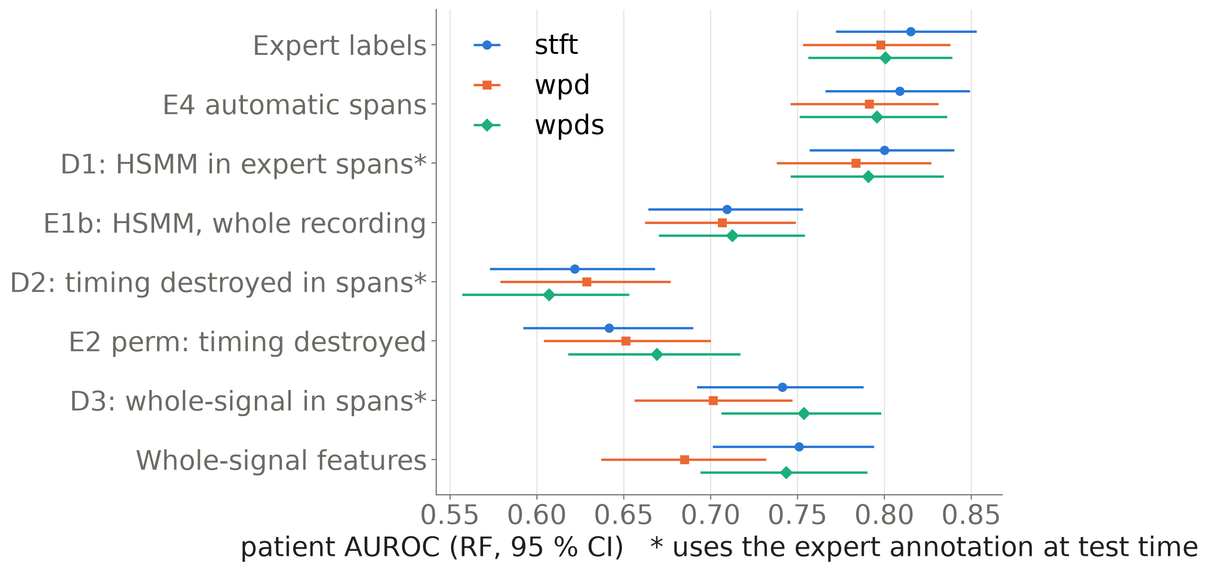
Finding 1: timing carries the information
• Timing destroyed (perm): +0.131 to +0.174
• Shifted labels: +0.192 to +0.206
• Within-span timing: +0.169 to +0.193
• Span choice without timing: −0.062 to −0.020
Notes:
Keeping the features but destroying their alignment to the cardiac cycle costs about a sixth of the AUROC, in all 25 folds. The diagnostics split the gain exactly: within-span timing explains it, while the expert's choice of spans contributes nothing positive. Rows with a star use the expert annotation at test time and are diagnostics only.

Slide 8
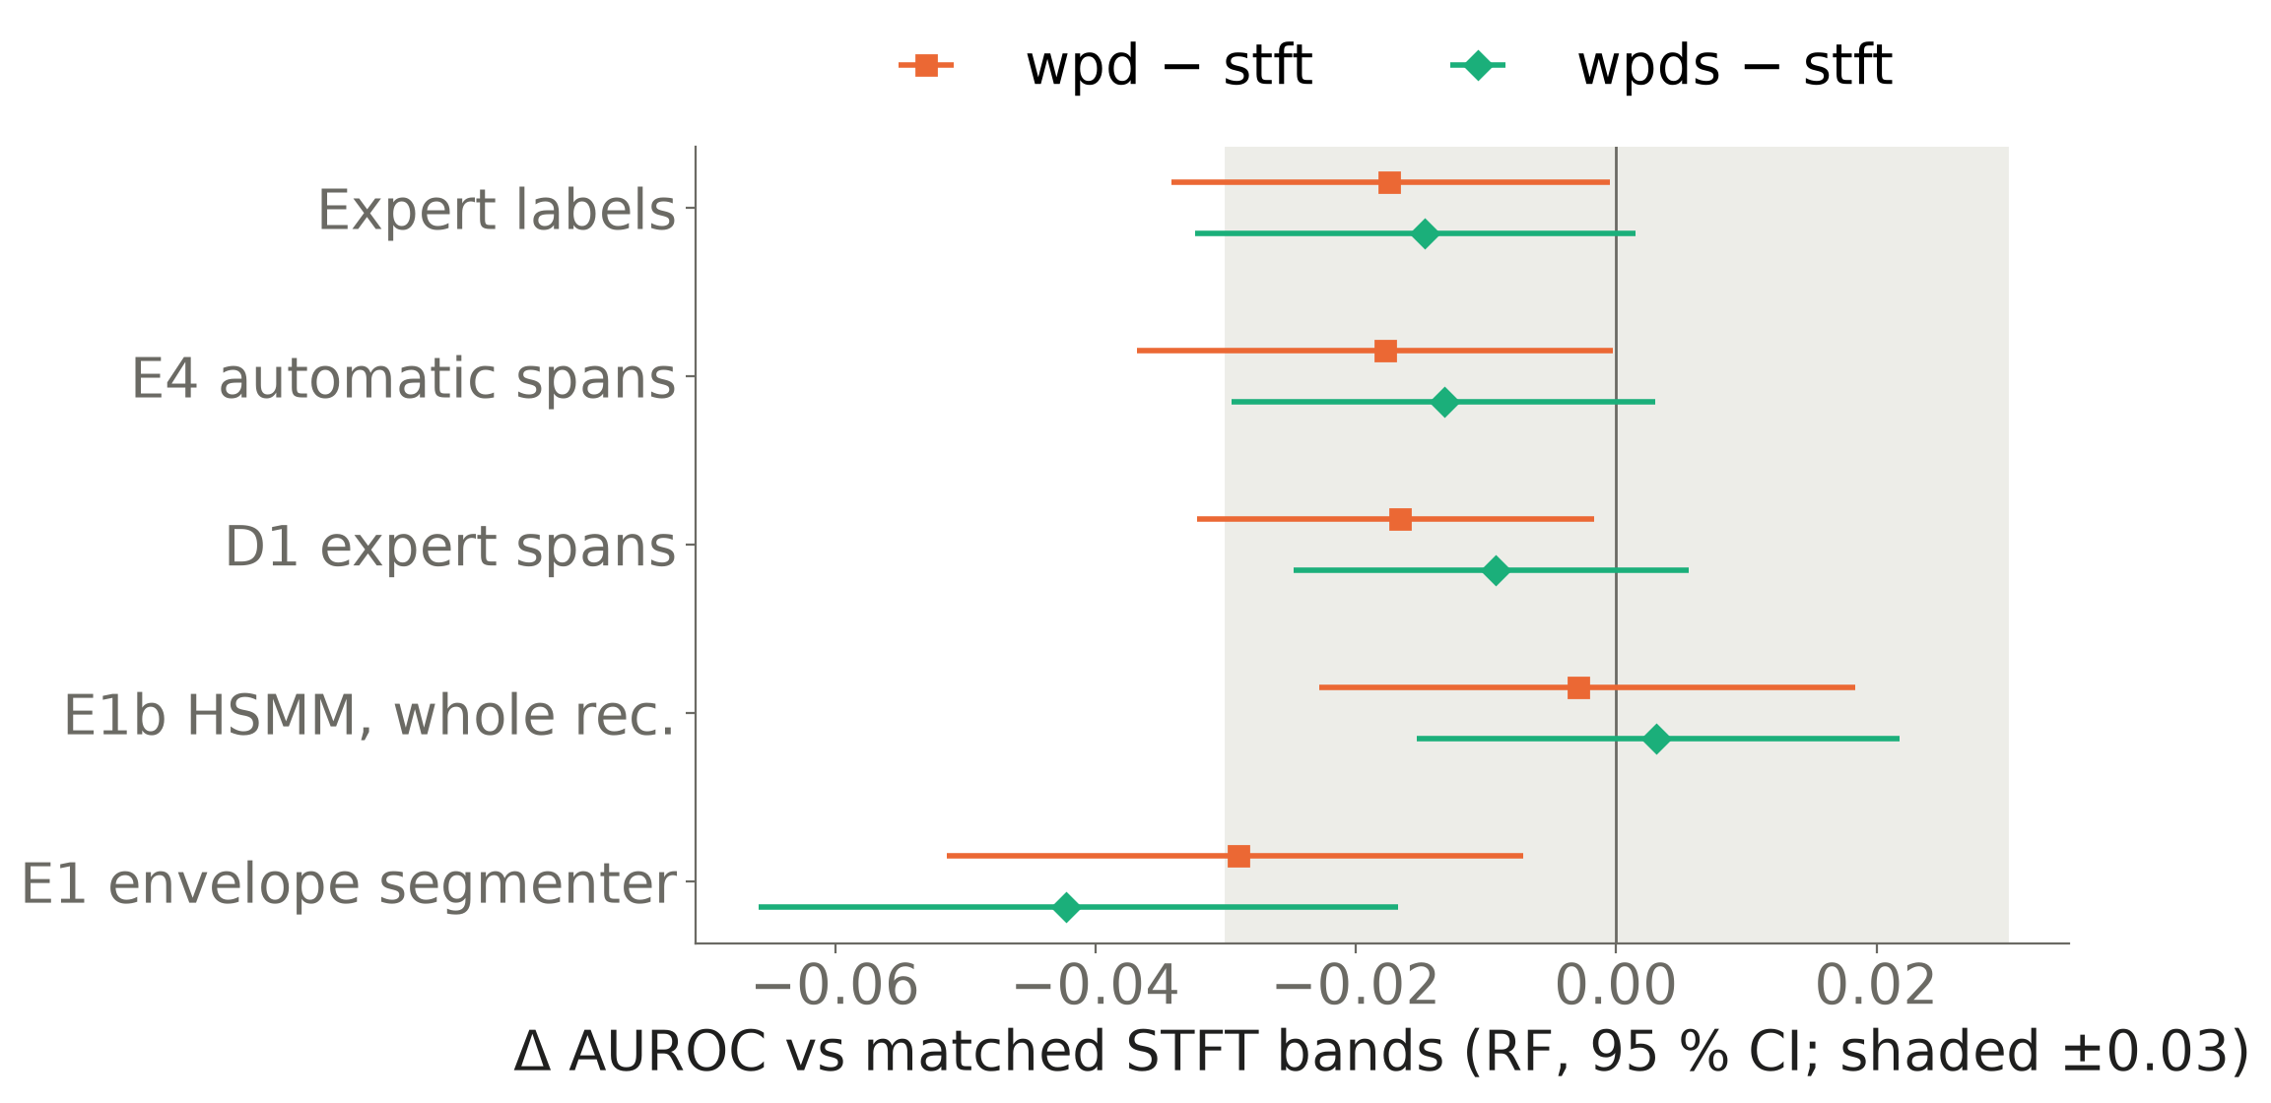
Finding 2: the transform does not matter
• WPD − STFT: −0.042 to +0.003
• Scattering − STFT (H11a): −0.026 [−0.058, +0.005]
• 2nd − 1st order (H11c): +0.013 [+0.001, +0.025]
• No wavelet advantage anywhere
Notes:
Under every labelling, wavelet packets are at most equal to matched STFT bands, and equivalence within the pre-registered margin is not shown either. Wavelet scattering does not beat STFT bands; its second-order gain is below the pre-registered 0.03.

Slide 9
Automatic pipeline and the shortcut check
• E4 vs expert labels (H9a): −0.007 to −0.005; rule met, non-inferiority not established
• E4 vs B1 (H9b): +0.065 to +0.083
• Span fraction alone predicts the class: AUROC 0.646
• E4q removes it: shortcut alone 0.482; missing features 15.8 % → 0.6 % (Absent)
• E4q vs random windows (H12b): +0.066 [+0.030, +0.100]
• E4q vs STFT + span info (H12a): +0.046 [−0.001, +0.093] → not established
Notes:
With a learned span detector the automatic pipeline comes within the pre-registered margin of expert labels on the point estimate, although the confidence interval is too wide to establish non-inferiority. Its span fraction is also predictive, so we built a shortcut-free version, E4q. E4q keeps the AUROC and beats random windows, yet its margin over a whole-signal STFT baseline with the same span information has a confidence interval that touches zero, so that advantage is not established.

Slide 10
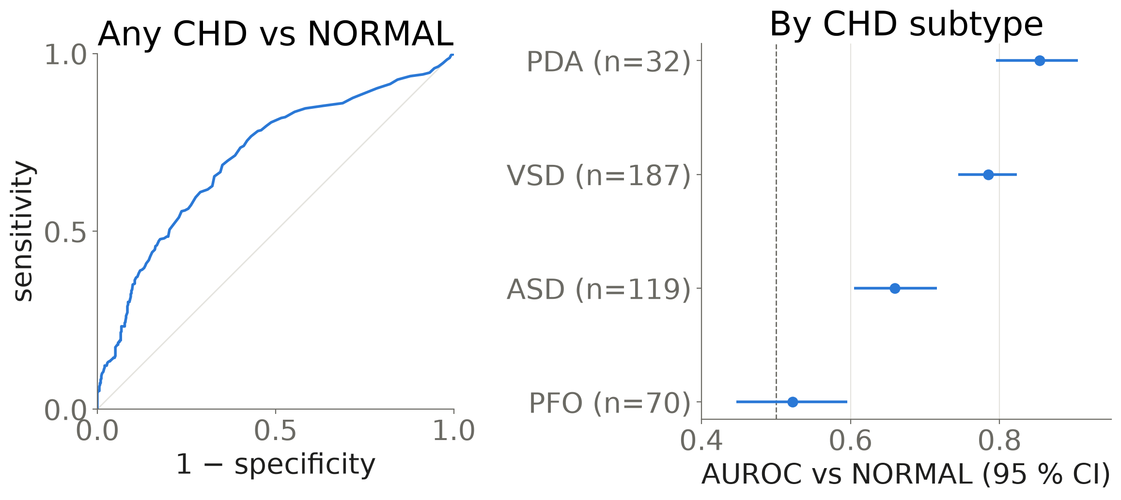
Finding 3: external AUROC 0.709 with the physiological order
• Clean set (H10a): 0.709 [0.675, 0.741]
• VSD − PFO (H10b): +0.263 [+0.180, +0.343]
• VSD − ASD: +0.126 [+0.064, +0.184]
• Noisy neonates: 0.535 (chance)
• Labels are CHD diagnoses, not murmurs; age does not explain the result (post-hoc check)
Notes:
Trained once on all CirCor patients and applied unchanged, the whole-signal STFT model detects CHD on ZCHSound. The subtypes follow the pre-registered physiological order: loud shunts are detected best, the silent PFO is at chance. On the noisy neonatal set every model is at chance.

Slide 11
Comparison with recent work
• Nogueira et al. 2026: (Se+Sp)/2 = 0.965, test segments start at expert S1 labels
• Ours on the same scale (expert labels): 0.736; E4 0.739
• Nie et al. 2024: 97.49 % on 5-s snippets from annotated periods
• Oracle conditioning is worth up to 0.106 AUROC in our data
• Kutlu & Çolak 2026 already validate CirCor models externally (CinC 2016, Yaseen)
Notes:
Recent papers report much higher numbers than ours, and these two show why they are not on the same scale. One reports a balanced accuracy at a single threshold with test segments cut at expert S1 labels; the other reports snippet accuracy on annotated periods. On the same balanced-accuracy scale our expert-label model is far lower.

Slide 12
Limitations (all negatives reported)
• H12a not established: +0.046 [−0.001, +0.093]
• Noisy neonatal recordings: every model at chance
• Scattering (G4) negative; SMO unstable on scattering features
• ZCHSound labels are CHD, not murmur; PFO at chance
• No CirCor hidden test set; Unknown class excluded
• E1b, E4, S1 and Phase 3 designed after earlier results on the same folds
• B0's external score is an artefact (recording characteristics)
Notes:
These are the results that did not work or that limit what we can claim. In particular, the advantage of the timing pipeline over a shortcut-aware STFT baseline is not established, and ZCHSound tests CHD rather than murmurs.

Slide 13
Conclusion
• Cardiac-cycle timing carries the murmur information
• The transform (WPD, STFT, scattering) does not matter
• External transfer to paediatric CHD with the physiological order
• Next: quality gating, learned models under the same protocol, murmur-labelled external data
• Future: a systematic audit of test-time expert segmentation in published CirCor work
Notes:
Timing matters, the transform does not, and a simple whole-signal model transfers to an independent CHD cohort with the expected physiological ordering. Future work is quality gating for noisy recordings, learned models under the same protocol, a murmur-labelled external set, and a systematic audit of test-time expert segmentation in the literature.

Slide 14
Reproducibility
• Pre-registration tags: v1.0-pilot, protocol-v2-lock, e1b/diag/e4/s1-prereg; protocol-v3-prereg in the cloud-sandbox history
• Frozen results: results-final and phase3-results, with SHA-256 manifests
• Linux (Phase 1) reproduced on macOS; WEKA CLI = pipeline exactly
• Numbers registry: scripts/p4_numbers.py; check: scripts/p4_check_numbers.py
Notes:
Everything is versioned: protocols were tagged before the runs, results are frozen with hash manifests, and Phase 1 was reproduced on a second platform. The numbers on these slides and in the report are generated from the saved tables and checked automatically.

Slide 15
Backup: every pre-registered hypothesis (RF)
Hyp. | Contrast | Δ AUROC | Verdict
H2a/b | WPD − STFT (aligned / whole) | −0.017 / −0.066 | not supported
H3 | aligned − whole WPD | +0.113 | supported
H4a/b | aligned WPD − B0 / B1 | +0.051 / +0.072 | no / supported
H5a–d | expert − timing destroyed | +0.131 to +0.206 | supported
H6, H8 | naive / HSMM − expert | −0.106 to −0.062 | not supported
H9a/b | E4 − expert / B1 | −0.007 to −0.005 / +0.065 to +0.083 | supported
H9c | E4 − W_stft | +0.040 to +0.058 | stft, wpds only
S1 | E4 − (W_stft + SC) | +0.026 to +0.043 | possibly shortcut
H10a/b | ZCHSound AUROC / subtype order | 0.709 / +0.263 | supported
H11a–c | scattering − STFT | −0.026 to +0.013 | not supported
H12a | E4q − (W_stft + SC_q) | +0.035 to +0.046 | possibly shortcut
H12b | E4q − random windows | +0.066 to +0.071 | supported
Notes:
This table summarises every pre-registered hypothesis family with the range over representations and the verdict. The full table with confidence intervals is in the report appendix.

