Slide 1
Physiology-Aligned Multiresolution Analysis for Patient-Independent Heart-Murmur Detection
A Comparative Study of Wavelet and Fourier Features
• Parth Mishra — National Institute of Technology Warangal
• EC418 Biomedical Instrumentation and Signal Processing · Mini Research Project
– [Roll number and course instructor to be added]
– Prepared with substantial AI assistance (Claude, via Claude Code); see the report's statement
Notes:
This project asks which part of a classical heart-sound pipeline carries the murmur information: the cardiac-cycle alignment or the time-frequency transform. Every number on these slides is generated from saved result tables, and every hypothesis was registered before it was tested.

Slide 2
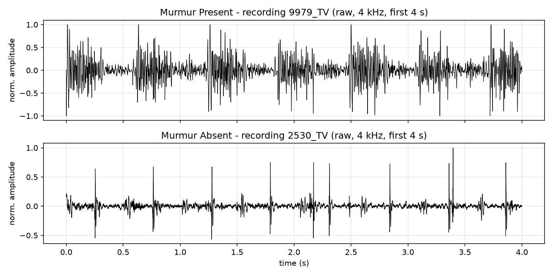
Clinical motivation
• Murmurs: extra sounds from turbulent flow, systolic or diastolic
• Innocent or a sign of structural disease (septal defects, PDA, valve lesions)
• Auscultation is cheap but depends on the listener's skill
• Murmur detection = screening, not diagnosis (echocardiography decides)
• Children are recorded at several sites and visits → evaluation must be patient-independent
Notes:
A murmur is an extra sound from turbulent blood flow, heard between the first and second heart sounds. Detecting it is a screening step that leads to echocardiography; it is not a diagnosis of the underlying disease. Automatic analysis could help where trained listeners are scarce.

Slide 3
Research question
• Does cardiac-cycle timing improve patient-level murmur detection?
• Does the transform matter — wavelet packets vs matched STFT bands vs scattering?
• Does it survive automatic segmentation, without the expert labels?
• Is an automatic gain real, or a shortcut from which spans are kept?
• Does a CirCor model transfer to an independent cohort?
Notes:
Many pipelines use cycle-aligned wavelet features and report good results. We separate the two ingredients with matched controls: the same features with and without cardiac-cycle timing, and wavelet versus Fourier bands with identical band edges. We also measure how much the expert segmentation used at test time is worth.

Slide 4
Related work (2024–2026)
Work | Approach | Expert seg. at test | Headline (as reported)
Vimalajeewa 2025, Sci Rep | multiscale wavelet features | no | re-evaluated on our folds
Niizumi 2024, EMBC | pre-trained audio representations | no | W.acc 0.832
Nie 2024, MLSP | 2-D CNN, 5-s snippets | yes (annotated periods) | accuracy 97.49 % (snippets)
Hong 2025, IEEE JBHI | periodic-pattern transformer | no | W.acc 84.27 %
Kutlu & Çolak 2026, J Clin Med | external zero-shot tests | no | external AUROC 0.738 / 0.985
Ladislaus 2026, arXiv | noise robustness, aggregation | no | 3-class W.acc 0.8021
Nogueira 2026, arXiv | multi-channel CNN | yes (expert S1 onsets) | (Se+Sp)/2 0.965
Values as reported by the authors (abstract or stated section); references/g3b/case_study_numbers.csv.
Notes:
Recent papers report high numbers, but on different scales: different metrics, label sets, units and splits, and some cut their test data at expert annotations. Only the 2025 wavelet baseline was re-evaluated on our folds, so it is the one direct comparison.

Slide 5
Dataset and patient independence
• CirCor DigiScope v1.0.3: 942 patients, 3,163 recordings, 4 sites, 4 kHz
• Task: 874 patients (179 Present, 695 Absent); Unknown excluded
• Linked visits share an Additional ID → 816 subjects; folds never split a subject
• 5 repeats × 5 subject-grouped folds, fixed before any model ran
• Official PhysioNet download verified file by file (10,434 checksums)
• External: ZCHSound, 941 clean recordings (408 CHD) + 318 noisy; CHD labels, not murmurs
Oliveira et al., IEEE JBHI 2022; physionet.org/content/circor-heart-sound/1.0.3; Jia et al., IEEE TBME 2024 (ZCHSound).
Notes:
CirCor is the PhysioNet Challenge 2022 training set with expert murmur labels and segmentation. We use Present versus Absent, verified the official download against PhysioNet's checksums, and group linked visits so that no child appears in both training and test data.

Slide 6
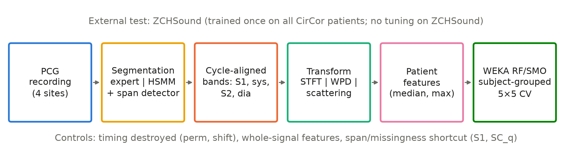
Methodology
• Preprocessing: 2 kHz, band-pass 25–900 Hz, z-score
• Segmentation: expert labels (oracle), envelope peaks, LR-HSMM, or HSMM + learned span detector
Notes:
Each recording is filtered, segmented into cardiac-cycle phases, described by band features, summarised per patient and classified in WEKA. The controls keep the features but destroy the timing, use whole-signal features, or give the baseline the same span information, so every contrast isolates one ingredient.

Slide 7
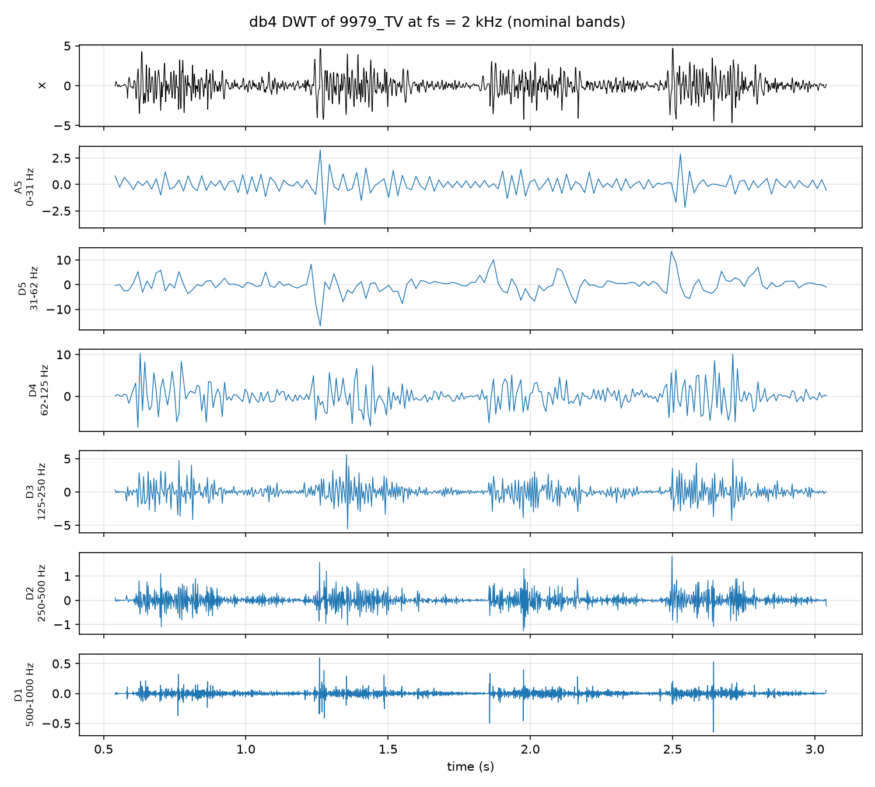
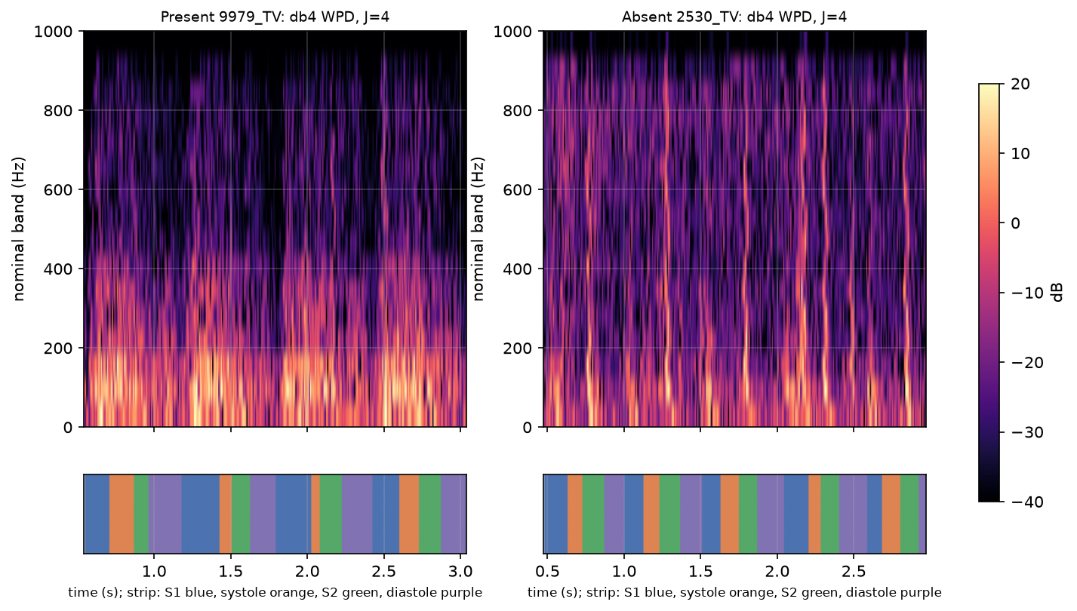
Wavelet decomposition
• DWT: low-pass h, high-pass g, downsample by 2 at each level
• WPD: split both branches → 16 bands of 62.5 Hz, 8 ms grid
• STFT bands: same 16 edges, same grid, same dimension
• Features per band: systolic vs S1, systolic vs diastolic energy
Daubechies db4 (8 taps), depth J = 4, fs = 2 kHz; band width fs / 2^(J+1). Scattering: Andén & Mallat 2014; kymatio.
Notes:
The wavelet packet transform splits both branches of the filter bank, giving 16 equal 62.5 Hz bands at depth 4. The STFT bands use the same edges and time grid, so the comparison changes only the transform. Real wavelet filters leak between bands, as the packet responses show.

Slide 8
WEKA classifier evaluation
• RandomForest -I 300 -K 0 -S 1 (primary); SMO, linear PolyKernel (secondary)
• Thresholds from inner training folds only (specificity ≥ 0.80)
• Demo fold: 699 train / 175 test patients; CLI = pipeline exactly; at 0.5: TN 131, FP 8, FN 19, TP 17
Screenshot placeholder
Preprocess tab
1_preprocess.png
Screenshot placeholder
RF options dialog
2_rf_options.png
Screenshot placeholder
Result buffer + confusion matrix
3_result_buffer.png
Frank, Hall & Witten, The WEKA Workbench, 2016; Breiman 2001 (RF); Platt 1998 (SMO).
Notes:
All models are WEKA 3.9.7 classifiers called in batch from Python on subject-grouped folds; WEKA's own cross-validation is never used because it would split a child's recordings. One fold run on the WEKA command line reproduces the pipeline's predictions exactly; the Explorer screenshots will show the same fold.

Slide 9
Baseline comparison
Model (WEKA RF, 874 patients) | AUROC [95 % CI]
2025 wavelet baseline (B1) | 0.726 [0.677, 0.773]
Whole-signal STFT bands | 0.751 [0.701, 0.794]
Expert-aligned STFT (oracle) | 0.815 [0.772, 0.853]
Automatic spans, STFT (E4) | 0.809 [0.766, 0.849]
• Aligned WPD − B1 (H4b): +0.072 [+0.027, +0.122]
• E4 − B1 (H9b): +0.065 to +0.083
Vimalajeewa, Lee & Vidaković, Sci Rep 15:10315, 2025. AUROC of repeat-averaged patient scores, 95 % CI.
Notes:
The 2025 Scientific Reports wavelet baseline was re-implemented from the authors' code and evaluated on our patient-level folds. On this common scale the aligned and automatic models are better. Published numbers from other papers are not on this scale and are not compared directly.

Slide 10
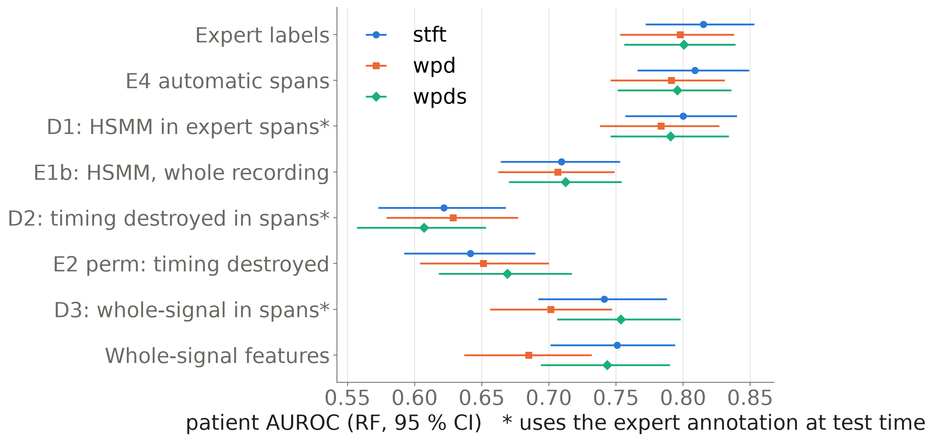
Timing-alignment experiments
• Timing destroyed (perm): +0.131 to +0.174
• Shifted labels: +0.192 to +0.206
• Within-span timing: +0.169 to +0.193
• Span choice without timing: −0.062 to −0.020
Notes:
Keeping the features but destroying their alignment to the cardiac cycle lowers AUROC in all 25 folds. The diagnostics split the gain exactly: within-span timing explains it, and the expert's choice of spans adds nothing positive. Rows with a star use the expert annotation at test time and are diagnostics only.

Slide 11
Automatic segmentation
• E1 envelope peaks, E1b LR-HSMM: targets missed (e.g. H8a −0.091 [−0.135, −0.045])
• HSMM timing inside expert spans is close to expert: +0.010 to +0.015
• What is missing is span selection: +0.077 to +0.091
• E4 learned span detector vs expert (H9a): −0.007 [−0.044, +0.031]
– point-estimate rule (≥ −0.03) met; statistical non-inferiority NOT established
LR-HSMM: Springer, Tarassenko & Clifford, IEEE TBME 2016 (Python port, GPL-3.0).
Notes:
Simple envelope peaks and an HSMM on whole recordings were not good enough. With a learned span detector the point estimate comes within the pre-registered margin of expert labels, but the confidence interval is too wide to call it non-inferior. This is the honest reading of the result.

Slide 12
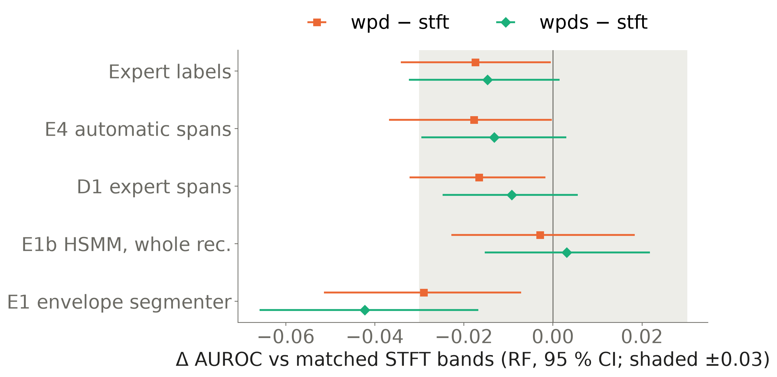
Wavelet vs Fourier findings
• WPD − STFT: −0.042 to +0.003
• Equivalence within ±0.03: not shown
• Scattering − STFT (H11a): −0.026 [−0.058, +0.005]
• STFT is at least as good — no wavelet superiority
Notes:
Under every labelling, wavelet packets were at most equal to matched STFT bands, and scattering did not help either. This is still a meaningful result: because bands, grid and features were matched, it shows that the transform itself brings no advantage here, so any wavelet advantage reported elsewhere needs another explanation.

Slide 13
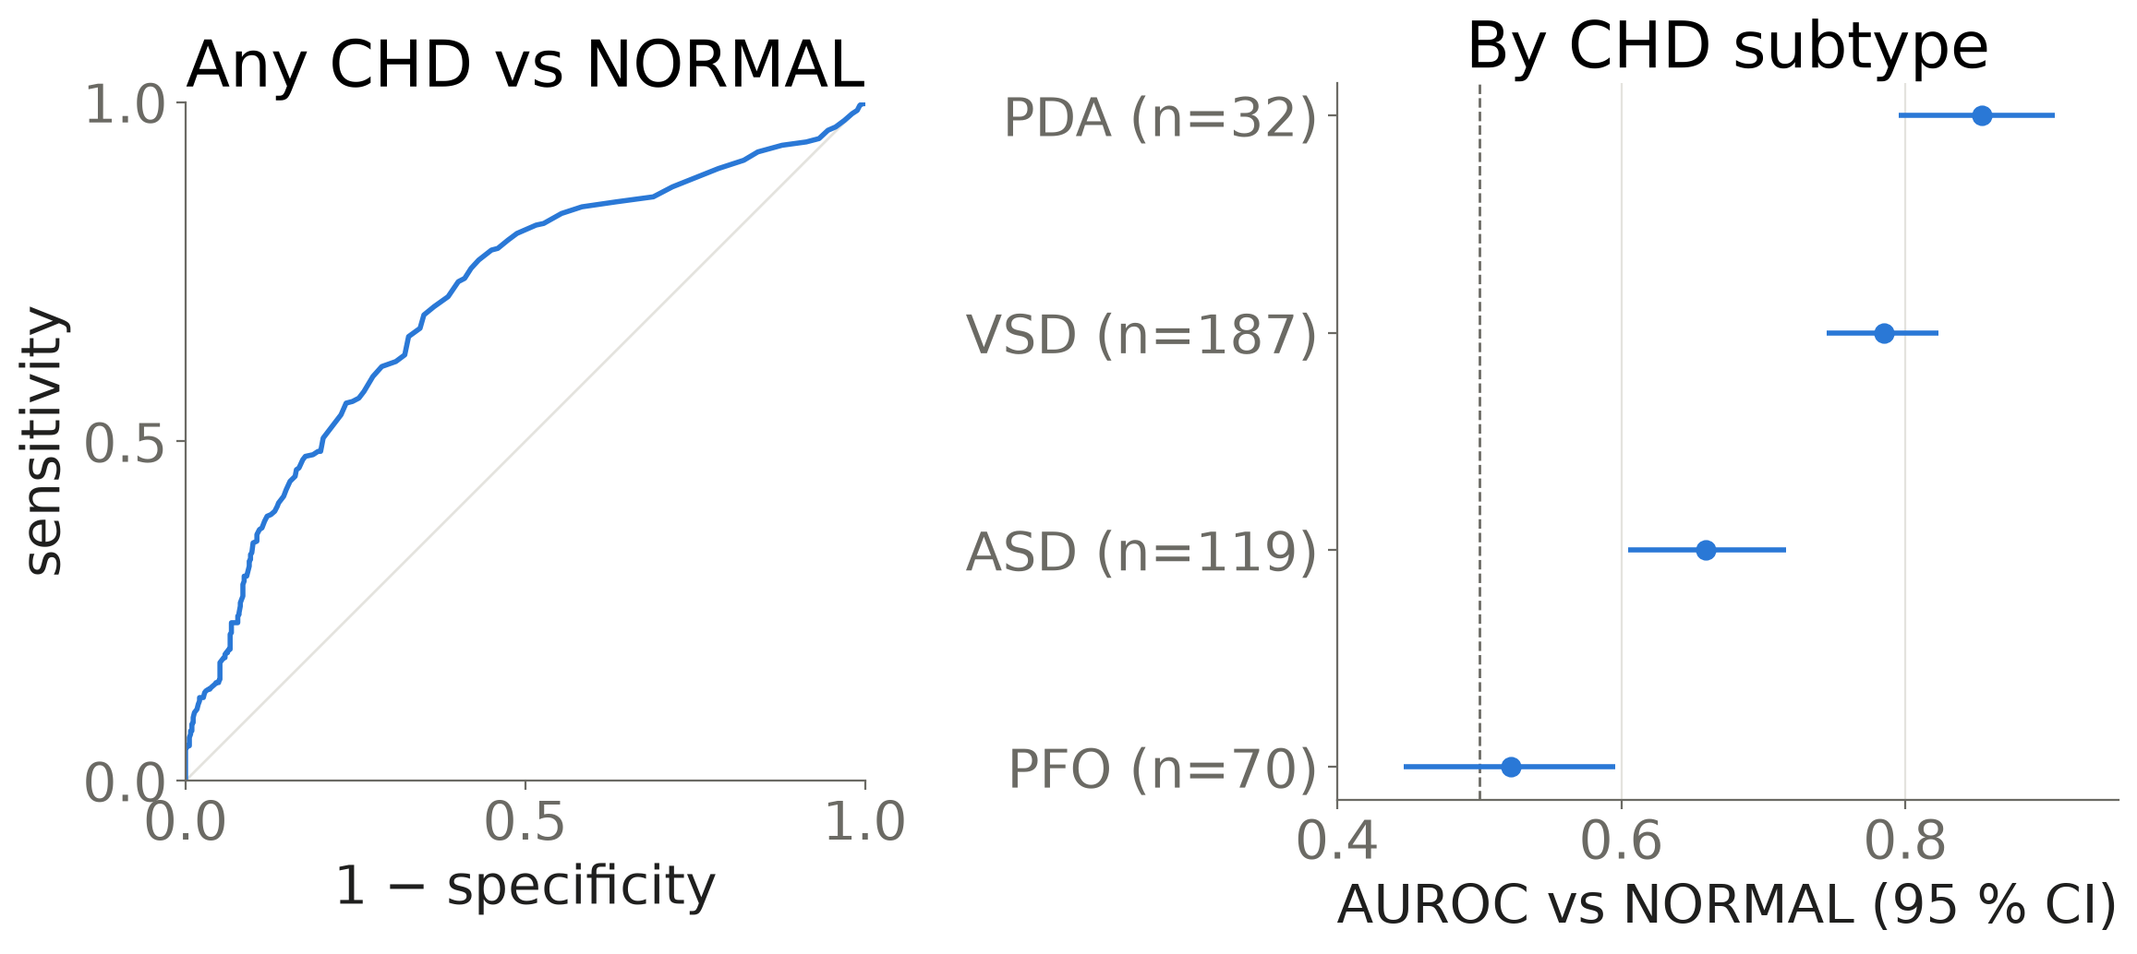
External test: ZCHSound AUROC 0.709
• Clean set (H10a): 0.709 [0.675, 0.741]
• VSD − PFO (H10b): +0.263 [+0.180, +0.343]
• Noisy neonates: 0.535 (chance)
• CHD label, not murmur
ZCHSound: Jia et al., IEEE TBME 71(8), 2024 (CC BY 4.0).
Notes:
A whole-signal STFT model trained once on all CirCor patients was applied unchanged to an independent paediatric cohort. The subtypes follow the pre-registered physiological order, and the silent defect PFO is at chance. ZCHSound is labelled with CHD diagnoses, not murmurs, and the noisy neonatal subset is at chance.

Slide 14
Shortcut learning and limitations
• Span fraction alone predicts the class: AUROC 0.646
• Shortcut-free E4q vs STFT + span info (H12a): +0.046 [−0.001, +0.093] — not established
• Cross-validation on one public cohort; no hidden test set; no clinical study
• Only 179 Present patients; Unknown class excluded
• Expert-label results are oracle-conditioned; sequential design after earlier results
• SMO unstable on scattering features; B0's external score is an artefact
Notes:
The automatic pipeline's span fraction predicts the class by itself. Once a whole-signal model gets the same information, the remaining advantage has a confidence interval that includes zero, so it is not established. The other limitations are listed plainly.

Slide 15
Conclusions
• Cardiac-cycle timing carries the murmur information
• The transform (WPD, STFT, scattering) does not change the result
• Automatic segmentation needs span selection; non-inferiority not established
• Transfer to paediatric CHD with the physiological order
• Every hypothesis, failure and erratum is reported
Notes:
Timing matters, the transform does not, and a simple whole-signal model transfers to an independent CHD cohort with the expected physiological ordering. The automatic pipeline is close to expert labels on the point estimate but not shown to beat a shortcut-aware baseline. Nothing here supports clinical deployment.

Slide 16
Future work
• Signal-quality gating for noisy (neonatal) recordings
• Learned models evaluated under the same subject-grouped, shortcut-controlled protocol
• A murmur-labelled external cohort and the CirCor hidden test set
• A systematic audit of test-time expert segmentation in published CirCor work
• Reproduce: scripts/p5_verify_integrity.py, docs/REPRODUCIBILITY.md
Notes:
The next steps follow from the limitations: noisy recordings, learned models under the same strict protocol, and an external test with murmur labels. The literature audit was searched and screened but not coded, so it stays future work.

Slide 17
Backup: every pre-registered hypothesis (RF)
Hyp. | Contrast | Δ AUROC | Verdict
H2a/b | WPD − STFT (aligned / whole) | −0.017 / −0.066 | not supported
H3 | aligned − whole WPD | +0.113 | supported
H4a/b | aligned WPD − B0 / B1 | +0.051 / +0.072 | no / supported
H5a–d | expert − timing destroyed | +0.131 to +0.206 | supported
H6, H8 | naive / HSMM − expert | −0.106 to −0.062 | not supported
H9a/b | E4 − expert / B1 | −0.007 to −0.005 / +0.065 to +0.083 | rule met / supported
H9c | E4 − W_stft | +0.040 to +0.058 | stft, wpds only
S1 | E4 − (W_stft + SC) | +0.026 to +0.043 | possibly shortcut
H10a/b | ZCHSound AUROC / subtype order | 0.709 / +0.263 | supported
H11a–c | scattering − STFT | −0.026 to +0.013 | not supported
H12a | E4q − (W_stft + SC_q) | +0.035 to +0.046 | possibly shortcut
H12b | E4q − random windows | +0.066 to +0.071 | supported
Notes:
This table summarises every pre-registered hypothesis family with the range over representations and the recorded verdict; the full table with confidence intervals is in the report appendix. SUPPORTED for H9a means only that the point-estimate rule was met.

