Slide 1
Build a hotel recommender with Amazon Personalize
Pavlos Mitsoulis-Ntompos
AWS ML Hero & Staff Data Scientist at Expedia Group

Slide 2
Agenda
Challenge of Hotel Recommender
Why Amazon Personalize
How to Build a Hotel Recommender
Why HRNNs and How They Work
Alternative Approaches

Slide 3
About Me
AWS ML Hero & Staff Data Scientist at Expedia Group’
Member of Expedia’s Reinforcement Learning team
Co-creator of Sagify, an open-source CLI tool for SageMaker
Author of ”Hands-On Machine Learning Using Amazon SageMaker” Packt video course
Main interests: personalization, recommender systems, search/ranking, ML Platforms
@PavlosMitsoulis

Slide 4
Challenge
Help users by providing them a personalized experience given the following constraints:
Users don’t purchase (i.e. book) very often compared to other e-commerce platforms
Context for each trip might be different within and across different seasons and destinations (e.g. winter trip to mountains with friends, summer trip to the beach with family, etc)
Budget is not always consistent for the same traveler

Slide 5
Why Amazon Personalize?
High quality recommendations, support for HRNN algorithm among others
Real-time recommendations (interaction events)
Support for all channels and devices
Quick personalization models with just a few commands or clicks

Slide 6
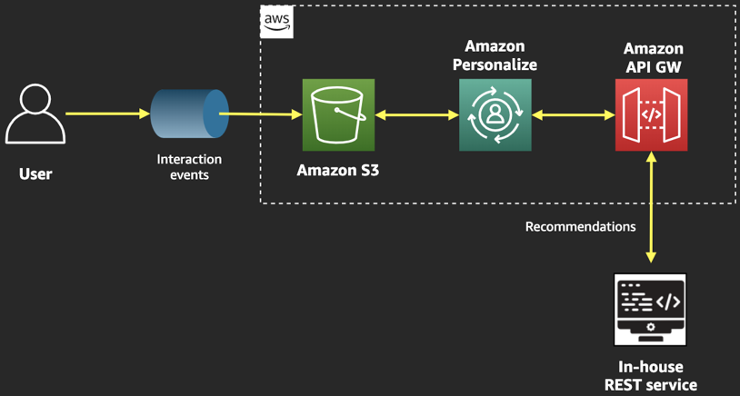
Architecture (1)

Slide 7
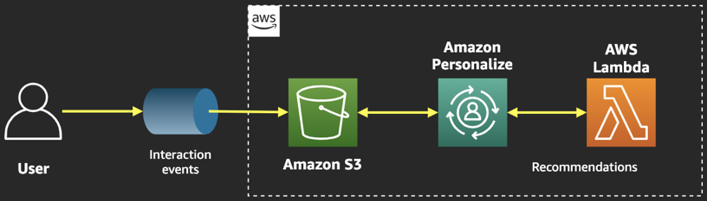
Architecture (2)

Slide 8
Paper
Personalized Session-based Recommendations with Hierarchical Recurrent Neural Networks et al M. Quadrana, A. Karatzoglou, B. Hidasi, P. Cremonesi
https://arxiv.org/pdf/1706.04148.pdf

Slide 9
What Problem the Authors Solve?
In Session-based recommenders, recommendations are provided based only on the visitor’s interactions in the current session
But there are cases (such as this one) where a visitor can be logged in or there are other forms of identifiers (cookies)
How can ”signals” be propagated from “recent” sessions to the current one?

Slide 10
HRNN Algorithm In Simple Words
Learns a representation embedding from “recent” sessions to inform the current one
If you’re planning for a ski holiday, you have probably searched in previous recent sessions for hotels in places such as French Alps and viewed hotels in ski areas
So the algorithm boosts hotels in ski areas in the current session

Slide 11
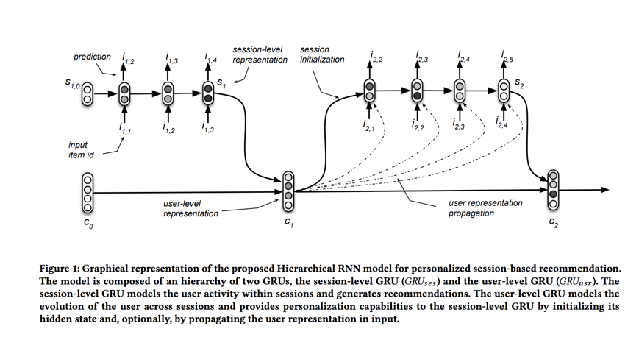
HRNN Algorithm

Slide 12
SageMaker + (LightFM or Spotlight)
Amazon SageMaker provides an easy way to train and host your custom models
LightFM and Spotlight are 2 great libraries that provide a Python API to train recommender models based on state-of-the-art methodologies
And, they give you the ability to make adjustments in the algorithmic part
https://github.com/lyst/lightfm and https://github.com/maciejkula/spotlight

Slide 13
Github Repo
https://github.com/pm3310/twitch-hotel-recommender-personalize

Slide 14
Thank you!

