Slide 1



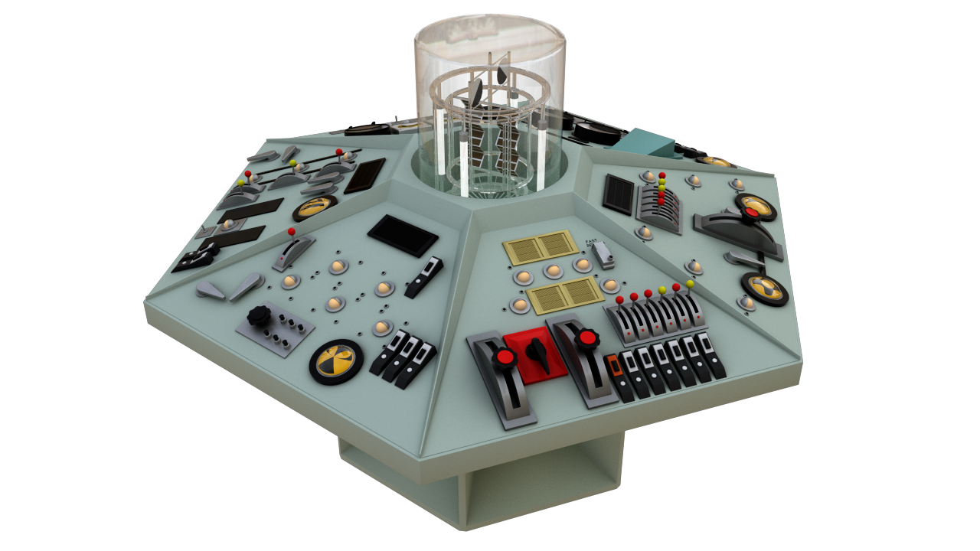
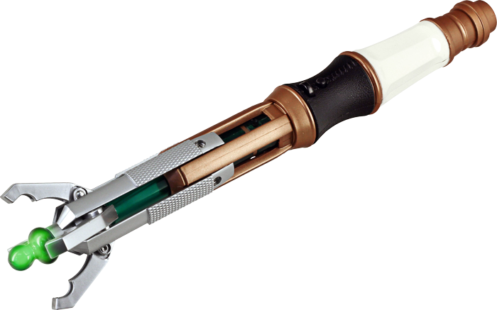
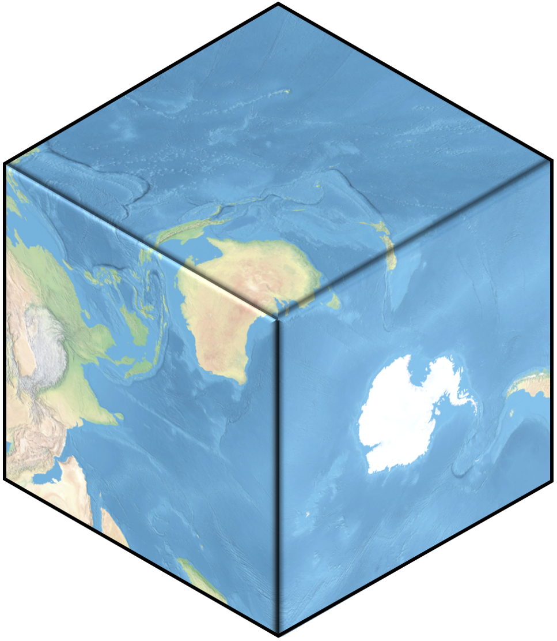
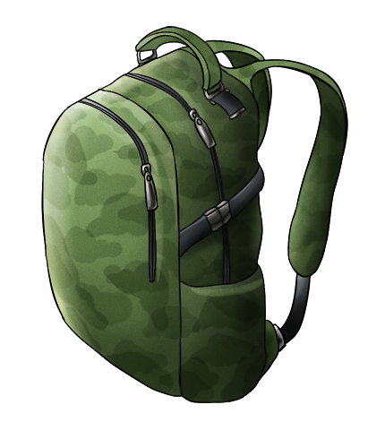
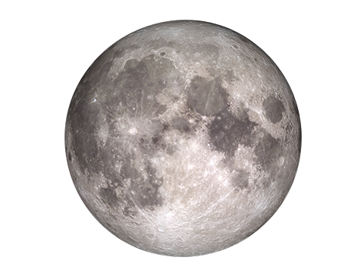
GIS DAY
14TH
NOV
GIS Day is Wednesday 14th November.
Celebrate how geographic information systems or
GIS technology is making a difference in our society.
INVESTIGATE!
it’s a
Happy Mappy, Finey Liney
kind of thing!
PROCRASTINATE!
We do maps now, Maps are cool!
There's a map that doesn't make sense. Let's go and poke it with a stick!
GIS related activities that school teachers and classes can use:
Explore classrooms around the world
Bigger on the Inside?
Online curriculum material from the LINZ geospatial Virtual Field Trips, from CORE Education’s LEARNZ Programme:
hae.re/2013: Welcome to Geospatial
hae.re/2014: Skills, tools and data
hae.re/2015: Using drones and tools
hae.re/2016: Land, sea and air
hae.re/2017: Natural Hazards
hae.re/2018: Land, Sky and Space
2017 Map My Waahi: hae.re/2017mmw
2018 Map My Waahi: hae.re/2018mmw
Eagle Technology GIS in Schools Lesson
plans for the NCEA Geography spatial analysis standards. hae.re/geo18
NZ Cartographic Society 2016-2017
Children's Map Competition - see the Winners!
hae.re/mapcomp
Create your own 3D Cube!
Download a PDF, print and sellotape together to create your own map cube.
hae.re/cube
London to the Himalayas!
hae.re/school
Or smaller on the outside?
hae.re/tardis
WE
ARE
HERE
Virtual 360 Views of NZ’s Great Walks
Ready for an off this world experience?
Explore the rainforest at your place.
hae.re/walk
Ever wonder about the moon's dark side?
hae.re/moon
www.gisday.com
This poster: hae.re/gisday
Resources: hae.re/gisday4teachers
Notes:
GIS Day is on Wednesday 14th November. Its a chance to celebrate how geographic information systems or GIS technology is making a difference in our society

Slide 2
GIS DAY
14TH
NOV
GIS Day is Wednesday 14th November.
Celebrate how geographic information systems or
GIS technology is making a difference in our society.
INVESTIGATE!
it’s a
Happy Mappy, Finey Liney
kind of thing!
PROCRASTINATE!
We do maps now, Maps are cool!
There's a map that doesn't make sense. Let's go and poke it with a stick!
GIS related activities that school teachers and classes can use:
Explore classrooms around the world
Bigger on the Inside?
Online curriculum material from the LINZ geospatial Virtual Field Trips, from CORE Education’s LEARNZ Programme:
hae.re/2013: Welcome to Geospatial
hae.re/2014: Skills, tools and data
hae.re/2015: Using drones and tools
hae.re/2016: Land, sea and air
hae.re/2017: Natural Hazards
hae.re/2018: Land, Sky and Space
2017 Map My Waahi: hae.re/2017mmw
2018 Map My Waahi: hae.re/2018mmw
Eagle Technology GIS in Schools Lesson
plans for the NCEA Geography spatial analysis standards. hae.re/geo18
NZ Cartographic Society 2016-2017
Children's Map Competition - see the Winners!
hae.re/mapcomp
Create your own 3D Cube!
Download a PDF, print and sellotape together to create your own map cube.
hae.re/cube
London to the Himalayas!
hae.re/school
Or smaller on the outside?
hae.re/tardis
WE
ARE
HERE
Virtual 360 Views of NZ’s Great Walks
Ready for an off this world experience?
Explore the rainforest at your place.
hae.re/walk
Ever wonder about the moon's dark side?
hae.re/moon
www.gisday.com
This poster: hae.re/gisday
Resources: hae.re/gisday4teachers
Notes:
GIS Day is on Wednesday 14th November. Its a chance to celebrate how geographic information systems or GIS technology is making a difference in our society

Slide 3
GIS DAY
14TH
NOV
GIS Day is Wednesday 14th November.
Celebrate how geographic information systems or
GIS technology is making a difference in our society.
INVESTIGATE!
it’s a
Happy Mappy, Finey Liney
kind of thing!
PROCRASTINATE!
We do maps now, Maps are cool!
There's a map that doesn't make sense. Let's go and poke it with a stick!
GIS related activities that school teachers and classes can use:
Explore classrooms around the world
Bigger on the Inside?
Online curriculum material from the LINZ geospatial Virtual Field Trips, from CORE Education’s LEARNZ Programme:
hae.re/2013: Welcome to Geospatial
hae.re/2014: Skills, tools and data
hae.re/2015: Using drones and tools
hae.re/2016: Land, sea and air
hae.re/2017: Natural Hazards
hae.re/2018: Land, Sky and Space
2017 Map My Waahi: hae.re/2017mmw
2018 Map My Waahi: hae.re/2018mmw
Eagle Technology GIS in Schools Lesson
plans for the NCEA Geography spatial analysis standards. hae.re/geo18
NZ Cartographic Society 2016-2017
Children's Map Competition - see the Winners!
hae.re/mapcomp
Create your own 3D Cube!
Download a PDF, print and sellotape together to create your own map cube.
hae.re/cube
London to the Himalayas!
hae.re/school
Or smaller on the outside?
hae.re/tardis
WE
ARE
HERE
Virtual 360 Views of NZ’s Great Walks
Ready for an off this world experience?
Explore the rainforest at your place.
hae.re/walk
Ever wonder about the moon's dark side?
hae.re/moon
www.gisday.com
This poster: hae.re/gisday
Resources: hae.re/gisday4teachers
Notes:
GIS Day is on Wednesday 14th November. Its a chance to celebrate how geographic information systems or GIS technology is making a difference in our society

Slide 4
GIS DAY
14TH
NOV
GIS Day is Wednesday 14th November.
Celebrate how geographic information systems or
GIS technology is making a difference in our society.
INVESTIGATE!
it’s a
Happy Mappy, Finey Liney
kind of thing!
PROCRASTINATE!
We do maps now, Maps are cool!
There's a map that doesn't make sense. Let's go and poke it with a stick!
GIS related activities that school teachers and classes can use:
Explore classrooms around the world
Bigger on the Inside?
Online curriculum material from the LINZ geospatial Virtual Field Trips, from CORE Education’s LEARNZ Programme:
hae.re/2013: Welcome to Geospatial
hae.re/2014: Skills, tools and data
hae.re/2015: Using drones and tools
hae.re/2016: Land, sea and air
hae.re/2017: Natural Hazards
hae.re/2018: Land, Sky and Space
2017 Map My Waahi: hae.re/2017mmw
2018 Map My Waahi: hae.re/2018mmw
Eagle Technology GIS in Schools Lesson
plans for the NCEA Geography spatial analysis standards. hae.re/geo18
NZ Cartographic Society 2016-2017
Children's Map Competition - see the Winners!
hae.re/mapcomp
Create your own 3D Cube!
Download a PDF, print and sellotape together to create your own map cube.
hae.re/cube
London to the Himalayas!
hae.re/school
Or smaller on the outside?
hae.re/tardis
WE
ARE
HERE
Virtual 360 Views of NZ’s Great Walks
Ready for an off this world experience?
Explore the rainforest at your place.
hae.re/walk
Ever wonder about the moon's dark side?
hae.re/moon
www.gisday.com
This poster: hae.re/gisday
Resources: hae.re/gisday4teachers
Notes:
GIS Day is on Wednesday 14th November. Its a chance to celebrate how geographic information systems or GIS technology is making a difference in our society

Slide 5
GIS DAY
14TH
NOV
GIS Day is Wednesday 14th November.
Celebrate how geographic information systems or
GIS technology is making a difference in our society.
INVESTIGATE!
it’s a
Happy Mappy, Finey Liney
kind of thing!
PROCRASTINATE!
We do maps now, Maps are cool!
There's a map that doesn't make sense. Let's go and poke it with a stick!
GIS related activities that school teachers and classes can use:
Explore classrooms around the world
Bigger on the Inside?
Online curriculum material from the LINZ geospatial Virtual Field Trips, from CORE Education’s LEARNZ Programme:
hae.re/2013: Welcome to Geospatial
hae.re/2014: Skills, tools and data
hae.re/2015: Using drones and tools
hae.re/2016: Land, sea and air
hae.re/2017: Natural Hazards
hae.re/2018: Land, Sky and Space
2017 Map My Waahi: hae.re/2017mmw
2018 Map My Waahi: hae.re/2018mmw
Eagle Technology GIS in Schools Lesson
plans for the NCEA Geography spatial analysis standards. hae.re/geo18
NZ Cartographic Society 2016-2017
Children's Map Competition - see the Winners!
hae.re/mapcomp
Create your own 3D Cube!
Download a PDF, print and sellotape together to create your own map cube.
hae.re/cube
London to the Himalayas!
hae.re/school
Or smaller on the outside?
hae.re/tardis
WE
ARE
HERE
Virtual 360 Views of NZ’s Great Walks
Ready for an off this world experience?
Explore the rainforest at your place.
hae.re/walk
Ever wonder about the moon's dark side?
hae.re/moon
www.gisday.com
This poster: hae.re/gisday
Resources: hae.re/gisday4teachers
Notes:
GIS Day is on Wednesday 14th November. Its a chance to celebrate how geographic information systems or GIS technology is making a difference in our society

