Slide 1
Guest Satisfaction Survey Key Factors
Process:
Understand the airlines industry.
Understand/frame the business problem.
Explore the data & potential key factors with key business question in mind.
Look at all levels of the variables.
Transform all 'ordinal' columns into 'numerical columns'
Run histograms on transformed columns to see/understand data patterns.
Treat missing values by deleting columns that contained > 77% null values
Train/validate a Random Forest Regression Model
Look at the Variable Importance Plot in R for variable selection to predict the response variable Q1.
Upon that, select the top/three factors that best explain the response variable

Slide 2
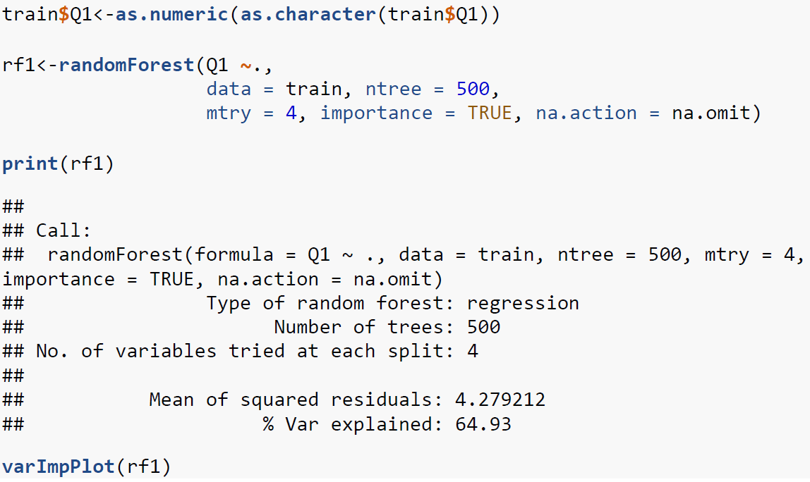
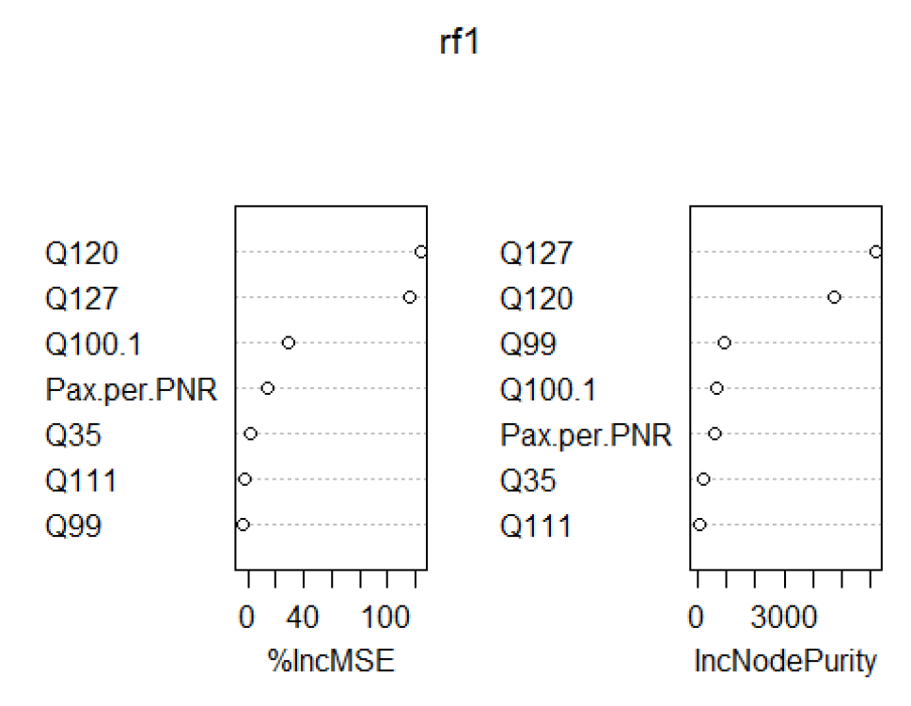
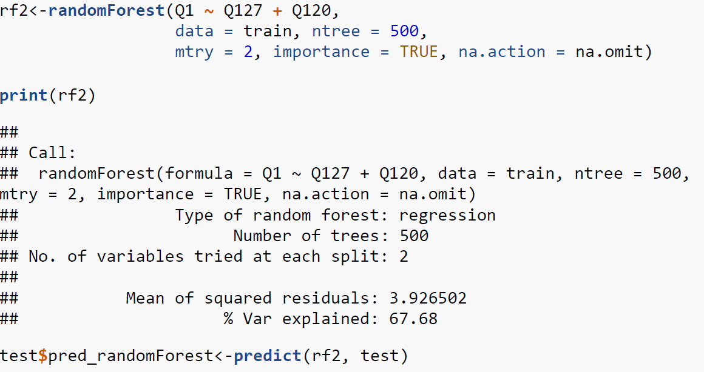
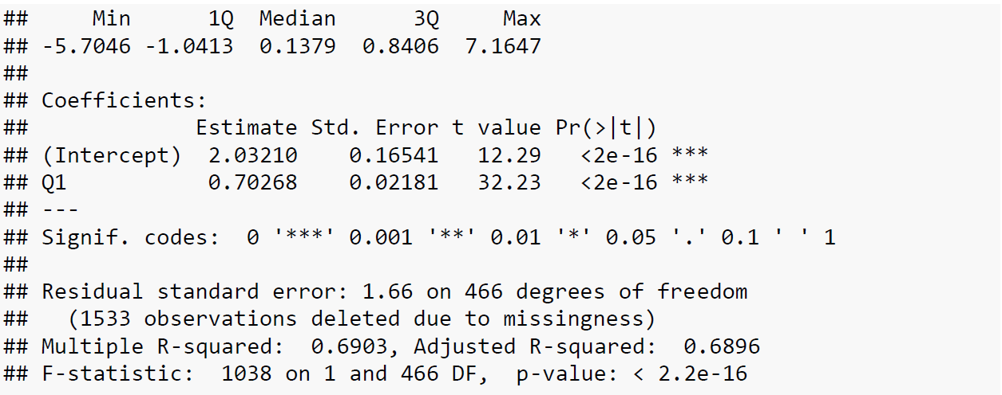
Random Forest Model Technical Analysis

Slide 3
Random Forest Results – Key Drivers Interpretation
Potential Key Drivers: Q127 and Q120
Explain roughly 67.68% of the response variable ‘Q1’ among the training data set.
Then predict/validate on the test data set, Adjusted R-square = 0.6896.
Fairly consistent measures on both training/test set
Overall Goal: Find the least number of key factors that explain the highest variance of the response variable to avoid multicollinearity

Slide 4
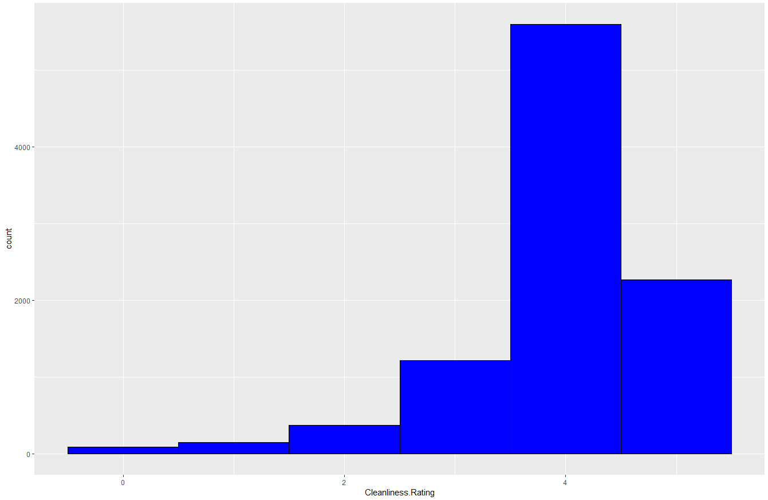
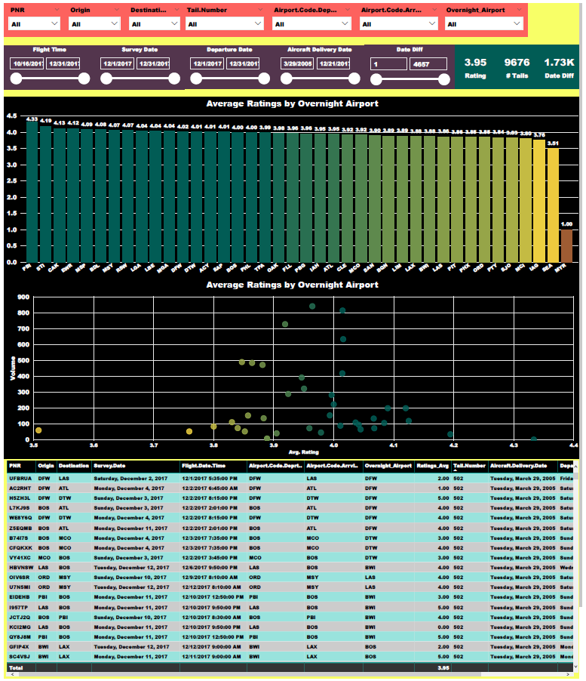
Aircraft Cabin Cleanliness Ratings Analysis
Tools Used: Excel, R (ggplot2), PowerBI
Copy paste Excel Test file into individual CSV Files and import them into R. Do basic data exploration.
Left outer join Tail Number Data so that the specified Tail Numbers would have a cabin cleanliness rating.
Concatenate Tail Number and Departure Date in Overnight Station Data for a unique ID.
Concatenate Tail Number and Departure Date in Test so you can join Overnight Station Data on Test Data.
Get rid of Tail Number, Departure Date in Overnight Station Data to get rid of duplicate columns (when they join)
Change the name of "Airport Code Deport" to "Overnight Airport "in Overnight Station Data
Left outer join Overnight Station Data on Test to get Overnight Airport matched up with cleanliness rating in original Test Data.
Left outer join Airport Delivery Dates on Test to get Aircraft Delivery Dates matched up with cleanliness rating in original Test Data.
Convert cleanliness rating where 0 = filthy and 5 = spotless.
Plot histogram to for data exploration using ggplot2.
Write to csv and do further analysis in PowerBI.

Slide 5


Key Questions
Which airports are the best at cleaning aircraft?
PBI 4.33
STI 4.19
CAK 4.13
EWR 4.12
MSP 4.09
BDL 4.08
MSY 4.07
RSW 4.07
LGA 4.04
LBE 4.04
Do certain airports impact the aircraft cleanliness ratings more than others?
Yes, the four high-volume airports with the lowest aircraft cleaning ratings are
MCO (3.92), ORD (3.85), LAS (3.86), BWI (3.88)
What other factors could drive the cleanliness ratings to be low?
Other factors would be time difference between the Aircraft Delivery Date and Departure Date.
Date Difference (in Days) between 0 Days and 1000 Days: 3.99 Rating
Date Difference (in Days) between 1000 Days To Max: 3.91 Rating
Obviously, further data analysis would allow us to look at certain thresholds with the worst ratings.

