Slide 1
ng-bootcamp
Day 3

Slide 2
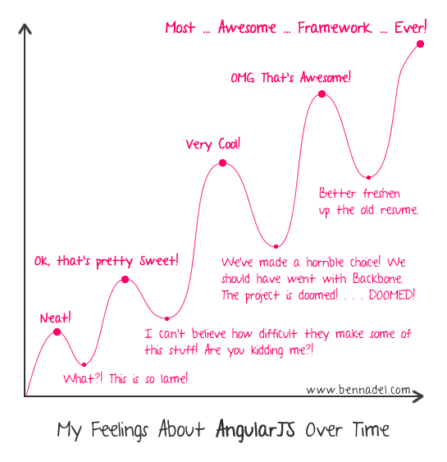

Slide 3
Checkpoint
git fetch origin
git checkout -f day-3/step-0
cd day-3/client
bower install
cd ../server
npm install
node server.js

Slide 4
Topics
Modules
Dependency Injection
Custom services

Slide 5

Music data platform
Search by artist, track, album, genre
Sorting by current popularity, play counts
Create dynamic playlists (based on artist, song, genre, BPM)
Register for key at developer.echonest.com
Edit day-3/server/lib/config/env/all.js, add API key to config object

Slide 6
Why Modules?
Separation of concerns
Package and reuse
Improved testability
Easier to scale

Slide 7
“The best advice about huge apps is not to make them. Write small, focused, modular parts, and progressively combine them into bigger things to make your app.”
- @substack via Brian Ford

Slide 8
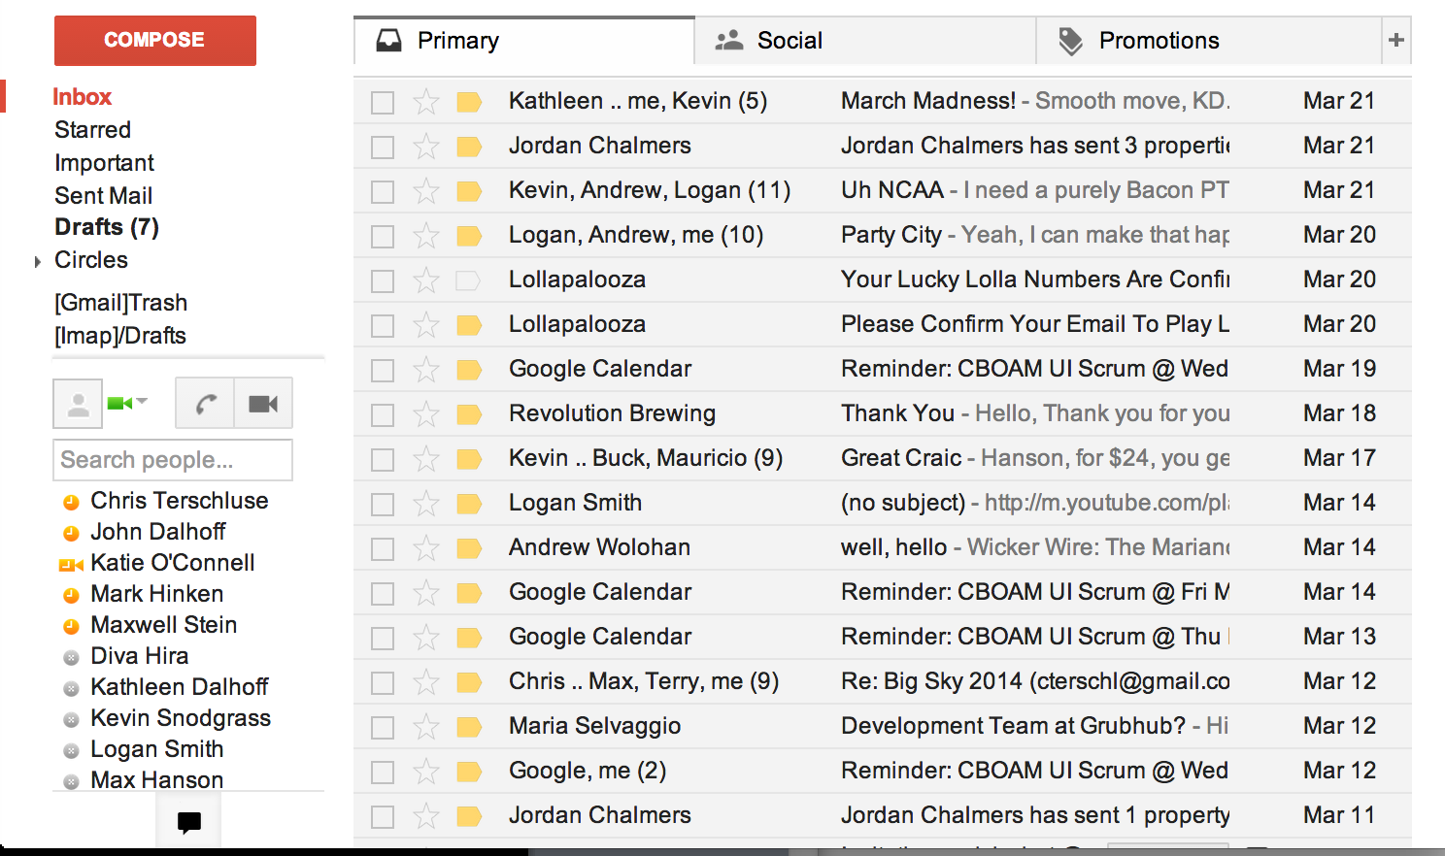
Example: Gmail
Small Modules
Chat Module
Folder Module
Message List Module
Main module composed of the 3 sub modules

Slide 9
Modules
Containers for related application functionality
Should be able to package a module and ship independently of other components
Expose functions for registering controllers, directives, services, constants, values
Can require other modules as dependencies

Slide 10
Creating/Retrieving Modules
Defining a new module:
var myModule = angular.module('myModule', []);
Retrieving an existing module:
var myModule = angular.module('myModule');
http://docs.angularjs.org/api/ng/function/angular.module

Slide 11
Registering Controllers
Use .controller method on module
http://docs.angularjs.org/api/ng/type/angular.Module
// Register controller 'MyController' on the new module
angular.module('myModule', [])
.controller('MyController', function($scope) {
$scope.name = 'Phil';
})

Slide 12
Specifying a “Main” Module
No “main” method in AngularJS apps
Use ng-app directive to declaratively specify how app should load
<!doctype html>
<html lang="en" ng-app="myModule">
<head>
<meta charset="utf-8">
<title>ng-bootcamp - Day 2</title>
<link rel="stylesheet" href="bower_components/bootstrap/dist/css/bootstrap.css" />
</head>
<body ng-controller="MyController" class="container">
<h1>{{'Hello ' + name}}</h1>
<script src="bower_components/angular/angular.min.js"></script>
<script src="app/app.js"></script>
</body>
</html>

Slide 13
Modules
Two types of module functions: configuration and run
Configuration blocks
Configure the application
define constants
configure injector with new services, filters, directives, etc.
Run blocks
Kick off functionality (fetch data, etc.)
Use registered services

Slide 14
angular.module('myModule', [])
.config(function($provide) {
$provide.constant('baseUrl', '/api');
})
.config(function(baseUrl) {
$provide.value('api', {
login: baseUrl + '/login',
users: baseUrl + '/users',
user: baseUrl + 'users/:id'
});
})
.run(function($log, baseUrl) {
$log.info('Starting myModule with baseUrl of ' + baseUrl);
})

Slide 15
Module Dependencies
Modules can depend on other modules
Dependencies will be loaded and configured before the requiring module
Controllers and services defined in dependency will be available for use in the requiring module
angular.module('myModule', [
'moduleDependency1',
'moduleDependency2']);

Slide 16
// TODO
Define two modules
App
App Controllers
Add Links Controller and Search Controller
Load App module on page, add controller directives

Slide 17
Checkpoint
git checkout -f day-3/step-1

Slide 18
What about reuse?
Modules allow for organization
Still need means of sharing code across modules

Slide 19
Dependency Injection
Dependency injection is a software design pattern that implements inversion of control and allows a program design to follow the dependency inversion principle. The term was coined by Martin Fowler. An injection is the passing of a dependency by reference or pointer to a client object, which is then made part of its state.
Wikipedia

Slide 20
Why DI?
Isolation of responsibilities
Removes knowledge from client
Isolates configuration
Promotes reuse and testing

Slide 21
How to Obtain Dependencies
Instantiate own
Retrieve from global variable
Pass where needed

Slide 22
Instantiate Own Dependencies
function CoffeeMaker() {
this.grinder = new Grinder();
this.carafe = new Carafe();
this.filter = new Filter();
}

Slide 23
Retrieve from Global Variable
function CoffeeMaker() {
this.grinder = window.deps.grinder;
this.carafe = window.deps.carafe;
this.filter = window.deps.filter;
}

Slide 24
Pass Where Needed (Ideal)
function CoffeeMaker(grinder, carafe, filter) {
this.grinder = grinder;
this.carafe = carafe;
this.filter = filter;
}

Slide 25
Dependency Injection
Function/object dependencies provided at runtime
Eliminates need for hard-coded dependencies stored on global variables
Dependencies provided as function parameters where needed
Injector subsystem handles instantiation, resolving, and provisioning of dependencies
All services, values, constants defined in loaded modules available to be injected

Slide 26
Providers and Injectors
$provide
Describes how to create dependencies
Registers components with the $injector
Registration methods for constants, values, services, factories, providers
$injector
Retrieves dependencies from providers
Handles instantiation of dependencies (can differ based on how dependency is defined)
Handles resolution of dependency name to instance
https://github.com/angular/angular.js/wiki/Understanding-Dependency-Injection
Notes:
Come back to this later on later slide

Slide 27
Dependency Annotations
// Inferred, NOT safe for minifiers
function MyController($scope, $http, myService) { };
// Inferred, NOT safe for minifiers
angular.module('myApp', ['services'])
.controller('MyController', function($scope, myService) {});
// $inject annotation, safe for minifiers
function MyController($scope, $http, myService) { };
MyController.$inject = ['$scope', '$http', 'myService'];
// Inline annotation, safe for minifiers
var myModule = angular.module('myModule', []);
myModule.controller('MyController',
['$scope', '$http', 'myService',
function ($scope, $http, myService) { }]);

Slide 28
Services
Substitutable objects that are wired together using dependency injection.
Used to share and organize code across the app
Notes:
Revisit this now that we’ve covered dependency injection

Slide 29
Built-in Services
$http, $resource
$window, $document, $location
$interval, $timeout
$log
$rootScope, $rootElement
$animate
And more: http://docs.angularjs.org/api/ng/service

Slide 30
Custom Services
Wrap common logic (e.g. $http calls, $resource calls)
Inject into controllers for usage

Slide 31
Services
Registered on a module using the $provide service
Module API exposes same methods for defining services based on needs
Different registration constructs depending on needs
Lazily instantiated
Singletons
Same reference shared across entire application

Slide 32
Defining/Creating Services
Service: singleton returned by a Service Factory
Service Factory: function created by a Service Provider
Service Provider: constructor function, create an object containing a $get method which returns the Service Factory
$injector: finds correct service provider, instantiates it, calls $get method to retrieve service instance
Shorthand methods exist on the $provide service and module API for defining services

Slide 33
$provide vs. module API
Expose same methods for registering services
angular.module('myModule', [])
.config(function ($provide) {
$provide.service('notifier', function Notifier() {
this.notify = function(msg) {
alert(msg);
}
});
});
// Identical as above
angular.module('myModule', [])
.service('notifier', function Notifier() {
this.notify = function(msg) {
alert(msg);
}
});

Slide 34
$provide.constant(obj)
Registers an object as a service
Can be injected in configuration blocks
Configuration blocks can register dependencies with the injector, so these constants could be used there
angular.module('myModule')
.constant('baseUrl', '/api');

Slide 35
$provide.value(obj)
Registers an object as a service
Cannot be injected in configuration blocks
angular.module('myModule')
.value('endpoints', {
account: '/account',
billing: '/billing'
dashboard: '/dasbhoard'
});

Slide 36
$provide.factory(fn)
Registers a factory that returns the service instance
Injectible with dependencies
angular.module('myModule')
.service('userService', function ($http) {
this.getUser = function(username) {
return $http.get('/user/' + username);
};
});

Slide 37
$provide.service(classFn)
Registers a service constructor function which will be invoked with the new operator
Injectible with dependencies
angular.module('myModule')
.factory('userService', function($http) {
return {
getUser: function(username) {
$http.get('/user/' + username);
}
}
});

Slide 38
$provide.provider(provider)
Register a service provider constructor function
Must contain a $get method for retrieving the service factory
All other shorthand methods end up being wrapped in a provider
angular.module('myModule')
.provider('userService', function () {
this.$get = function($http) {
return {
getUser: function(username) {
return $http.get('/user/' + username);
}
};
}
});

Slide 39
Services
Unique by name only, not by module name!
http://jsbin.com/yifip/17/edit

Slide 40
Modules
Unique by name only!
Modules will overwrite one another!
http://jsbin.com/becek/2/edit

Slide 41
// TODO
Add a services module
Use service to get playlist

Slide 42
Recommended Setup
Modules:
A module for each feature
A module for each reusable component (esp. directives and filters)
An application level module which depends on the above modules and contains any initialization code
http://docs.angularjs.org/guide/module#recommended-setup
Rule of thumb: Modules should never be altered outside of their definition
https://google-styleguide.googlecode.com/svn/trunk/angularjs-google-style.html#modules
ng-app directive: specifies the module to bootstrap the app

Slide 43
RequireJS/AMD vs. AngularJS
RequireJS/AMD Modules: lazy file loading, script load ordering
AngularJS Modules: remove global state, configure dependency injector
All files defining AngularJS modules must be loaded on the page
Can be used in tandem
File order not as important with AngularJS modules
http://docs.angularjs.org/guide/module#asynchronous-loading

Slide 44
Mock Services
Available in the angular-mocks package
bower install --save-dev angular-mocks
$httpBackend
Listen for requests, specify responses
$interval, $timeout
flush([milliseconds]) method to execute pending tasks
module(moduleName|fn) (shortcut for angular.mock.module())
Configure injector using either identified module or anonymous function
inject(fn) (shortcut for angular.mock.inject())
makes fn arguments injectible

Slide 45
angular.module('ngBootcamp', [])
.controller('MyController', function ($scope) {
$scope.name = 'Phil';
});
// app.spec.js
describe('MyController', function() {
beforeEach(module('ngBootcamp'));
var myController, scope;
beforeEach(inject(function($controller, $rootScope) {
scope = $rootScope.$new();
myController = $controller('MyController', {
$scope: scope
});
}));
it('should set the name property on the scope', function() {
expect($scope.name).toBe('Phil');
});
});
Notes:
module(‘ngBootcamp’); // load the module we want to test
Inject(function ($controller, $rootScope){…}); // wrap the provided function into an injectible function, allowing dependencies to be provided by the $injector
$controller(controllerName, locals); // controller service just loads the constructor function via the injector, then calls the function with its dependencies first from the locals object, then loading everything else from the $injector

Slide 46
Recap
Modules
DI
Custom Services
Testing

