Slide 1
ng-bootcamp
Day 1

Slide 2
Code
https://github.com/pmaccart/ng-bootcamp

Slide 3
Topics
Application Bootstrap
Static Templates
Root Scope
Dynamic Templates
Controllers
Directives
Data Binding
Event Handling
Forms

Slide 4
Why AngularJS
Declarative UI
Extensible HTML
Dependency Injection
Bidirectional Data Binding
Testability

Slide 5
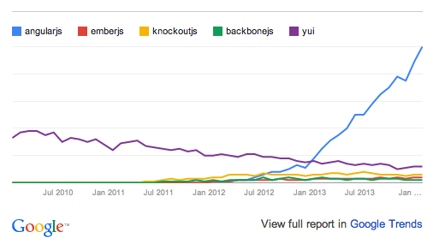

Slide 6
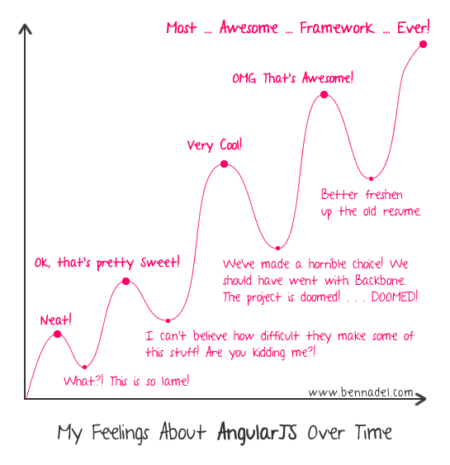

Slide 7
AngularJS
Declarative DOM interactions
Extended HTML vocabulary
Bidirectional Data Bindings
Focus on Testability

Slide 8
Application Bootstrap
Load JS dependency
Define root application element (ngApp directive)
AngularJS will:
Create new injector for dependency injection
Create a new Root Scope
Compile the DOM starting with the ngApp element

Slide 9
<!doctype html>
<html lang="en" ng-app>
<head>
<meta charset="utf-8">
<title>ng-bootcamp - Day 1</title>
</head>
<body>
<h1>{{'Hello from AngularJS!'}}</h1>
<script src="bower_components/angular/angular.min.js"></script>
</body>
</html>

Slide 10
// TODO
Create base application
Use Bower to install Angular dependency
bower install --save angular
Use Bower to install Twitter Bootstrap dependency
bower install --save bootstrap
Setup base index.html page (copy from previous slide)

Slide 11
Checkpoint
git checkout -f day-1/step-0

Slide 12
ng-app
Points AngularJS to the root DOM element of the application
Allows for only using Angular on small sub-sections of a page

Slide 13
Bindings and Expressions
Double-curly braces denote a binding
Bindings contain an expression
{{ expression }}
Evaluated in the context of the $scope object
Support simple expressions and forgiving attribute evaluation, but no control flow statements
{{ ‘Hello’ + ‘ ‘ + ‘World!’ }}
{{ model.person.firstName }}
Won’t throw an exception if model or person is null

Slide 14
Controllers
Constructor functions that take in a $scope paramter
Responsible for augmenting the scope
Attached to an element (view) via ng-controller directive
Injectable

Slide 15
Scope
Act as the model; execution context for AngularJS expressions in the templates
Single $rootScope created for an application
Hierarchical arrangement – single $rootScope object for application, with nested child scopes attached to DOM elements
Child scopes can either prototypically inherit from their parent, or be isolated
Child scopes generally created by directives (ng-controller, ng-repeat, etc.)

Slide 16
Dynamic Expressions
Angular expressions have access to all properties on the scope
Properties for read/write data access
Functions for event handlers
$scope.name = 'Phil';
<div>{{name}}</div> // <div>Phil</div>
Null-safe
Won’t throw exception if parent property is null
{{model.my.null.property.name}} // won’t bomb

Slide 17
<!doctype html>
<html lang="en" ng-app>
<head>
<meta charset="utf-8">
<title>ng-bootcamp - Day 1</title>
</head>
<body ng-controller="MyController">
<h1>{{'Hello ' + name}}</h1>
<script src="bower_components/angular/angular.js"></script>
<script src=”app/app.js"></script>
</body>
</html>
// app.js
function MyController($scope) {
$scope.name = 'Phil';
}

Slide 18
Unit Testing
Primary focus of AngularJS
Isolation of DOM interaction to directives allows for easy testing of services and controllers
Dependency injection allows for easy mocking of dependencies

Slide 19
// app.js
function MyController($scope) {
$scope.name = 'Phil';
}
// app.spec.js
describe('MyController', function() {
var controller, scope;
beforeEach(function() {
scope = {};
controller = new MyController(scope);
})
it('should set the name property on the scope', function() {
expect(scope.name).toBe('Phil');
});
});
Notes:
module(‘ngBootcamp’); // load the module we want to test
Inject(function ($controller, $rootScope){…}); // wrap the provided function into an injectible function, allowing dependencies to be provided by the $injector
$controller(controllerName, locals); // controller service just loads the constructor function via the injector, then calls the function with its dependencies first from the locals object, then loading everything else from the $injector

Slide 20
Karma Test Runner
Built by AngularJS team
Test harness for JavaScript unit tests
Supports multiple browsers, headless PhantomJS
Capture browsers automatically or manually
Instruct Karma to start browsers on host machine (Chrome, FF, Safari, IE, Opera, PhantomJS)
Navigate browser to Karma server URL (useful for mobile devices)

Slide 21
Karma
Installation
npm install -g karma-cli karma
npm init # run this if you don’t have a package.json file already
npm install --save karma-jasmine karma-chrome-launcher
Configuring Karma
karma init
Creates karma.conf.js
Port, test browsers, files to load
Running Karma
karma start karma.conf.js

Slide 22
// TODO
Create Controller in app.js
Set name property on $scope
Add ng-controller directive in index.html
Display name
Add unit test for controller

Slide 23
Checkpoint
git checkout -f day-1/step-1

Slide 24
Scope Inheritance
Child Scopes prototypically inherit from parent scopes based on nesting in DOM
Exception: Isolote scopes
Controller instances do not prototypically inherit – must do this manually!
All scopes inherit from $rootScope
Useful for cases like multi-step form wizards
Store model on parent controller, let each step have its own child controller that augments the model on the $scope
<div ng-controller="ParentController">
<div ng-controller="ChildController"></div>
<div ng-controller="ChildController"></div>
</div>

Slide 25
// TODO
Create two controllers, ParentController and ChildController
ParentController should set a ‘parentName’ property on the scope
ChildController should set a ‘childName’ property on the scope
Attach ParentController to DOM element, and display parent name
Attach ChildController to DOM element that is child of parent controller, display parent name AND child name

Slide 26
ng-bootcamp
Day 1

Slide 28
Checkpoint
git checkout -f day-1/step-2

Slide 29
Directives
Markers on DOM elements notifying Angular’s compiler to attach behavior
Compile: attach event handling
Only source of JS -> DOM interactions!
Naming Standards: Camel-case in JS, hyphenated when using in markup
angular.directive(‘ngController’, function() { … });
<div ng-controller=“MyController”></div>
Notes:
Ng-controller: instantiates controller, creates new $scope
Angular MVC: Model = $scope properties, view = template, controller = controller

Slide 30
Built-In Directives
ng-app – indicates module to bootstrap app
ng-controller – instantiates controller, attaches to view
ng-repeat – iterates over array/object, creating new scope and view for each item
ng-model
ng-show/ng-hide
ng-class, ng-href, ng-src vs. class, href, src

Slide 31
Two-Way Data Binding
One-way binding
<div>{{model.user.firstName}}</div>
Two-way bindings allow DOM elements to update scope properties
ng-model - binds input value to a property on the scope
<input ng-model=“model.user.firstName” />
<span>Hello, {{model.user.firstName}}!</span>

Slide 32
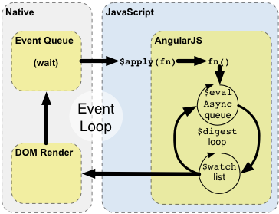
Two-Way Data Binding
Angular uses dirty checking, notifies watchers of changes
Watchers respond to model updates (update DOM, update other properties on model)
Watchers can also change model, so the loop runs until model stabilizes

Slide 33
Event Directives
Function references can be added to the scope, referenced as callbacks for events
Functions can accept scope properties as parameters
<button ng-click=“handleThis(model)”>Click me!</button>
Angular event handlers vs. native DOM event handlers
Functions on the $scope
Can accept $scope properties as parameters
Executed within Angular execution context

Slide 34
// TODO
Add an input that is bound to a scope property with ng-model directive
Display the property on the page
Add a button that logs the current input value, then clears the input
Reset function can be added to scope by the MyController class on the <body> element
Add unit test

Slide 35
Checkpoint
git checkout -f day-1/step-3

Slide 36
ng-repeat Directive
Directive for iterating over a collection
Renders a template once per item
Each template instance gets its own scope:
Item value
$index (number)
$first, $middle, $last, $even, $odd (booleans)

Slide 37
$scope.items = [
{name: 'First Item'},
{name: 'Second Item'},
{name: 'Third Item'}
];
<div>
<h2> List Items</h2>
<ul>
<li ng-repeat="item in items">{{$index}}: {item.name}}</li>
</ul>
</div>

Slide 38
Filters
Formats value of an expression for display
Can be used for object to string transformations, or for filtering lists of values
Take in a value, return a value
Built in: date, currency, filter, json, limitTo, lowercase, number, orderBy, uppercase

Slide 39
$scope.now = new Date();
<div>Date: {{now | date:'MMM d, yyyy'}}</div>
$scope.items = [
{name: 'First Item'},
{name: 'Second Item'},
{name: 'Third Item'}
];
<div>
<h2> List Items</h2>
<div>
<label for="query">Query: </label>
<input type="text" id="query" ng-model="query"/>
<ul>
<li ng-repeat="item in items | filter:query">{{$index}}: {{item.name}}</li>
</ul>
</div>

Slide 40
// TODO
Add a list of items to the $scope
Use an ng-repeat directive to display the items
Use the ‘filter’ filter bound to a text input to filter the list of items

Slide 41
Checkpoint
git checkout -f day-1/step-4

Slide 42
Forms
Form directive (or ng-form) creates instance of FormController
Provides validation services
CSS Classes applied based on form state (ng-valid, ng-invalid, ng-pristine, ng-dirty)
use novalidate attribute on <form> element to disable native browser validation
Allows for nesting of forms (nesting ng-form directives)
Publishes form and inputs to the scope by using name attributes
ng-submit: binds to submit event of form

Slide 43
Inputs
Input directives augment existing input functionality
Provide validation directives
Bind values to input states (ex: checkboxes)
Support for most HTML5 input styles
date, dateTimeLocal, email, month, number, url, week
Custom validation directives
required, pattern, minlength, maxlength, min, max

Slide 44
<form name="myForm" ng-submit="submitForm(model.firstName, model.lastName)" novalidate>
<div>
<label for="firstName">Enter your first name: </label>
<input type="text" id="firstName" ng-model="model.firstName" required/>
</div>
<div>
<label for="lastName">Enter your last name: </label>
<input type="text" id="lastName" ng-model="model.lastName" required/>
</div>
<button type="submit" ng-disabled="myForm.$invalid">Create User</button>
</form>

Slide 45
// TODO
Add new controller for form example (MyFormController)
Add form element with inputs for first and last name
Add handler for submit event
Submit should accept first and last name as arguments
Submit should call $window.alert with the first and last name
Style input based on state (ng-valid, ng-invalid + ng-dirty)
Enable button based on state

Slide 46
Checkpoint
git checkout -f day-1/step-5

Slide 47
Review
Application Bootstrap
Static Templates
Root Scope
Dynamic Templates
Controllers
Directives
Data Binding
Event Handling
Forms

