Slide 1
ng-bootcamp
Day 2

Slide 2
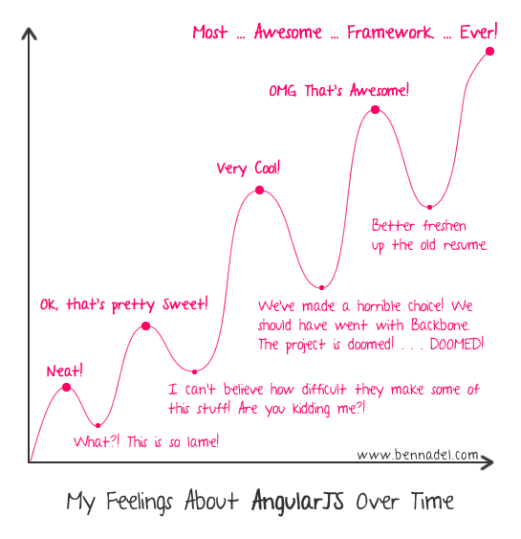

Slide 3
Checkpoint
git fetch origin
git checkout -f day-2/step-0
cd day-2
npm install -g karma-cli
npm install
bower install
Open day-2/index.html in a browser

Slide 4
Directives
Markers on DOM elements notifying Angular’s compiler to attach behavior
Compile: attach event handling
Only source of JS -> DOM interactions!
Naming Standards: Camel-case in JS, hyphenated when using in markup
angular.directive(‘ngController’, function() { … });
<div ng-controller=“MyController”></div>
Notes:
Ng-controller: instantiates controller, creates new $scope
Angular MVC: Model = $scope properties, view = template, controller = controller

Slide 5
Built-In Directives
ng-app – indicates module to bootstrap app
ng-controller – instantiates controller, attaches to view
ng-repeat – iterates over array/object, creating new scope and view for each item
ng-model
ng-show/ng-hide
ng-class, ng-href, ng-src vs. class, href, src

Slide 6
ng-repeat Directive
Directive for iterating over a collection
Renders a template once per item
Each template instance gets its own scope:
Item value
$index (number)
$first, $middle, $last, $even, $odd (booleans)

Slide 7
$scope.items = [
{name: 'First Item'},
{name: 'Second Item'},
{name: 'Third Item'}
];
<div>
<h2> List Items</h2>
<ul>
<li ng-repeat="item in items">{{$index}}: {item.name}}</li>
</ul>
</div>

Slide 8
Filters
Formats value of an expression for display
Can be used for object to string transformations, or for filtering lists of values
Take in a value, return a value
Built in: date, currency, filter, json, limitTo, lowercase, number, orderBy, uppercase

Slide 9
Filter Syntax
<div>{{expression_to_filter | filterName:arg1:arg2:argN}}</div>
Date Filter:
expression | date:format
Order By Filter:
expression | orderBy:property:reverse

Slide 10
$scope.now = new Date();
<div>Date: {{now | date:'MMM d, yyyy'}}</div>
$scope.items = [
{name: 'First Item'},
{name: 'Second Item'},
{name: 'Third Item'}
];
<div>
<h2> List Items</h2>
<ul>
<li ng-repeat="item in items | orderBy:'name'">{{$index}}: {{item.name}}</li>
</ul>
</div>

Slide 11
// TODO
Add a list of items to the $scope
Use an ng-repeat directive to display the items
Use the ‘orderBy’ filter to sort the items by one of their properties

Slide 12
Checkpoint
git checkout -f day-2/step-1

Slide 13
Two-Way Data Binding
One-way binding
<div>{{model.user.firstName}}</div>
Two-way bindings allow DOM elements to update scope properties
ng-model - binds input value to a property on the scope
<input ng-model=“model.user.firstName” />
<span>Hello, {{model.user.firstName}}!</span>

Slide 14
Event Directives
Function references can be added to the scope, referenced as callbacks for events
Functions can accept scope properties as parameters
<button ng-click=“handleThis(model)”>Click me!</button>
Angular event handlers vs. native DOM event handlers
Functions on the $scope
Can accept $scope properties as parameters
Executed within Angular execution context

Slide 15
// TODO
Add an input that is bound to a scope property with ng-model directive
Display the property on the page
Add a button that increments a counter, and display the counter on the page

Slide 16
Checkpoint
git checkout -f day-2/step-2

Slide 17
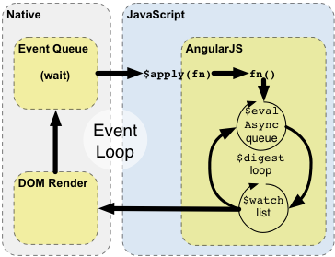
Two-Way Data Binding
Angular uses dirty checking, notifies watchers of changes
Watchers respond to model updates (update DOM, update other properties on model)
Watchers can also change model, so the loop runs until model stabilizes

Slide 18
$scope.$apply and $scope.$digest
Potential bugs:
Non-Angular event updates the $scope (jQuery AJAX call, native browser event, setTimeout/setInterval)
Use Angular Services/Directives!!!
$http, ng-click, ng-blur, $timeout, $interval
$scope.$digest()
Notify watchers of CURRENT SCOPE and CHILDREN
$scope.$apply(fn)
Execute function in context of $scope, run $rootScope.digest()

Slide 19
Example (won’t update watchers)
angular.module('myModule').controller('IntervalController',
function ($scope) {
$scope.counter = 0;
setInterval(function() {
$scope.counter++;
}, 1000);
});
http://jsbin.com/fenir/1/edit

Slide 20
Example (using $scope.$digest())
angular.module('myModule').controller('IntervalController',
function ($scope) {
$scope.counter = 0;
setInterval (function() {
$scope.counter++;
// notify only current scope and children
$scope.digest();
}, 1000);
});
http://jsbin.com/keluq/2/edit

Slide 21
Example (using $scope.$apply(fn))
angular.module('myModule').controller('IntervalController',
function ($scope) {
$scope.counter = 0;
setInterval (function() {
// perform $digest cycle from $rootScope
$scope.apply(function() {
$scope.counter++;
});
}, 1000);
});
http://jsbin.com/behat/1/edit

Slide 22
Example (using $timeout service)
angular.module('myModule').controller(’IntervalController',
function ($scope, $interval) {
$scope.counter = 0;
$interval (function() {
$scope.counter++;
}, 1000);
});
http://jsbin.com/keluq/4/edit

Slide 23
Forms
Form directive (or ng-form) creates instance of FormController
Provides validation services
CSS Classes applied based on form state (ng-valid, ng-invalid, ng-pristine, ng-dirty)
use novalidate attribute on <form> element to disable native browser validation
Allows for nesting of forms (nesting ng-form directives)
Publishes form and inputs to the scope by using name attributes
ng-submit: binds to submit event of form

Slide 24
Inputs
Input directives augment existing input functionality
Provide validation directives
Bind values to input states (ex: checkboxes)
Support for most HTML5 input styles
date, dateTimeLocal, email, month, number, url, week
Custom validation directives
required, pattern, minlength, maxlength, min, max

Slide 25
<form name="myForm" ng-submit="submitForm(model.firstName, model.lastName)" novalidate>
<div>
<label for="firstName">Enter your first name: </label>
<input type="text" id="firstName" ng-model="model.firstName" required/>
</div>
<div>
<label for="lastName">Enter your last name: </label>
<input type="text" id="lastName" ng-model="model.lastName" required/>
</div>
<button type="submit" ng-disabled="myForm.$invalid">Create User</button>
</form>

Slide 26
// TODO
Add new controller for form example (MyFormController)
Add form element with inputs for first and last name
Add handler for submit event
Accept first and last name as arguments
Display message indicating the user was added
Style input based on state (ng-valid, ng-invalid + ng-dirty)
Enable button based on state

Slide 27
Checkpoint
git checkout -f day-2/step-3

Slide 28
Recap
Models: $scope
Glue between controllers and views
Views: templates (HTML, Jade, etc.)
Bindings to scope properties and functions
Controllers: constructor functions
Injected with dependencies via Angular’s DI framework
Prepare the scope for display by templates

Slide 29
Services
Substitutable objects that are wired together using dependency injection.
Used to share and organize code across the app
Built-in services:
$http, $q, $templateCache, $window, $document, $timeout, $interval

Slide 30
$http
Used to make HTTP requests using either XMLHttpRequest or JSONP
jQuery-like semantics
No callbacks – returns promises instead (based on $q service)

Slide 31
function AjaxController($scope, $http, $log) {
$http({
method:'GET',
url: '/data/users.json'
}).then(function(resp) {
$scope.users = resp.data;
}, function (error) {
$log.error('Error fetching users.', error);
});
}

Slide 32
Promises
Representations of future objects
Promises are fulfilled with a value, or rejected with an error/reason
Chainable
Promises have .then(fulfilled, rejected) method that takes in a fulfilled callback and a rejected callback, and returns a new promise (thus becoming chainable)
Either the fulfilled or rejected callbacks will be called as soon as a value is available

Slide 33
Simple File Server
npm install --save-dev connect
// server.js
var connect = require('connect');
connect.createServer(
connect.static(__dirname)
).listen(3000);
node server.js

Slide 34
data/users.json
[
{"username":"pmaccart", "first":"Phil", "last":"MacCart"},
{"username":"pmaccart1", "first":"Jon", "last":"Smith"},
{"username":"pmaccart2", "first":"Phil", "last":"Jones"}
]

Slide 35
function AjaxController($scope, $http, $log) {
$http({
method:'GET',
url: '/data/users.json'
}).then(function(resp) {
$scope.users = resp.data;
}, function (error) {
$log.error('Error fetching users.', error);
});
}
<h2>$http</h2>
<div ng-controller="AjaxController">
<h4>Users</h4>
<ul>
<li ng-repeat="user in users">{{user.username}}: {{user.first + ' ' + user.last}}</li>
</ul>
</div>

Slide 36
// TODO
Setup server.js as a static file server
Add data/users.json for mock data
Add a new AjaxController that takes in the $http service
Fetch the data/users.json data
Display the users on the page

Slide 37
Checkpoint
git checkout -f day-2/step-4
NOTE: need to run ‘npm install’ to install the connect package for the static file server

